Slide 1

An Augmented Reality Based Educational Mobile Application
Md. Rabbi Amin ID # 1611233042
Shahadat Hossain Pavel ID # 1612332042
Ahsan Ahmed Sojib ID # 1612209642
Md Anik Islam ID # 1512132642

Slide 2
What is Augmented Reality?
Augmented reality is any sort of computer based system that overlays data on top of your current view of the (physical) world ,while continuing to let you see the world around you. The real elements are augmented by computer generated sensory input such as sound,video,graphics or GPS data.

Slide 3
Why we are using Augemented Reality?
Augmented reality is increasingly reaching young users such as elementary-school and high-school children, as their parents and teachers become aware of the technology and its potential for education. Although research has shown that AR systems have the potential to improve student learning, the educator community does not clearly understand the educational impact of AR, nor the factors which impact the educational effectiveness of AR

Slide 4
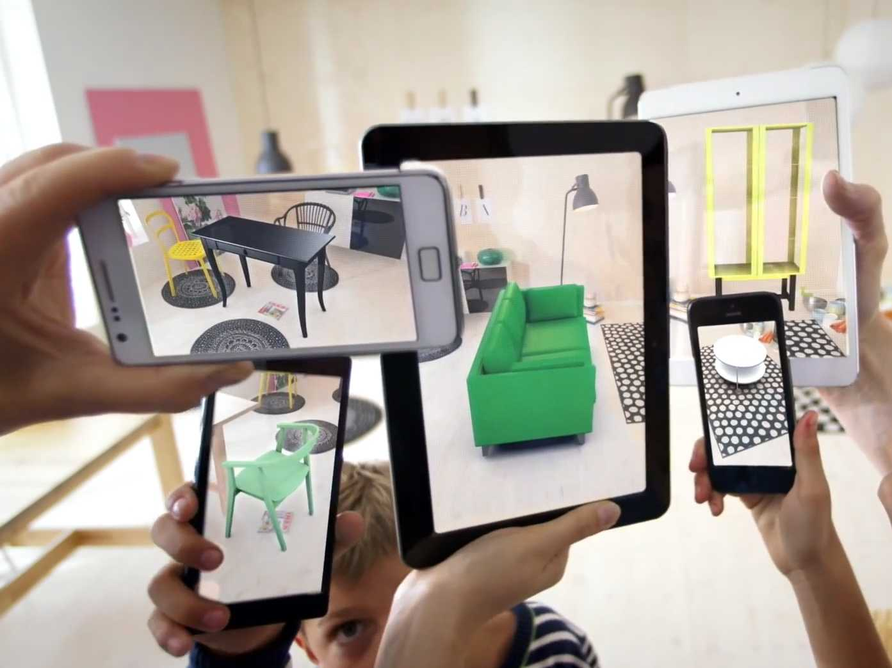
Related works done before
Please explain the question or problem that you investigated

Slide 5
Project Summary
1. Recognition
2. Project Development
3. System Interface
4. Project Simulation

Slide 6
Project Goad
There are three major goals that we want to focus on with our project. They are as follows:
i. Develop an Educational Application: To spread the education in a technical and costefficient way. Augmented application for various purpose of information collection. ii. Information Understanding: To understand and learn information in a very easy way is augmented reality. iii. Advance the Generation: Knowing the information in an advance application without any cost.

Slide 7
Project Goad
ii. Information Understanding: To understand and learn information in a very easy way is augmented reality. iii. Advance the Generation: Knowing the information in an advance application without any cost.
iii. Advance the Generation: Knowing the information in an advance application without any cost.

Slide 8
Technical Details
System Database
System Compilation
Export Environment
Application Test and Assets
UI Design
System UI

Slide 9


Technical Details
System Database

Slide 10
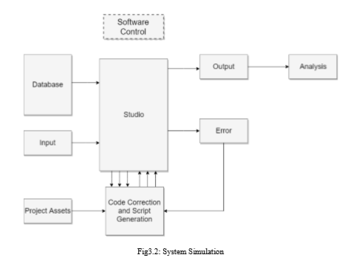
Technical Details
System Compilation

Slide 11
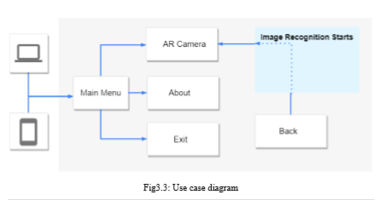
Technical Details
UI Design

Slide 12
FUTURE WORK
Air or Augmented Writing
System Updates

Slide 13
FUTURE WORK
Air or Augmented Writing
This is the concept which we like to develop in future. We would like to develop a mobile application which use hand gesture recognition system for detect air writing. We already started to develop the gesture recognition system for the future application.

Slide 14
FUTURE WORK
2. System Updates
The main objective of developing this system is to provide a basic platform for startup application technology. The system can be more improved than the current form. In the context of securing this system further work can be done by including firewalls and other means of securing this system.

Slide 15
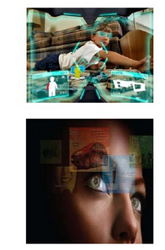
Future of Augmented Reality
Gaming Industry
Augmented reality contact lens being developed at the University of Washington by Babak Rarviz, a bio-nenotechnologist. The lens would layer the computer graphics on everything around us.

Slide 16
Conclusion
The Adorsholipi is primarily educational application. The system takes care of all the requirements of an average Bengali word book. Additionally, we expanded the application system is a fully functional state of the art and presentation. This application inherits all the previous modules and additional functionalities have been developed

