Slide 1

Conditional GAN
Ahsan Lohdi, Yang An
Technical University of Munich
Department of Informatics
Computer Vision Group
Garching, 07. May 2019

Slide 2
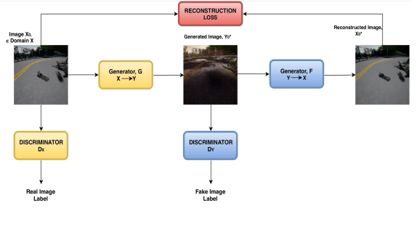
What we did?
Working on the binary domain case with CycleGAN
Goal: One generator G can translate an input image to domain ‚A‘ or ‚B‘ depending on the conditioning

Slide 3
Added Conditional Channels
( )
1 | 1 | 1 | 1 | 1 | 1
1 | 1 | 1 | 1 | 1 | 1
1 | 1 | 1 | 1 | 1 | 1
…
0 | 0 | 0 | 0 | 0 | 0
0 | 0 | 0 | 0 | 0 | 0
0 | 0 | 0 | 0 | 0 | 0

Slide 4
Replaced Generator F with G
Generator G
Y→X

Slide 5
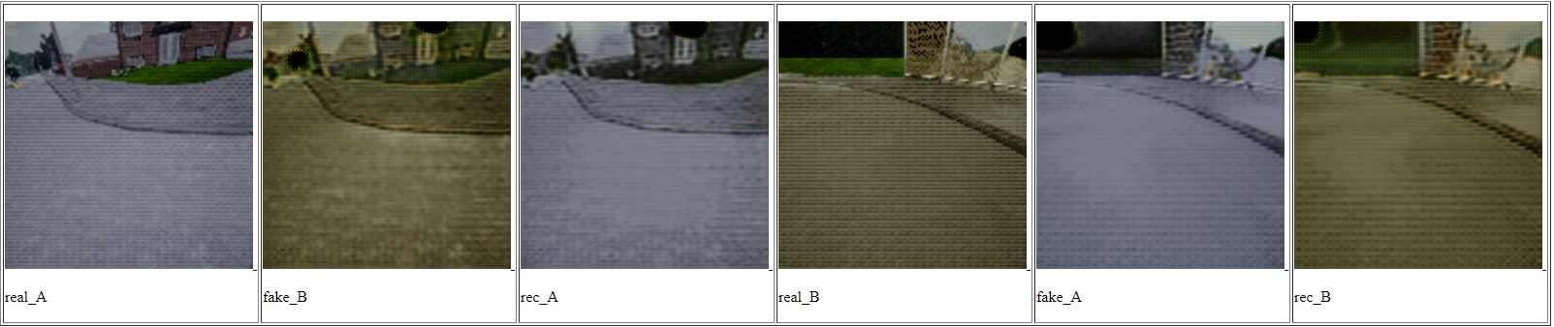
Evaluation
conditioned to B
conditioned to A
conditioned to A
conditioned to B

Slide 6
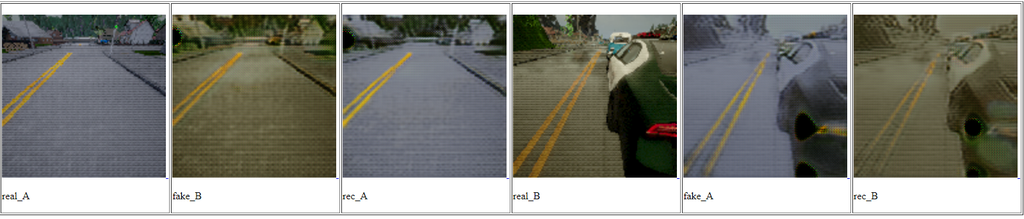
Evaluation – changed index of conditional channel
conditioned to A
conditioned to A
conditioned to B
conditioned to B

Slide 7
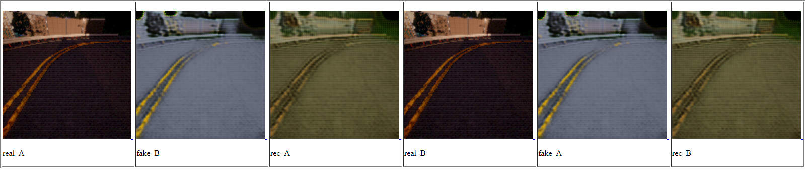
Another evaluation with input domain C
conditioned to A
conditioned to B
conditioned to B
conditioned to A

Slide 8
Something went wrong, but what?
Two hypothesis:
We messed up something in the code (maybe both generators doesn’t share weights, conditional channel is not added properly,…)
During training, we didn’t had the case, input A conditioned to target A. The model finds a loophole and ignores the conditional channels.

Slide 9
To add training images ‚A conditioned to A‘ we need to change the Discriminators, too
Input A conditioned to A
Target A conditioned to A
Generator G
Y→X
Re-constructed
A
Discriminator
A
Discriminator
A

Slide 10
To Do‘s
Fix our problem for the binary case
After we‘ve done with it, scaling to number of target domains > 2
Try out MUnit

