Slide 1

Conditional GAN
Ahsan Lohdi, Yang An
Technical University of Munich
Department of Informatics
Computer Vision Group
Garching, 16. July 2019

Slide 2
Recap (1/2): Making dataset aligned and relative
Camera 1
Camera 2
Camera 3
target dist
source dist
image
label
time stamp
target image
random
target label
relative
dist

Slide 3
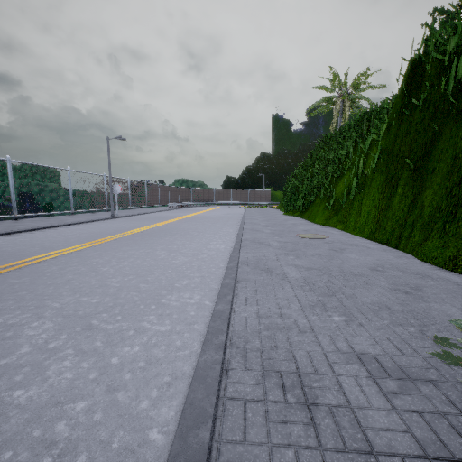
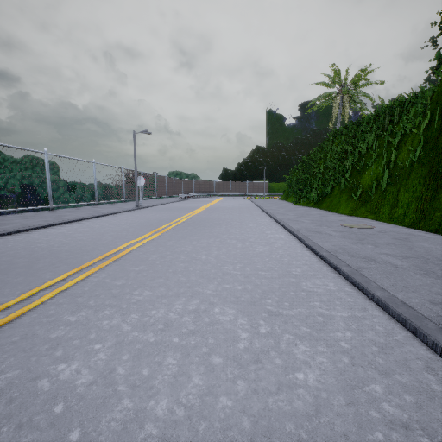
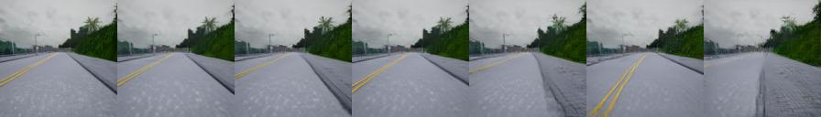
Recap (2/2): Our new architecture
dashed lines are loss
Cycle Loss (L1)
Ground
Truth
L1
Generator
G
Generator
G
Input Image
0m
GAN Loss
Fake Image
2m
GAN Loss
+2.0m
-2.0m
Discriminator D
Discriminator D
relative
target
distance
minus
target
distance

Slide 4
Follow-up from last week: Discriminator Architecture
Source Loss
Real or Fake? (Wasserstein)
Discriminator D
GAN Loss
Classification Loss
Which camera? (Cross Entropy)
Still treating each camera as class

Slide 5
Trained model from last time longer
It works now and learned the concept of shifting an image by a relative distance.
Demo of App
http://efe5425e.ngrok.io/ (may be offline)

Slide 6
Many more experiments
No Cycle Loss
No Classification Loss from Discriminator
No Real/Fake Loss from Discriminator
Training on dataset with different weather

Slide 7
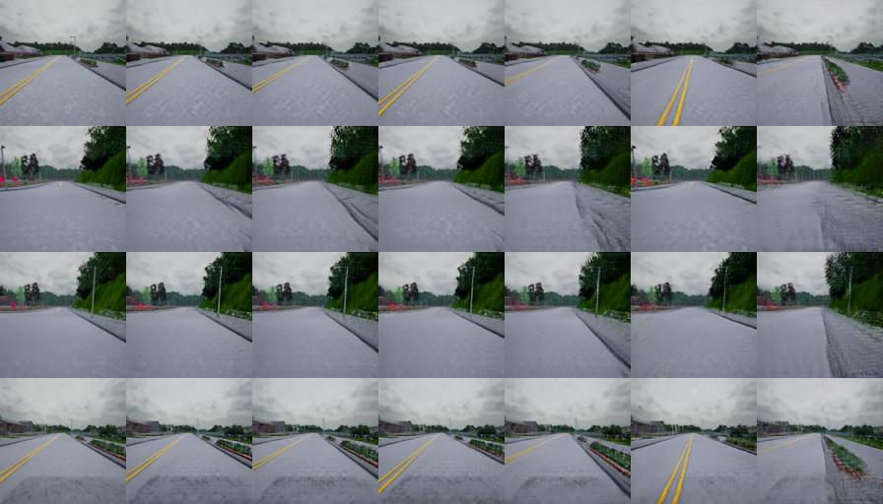
No Cycle Loss
The objective of cycle loss, is to inherently preserve the structures in the image
Now only L1 loss between fake and reference image preserves structures, and it seems to be enough
 | Translated Image (Fake Image)
Input Image | Cam 0 0m | Cam 1 0.5m | Cam 2 -0.3m | Cam 3 1.0m | Cam 4 -1.3m | Cam 5 2.0m
Sample 1
Sample 2
Sample 3
Sample 4

Slide 8
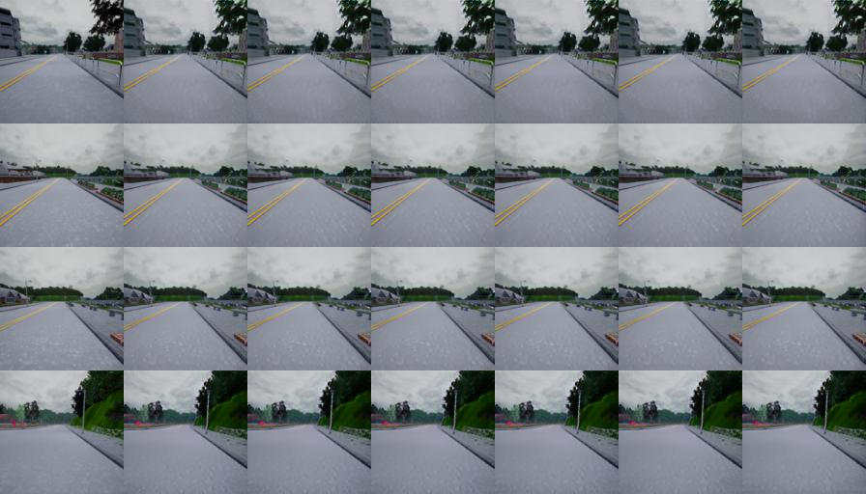
No Classification Loss from Discriminator
L1 should still make class. Possible. Maybe source loss dominates L1 loss?
Generator doesn’t change the input image, as the input image is already “real”
 | Translated Image (Fake Image)
Input Image | Cam 0 0m | Cam 1 0.5m | Cam 2 -0.3m | Cam 3 1.0m | Cam 4 -1.3m | Cam 5 2.0m
Sample 1
Sample 2
Sample 3
Sample 4

Slide 9
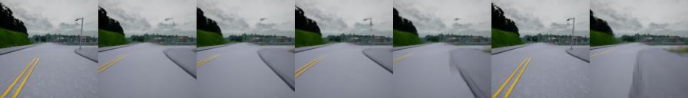
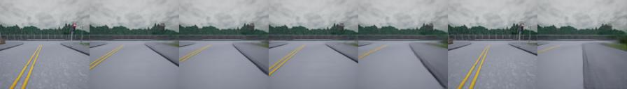
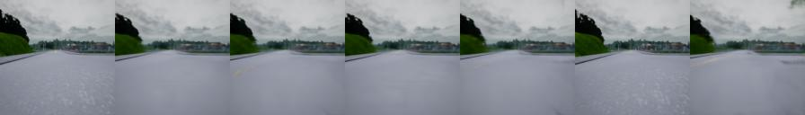
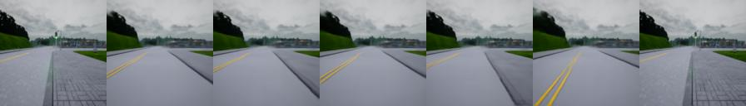
No Discriminator -> Only L1 Loss
Translation works, though the images look blurrier.
 | Translated Image (Fake Image)
Input Image | Cam 0 0m | Cam 1 0.5m | Cam 2 -0.3m | Cam 3 1.0m | Cam 4 -1.3m | Cam 5 2.0m
Sample 1
Sample 2
Sample 3
Sample 4

Slide 10
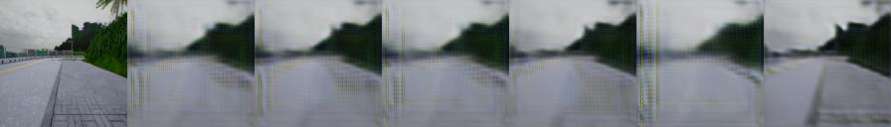
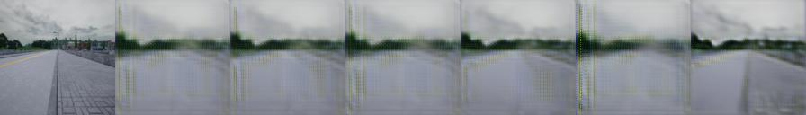
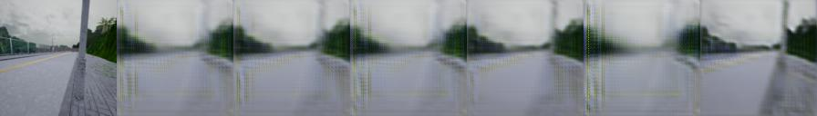
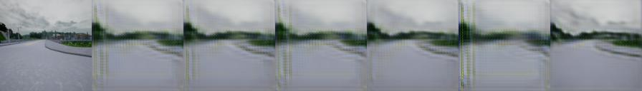
No Source Loss from Discriminator
Still L1 loss should be able to make images almost real?
Generated images are not looking like “real” images, but still they are changing, as discriminator still gives critic about the camera class.
 | Translated Image (Fake Image)
Input Image | Cam 0 0m | Cam 1 0.5m | Cam 2 -0.3m | Cam 3 1.0m | Cam 4 -1.3m | Cam 5 2.0m
Sample 1
Sample 2
Sample 3
Sample 4

Slide 11
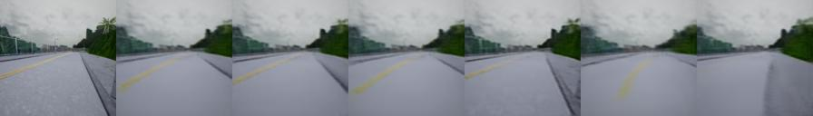
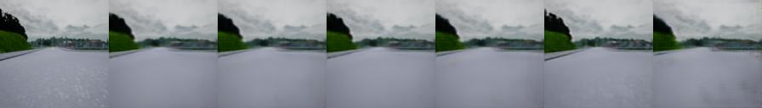
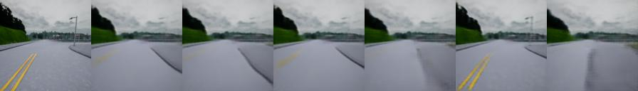
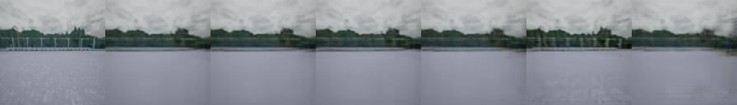
No Source Loss from Discriminator & 100*L1 Loss
It seems that the Classification Loss dominated the L1 Loss. Multiplying L1 Loss with 100 makes the images look more real.
 | Translated Image (Fake Image)
Input Image | Cam 0 0m | Cam 1 0.5m | Cam 2 -0.3m | Cam 3 1.0m | Cam 4 -1.3m | Cam 5 2.0m
Sample 1
Sample 2
Sample 3
Sample 4

Slide 12
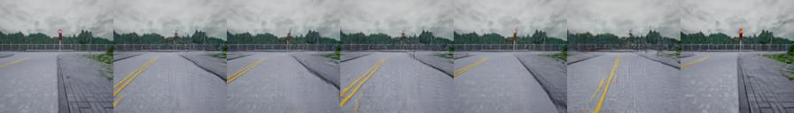
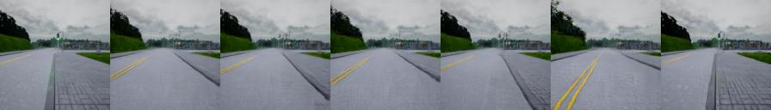
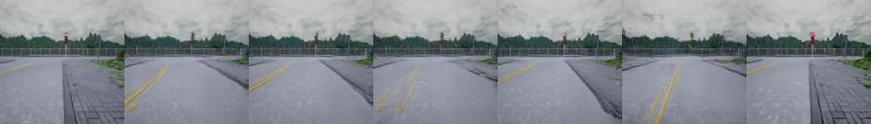
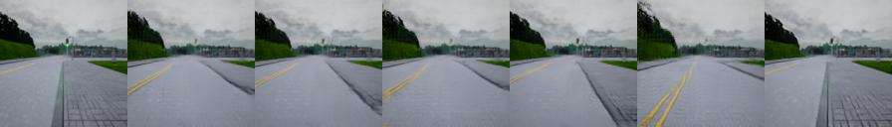
No L1 Loss
Looks the same as with L1 Loss -> It seems that L1 loss values are very small compared to Source and Classification Loss, therefore doesn’t contribute anything. Small structures (pole or red light) disappear
 | Translated Image (Fake Image)
Input Image | Cam 0 0m | Cam 1 0.5m | Cam 2 -0.3m | Cam 3 1.0m | Cam 4 -1.3m | Cam 5 2.0m
Sample 1
Sample 2
Sample 3
Sample 4
No L1 Loss
With L1 Loss

Slide 13
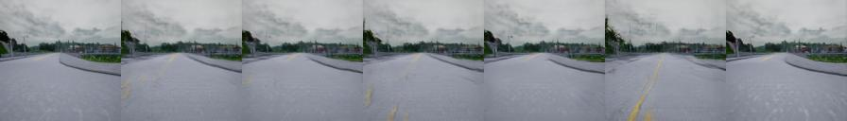
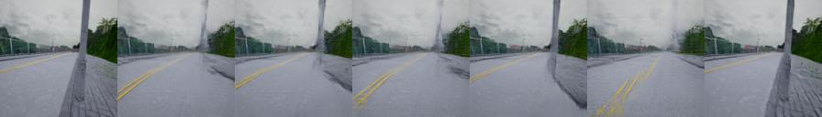
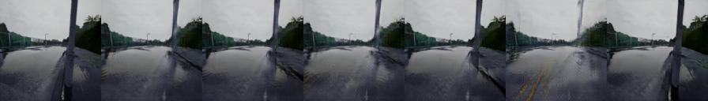
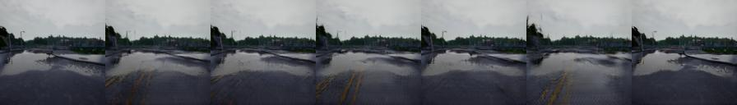
Training on dataset with different weather
Generator learns to only translate the perspective of the image, not the weather
 | Translated Image (Fake Image)
Input Image | Cam 0 0m | Cam 1 0.5m | Cam 2 -0.3m | Cam 3 1.0m | Cam 4 -1.3m | Cam 5 2.0m
Sample 1
Sample 2
Sample 3
Sample 4

Slide 14
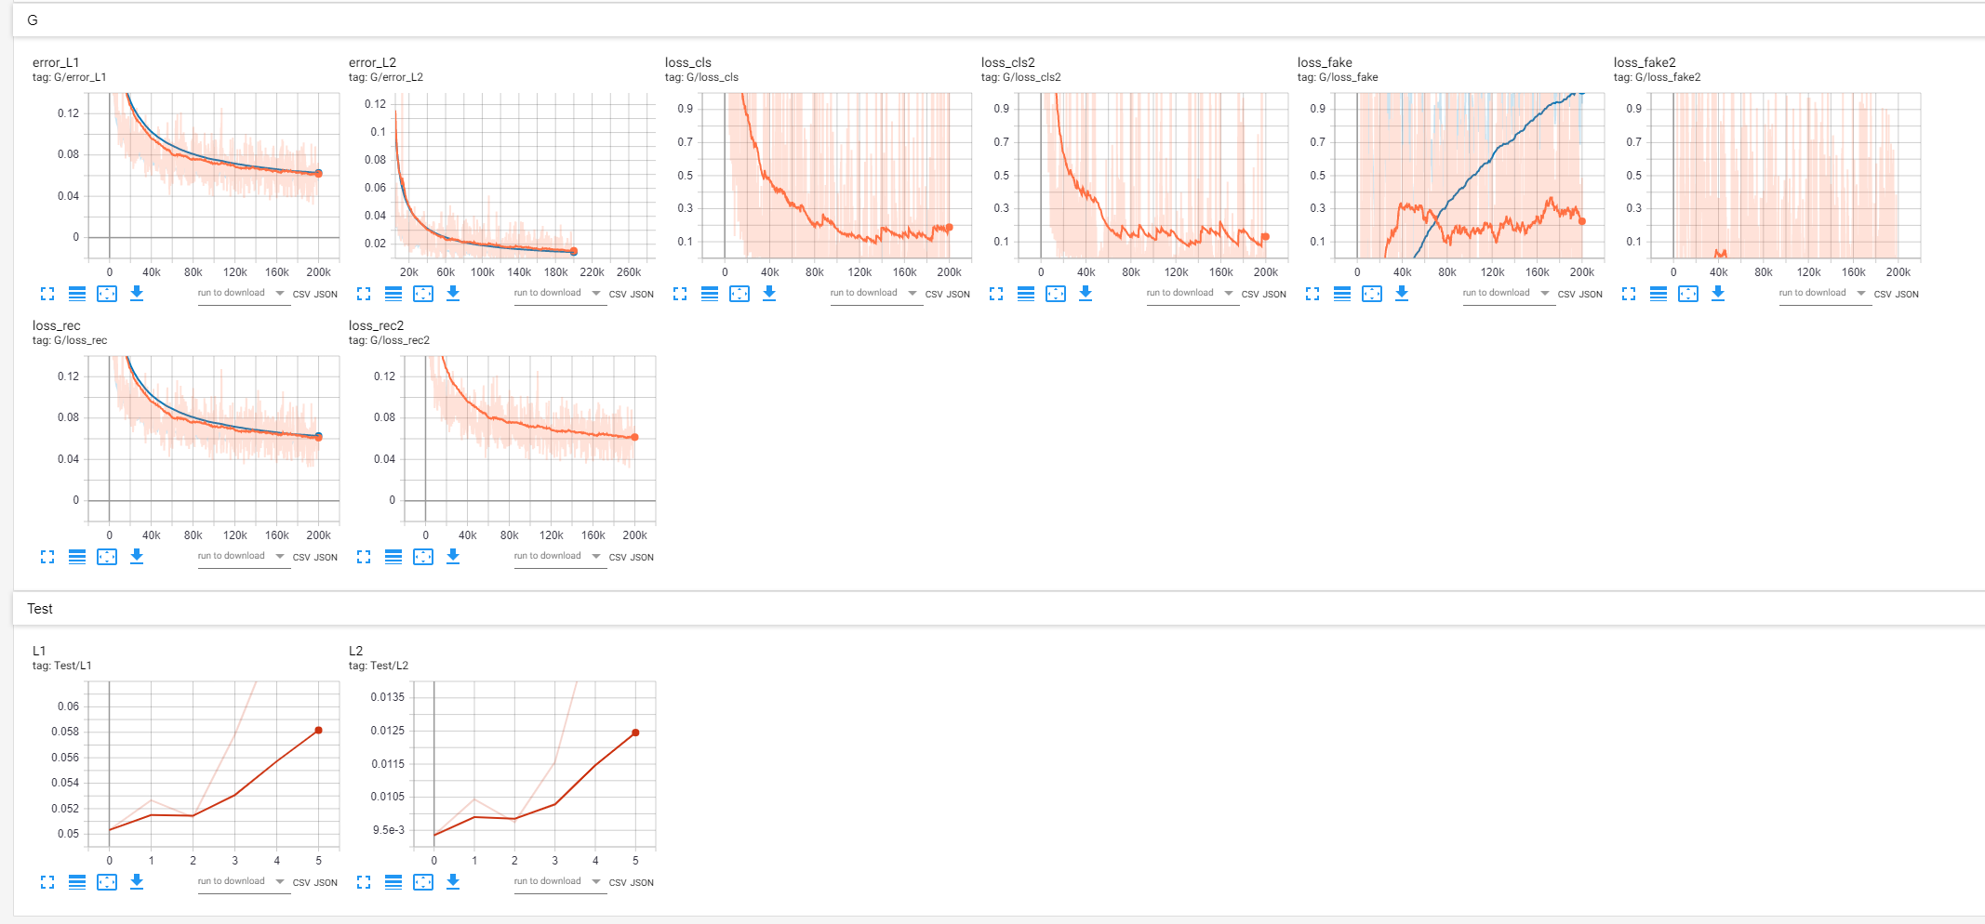
Adding Quantitative metric and Visualization to our code
As quantitative metric, we are using L1/L2 error between the translated and reference image
We also added visualization to our code, for better evaluate and inspect the behavior during training (e.g. overfitting)

Slide 15
To Do
Evaluation on quantitative metric
Making more experiments
Balancing all Losses (as L1 seems to get dominated by other losses)
MSE instead of cross entropy for classification loss (second head of discriminator)
Hold out one camera, so we can evaluate on unseen value
L2 instead of L1 (we expect the pictures getting blurrier)
Changing model size

