Slide 1
Data Collection from sensors
Jan 02, 2023
20227490 AHSAN AZIZ
Advisor – Nam yunyoung (Soonchunhyang University) 남윤영
Department of ICT Convergence
Graduate School, Soonchunhyang University
1

Slide 2
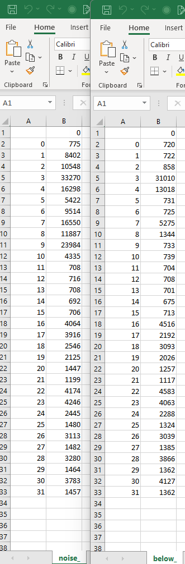
Comparison of data with noise

Slide 3
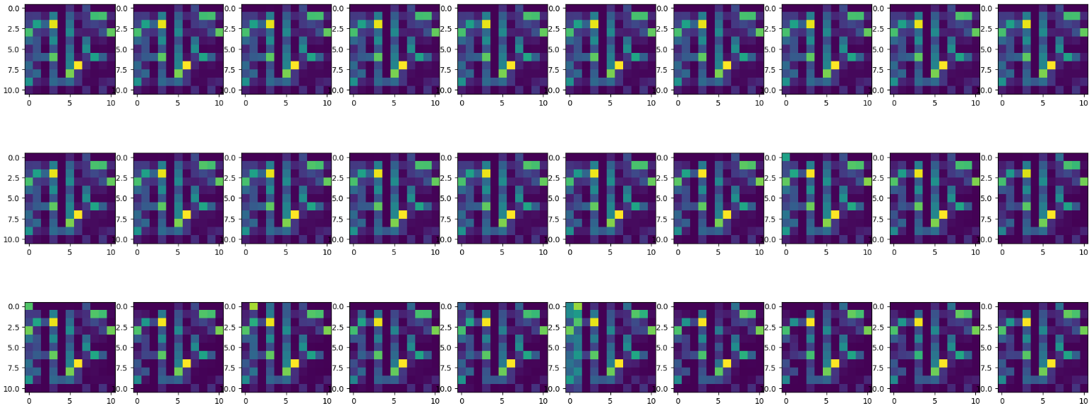
No movement on these sensors

Slide 4
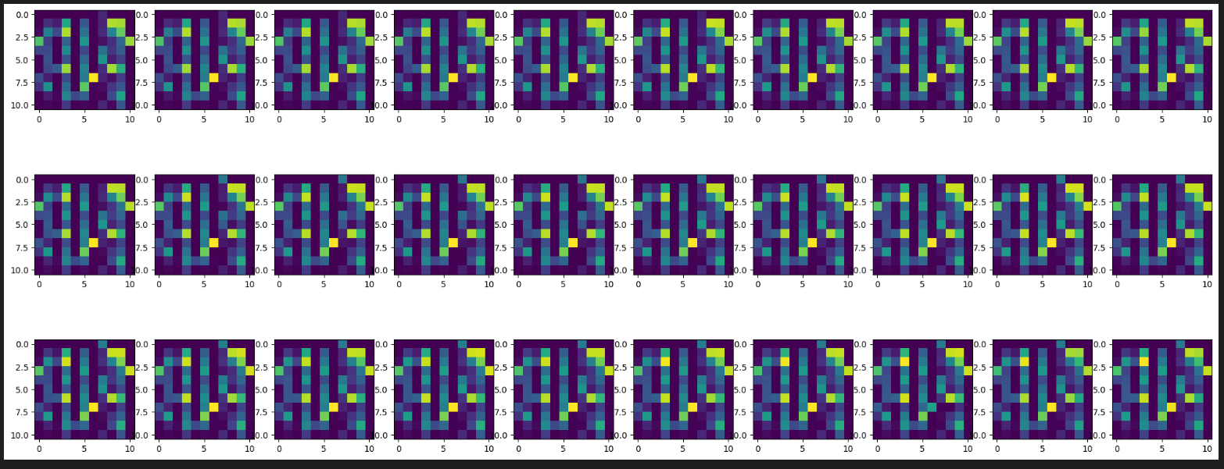
The only movement on the top right corner

Slide 5
Thank you for your attention!
Q & A

