Slide 1
Web Engineering
Lab 1

Slide 2
Lab Evaluation
Lab Evaluation
Mid Term | 25%
Assignments | 25%
Final Exam + Project | 50%
Total | 100%

Slide 3
Course Contents
HTML (to define the content of web pages)
CSS (to specify the layout of web pages)
Bootstrap (to develop responsive web pages)
JavaScript (to program the behavior of web pages)
PHP (Use for database)

Slide 4
Recommended Text Books:
Beginning HTML with CSS and XHTML by David Schultz and Craig Cook
PHP and MySQL by example by Ellie Quigley with Marko Gargenta
Web Engineering by Gerti Kappel, Birgit Proll, Siegfried Reich, Werner Retschitzegger
HTML5: Up and Running by Mark Pilgrim 2010
W3Schools Online Web Tutorials http://www.w3schools.com

Slide 5
Editor
Sublime Text Editor
Notepad ++
Notepad

Slide 6
Web Server
Install a web server on your own PC and then install PHP & MYSQL
WAMP: Window, Apache, MYSQL, PHP
XAMPP: All OS, Apache, MYSQL, PHP, Perl
Note: Install the web server start as services & then type localhost in your browser to check whether it is running or not
LAMP: used for Linux Machines users

Slide 7
Web Application?
A Web Application is a software system based on technologies and standards of the World Wide Web Consortium (W3C) that provides Web specific resources such as content and services through a user interface, the Web browser.
World Wide Web Consortium (W3C)
international consortium where member organizations, a full-time staff, and the public work together to develop Web standards.
W3C's mission:
To lead the World Wide Web to its full potential by developing protocols and guidelines that ensure long-term growth for the Web.

Slide 8
HTML – Hypertext Markup Language
HTML stands for Hypertext Markup Language
HTML describes the structure of Web pages using markup
HTML elements are the building blocks of HTML pages
HTML elements are represented by tags
Different versions exists, HTML v. 1.0 published in 1991, then 2 , 3, 4, 4.01 and 5 versions. Version 4.01 is used more than other versions.
Defines large number of tags to denote different semantics. E.g. <H1>tag can be used to mark a level-1 heading.

Slide 9
HTML – Hypertext Markup Language Components of HTML
HTML document composed in two components
Tags and
Attributes
Both are work togather to identify different document parts and tell the browser how to display them. E.g. A Tag specify a chunk of information be displayed as a paragraph or something else. Whereas attributes are optional part of tags specify information or more thoroughly explains about a particular tag e.g. Color, aligenment, width and height etc.

Slide 10
HTML Tags
HTML tags are element names surrounded by angle brackets:
<tagname>content goes here...</tagname>
HTML tags normally come in pairs like <p> and </p>
The first tag in a pair is the start tag, the second tag is the end tag
The end tag is written like the start tag, but with a forward slash inserted before the tag name

Slide 11
HTML – Hypertext Markup Language (cont.)
<html>
<head>
<title>First Web Page</title>
</head>
<body>
<h1>Heading</h1> <p>Paragraph</p>
</body>
</html>
-Save it with HTML extension e.g. First.html
Head Tag
HTML Tag
Body Tag

Slide 12
HTML – Hypertext Markup Language (cont.)
The <!DOCTYPE html> declaration defines this document to be HTML5
The <html> element is the root element of an HTML page
The <head> element contains meta information about the document
The <title> element specifies a title for the document
The <body> element contains the visible page content
The <h1> element defines a large heading
The <p> element defines a paragraph

Slide 13
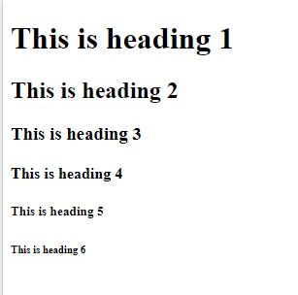
HTML Headings
HTML headings are defined with the <h1> to <h6> tags.
<h1> defines the most important heading. <h6> defines the least important heading:
<!DOCTYPE html>
<html>
<body>
<h1>This is heading 1</h1>
<h2>This is heading 2</h2>
<h3>This is heading 3</h3>
<h4>This is heading 4</h4>
<h5>This is heading 5</h5>
<h6>This is heading 6</h6>
</body>
</html>

Slide 14
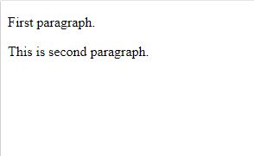
HTML Paragraphs
HTML paragraphs are defined with the <p> tag:
<!DOCTYPE html>
<html>
<body>
<p>First paragraph.</p>
<p>This is second paragraph.</p>
</body>
</html>

Slide 15
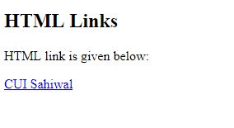
HTML Links
HTML links are defined with the <a> tag:
<!DOCTYPE html>
<html>
<body>
<h2>HTML Links</h2>
<p>HTML link is given below:</p>
<a href="https://www.sahiwal.comsats.edu.pk/">CUI Sahiwal</a>
</body>
</html>

Slide 16
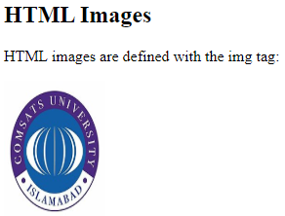
HTML Images
HTML images are defined with the <img> tag.
The source file (src), alternative text (alt), width, and height are provided as attributes:
<!DOCTYPE html>
<html>
<body>
<h2>HTML Images</h2>
<p>HTML images are defined with the img tag:</p>
<img src=“ciit.jpg" alt="W3Schools.com" width="104px" height="142px">
</body>
</html>

Slide 17
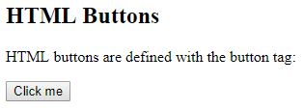
HTML Buttons
HTML buttons are defined with the <button> tag:
<!DOCTYPE html>
<html>
<body>
<h2>HTML Buttons</h2>
<p>HTML buttons are defined with the button tag:</p>
<button>Click me</button>
</body>
</html>

Slide 18

Lab Task

