Slide 1
Web Technologies
Lab 2

Slide 2
HTML Lists
Three types of HTML Lists:
Ordered HTML List
Unordered HTML List
Description HTML List

Slide 3
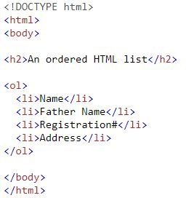
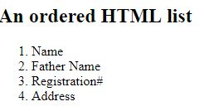
Ordered HTML List
An ordered list starts with the <ol> tag. Each list item starts with the <li> tag.
The list items will be marked with numbers by default:

Slide 4
Ordered HTML List - The Type Attribute
The type attribute of the <ol> tag, defines the type of the list item marker:
Type | Description
type="1" | The list items will be numbered with numbers (default)
type="A" | The list items will be numbered with uppercase letters
type="a" | The list items will be numbered with lowercase letters
type="I" | The list items will be numbered with uppercase roman numbers
type="i" | The list items will be numbered with lowercase roman numbers

Slide 5
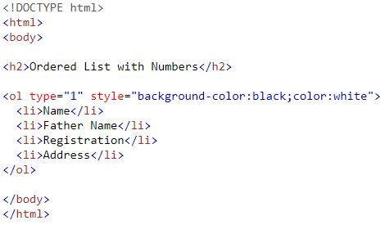

Numbers:

Slide 6
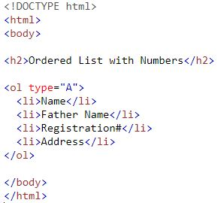
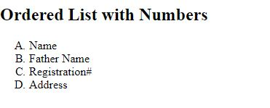
Uppercase Letters:

Slide 7
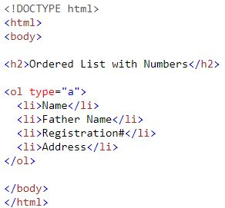
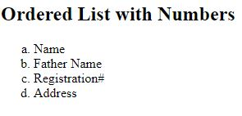
Lowercase Letters:

Slide 8
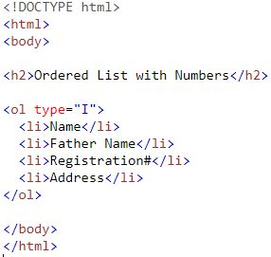
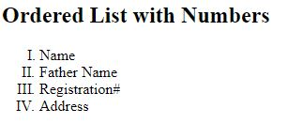
Uppercase Roman Numbers:

Slide 9
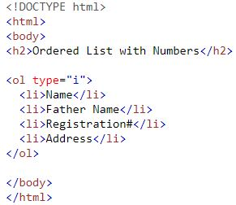
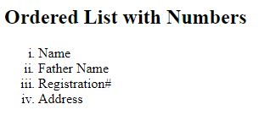
Lowercase Roman Numbers:

Slide 10
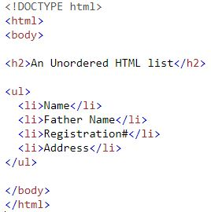
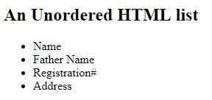
Unordered HTML List
An unordered list starts with the <ul> tag. Each list item starts with the <li> tag.
The list items will be marked with bullets (small black circles) by default:

Slide 11
Unordered HTML List Propertise
The CSS list-style-type property is used to define the style of the list item marker:
Value | Description
disc | Sets the list item marker to a bullet (default)
circle | Sets the list item marker to a circle
square | Sets the list item marker to a square
none | The list items will not be marked

Slide 12
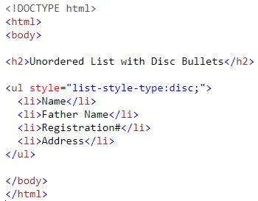
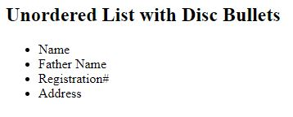
Disc

Slide 13
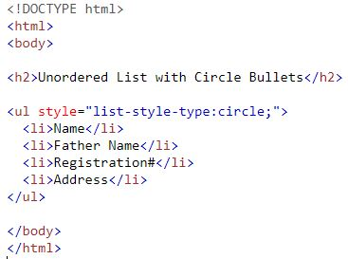
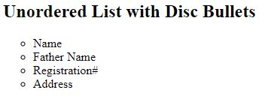
Circle

Slide 14
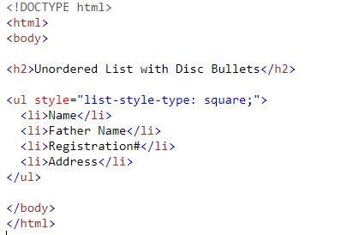
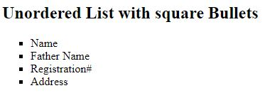
Square

Slide 15
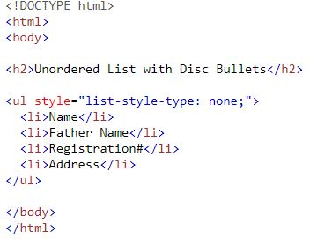
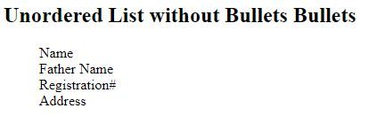
None

Slide 16
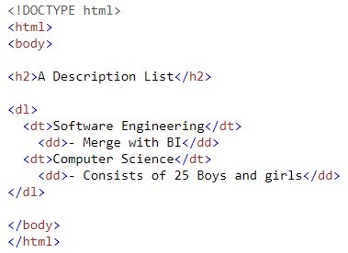
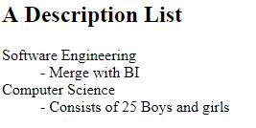
HTML Description Lists
A description list is a list of terms, with a description of each term.
The <dl> tag defines the description list, the <dt> tag defines the term (name), and the <dd> tag describes each term:

Slide 17
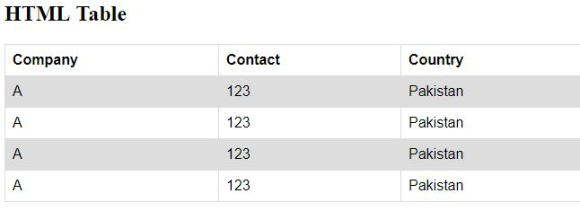
HTML Table
An HTML table is defined with the <table> tag.
Each table row is defined with the <tr> tag.
A table data/cell is defined with the <td> tag.
A table header is defined with the <th> tag.

Slide 18
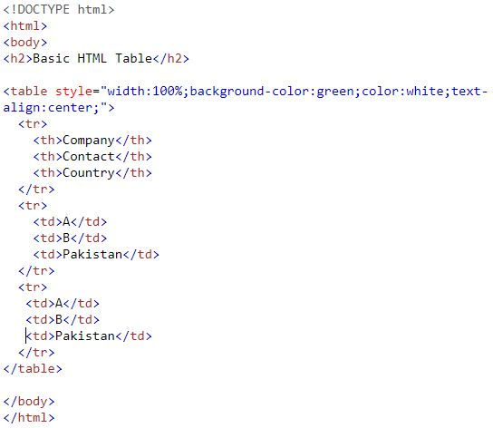

HTML Table

Slide 19
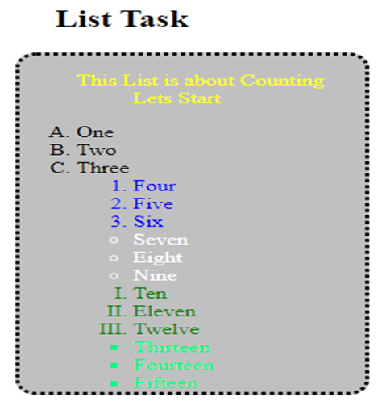
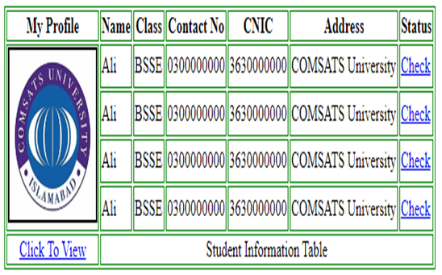
Task

Slide 20
Questions

