Slide 1
Web Engineering
Lab 3

Slide 2
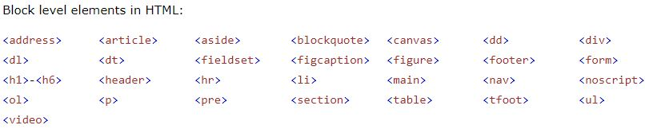
HTML Block and Inline Elements
A block-level element always starts on a new line and takes up the full width available
The <div> element is a block-level element.

Slide 3
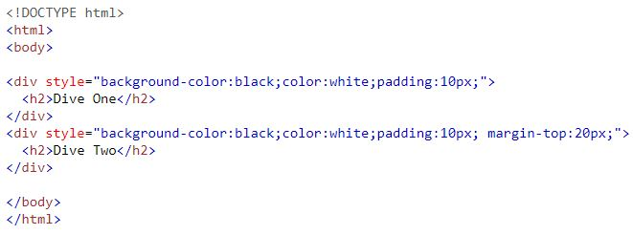
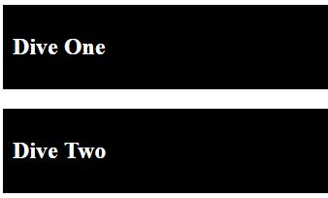
The <div> Tag
The <div> element is often used as a container for other HTML elements.
The <div> element has no required attributes, but style, class and id are common.

Slide 4
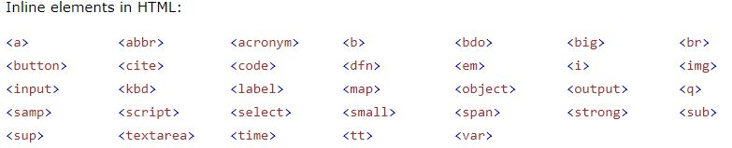
HTML Inline Elements
An inline element does not start on a new line and only takes up as much width as necessary.
The <span> is an inline element.

Slide 5
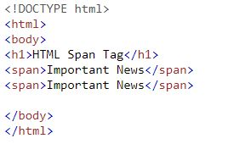

Inline <span> element
The <span> element is often used as a container for some text.
The <span> element has no required attributes, but style, class and id are common.

Slide 6
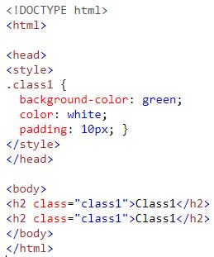
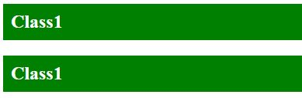
HTML The class Attribute
The HTML class attribute is used to define equal styles for elements with the same class name.
To select elements with a specific class, write a (.) character, followed by the name of the class:

Slide 7
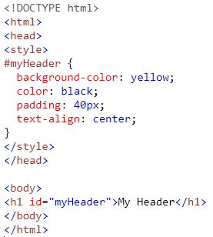

HTML The id Attribute
The id attribute specifies a unique id for an HTML element
To select an element with a specific id, write a hash (#) character, followed by the id of the element:

Slide 8
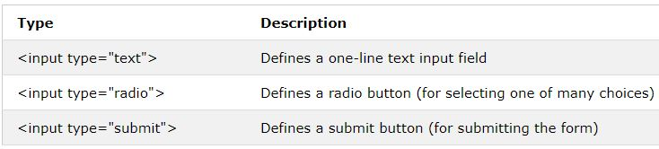
HTML Forms
The HTML <form> element defines a form that is used to collect user input.
The <input> is the most important form element
The <input> element can be displayed in several ways depending on the type attribute.

Slide 9
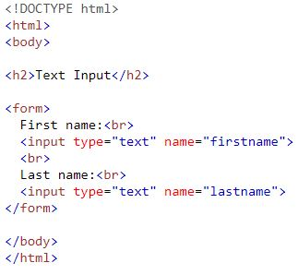
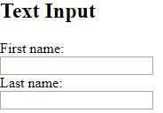
Text Input
<input type="text"> defines a one-line input field for text input:

Slide 10
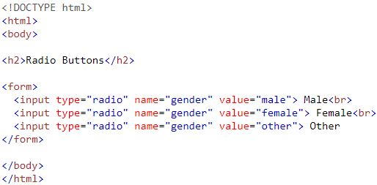
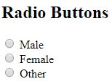
Radio Button Input
<input type="radio"> defines a radio button.

Slide 11
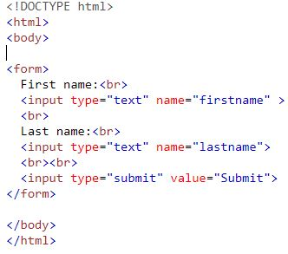
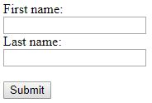
The Submit Button Input
<input type="submit"> defines a button for submitting the form data to a form-handler.

Slide 12
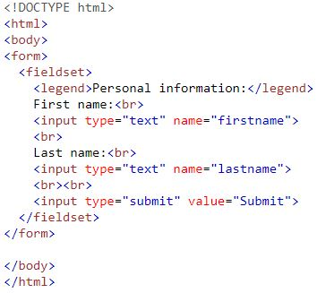
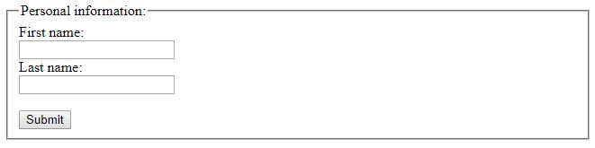
Grouping Form Data with <fieldset>
The <fieldset> element is used to group related data in a form.
The <legend> element defines a caption for the <fieldset> element.

Slide 13
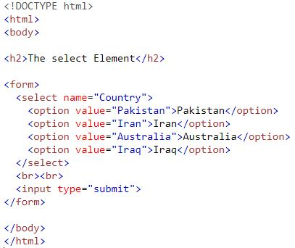
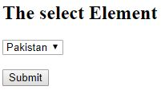
The <select> Element
The <select> element defines a drop-down list.

Slide 14
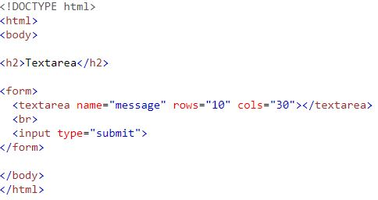
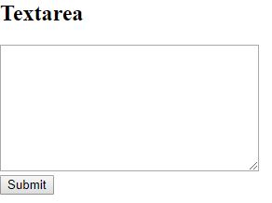
The <textarea> Element
The <textarea> element defines a multi-line input field (a text area).

Slide 15
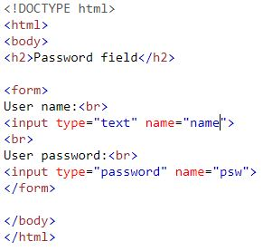
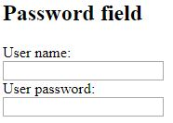
Input Type Password
<input type="password"> defines a password field.

Slide 16
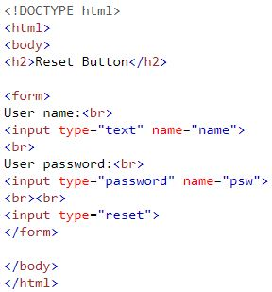
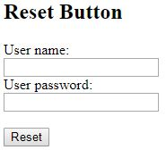
Input Type Reset
<input type="reset"> defines a reset button that will reset all form values to their default values:

Slide 17
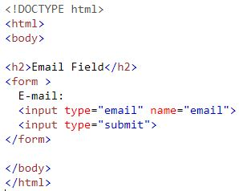

Input Type Email

Slide 18
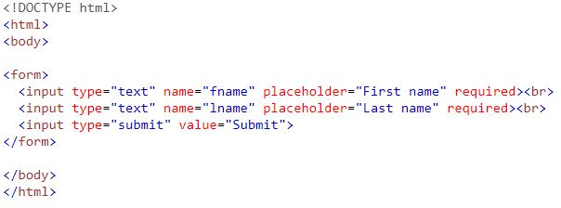

The placeholder & Required Attribute

Slide 19
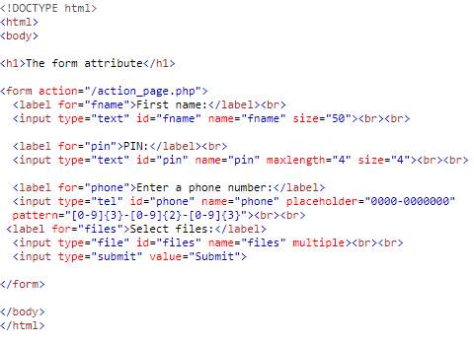
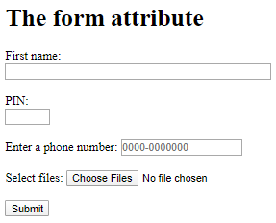
The Input Size,Maxlength and Multiple Attribute

Slide 20
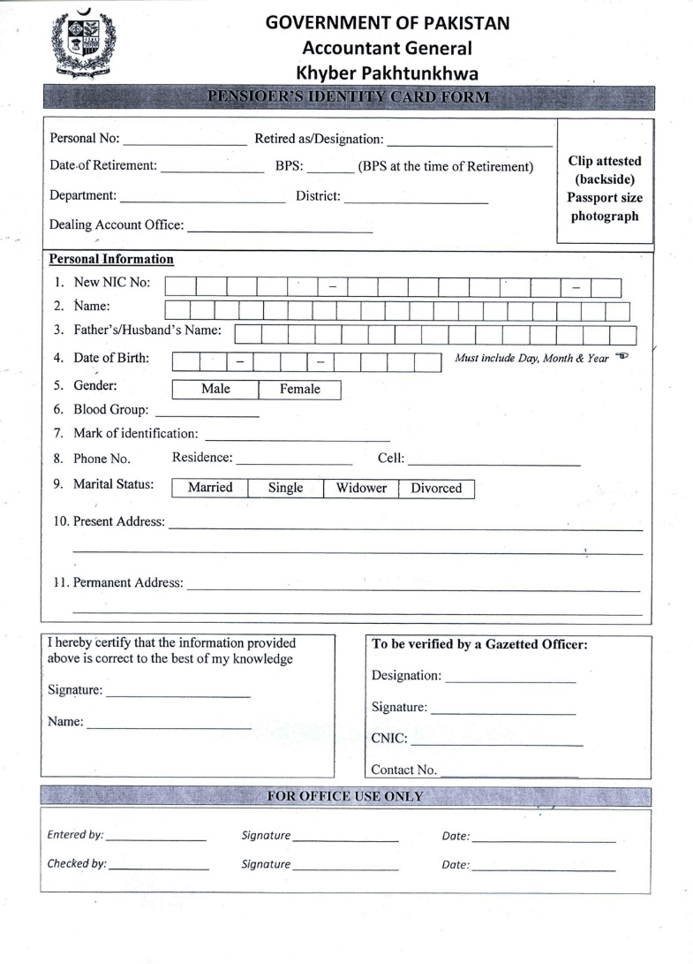
Task

Slide 21
Assignment 2: HTML5 Input Types
color
date
datetime-local
email
month
number
range
search
tel
time
url
Week
File
Checkbox

Slide 22
Questions

