Slide 1
Analyzing GA Performance
Understanding Best-So-Far (BSF) and Average Current Population (ACP) Metrics

Slide 2
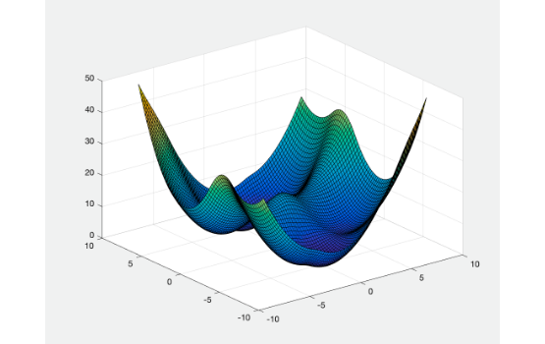

The Optimization Problem
Evolutionary Algorithms (EAs) attempt to find the absolute minimum point in a complex mathematical landscape. We evaluated our selection schemes on two distinct functions:
•
Sphere Function: A smooth, continuous, convex landscape where the minimum is easily accessible.
•
Rosenbrock Function: A non-convex function featuring a long, narrow, parabolic flat valley that challenges optimization algorithms.

Slide 3




Algorithm Components
Parent Selection
Variation Operators
Survival Selection
Determines which individuals mate. We compared Fitness Proportionate Selection (FPS), Rank-Based Selection (RBS), and Binary Tournament Selection.
Determines who lives to the next generation. We tested Truncation (keeping the absolute fittest) versus Tournament survival.
Arithmetic crossover creates new offspring by interpolating between parents. Mutation adds a random variance (prob=0.3) to search new areas.

Slide 4
Metric 1: Best-So-Far
BSF
The Ultimate Discovery Metric
The "Average Best-So-Far" (BSF) tracks the absolute lowest objective value found from generation zero up to the current generation. It is averaged over 10 independent runs to eliminate stochastic noise.
Monotonically Decreasing
Because it records the best solution historically, this curve never worsens. It is a direct measure of the algorithm's pure exploitation capabilities and its success in finding the global minimum.

Slide 5
Metric 2: Average Pop.
ACP
The Population Health Metric
The "Average of Current Population" (ACP) is the mean objective value of all individuals currently alive in a specific generation.
Unlike BSF, the ACP curve can fluctuate. When the algorithm undergoes heavy mutation or uses a loose survival selection, the overall population fitness drops (increasing objective value), signifying broad exploration of the search space.
Dynamic & Fluctuating

Slide 6

Exploitation vs. Exploration
Visualizing Diversity
BSF illustrates exploitation—locking onto the best discovered solution. ACP illustrates exploration—how much the population spreads out to search the space. A high gap between them indicates high diversity.

Slide 7
Comparing Selection Schemes
How different combinations impact BSF and ACP

Slide 8
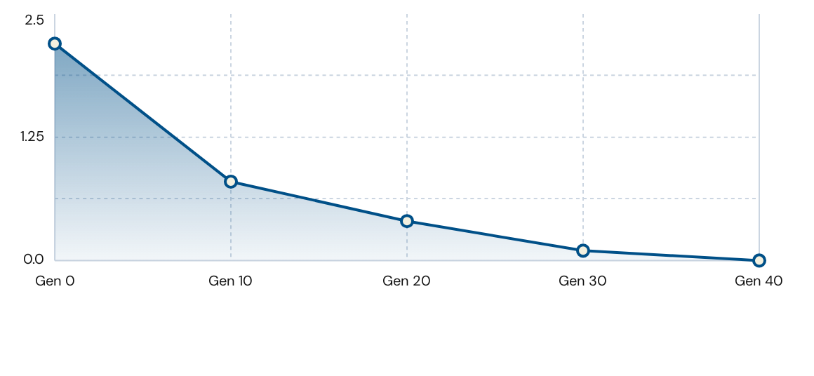
BSF Convergence Trend
BSF curves monotonically decrease. They drop rapidly as obvious improvements are found, then flatten out as the algorithm struggles to find marginally better variations.

Slide 9
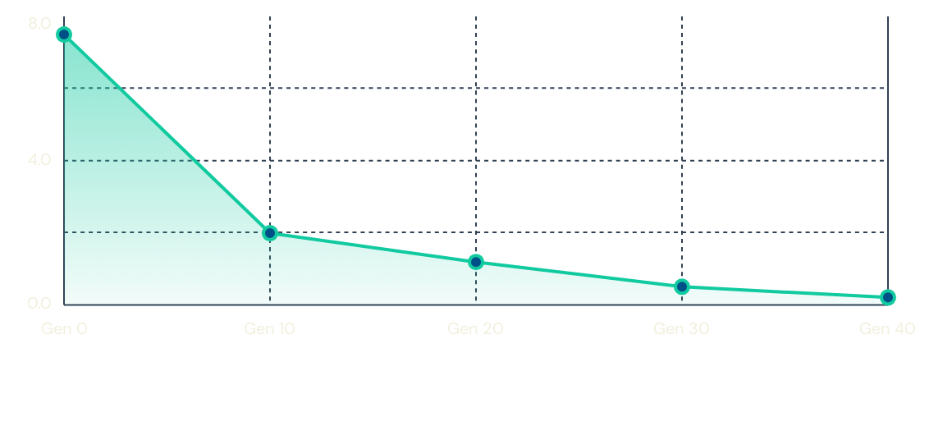
ACP Convergence Trend
The ACP curve generally descends but can fluctuate. It remains consistently higher than the BSF curve because the population deliberately contains diverse, non-optimal individuals searching new areas.

Slide 10
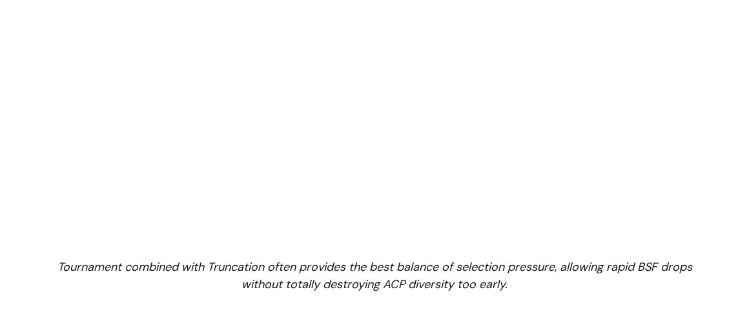
Scheme Performance Summary
Parent Scheme | Survival Scheme | Convergence (Sphere) | Convergence (Rosenbrock)
FPS | Truncation | Slow | Slow
Rank-Based (RBS) | Tournament | Moderate | Moderate / Fast
Tournament | Truncation | Fast | Fast (Best Accuracy)
Tournament | Tournament | Fastest | Premature Convergence

Slide 11

Achieving The Goal
The ideal evolutionary algorithm behaves optimally when it balances the forces shown in both graphs:
•
Rapid BSF Decline: We want the Best-So-Far metric to plummet quickly, indicating strong, targeted exploitation of the fitness landscape.
•
Healthy ACP Gap: We want the Average Current Population metric to stay slightly above the BSF, indicating the population is still actively searching and resisting premature convergence.

Slide 12



Image Sources
https://science.hkust.edu.hk/sites/default/files/prof._jianfeng_cais_project.png
Source: science.hkust.edu.hk
https://static.vecteezy.com/system/resources/thumbnails/066/855/496/small_2x/abstract-network-background-showing-glowing-nodes-connected-by-lines-representing-digital-document-and-data-management-cloud-storage-and-technology-concepts-video.jpg
Source: www.vecteezy.com
https://www.bounteous.com/sites/default/files/insights/2024-01/previews/2023_bullseye_website.png
Source: www.bounteous.com

