Slide 1

CSE754: DEEP LEARNING FOR COMPUTER VISION · FINAL PROJECT
Contactless Vital Sign Estimation from Face Video
A Rigor-First Audit of Reproducibility and Robustness in Remote Photoplethysmography (rPPG)
Noshin Tabassum Arthi · Samin Ahsan Tausif
Supervisor: Dr. Md. Ashraful Alam
Notes:
Good [morning/afternoon]. This is our final project presentation for CSE754. Our project audits contactless heart-rate estimation, remote photoplethysmography or rPPG, for two things at once: does it stay accurate under different recording conditions, and can we trust the pipeline that produces that accuracy number in the first place. We'll walk through why this matters, the problem we targeted, our method, our results, one detailed failure case, and what we'd do next.

Slide 2






AGENDA
One journey, five stops
01 · WHY
02 · PROBLEM
03 · APPROACH
04 · RESULTS
05 · CLOSE
Motivation
The Gap
Method
Outcomes
Conclusion
A fairness or robustness number is only as trustworthy as the pipeline behind it — that idea threads through every stop on this map.
Notes:
Five sections as required by the course, but one continuous journey: why this matters, the gap we found in the literature, how we built and validated our pipeline, what we measured once it was trustworthy, and where that leaves us. Since we covered the motivation and the literature gap in depth during our proposal presentation, we'll move through the first two sections briskly today as a refresher rather than repeating them in full, and spend most of our time from Method onward, where the actual hands-on work lives: the pipeline we built, the data we ran, and the results we measured. We'll keep coming back to a single idea throughout: rigor about the pipeline is not separate from rigor about fairness or robustness, it's a precondition for it.

Slide 3



01 · MOTIVATION
A camera can read your pulse — but does it read everyone, everywhere, reliably?
Telehealth, neonatal care, driver monitoring: no wearable, just a webcam already running.
REPORTED ACCURACY GAP, PRIOR AUDITS
5.2
The signal is weak, easily corrupted by motion and lighting, and rarely audited for consistency.
bpm error, easy case
14.1
Most published methods report one clean accuracy number, not whether it holds up everywhere.
bpm error, harder case
Notes:
Picture a telehealth visit with no pulse oximeter, just the webcam. Software silently estimates heart rate from color changes in skin too small to see. That already works in the lab. What's unresolved is whether it works consistently outside the lab, across conditions, and reliably enough to trust. Prior audits show error roughly tripling between easy and hard conditions, from about 5 bpm to over 14 bpm. That gap motivates everything that follows.

Slide 4



02 · PROBLEM ADDRESSING
The Literature Gap: An Unaudited Intersection
Robustness work
Label-free learning
Fairness audit (2025)
Motion-tolerant & compression-robust methods, never audited for fairness.
Unsupervised, state-of-the-art accuracy, never audited for fairness.
Confirms demographic bias across the field's datasets; audits, proposes no fix.
TULYAKOV 2016 · YU 2019
SUN & LI 2022 / 2024
BONDARENKO ET AL.
No published work is robustness-tested AND fairness-audited on the same model, same protocol. That's the gap this project targets.
Notes:
Across the papers we reviewed, robustness work and fairness work never overlap on the same method. Even the most recent unsupervised state of the art has never been checked for consistency across conditions in a way that also questions whether the checking pipeline itself is trustworthy. That combination, robustness plus a rigor-first audit of the pipeline itself, is where we aimed our contribution.

Slide 5




02 · PROBLEM ADDRESSING
Problem Statement and Research Scope
RQ1
RQ2
RQ3
Reproduce it correctly
Test a real condition shift
Diagnose failure honestly
Can classical and deep rPPG baselines be independently reproduced to published accuracy?
Does accuracy hold across resting vs. post-exercise recordings, and is any gap real or an artifact?
When a method fails, is it explainable, and does a proposed fix actually generalize?
Scope note: a skin-tone fairness axis was originally planned; the gated datasets needed weren't obtainable in time. We redirected the same rigor to the condition axis our data supports.
Notes:
We want to be upfront about scope rather than let it surface as a surprise question. The original plan targeted skin-tone fairness using MMPD and EquiPleth, both gated-access datasets we could not obtain in time. Rather than claim an audit we couldn't actually run, we applied the same standard of rigor to resting-versus-post-exercise, the one real condition contrast our obtained data supports. The three questions on screen, tied together as one connected line of inquiry, are what we actually executed.

Slide 6





03 · METHOD
Pipeline Overview: A Six-Stage Evaluation Protocol
Versioned setup
Subject-independent
Resting vs. exercise
Environment
Split
Core eval
STEP 01
STEP 03
STEP 05
STEP 02
STEP 04
STEP 06
Preprocess
Reproduce
Diagnose
Face ROI, GT align
vs. published numbers
Failure + mitigation
Step 4 is a hard gate: we do not move to steps 5 and 6 until baseline reproduction actually passes.
Notes:
Quick pacing note: we covered motivation and the literature gap in our proposal talk, so we'll move fast through those and spend most of today from here on: the actual pipeline, data, and results. Six steps, shown as one connected thread since each depends on the last. Steps 1 to 3 are infrastructure: versioned environment, preprocessing, and a subject-independent split, by person, never by frame, so no model can cheat by learning a face. Step 4 is the real gate: reproduction against published numbers. We don't touch steps 5 and 6, our actual evaluation and failure diagnosis, until step 4 genuinely passes. That's what the rest of today is built on.

Slide 7



03 · METHOD
Data and Baselines
CHROM & POS classical, training-free chrominance methods
22
PhysNet ×2 deep spatiotemporal network, two pretrained checkpoints, inference-only
pooled UBFC-rPPG clips, both public releases · subject-independent 15/3/4 split
MAE / RMSE in bpm, whole-clip heart rate, subject-independent
Notes:
Twenty-two clips, pooled from both UBFC-rPPG releases: six from the original eight-subject set after excluding two for a duplicate-video issue, sixteen from the standard forty-two-subject benchmark the literature is measured against. We span both baseline families so our claims generalize: CHROM and POS, classical and training-free, and PhysNet under two pretrained checkpoints, one on UBFC-rPPG, one on PURE. Everything is inference-only; twenty-two clips is nowhere near enough to train from scratch without overfitting. Every number from here on is MAE and RMSE in bpm, computed per whole clip and always broken out by split, so it's directly comparable to the literature.

Slide 8
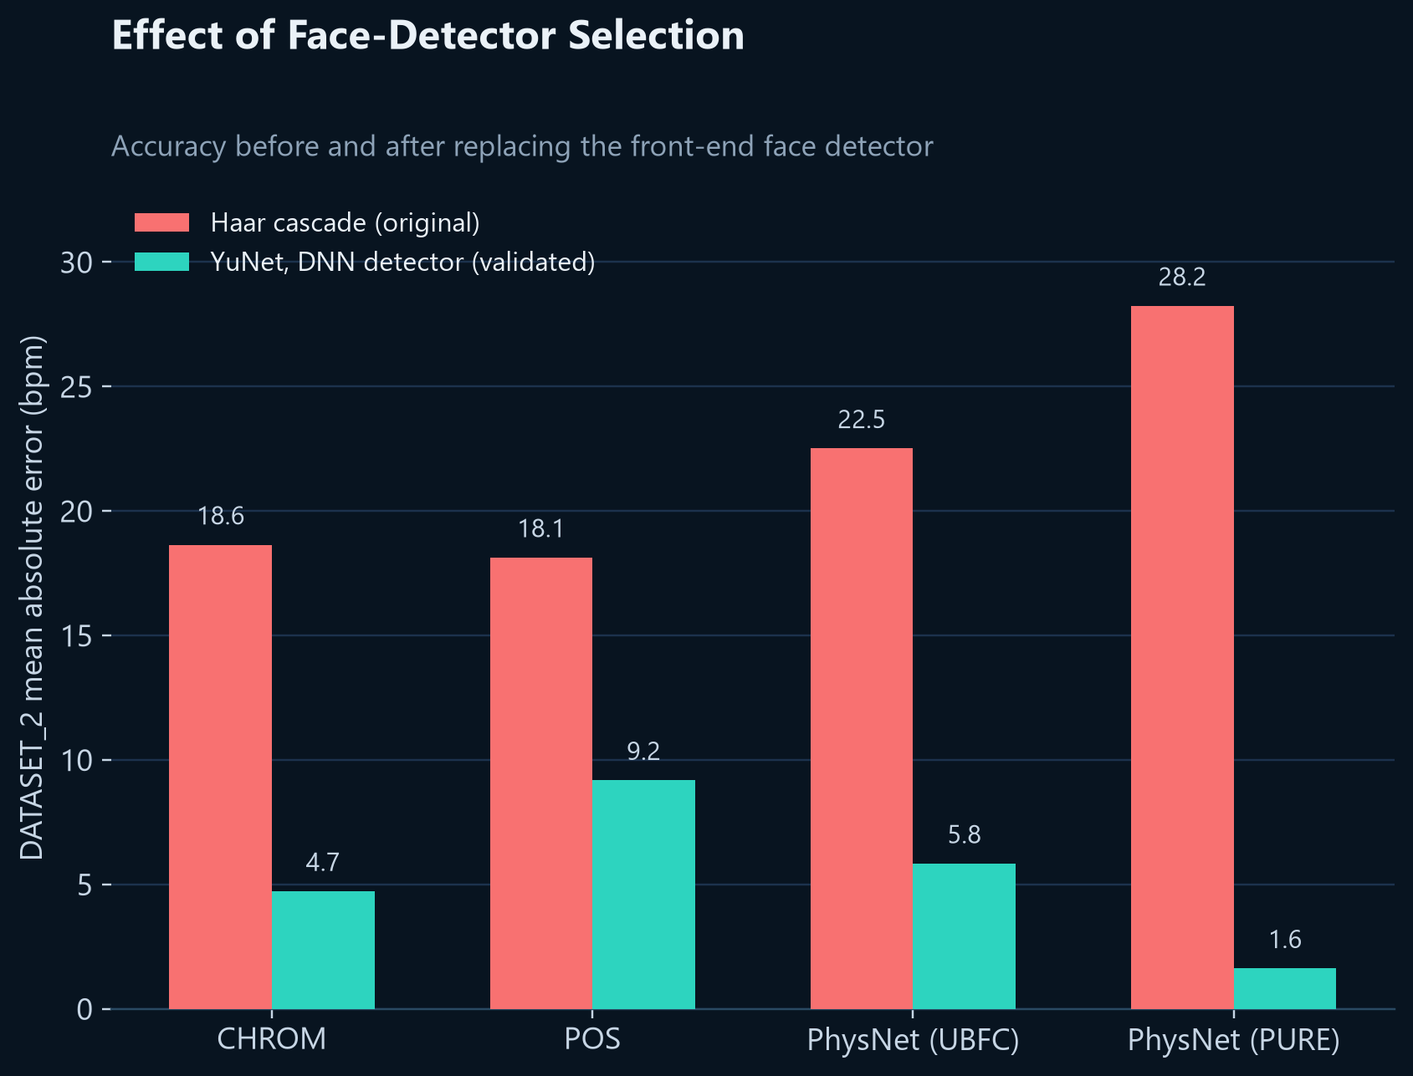
04 · OUTCOMES
Validating the Pipeline: Implementation Defects Identified and Resolved
CHROM normalization defect
Missing per-window demean step
34.5 → 0.7 bpm
PhysNet reconstruction defect
Chunk-boundary splicing artifact
Resolved via windowed overlap-add
Face-detector front end
Haar cascade produced clothing-dominated crops
Resolved via DNN-based detector
Notes:
Each fix was verified by testing a rejected alternative, not accepted just because a number improved. The chart on the right is the strongest single piece of evidence: replacing the face detector alone cut error three to four times across every method. Worth flagging for anyone who's debugged a vision pipeline: none of these three bugs threw an exception or produced obviously broken output, they produced plausible numbers that were simply wrong. That's the failure mode that actually matters in this field, and it's why we treat implementation validation as inseparable from the science, not a formality before it.

Slide 9
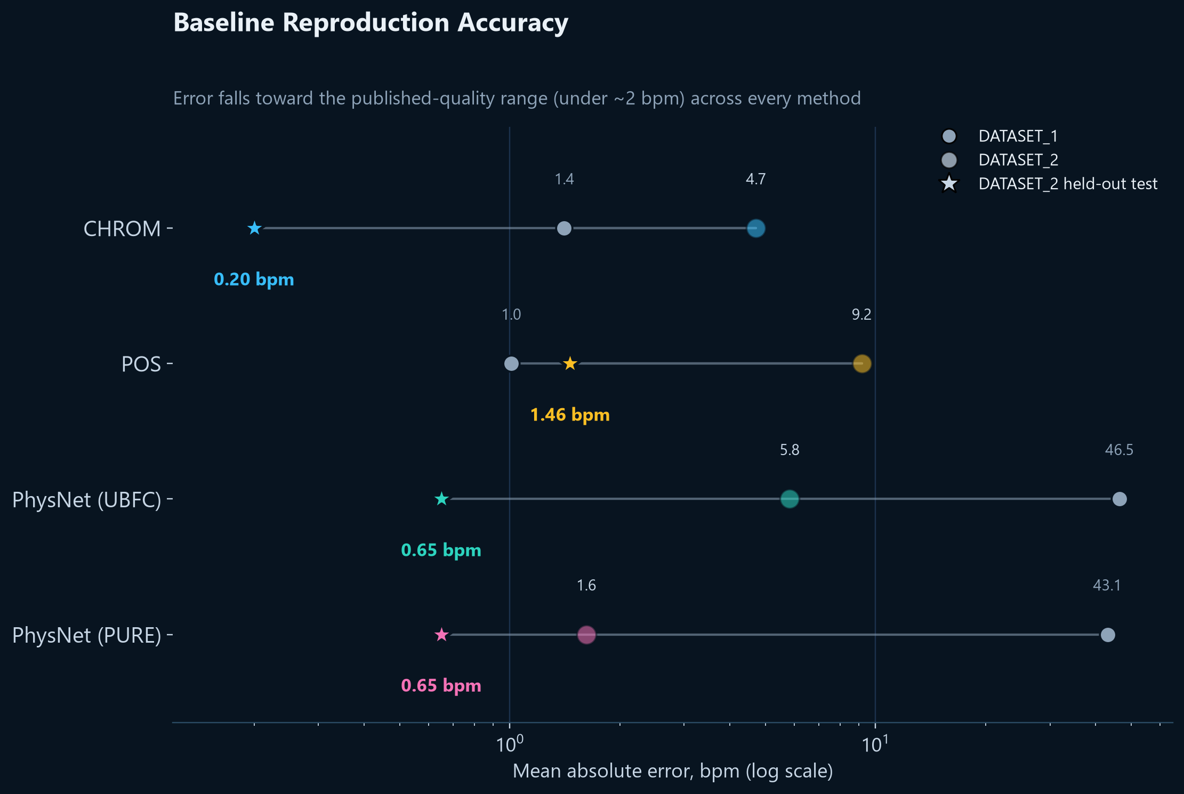
04 · OUTCOMES
Validated Baseline Reproduction
All 4 methods, held-out test split
0.2–1.5 bpm
PhysNet vs. published benchmark
1.62 vs 1.63 bpm
Notes:
All four methods converge under 1.5 bpm error on the held-out test subjects. PhysNet, trained on an entirely different dataset and evaluated cross-dataset here, lands almost exactly on its published benchmark number, 1.62 against 1.63. That's not just close, it's within the kind of clip-level sampling noise you'd expect regardless, about as clean a reproduction as this field typically reports. This is the gate passing cleanly: the validated foundation everything after this builds on.

Slide 10
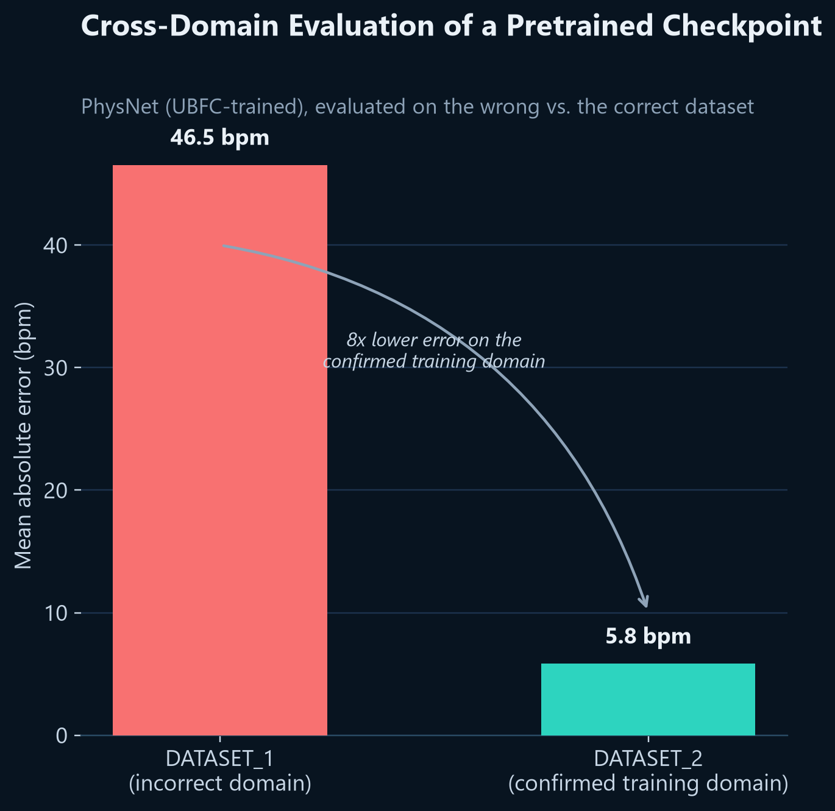
04 · OUTCOMES
Diagnosing a Cross-Domain Accuracy Anomaly
A checkpoint named "UBFC-rPPG" performed worse than one trained on an entirely different dataset, the opposite of what we’d expect.
Tracing the training source code directly showed it was trained on a different release of UBFC-rPPG than the one we tested it on, never truly in-domain at all.
Confirmed empirically: re-tested on its correct domain, error dropped 8×.
Notes:
This looked like an interesting anomaly at first, and we deliberately treated it as a signal to rule out a mundane bug before accepting an interesting explanation. We checked the checkpoint file wasn't swapped and checked our frame-rate handling, both clean. The real cause was a training-data mismatch, confirmed two independent ways: tracing source code and empirically re-testing on the correct domain, an eight-fold error reduction, 46.5 down to 5.8 bpm. The lesson generalizes well beyond our project: as more of the field adopts released pretrained checkpoints instead of training from scratch, a checkpoint's name is not proof of its training domain, and that exact gap is where a confident, wrong fairness or robustness claim would slip through unnoticed.

Slide 11
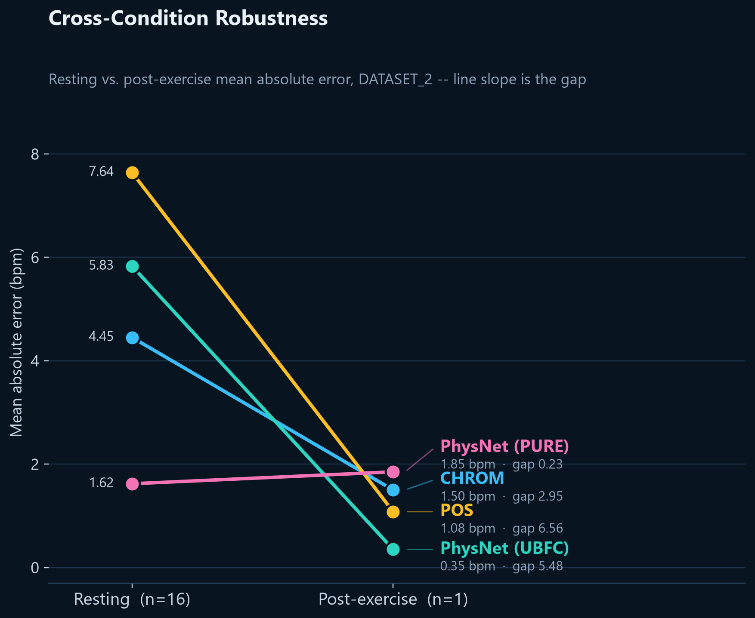
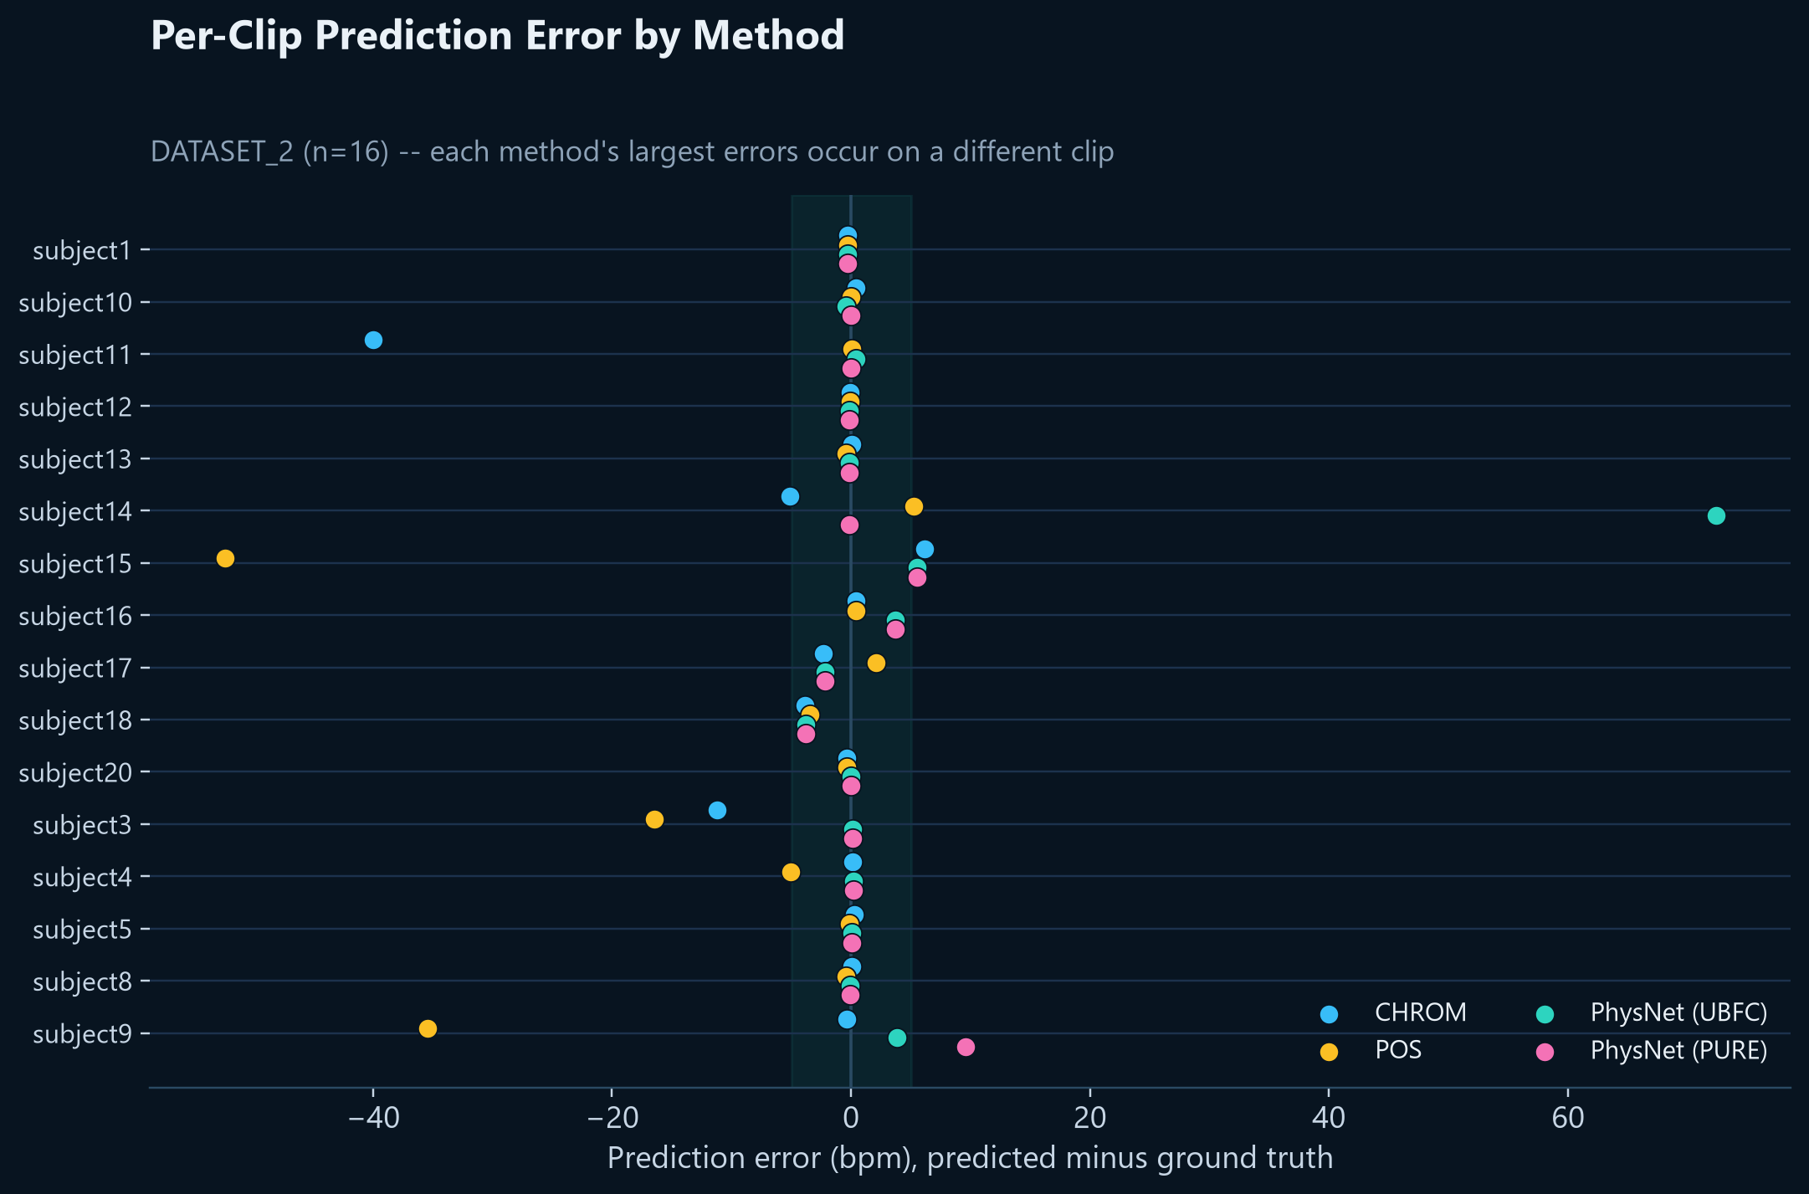

04 · OUTCOMES
Cross-Condition Robustness: Resting versus Post-Exercise
A modest, real gap for the classical methods (3–7 bpm); no two methods fail on the same subject.
Notes:
Left: classical methods show a small but genuine gap between resting and post-exercise conditions, roughly three to seven bpm, post-exercise is modestly harder. Right, and more interesting: plot every method's per-subject error, and every method's worst failures land on a different subject. No subject is uniformly hard. Worth pausing on: a lot of robustness literature implicitly assumes some subjects are just inherently harder cases. Our data doesn't support that here; the residual error looks like each method's own instability, not a property of the person recorded, a distinction we lean on directly in the failure case coming up next.

Slide 12
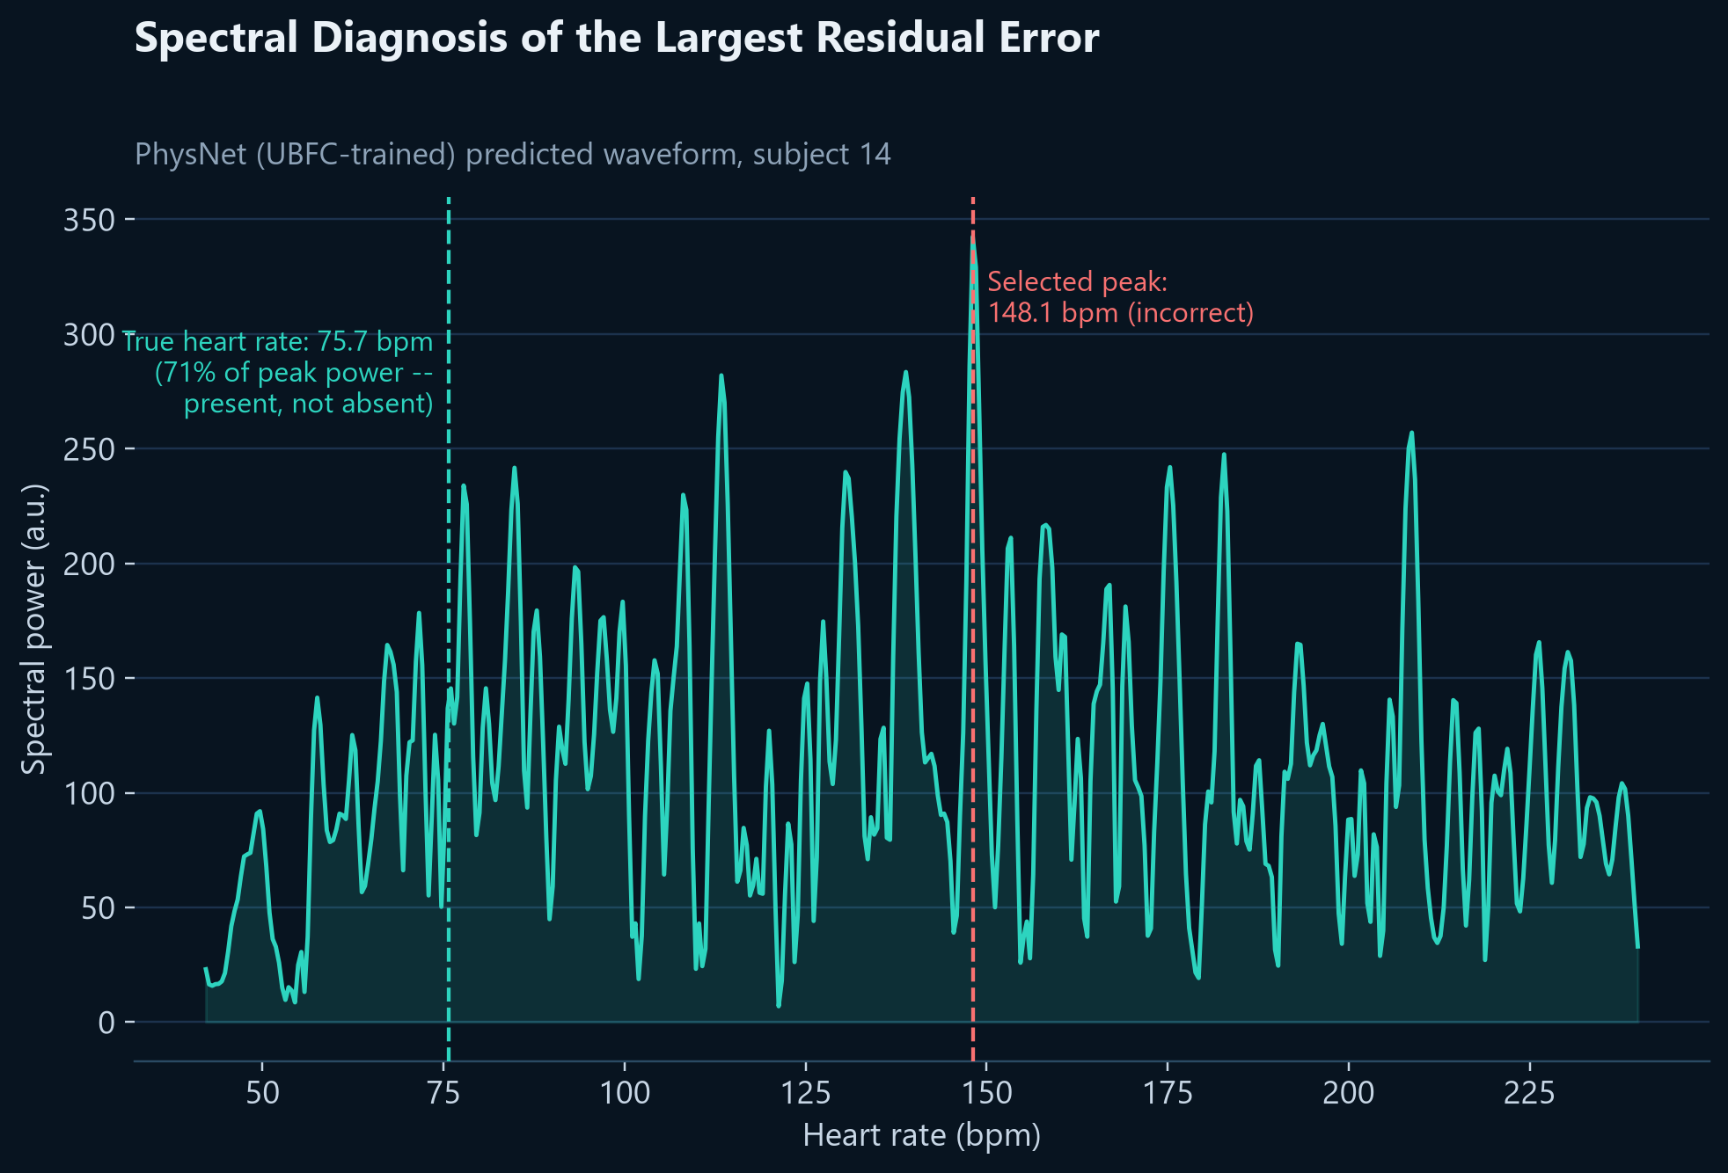
FAILURE & INSIGHT
Failure Case Analysis: Spectral Peak Diagnosis
Model selected
148.1 bpm
True HR, 71% of peak power
75.7 bpm
Notes:
Our largest single error, 72 bpm off. Before assuming the model failed to extract any pulse at all, we inspected the full spectrum, not just the winning peak. The true heart rate is right there: a strong second-place candidate at 71% of the winning peak's power. This reframes the failure as a peak-selection problem, not a signal-extraction failure, and it's a familiar failure mode to anyone who's worked with FFT-based peak picking on noisy, multi-modal spectra: argmax is a brittle decision rule exactly when two candidates are close, which is precisely the regime where it matters most. Signal present versus signal picked wrong is what actually determines whether a fix is worth building at all.

Slide 13
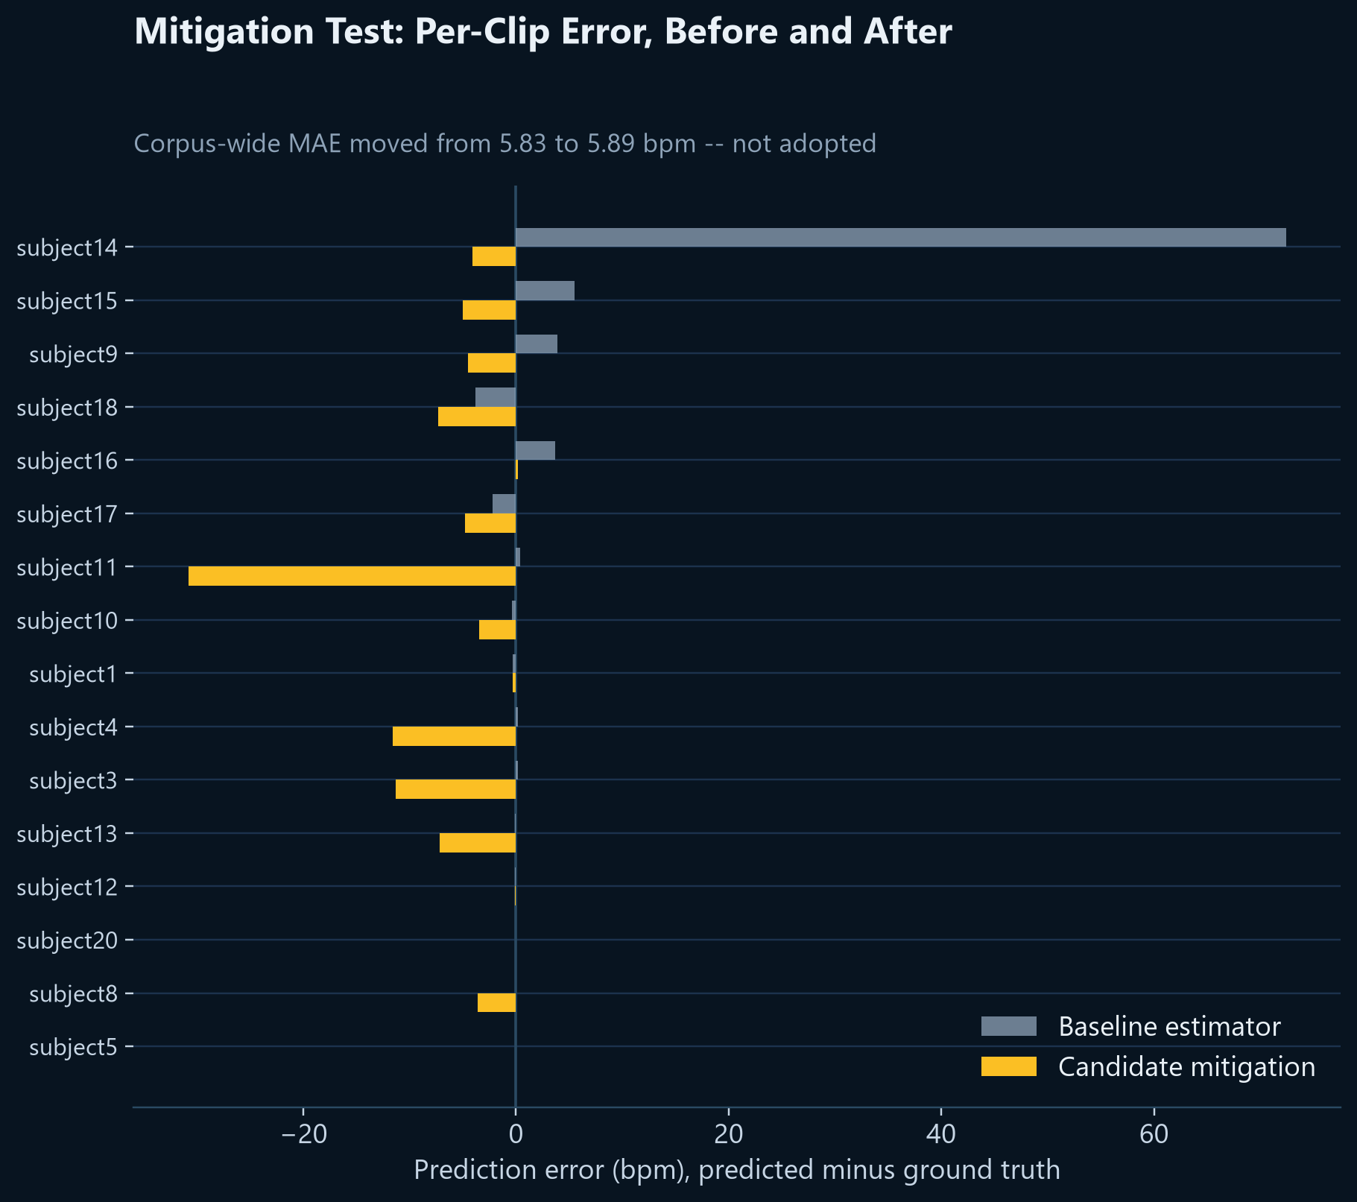
FAILURE & INSIGHT
Mitigation Testing: A Rejected Candidate Fix
Candidate fix: prefer the lower of two closely competing spectral peaks. Tested on all 16 subjects, not just the one that motivated it.
Corrected one clip (72 → 4 bpm error), degraded seven others, one severely (0.4 → 31 bpm).
Net effect: no improvement. Not adopted.
Notes:
This is the second post-hoc fix we tested and rejected on the same standard: evaluate against the whole dataset, not the one case that motivated the idea. Both times, the fix traded one set of failures for a different set. That pattern is worth naming: it's the same failure mode as overfitting to a single validation example, just done by hand instead of by an optimizer, and it's exactly why we hold post-hoc heuristics to full-corpus evaluation rather than declaring victory on the motivating case. The real insight, and the actual lever that worked in this project: fixing the face detector, not tuning the estimator after the fact.

Slide 14



05 · CONCLUDING REMARKS
Summary of Contributions
A Validated Pipeline
Three Real Defects, Fixed
An Honest Robustness Gap
Two Rejected Fixes, Reported
Four baselines reproduced to within 1.5 bpm of published accuracy.
Each one alone was large enough to fake a fairness result.
Measured across resting and post-exercise conditions, not assumed.
Tested rigorously, found not to help, and disclosed anyway.
CHROM · POS · PhysNet ×2
Chrominance · Inference · Detection
2.9–6.6 bpm classical gap
Welch's method · Peak selection
The core takeaway: a fairness or robustness number is only as trustworthy as the pipeline behind it.
Notes:
Four things we'd want you to remember, laid out as one connected line because that's really what they are: a single pipeline, built and stress-tested end to end. A working, validated pipeline. Three real bugs, each one individually capable of faking a fairness finding. An honest, appropriately caveated robustness measurement. And two negative results we chose to report rather than quietly drop. If there's one sentence to take away, it's the one on screen: rigor about the pipeline is a precondition for rigor about fairness. And if there's one habit worth taking into your own work: validate the harness before you trust what it measures.

Slide 15



05 · LIMITATIONS & NEXT STEPS
Limitations and Future Directions
Skin-tone fairness axis untested: no such metadata in the data we obtained
Acquire MMPD / EquiPleth for the originally planned skin-tone audit
One PhysNet regression on the older dataset remains unresolved
Diagnose the remaining PhysNet crop-mismatch directly
n=4 test / n=1 exercise: directional, not statistically powered
Turn our rigor checks into a reusable checklist for future audits
Every limitation on the left has a concrete next step on the right: none of them undermine what we did establish.
Notes:
Being direct about scope: our test set is small, we never tested the skin-tone axis this was originally framed around, and one regression on the older dataset is still open. None of that undermines what we did establish, but we'd rather name the boundary clearly than let it surface as a surprise question. Each limitation here maps directly to a next step: the clearest one is going back to the original skin-tone ambition with this now-validated pipeline underneath it.

Slide 16

Thank you
A fairness or robustness claim is only as trustworthy as the pipeline behind it.
Noshin Tabassum Arthi Samin Ahsan Tausif Supervisor: Dr. Md. Ashraful Alam
Notes:
Thank you, we're happy to take questions. We have the full per-clip results, every figure, and both the classical and deep-learning code ready if you'd like to go deeper on any specific result.

