Slide 1

Set Cover Formulation and Applications
1605018, 1605047, 1605057, 1605102, 1605107
$$Group 4$$

Slide 2

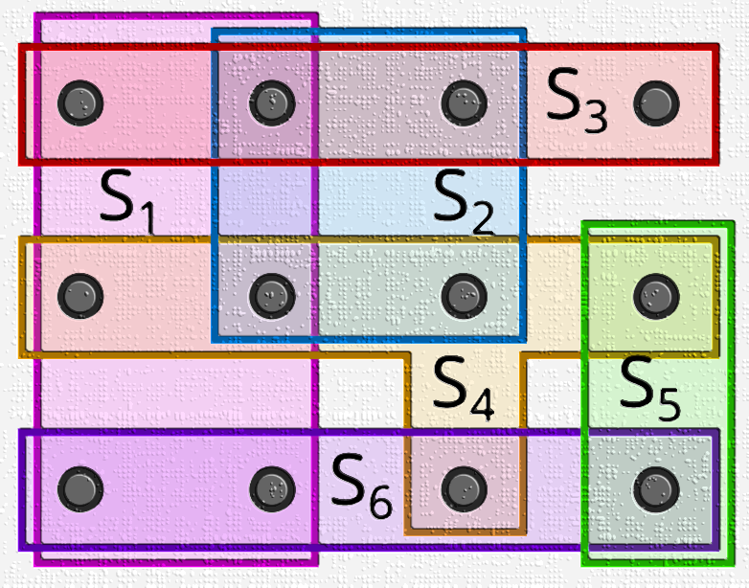
Introduction

Slide 3
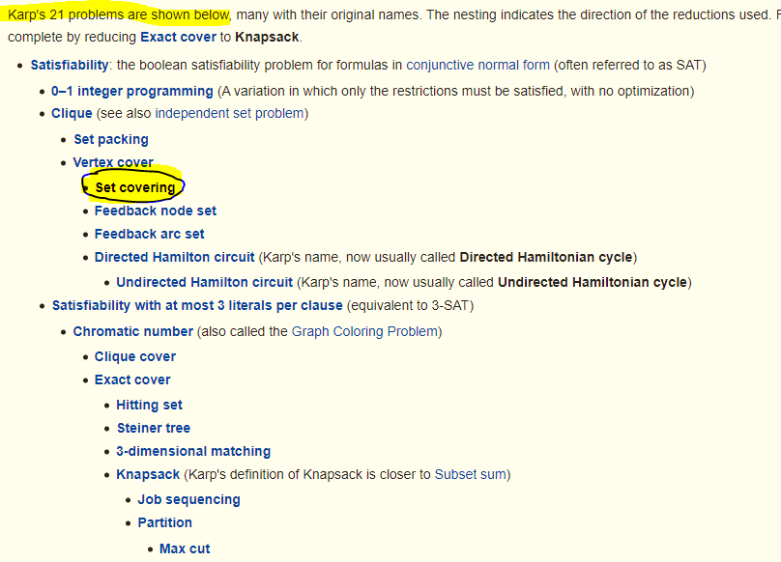
Introduction
Introduction

Slide 4
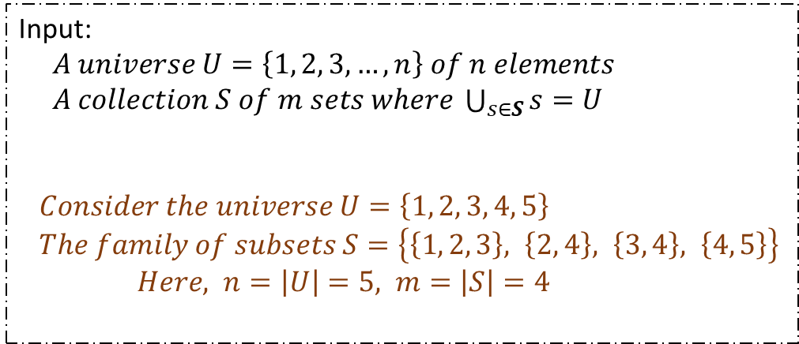
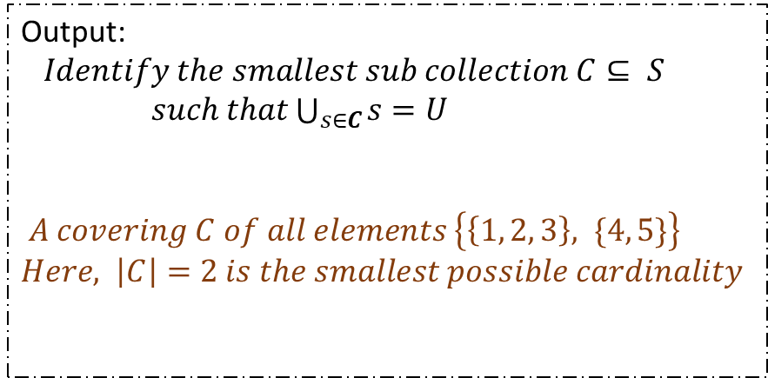
Problem Formulation
Input:
$A universe U=\left\{1, 2, 3, …, n\right\} of n elements$
$A collection S of m sets where \bigcup_{s∈S}{s}=U$
$Consider the universe U=\left\{1, 2, 3, 4, 5\right\}$
$The family of subsets S=\left\{\left\{1, 2, 3\right\}, \left\{2, 4\right\}, \left\{3, 4\right\}, \left\{4, 5\right\}\right\}$ $Here, n=\left|U\right|=5, m=\left|S\right|=4$
Output:
$Identify the smallest sub collection C⊆ S$
$such that\bigcup_{s∈C}{s}=U$
$A covering C of all elements \left\{\left\{1, 2, 3\right\}, \{4, 5\}\right\}$
$Here, \left|C\right|=2 is the smallest possible cardinality$

Slide 5
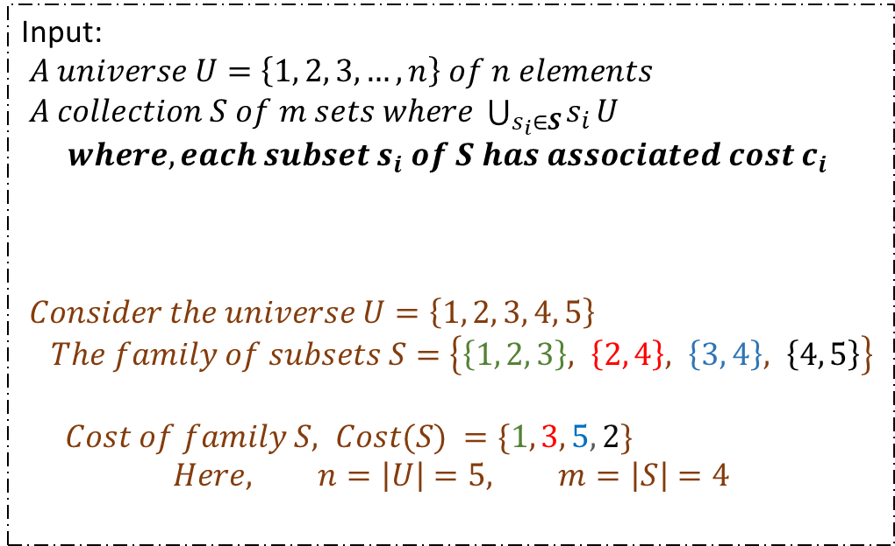
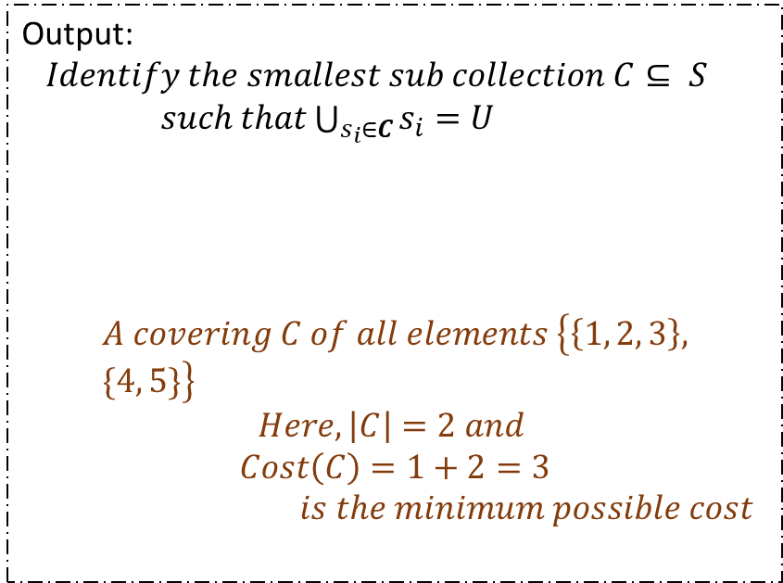
Problem Formulation
$$Variation :Weighted Set Cover$$
Input:
$A universe U=\left\{1, 2, 3, …, n\right\} of n elements$
$A collection S of m sets where \bigcup_{s_{i}∈S}{s_{i}}U$
$$where, each subset s_{i} of S has associated cost c_{i}$$
$Consider the universe U=\left\{1, 2, 3, 4, 5\right\}$
$The family of subsets S=\left\{\left\{1, 2, 3\right\}, \left\{2, 4\right\}, \left\{3, 4\right\}, \left\{4, 5\right\}\right\}$
$Cost of family S, Cost(S) =\{1, 3, 5, 2\}$
$$Here, n=\left|U\right|=5, m=\left|S\right|=4$$
Output:
$Identify the smallest sub collection C⊆ S$
$such that\bigcup_{s_{i}∈C}{s_{i}}=U$
$$A covering C of all elements \left\{\left\{1, 2, 3\right\}, \{4, 5\}\right\}$$
$$Here, \left|C\right|=2 and$$
$$Cost\left(C\right)=1+2=3$$
$is the minimum possible cost$

Slide 6
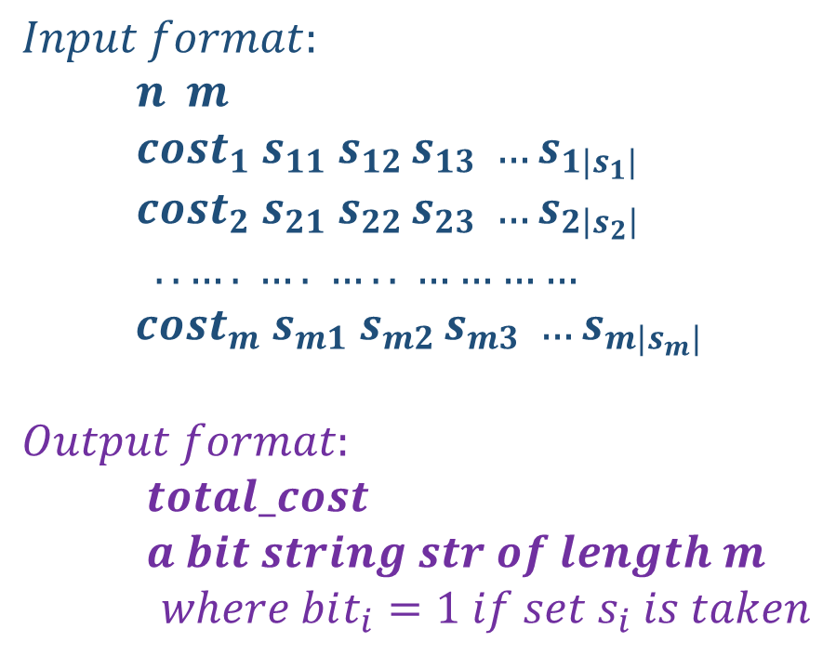
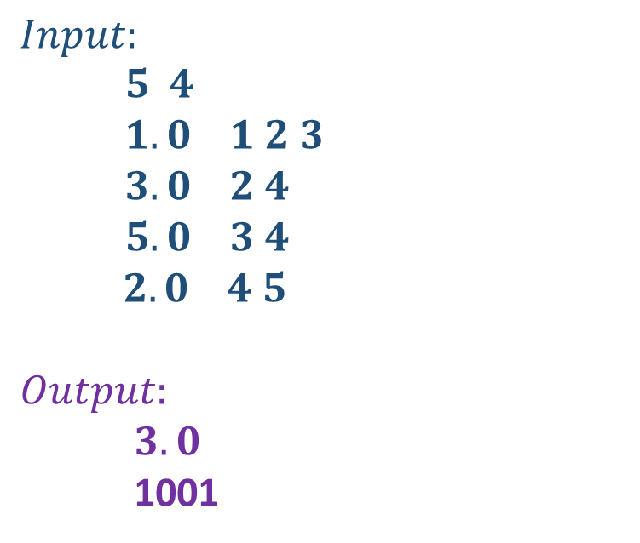
Sample Input-Output
$$Input format:$$
$n m$
$cost_{1} s_{11} s_{12 }s_{13} …s_{1|s_{1}|}$
$cost_{2} s_{21} s_{22 }s_{23} …s_{2\left|s_{2}\right|}$
$$..…. …. ….. …………$$
$cost_{m} s_{m1} s_{m2 }s_{m3} …s_{m|s_{m}|}$
$$Output format:$$
$total_cost$
$a bit string str of length m$
$where bit_{i}=1 if set s_{i} is taken$
$$Input:$$
$5 4$
$1.0 1 2 3$
$3.0 2 4$
$5.0 3 4$
$2.0 4 5$
$$Output:$$
$3.0$
1001

Slide 7
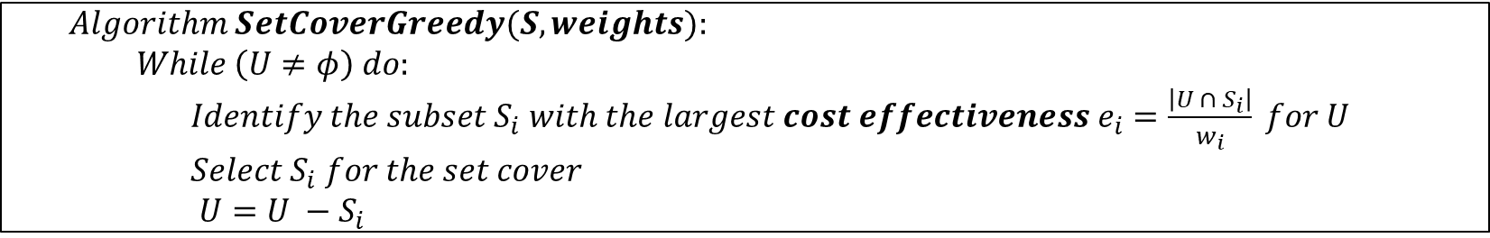
Solution Approach : Greedy Heuristic Based
$$Problem:Set Cover$$
$$Input:A collection of subsets S=\left\{S_{1}, …, S_{m}\right\} of the universal set U=\left\{1, 2, …, n\right\}.$$
$$Output:What is the smallest subset T of S whose union equals the universal set−i.e. , ∪_{i=1}^{\left|T\right|}T_{i}=U$$
$$Repeatedly select the subset that covers the largest collection of thus−far uncovered elements$$
$$Algorithm SetCoverGreedy(S, weights):$$
$While \left(U≠φ\right) do:$
$Identify the subset S_{i} with the largest cost effectiveness e_{i}=\frac{\left|U ∩{ S}_{i}\right|}{w_{i}} for U$
$Select S_{i} for the set cover$
$U=U −S_{i}$
Time complexity is O(${mn}^{2}$)

Slide 8
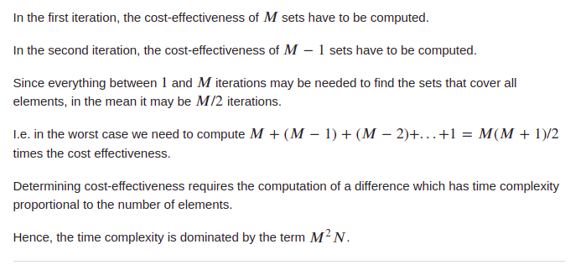
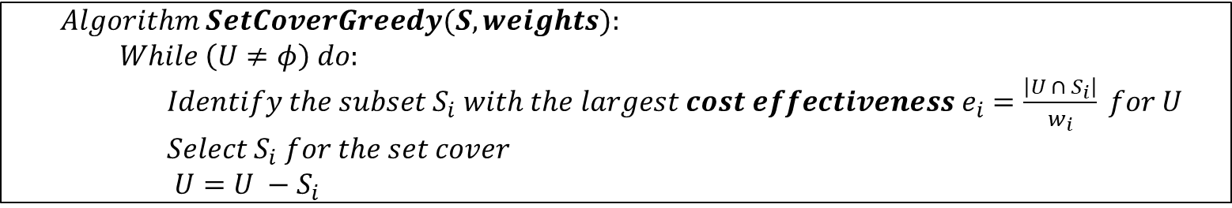
Solution Approach : Greedy Heuristic Based
$$Algorithm SetCoverGreedy(S, weights):$$
$While \left(U≠φ\right) do:$
$Identify the subset S_{i} with the largest cost effectiveness e_{i}=\frac{\left|U ∩{ S}_{i}\right|}{w_{i}} for U$
$Select S_{i} for the set cover$
$U=U −S_{i}$

Slide 9
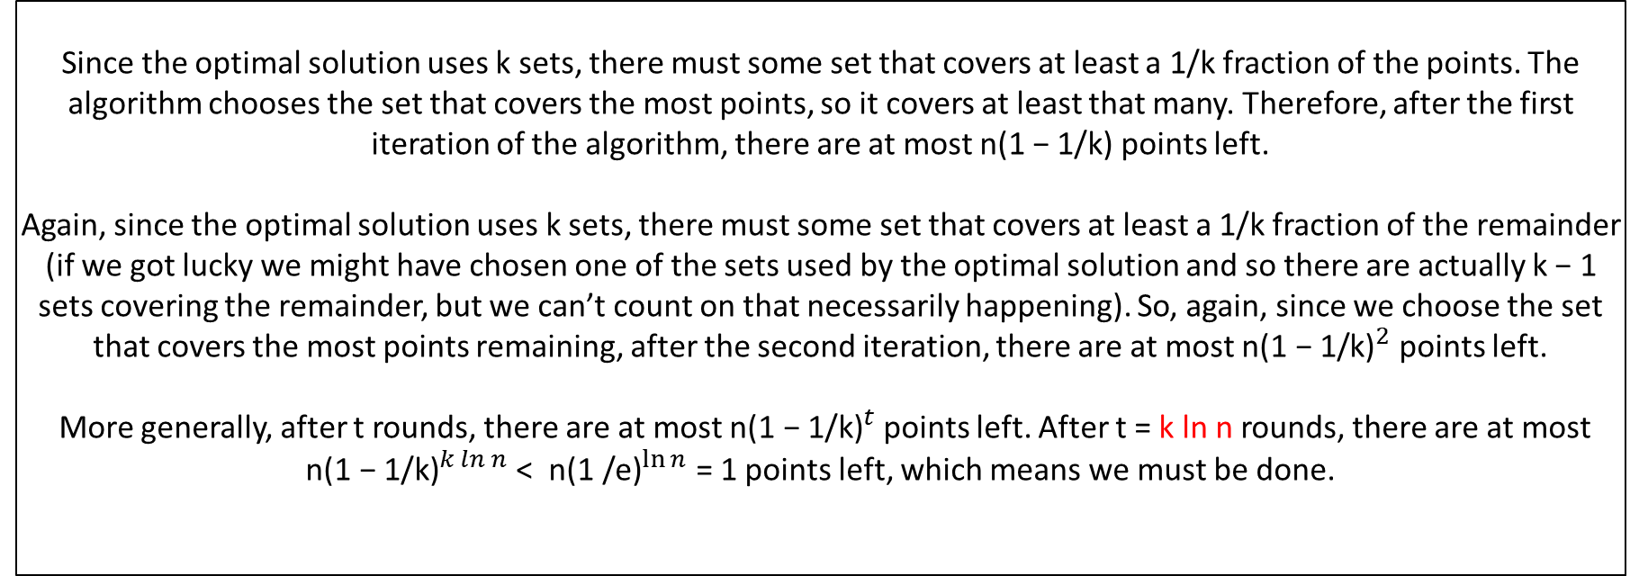
Solution Approach : Greedy Heuristic Based
Greedy approximation algorithm is ln(n) approximate.
Theorem :
If the optimal solution uses k sets, the greedy algorithm finds a solution with at most k ln n sets.
Since the optimal solution uses k sets, there must some set that covers at least a 1/k fraction of the points. The algorithm chooses the set that covers the most points, so it covers at least that many. Therefore, after the first iteration of the algorithm, there are at most n(1 − 1/k) points left.
Again, since the optimal solution uses k sets, there must some set that covers at least a 1/k fraction of the remainder (if we got lucky we might have chosen one of the sets used by the optimal solution and so there are actually k − 1 sets covering the remainder, but we can’t count on that necessarily happening). So, again, since we choose the set that covers the most points remaining, after the second iteration, there are at most ${\text{n}\text{(1 − 1/}\text{k}\text{)}}^{2}$ points left.
More generally, after t rounds, there are at most ${\text{n}\text{(1 − 1/}\text{k}\text{)}}^{t}$points left. After t = k ln n rounds, there are at most
${\text{n}\text{(1 − 1/}\text{k}\text{)}}^{k ln n}$ < ${\text{n}\text{(1 /}\text{e}\text{)}}^{\ln{n}}$= 1 points left, which means we must be done.

Slide 10
Improved Greedy Algorithm
This paper proposes a greedy algorithm named as Big step greedy set cover algorithm to compute approximate minimum set cover. The Big step greedy algorithm, in each step selects p sets such that the union of selected p sets contains greatest number of uncovered elements and adds the selected p sets to partial set cover. The process of adding p sets is repeated until all the elements are covered. When p=1 it behaves like the classical greedy algorithm.
The process of adding p sets is repeated until all elements of X are covered by partial set cover. In the last step it may add less than p sets to avoid redundant sets.
Experimental results show that proposed Big step greedy set cover algorithm with p=2 computes smaller set cover than the set cover computed by the classical greedy algorithm in many cases. When step size p is small enough Big step greedy set cover algorithm runs in polynomial time. Big step greedy set cover algorithm is preferable than the classical greedy algorithm in scenarios where small improvement in the solution is valuable and some increment in running time is acceptable.
Reference:
https://arxiv.org/ftp/arxiv/papers/1506/1506.04220.pdf

Slide 11
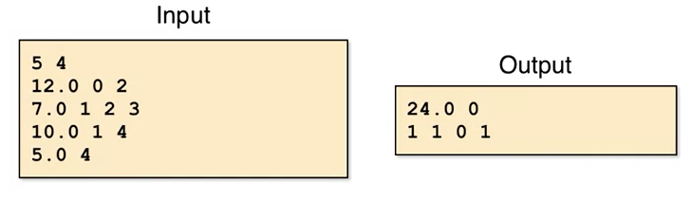
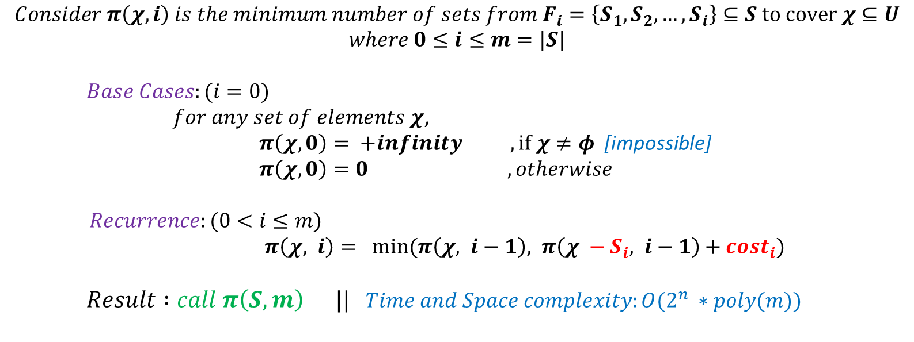
Solution Approach : Dynamic Programming
$$Consider π\left(χ, i\right) is the minimum number of sets from F_{i}=\left\{S_{1},S_{2},…, S_{i}\right\}⊆S to cover χ⊆U$$
$$where 0≤i≤m=|S|$$
$Base Cases:(i=0)$
$for any set of elements χ$,
$π\left(χ, 0\right)= +infinity , if χ≠φ$ [impossible]
$π\left(χ, 0\right)=0 , otherwise$
$Recurrence:(0<i≤m)$
$π\left(χ, i\right)= min(π\left(χ, i−1\right), π\left(χ −S_{i}, i−1\right)+cost_{i})$
$Result :call π\left(S, m\right) ||$ $Time and Space complexity:O(2^{n} ∗poly(m))$

Slide 12
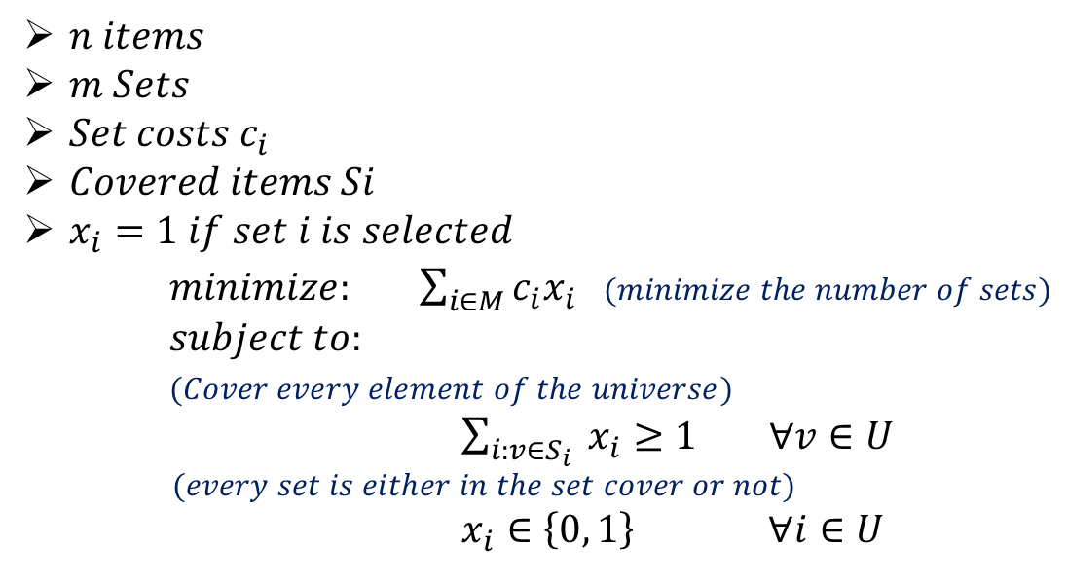

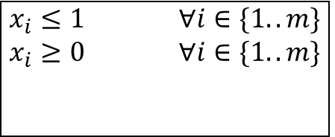
Solution Approach : Linear Programming Relaxation
$n items$
$m Sets$
$Set costs c_{i}$
$Covered items Si$
$x_{i}=1 if set i is selected$
$minimize: \sum_{i∈M}^{ }{c_{i}x_{i}}$ $(minimize the number of sets)$
$subject to:$
$(Cover every element of the universe)$ $\sum_{i:v∈S_{i}}^{ }{ x_{i}≥1 ∀v∈U}$
$$(every set is either in the set cover or not)$$
$x_{i}∈\left\{0, 1\right\} ∀i∈U$
$$(1)$$
$$x_{i}≤1 ∀i∈\{1..m\}$$
$$x_{i}≥0 ∀i∈\{1..m\}$$

Slide 13
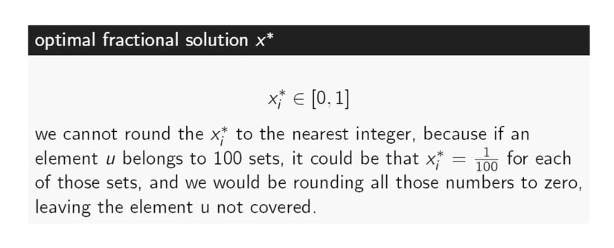
Solution Approach : Linear Programming Relaxation

Slide 14
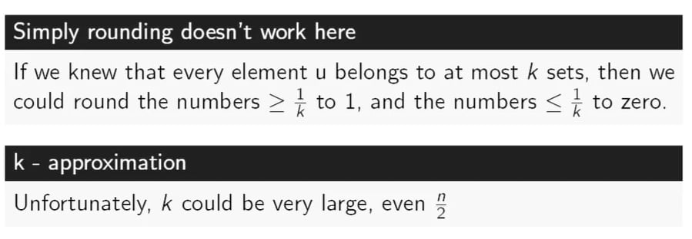
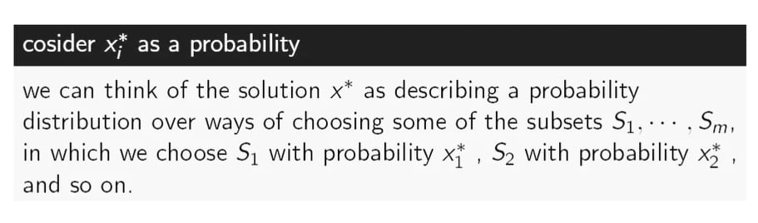
Solution Approach : Linear Programming Relaxation

Slide 15
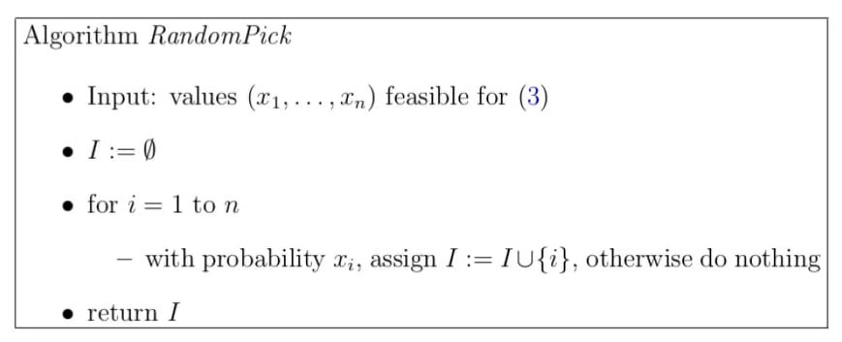
Solution Approach : Linear Programming Relaxation
RandomPick Algorithm:

Slide 16
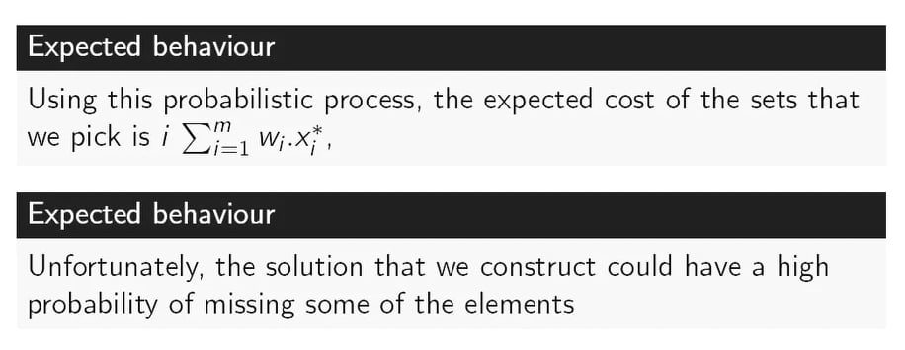
Solution Approach : Linear Programming Relaxation
RandomPick Algorithm :

Slide 17
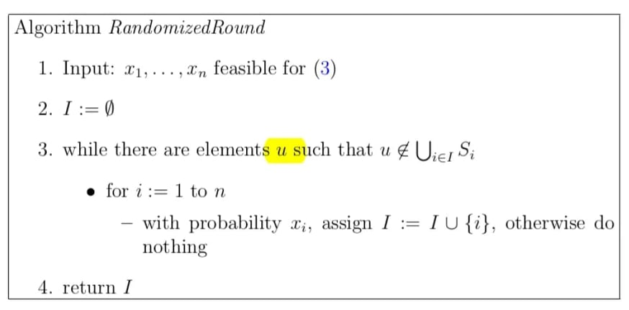
Solution Approach : Linear Programming Relaxation
RandomizedRound Algorithm:

Slide 18
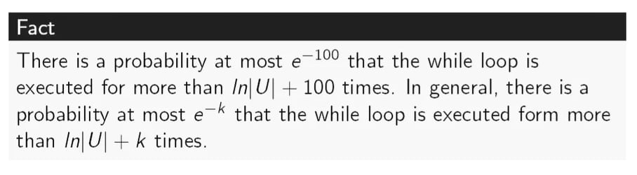
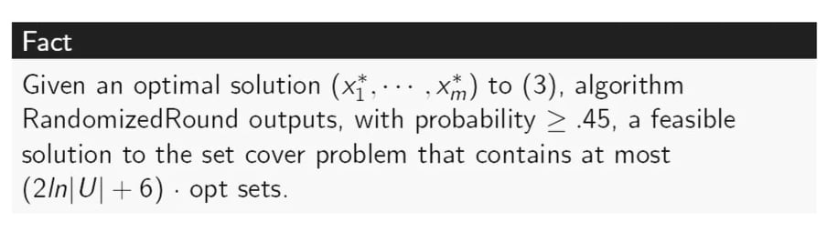
Solution Approach : Linear Programming Relaxation

Slide 19
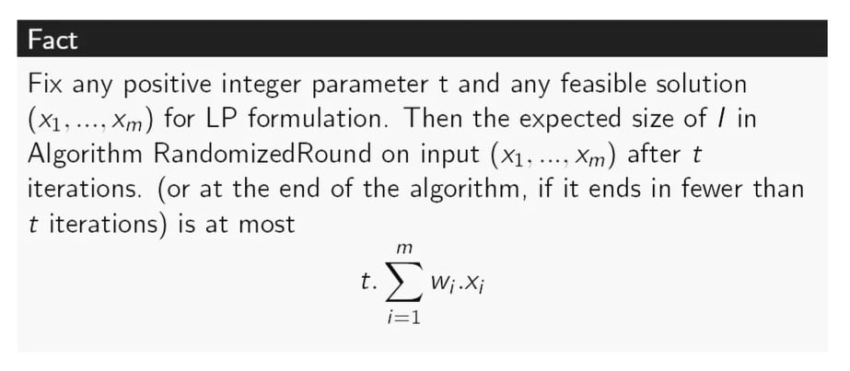
Solution Approach : Linear Programming Relaxation

Slide 20
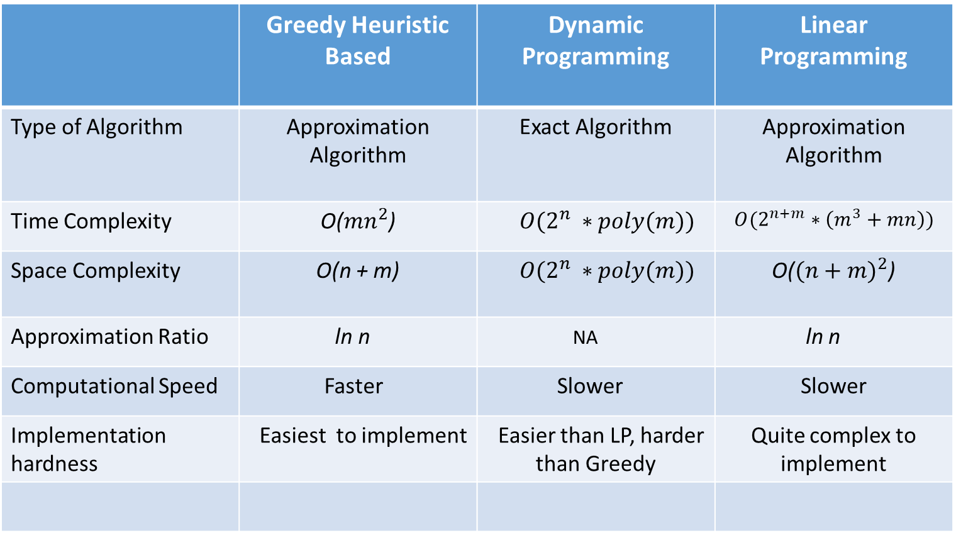
Analysis & Comparison
 | Greedy Heuristic Based | Dynamic Programming | Linear Programming
Type of Algorithm | Approximation Algorithm | Exact Algorithm | Approximation Algorithm
Time Complexity | O(${mn}^{2}$) | $O(2^{n} ∗poly(m))$ | $$O(2^{n+m}∗\left(m^{3}+mn\right))$$
Space Complexity | O(n + m) | $O(2^{n} ∗poly(m))$ | O(${(n+m)}^{2}$)
Approximation Ratio | ln n | NA | ln n
Computational Speed | Faster | Slower | Slower
Implementation hardness | Easiest to implement | Easier than LP, harder than Greedy | Quite complex to implement

Slide 21
Analysis & Comparison
 | Greedy Heuristic Based | Dynamic Programming | Linear Programming
For 5 inputs all together | real 0m0.003s user 0m0.00s sys 0m0.003s (C++ implementation) | real 0m0.013s user 0m0.000s sys 0m0.013s (C++ implementation) | real 0m0.250s user 0m0.291s sys 0m0.112s (Python implementation)

Slide 22
Analysis & Comparison
Input | Greedy Heuristic Based Output | Dynamic Programming Output | Linear Programming Output
5 4 1 2 3 4 5 1.0 3.0 5.0 2.0 3 1 2 3 2 2 4 2 3 4 2 4 5 | Total Cost: 3 Output String: 1001 Sets chosen: 1 2 3 4 5 | Total Cost: 3 Output String: 1001 Sets chosen: 1 2 3 4 5 | Objective value = 3.0 x_0 : 1.0 x_1 : 0.0 x_2 : 0.0 x_3 : 1.0 optimal fractional solution x_star = [1.0, 0.0,0.0,1.0] RandomPickCost : 3.0 chosen sets : 1001 RandomizedRoundCost : 3.0 chosen sets : 1001

Slide 23
Analysis & Comparison
Input | Greedy Heuristic Based Output | Dynamic Programming Output | Linear Programming Output
13 5 1 2 3 4 5 6 7 8 9 10 11 12 13 1 1 1 1 1 2 1 2 4 2 3 4 5 8 6 7 8 9 10 11 12 13 7 1 3 5 7 9 11 13 7 2 4 6 8 10 12 13 | Total Cost: 3 Output String: 11100 Sets chosen: 1 2 2 3 4 5 6 7 8 9 10 11 12 13 | Total Cost: 2 Output String: 00011 Sets chosen: 1 3 5 7 9 11 13 2 4 6 8 10 12 13 | Number of variables = 5 Number of constraints = 13 Solution: Objective value = 2.0 x_0 : 0.0 x_1 : 0.0 x_2 : 0.0 x_3 : 1.0 x_4 : 1.0 optimal fractional solution x_star = [0.0, 0.0, 0.0, 1.0, 1.0] RandomPickCost : 1.0 chosen sets : 00010 RandomizedRoundCost : 2.0 chosen sets : 00011

Slide 24
Analysis & Comparison
Input | Greedy Heuristic Based Output | Dynamic Programming Output | Linear Programming Output
5 3 1 2 3 4 5 5.0 10.0 3.0 3 4 3 1 2 2 5 4 1 4 3 2 | Total Cost: 13 Output String: 011 Sets chosen: 2 5 1 2 3 4 | Total Cost: 13 Output String: 011 Sets chosen: 2 5 1 2 3 4 | Number of variables = 3 Number of constraints = 5 Solution: Objective value = 13.0 x_0 : 0.0 x_1 : 1.0 x_2 : 1.0 optimal fractional solution x_star = [0.0, 1.0, 1.0] RandomPickCost : 10.0 chosen sets : 010 RandomizedRoundCost : 13.0 chosen sets : 011

Slide 25
Analysis & Comparison
Input | Greedy Heuristic Based Output | Dynamic Programming Output | Linear Programming Output
10 11 1 2 3 4 5 6 7 8 9 10 22.0 20.0 2.0 1.8 20.9 43.0 3.0 2.9 100.9 30.5 -30.2 4 1 2 3 4 4 2 3 4 5 4 3 4 5 6 4 4 5 6 7 4 5 6 7 8 6 6 7 8 9 1 4 4 7 8 9 10 3 8 9 10 2 9 10 1 10 2 10 1 | Total Cost: 28.7 Output String: 10110001000 Sets chosen: 1 2 3 4 3 4 5 6 4 5 6 7 8 9 10 | Total Cost: -5.5 01010001001 Minimum sets : 4 { 2 3 4 5 } { 4 5 6 7 } { 8 9 10 } { 10 1 } | Number of variables = 11 Number of constraints = 10 Solution: Objective value = -5.5 x_0 : 0.0 x_1 : 1.0 x_2 : 0.0 x_3 : 1.0 x_4 : 0.0 x_5 : 0.0 x_6 : 0.0 x_7 : 1.0 x_8 : 0.0 x_9 : 0.0 x_10 : 1.0 optimal fractional solution x_star = [0.0, 1.0, 0.0, 1.0, 0.0, 0.0, 0.0, 1.0, 0.0, 0.0, 1.0] RandomPickCost : -5.5 chosen sets : 01010001001 RandomizedRoundCost : -5.5 chosen sets : 01010001001

Slide 26
Analysis & Comparison
Input | Greedy Heuristic Based Output | Dynamic Programming Output | Linear Programming Output
3 4 1 2 3 10.5 20.5 30.5 30.4 2 1 2 2 1 3 2 2 3 2 1 2 | Total Cost: 31 Output String: 1100 Sets chosen: 1 2 1 3 | Total Cost: 31 1100 Minimum sets : 2 { 1 2 } { 1 3 } | Number of variables = 4 Number of constraints = 3 Solution: Objective value = 30.75 x_0 : 0.5 x_1 : 0.5 x_2 : 0.5 x_3 : 0.0 optimal fractional solution x_star = [0.5, 0.5, 0.5, 0.0] RandomPickCost : 51.0 chosen sets : 0110 RandomizedRoundCost : 31.0 chosen sets : 1100

Slide 27
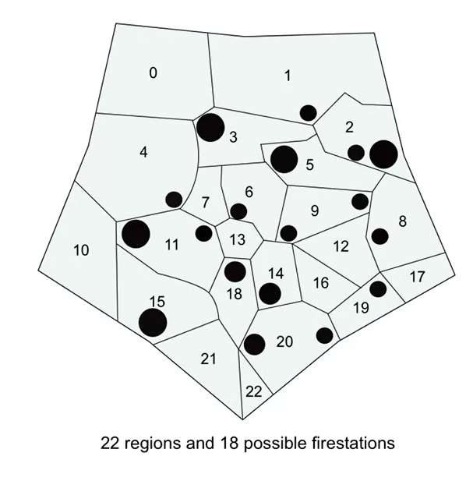
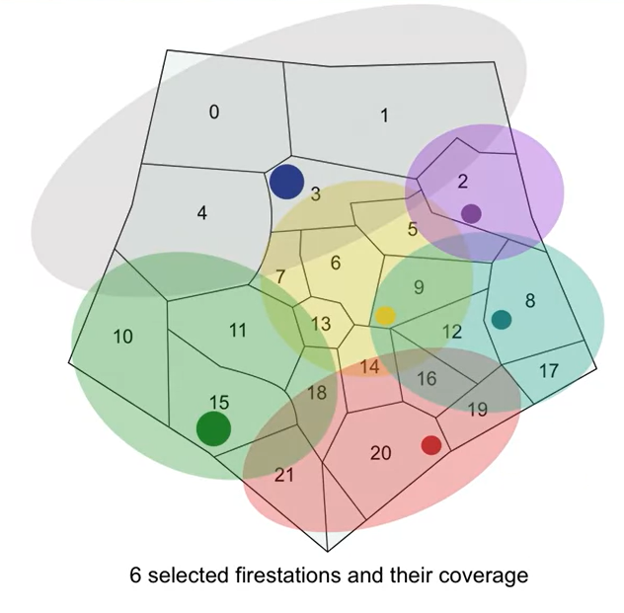
Real Life Application – 1 : Fire Stations

Slide 28








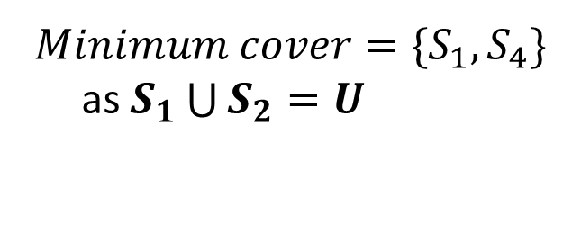
Real Life Application – 2 : Software Package
$$S_{1}= \{Chat, Slides, Drawing\}$$
Capabilities, $U= \{Chat, Slides, Drawing, Audio call, Video call\}$
$$S_{2}= \{Drawing\}$$
$$S_{3}= \{Audio call, Chat, Video call\}$$
$$Minimum cover=\{S_{1}, S_{4}\}$$
as $S_{1}\bigcup{S_{2}=U }$
$$S_{4}= \{Audio call, Chat, Video call, Drawing\}$$
$$S_{5}= \{Audio call, Chat, Video call, Slides\}$$

Slide 29
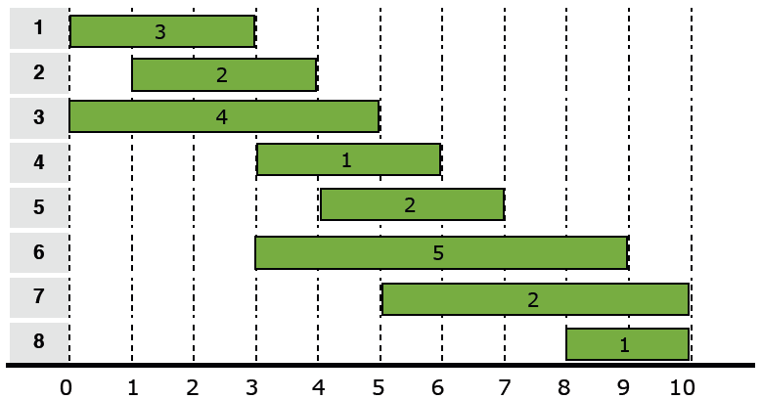
Real Life Application – 3 : Interval Scheduling (Assigning minimum observers/guards)

Slide 30
Conclusion
Apart from these three algorithms we worked on, there are some other algorithms to solve the Set Cover problem, such as - Dual linear programming, Hitting set formulation etc.
We have many other scopes to study the Set Cover problem in the future and we can also figure out more time effective methods/heuristics in this regard or maybe develop one!

Slide 31
Thank You

