Slide 1

Set Cover Formulation and Applications
1605018, 1605047, 1605057, 1605102, 1605107

Slide 2

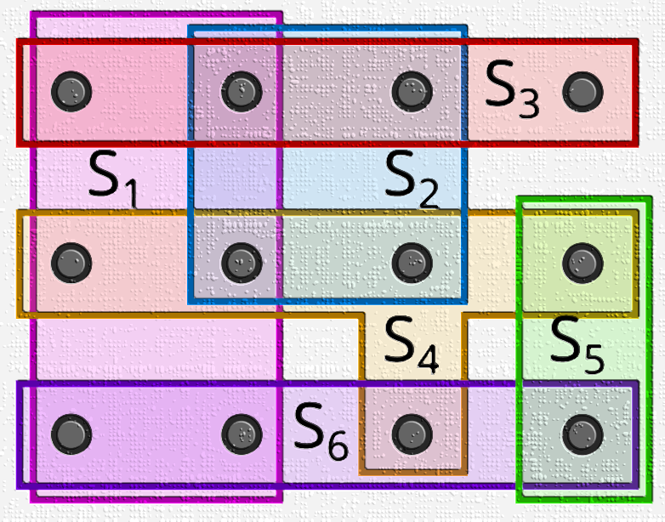
Introduction

Slide 3
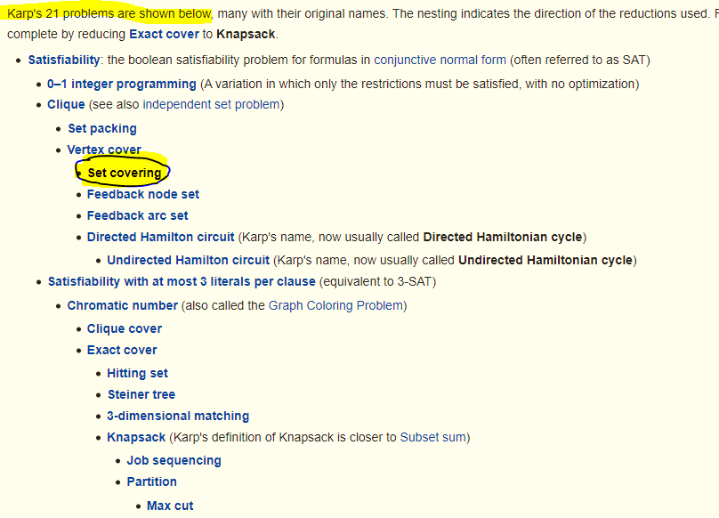
Introduction
Introduction

Slide 4
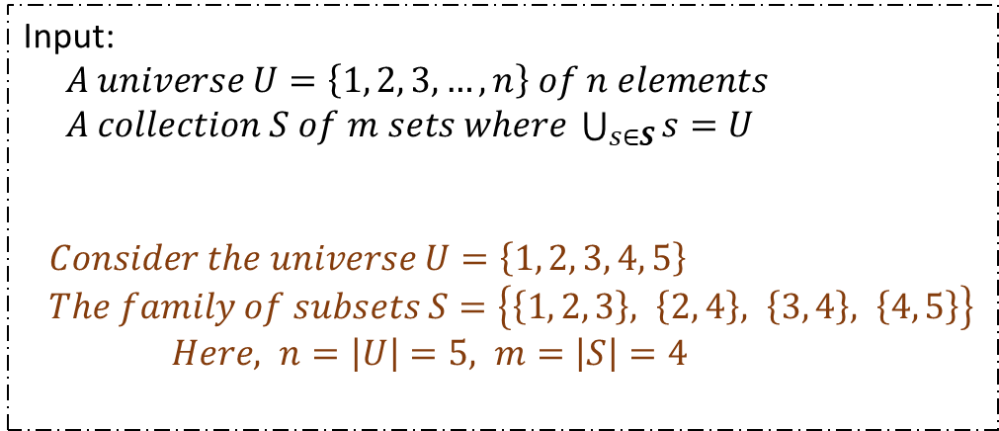
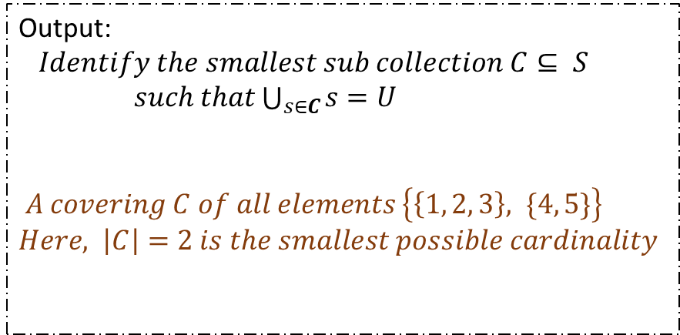
Problem Formulation

Slide 5
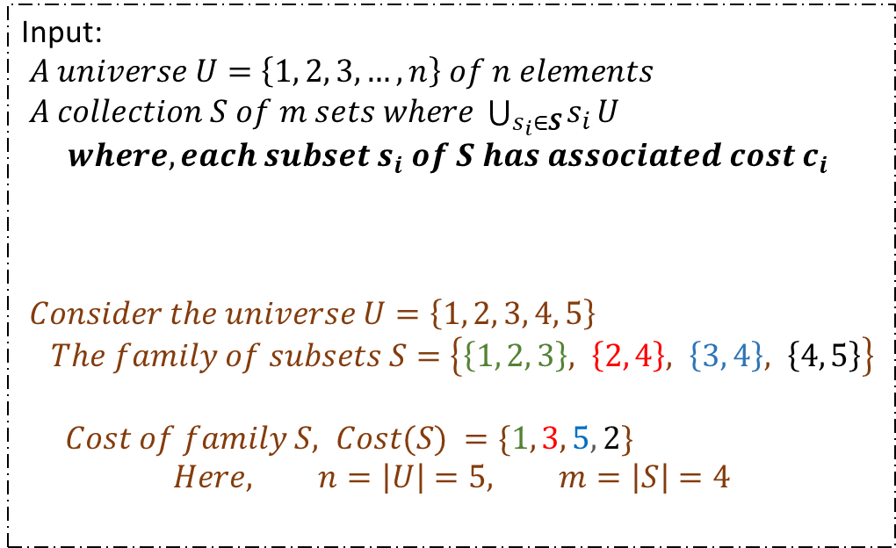
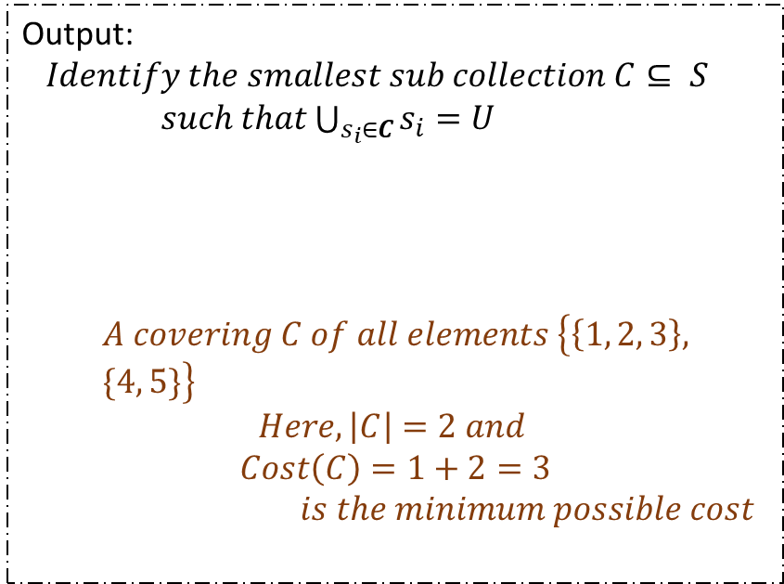
Problem Formulation

Slide 6
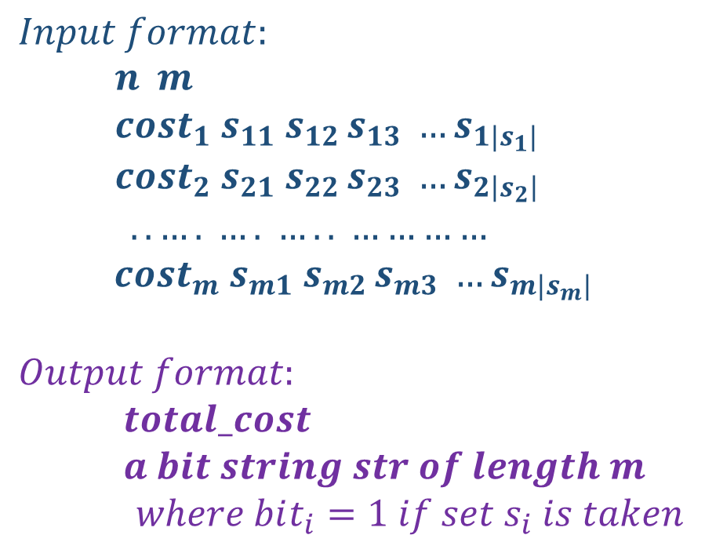
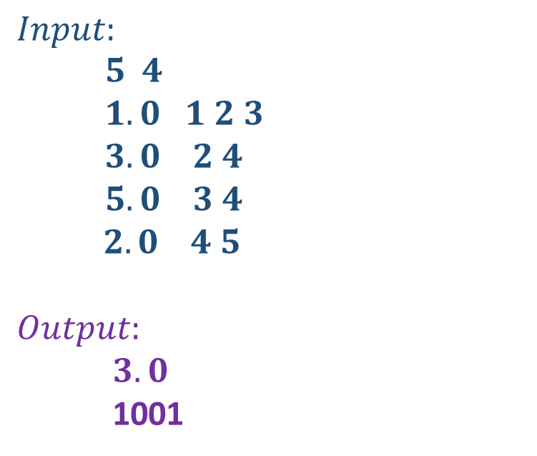
Sample Input-Output

Slide 7

Proof of NP-Completeness of Decision Version

Slide 8



Proof of NP-Completeness of Decision Version

Slide 9







Proof of NP-Completeness of Decision Version

Slide 10


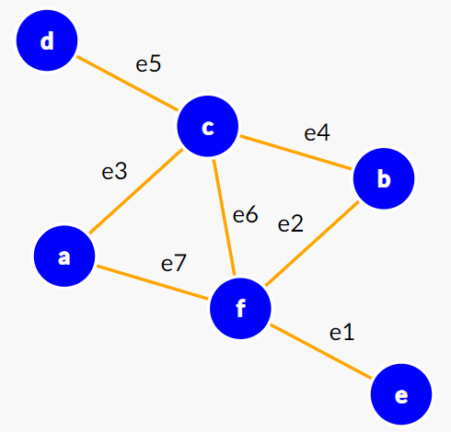
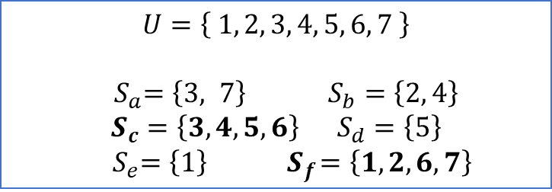

Proof of NP-Completeness of Decision Version

Slide 11
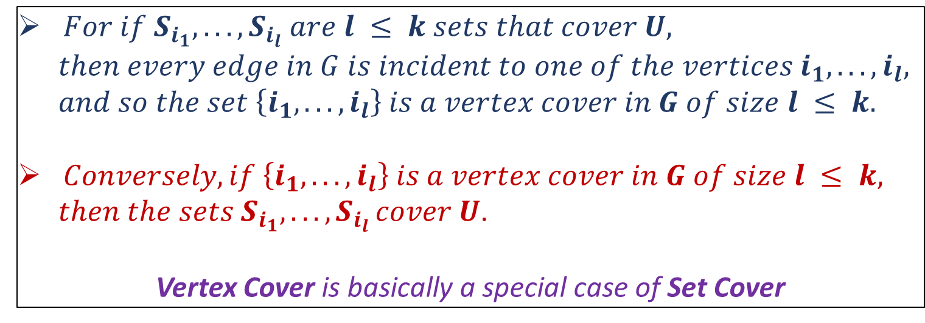
Proof of NP-Completeness of Decision Version

Slide 12
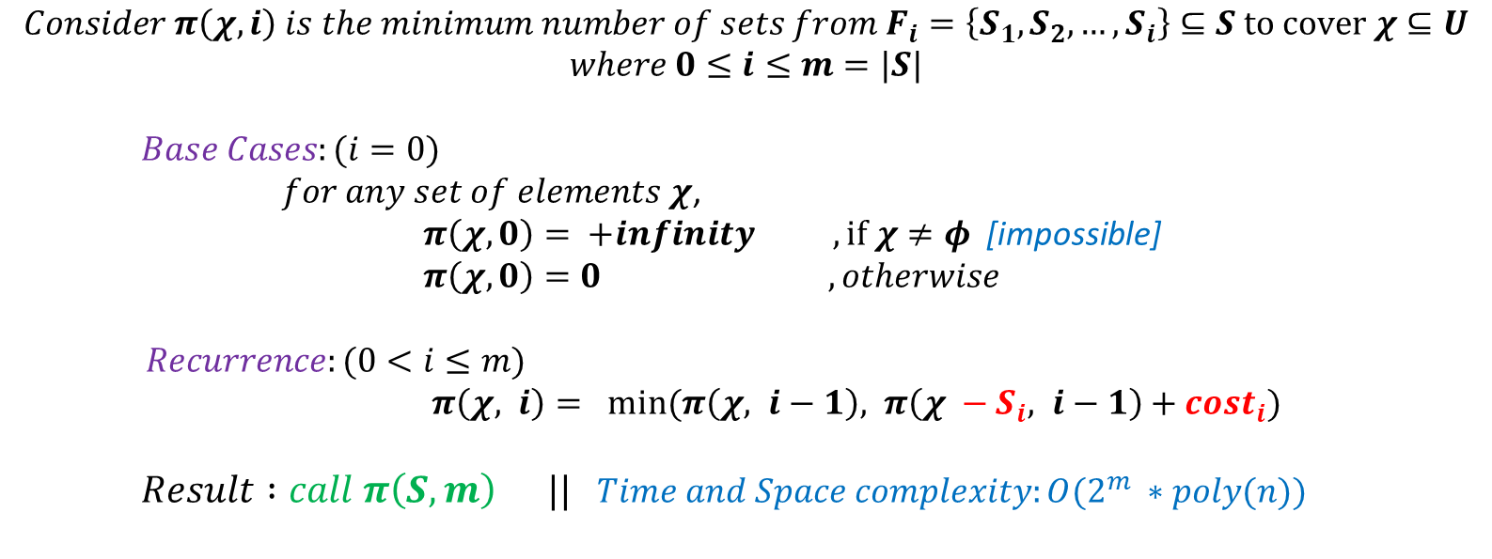
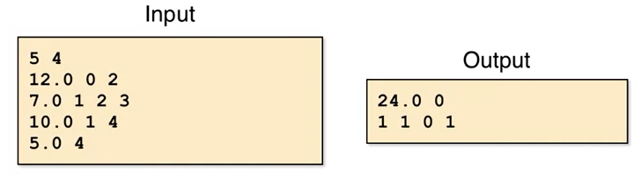
Solution Approach 1 : Dynamic Programming

Slide 13
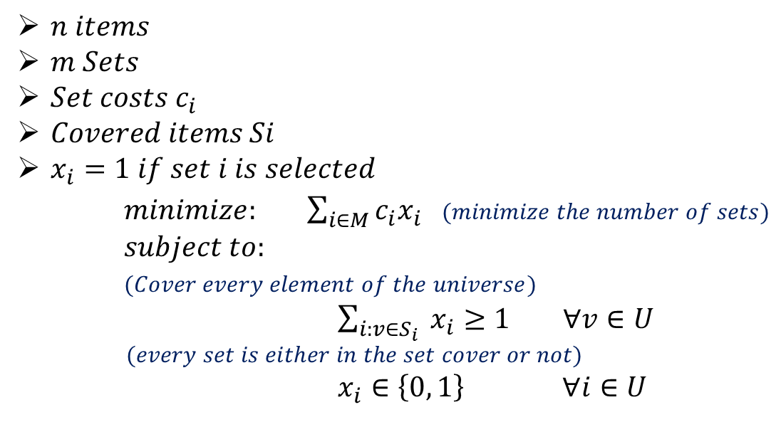

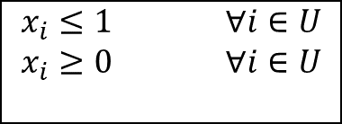
Solution Approach 2 : Linear Programming Relaxation

Slide 14
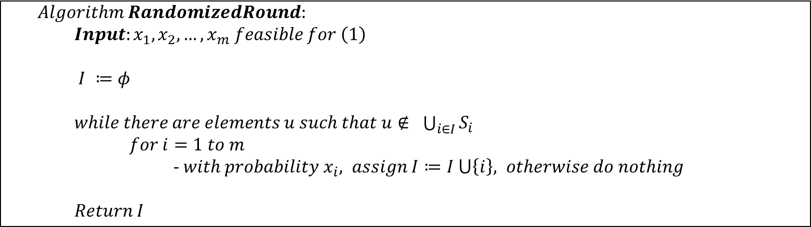
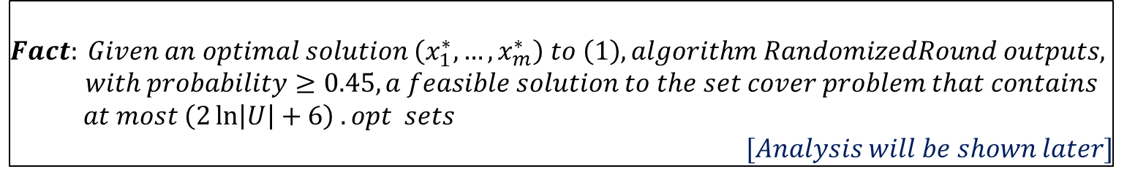
Solution Approach 2 : Linear Programming Relaxation

Slide 15
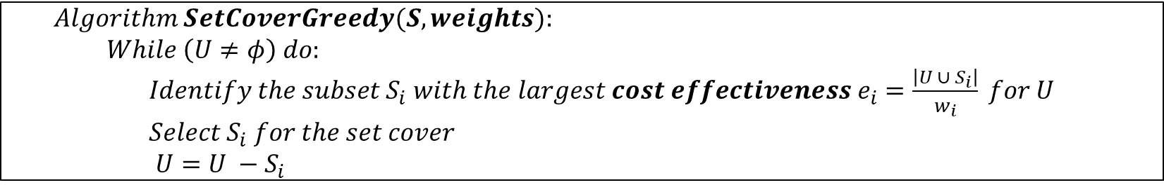
Solution Approach 3 : Greedy Heuristic Based

Slide 16
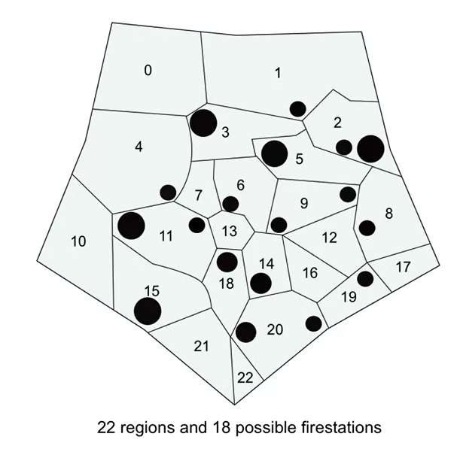
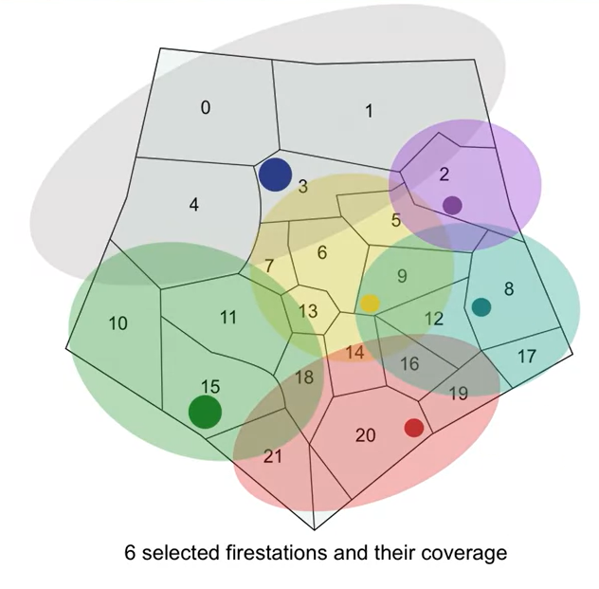
Real Life Application – 1 : Fire Stations

Slide 17






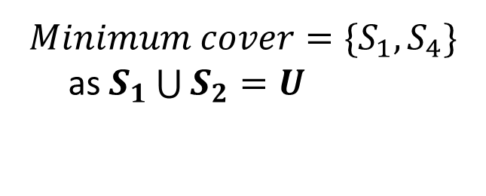


Real Life Application – 2 : Software Package

Slide 18
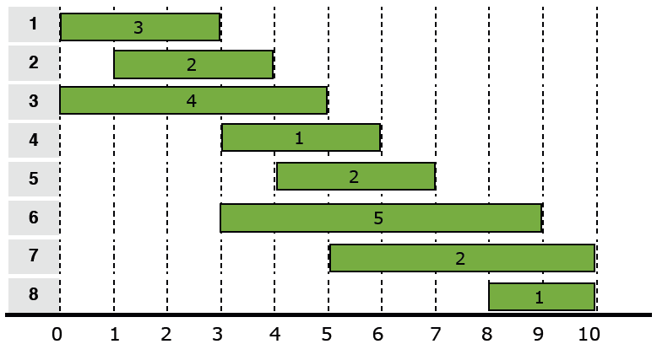
Real Life Application – 3 : Interval Scheduling (Assigning minimum observers/guards)

Slide 19
Thank You

