Slide 1
CSE-719(Distributed and Cloud Computing)-Distributed Systems
Dr. Atiqur Rahman
ড. আতিকুর রহমান
Ph.D.(CQUPT, China), MS.Engg.(CU), B.Sc.(CU)
Associate Professor
Department of Computer Science and Engineering
University of Chittagong
Lecture 1: Welcome, and Introduction

Slide 2
Our Main Goal Today
To Define the Term Distributed System

Slide 3
Can you name some examples of Operating Systems?

Slide 4
Can you name some examples of Operating Systems?
…
Linux WinXP Vista 7/8 Unix FreeBSD Mac OSX
2K Aegis Scout Hydra Mach SPIN
OS/2 Express Flux Hope Spring
AntaresOS EOS LOS SQOS LittleOS TINOS
PalmOS WinCE TinyOS iOS
…

Slide 5
What is an Operating System?

Slide 6
What is an Operating System?
User interface to hardware (device driver)
Provides abstractions (processes, file system)
Resource manager (scheduler)
Means of communication (networking)
…

Slide 7
FOLDOC definition
(FOLDOC = Free On-Line Dictionary of Computing)
Operating System-The low-level software which handles the interface to peripheral hardware, schedules tasks, allocates storage, and presents a default interface to the user when no application program is running.

Slide 8
Can you name some examples of
Distributed Systems?

Slide 9
Can you name some examples of
Distributed Systems?
Client-Server (NFS)
The Web
The Internet
A wireless network
DNS
Gnutella or BitTorrent (peer to peer overlays)
A “cloud”, e.g., Amazon EC2/S3, Microsoft Azure
A datacenter, e.g., NCSA, a Google datacenter, The Planet
Notes:
National Center for Supercomputing Applications (NCSA) at the University of Illinois at Urbana. Elastic Compute Cloud (EC2), Simple Storage Service (S3):

Slide 10
What is a Distributed System?

Slide 11
FOLDOC definition
A collection of (probably heterogeneous) automata whose distribution is transparent to the user so that the system appears as one local machine. This is in contrast to a network, where the user is aware that there are several machines, and their location, storage replication, load balancing and functionality is not transparent. Distributed systems usually use some kind of client-server organization.

Slide 12
Textbook definitions
A distributed system is a collection of independent computers that appear to the users of the system as a single computer.
[Andrew Tanenbaum]
A distributed system is several computers doing something together. Thus, a distributed system has three primary characteristics: multiple computers, interconnections, and shared state.
[Michael Schroeder]
Notes:
Contradictions:
uh, doesn’t each computer need to know about a few other computers in the system (somewhere deep down there in the RAM)?
If computers don’t exchange any information and make no progress, would this count as a distributed system?

Slide 13
Unsatisfactory
Why are these definitions short?
Why do these definitions look inadequate to us?
Because we are interested in the insides of a distributed system
  design and implementation
  Maintenance
  Algorithmics (“protocols”)

Slide 14
“I shall not today attempt further to define the kinds of material I understand to be embraced within that shorthand description; and perhaps I could never succeed in intelligibly doing so. But I know it when I see it, and the motion picture involved in this case is not that.”
[Potter Stewart, Associate Justice, US Supreme Court (talking about his interpretation of a technical term laid down in the law, case Jacobellis versus Ohio 1964) ]

Slide 15
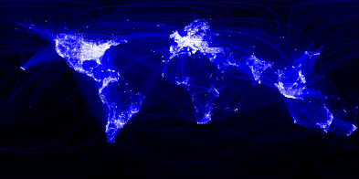
Which is a Distributed System – (A) or (B)?
(A)
(A) Facebook Social Network Graph among humans
Source: https://www.facebook.com/note.php?note_id=469716398919

Slide 16
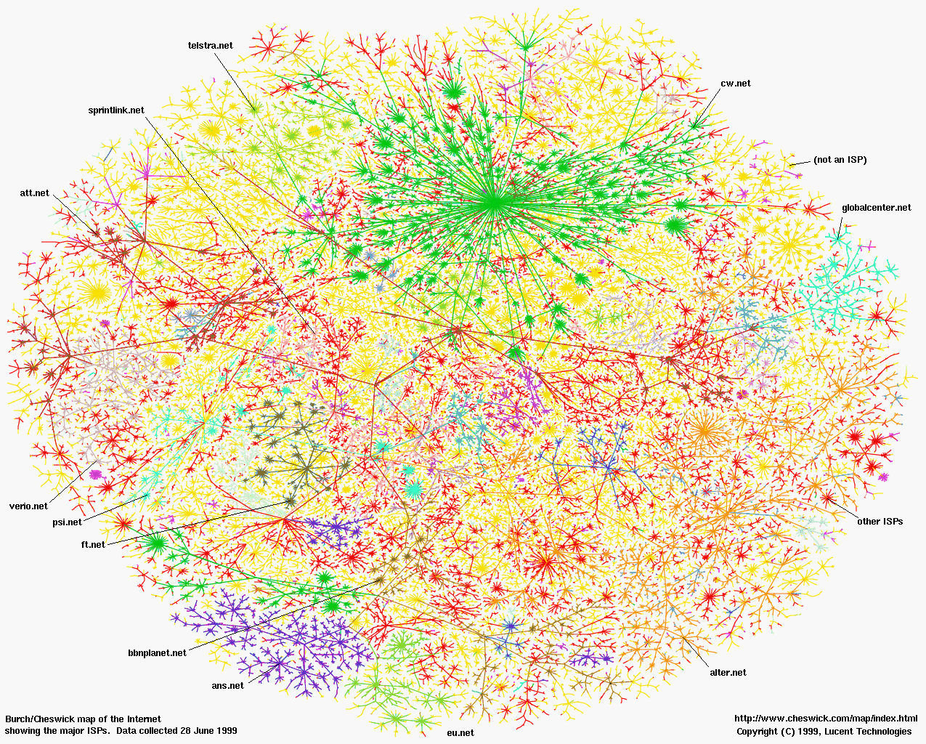
(B)
(B) The Internet (Internet Mapping Project, color coded by ISPs)

Slide 17
A working definition for us
A distributed system is a collection of entities, each of which is autonomous, programmable, asynchronous and failure-prone, and which communicate through an unreliable communication medium.
Entity=a process on a device (PC, PDA)
Communication Medium=Wired or wireless network
Our interest in distributed systems involves
  design and implementation, maintenance, algorithmic
Notes:
Designers and progammers interested in : algorithmics, maintenance.
(informal definition, for us programmers of distributed systems)
Ok: peer to peer systems
Contradiction: a computer without ROM or disk drives that needs to boot over the network. Is a collection of these computers a distributed system?

Slide 18
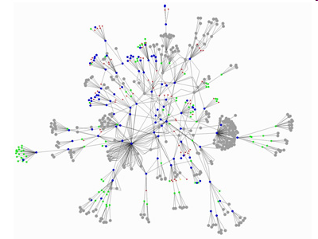
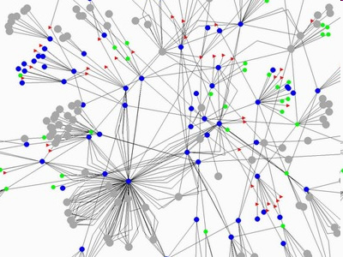
Gnutella Peer to Peer System
What are the “entities”
(nodes)?
What is the
communication medium
(links)?
Source: GnuMap Project

Slide 19
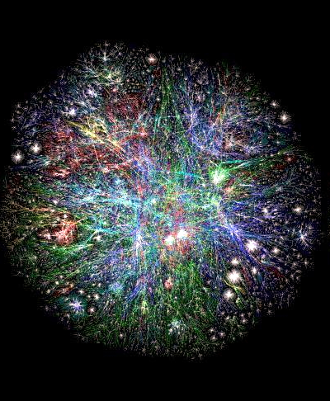
Web Domains
What are the “entities”
(nodes)?
What is the
communication medium
(links)?
Source: http://www.vlib.us/web/worldwideweb3d.html

Slide 20
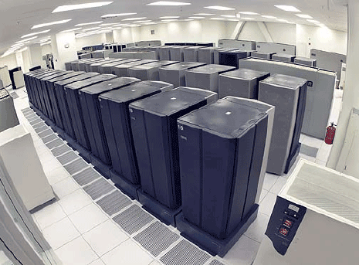
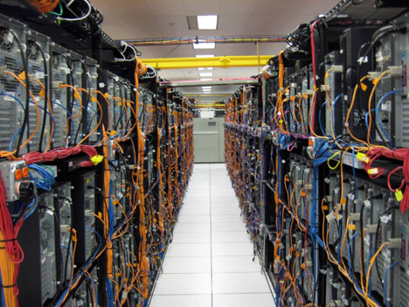
Datacenter
What are the “entities”
(nodes)?
What is the
communication medium
(links)?

Slide 21
The Internet – Quick Refresher
Underlies many distributed systems.
A vast interconnected collection of computer networks of many types.
Intranets – subnetworks operated by companies and organizations.
Intranets contain subnets and LANs.
WAN – wide area networks, consists of LANs
ISPs – companies that provide modem links and other types of connections to users.
Intranets (actually the ISPs’ core routers) are linked by backbones – network links of large bandwidth, such as satellite connections, fiber optic cables, and other high-bandwidth circuits.
UC2B? Google Fiber?
Notes:
The Urbana Champaign Big Broadband (UC2B) Community Benefit Fund is accepting applications focusing on improving digital inclusion and digital equity. Google Fiber: Fastest in the US. Speeds up to 8 Gig, both down and up. Next-gen fiber speed to and inside your home.

Slide 22
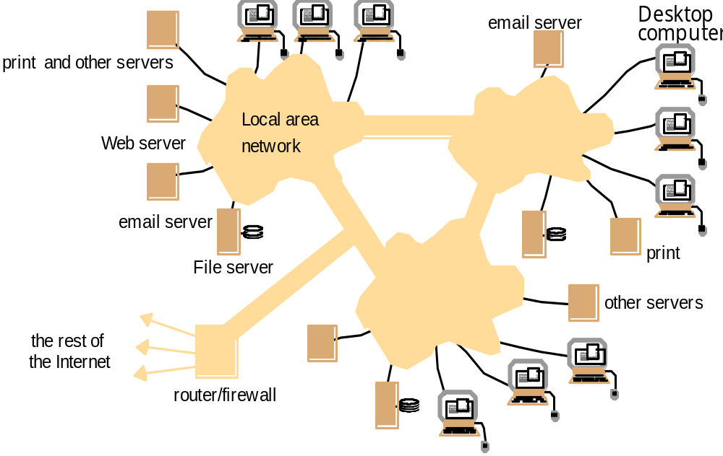
An Intranet & a distributed system
Running over this Intranet is a distributed file system
prevents unauthorized messages from leaving/entering;
implemented by filtering incoming and outgoing messages

Slide 23
Networking Stacks
Application
layer protocol
smtp [RFC 821]
telnet [RFC 854]
http [RFC 2068]
ftp [RFC 959]
proprietary
(e.g. RealNetworks)
NFS
proprietary
(e.g., Skype)
Underlying
transport protocol
TCP
TCP
TCP
TCP
TCP or UDP
TCP or UDP
typically UDP
Application
e-mail
remote terminal access
Web
file transfer
streaming multimedia
remote file server
Internet telephony
Distributed System Protocols!
Networking Protocols
TCP=Transmission Control Protocol
UDP=User Datagram Protocol
(Implemented via sockets)

Slide 24
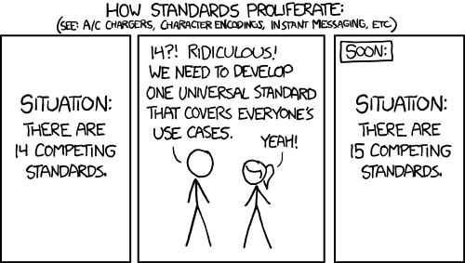
The History of Internet Standards
Source: http://xkcd.com/927/

Slide 25

The Heart of the World Wide Web: the HTTP Standard
HTTP: hypertext transfer protocol
WWW’s application layer protocol
client/server model
  client: browser that requests, receives, and “displays” WWW objects
  server: WWW server, which is storing the website, sends objects in response to requests
http1.0: RFC 1945
http1.1: RFC 2068
  Leverages same connection to download images, scripts, etc.
http request
PC running
Explorer
http response
http request
Server
Running
Apache
Web
server
http response
Mac running
Safari

Slide 26
The HTTP Protocol: More
http: TCP transport service:
client initiates a TCP connection (creates socket) to server, port 80
server accepts the TCP connection from client
http messages (application-layer protocol messages) exchanged between browser (http client) and WWW server (http server)
TCP connection closed
http is “stateless”
server maintains no information about past client requests
Why?
Protocols that maintain session “state” are complex!
past history (state) must be maintained and updated.
if server/client crashes, their views of “state” may be inconsistent, and hence must be reconciled.
RESTful protocols are stateless.

Slide 27
HTTP Example
(contains text,
references to 10
jpeg images)
Suppose user enters URL www.cs.uiuc.edu/
1a. http client initiates a TCP connection to http server (process) at www.cs.uiuc.edu. Port 80 is default for http server.
1b. http server at host www.cs.uiuc.edu waiting for a TCP connection at port 80. “accepts” connection, notifying client
2. http client sends a http request message (containing URL) into TCP connection socket
3. http server receives request messages, forms a response message containing requested object (index.html), sends message into socket
time

Slide 28
HTTP Example (cont.)
4. http server closes the TCP connection (if necessary).
5. http client receives a response message containing html file, displays html, Parses html file, finds 10 referenced jpeg objects
6. Steps 1-5 are then repeated for each of 10 jpeg objects
time
For fetching referenced objects, have 2 options:
non-persistent connection: only one object fetched per TCP connection
  some browsers create multiple TCP connections simultaneously - one per object
persistent connection: multiple objects transferred within one TCP connection

Slide 29
Your Shell as a browser
1. Telnet to your favorite WWW server:
telnet www.google.com 80
Opens TCP connection to port 80
(default http server port) at www.google.com
Anything typed in sent
to port 80 at www.google.com
2. Type in a GET http request:
GET /index.html
Or
GET /index.html HTTP/1.0
By typing this in (may need to hit
return twice), you send
this minimal (but complete)
GET request to http server
3. Look at response message sent by http server!
What do you think the response is?

Slide 30
Does our Working Definition work for the http
Web?
A distributed system is a collection of entities, each of which is autonomous, programmable, asynchronous and failure-prone, and that communicate through an unreliable communication medium.
Entity=a process on a device (PC, PDA)
Communication Medium=Wired or wireless network
Our interest in distributed systems involves
  design and implementation, maintenance, study, algorithmic
Notes:
Designers and progammers interested in : algorithmics, maintenance.
(informal definition, for us programmers of distributed systems)
Ok: peer to peer systems
Contradiction: a computer without ROM or disk drives that needs to boot over the network. Is a collection of these computers a distributed system?

Slide 31
“Important” Distributed Systems Issues
No global clock; no single global notion of the correct time (asynchrony)
Unpredictable failures of components: lack of response may be due to either failure of a network component, network path being down, or a computer crash (failure-prone, unreliable)
Highly variable bandwidth: from 16Kbps (slow modems or Google Balloon) to Gbps (Internet2) to Tbps (in between DCs of same big company)
Possibly large and variable latency: few ms to several seconds
Large numbers of hosts: 2 to several million

Slide 32
Many Interesting Design Problems
Real distributed systems
  Cloud Computing, Peer to peer systems, Hadoop, key-value stores/NoSQL, distributed file systems, sensor networks, measurements, graph processing, stream processing, …
Classical Problems
  Failure detection, Asynchrony, Snapshots, Multicast, Consensus, Mutual Exclusion, Election, …
Concurrency
  RPCs, Concurrency Control, Replication Control, …
Security
  Byzantine Faults, …
Others…

Slide 33
Typical Distributed Systems Design Goals
Common Goals:
  Heterogeneity – can the system handle a large variety of types of PCs and devices?
  Robustness – is the system resilient to host crashes and failures, and to the network dropping messages?
  Availability – are data+services always there for clients?
  Transparency – can the system hide its internal workings from the users?
  Concurrency – can the server handle multiple clients simultaneously?
  Efficiency – is the service fast enough? Does it utilize 100% of all resources?
  Scalability – can it handle 100 million nodes without degrading service? (nodes=clients and/or servers) How about 6 B? More?
  Security – can the system withstand hacker attacks?
  Openness – is the system extensible?

Slide 34
“Important” Issues
If you’re already complaining that the list of topics we’ve discussed so far has been perplexing…
  You’re right!
  It was meant to be (perplexing)
The Goal for the Rest of the Course: see enough examples and learn enough concepts so these topics and issues will make sense
  We will revisit many of these slides in the very last lecture of the course!
Notes:
puzzle

Slide 35
“Concepts”?
Which of the following inventions do you think is the most important?
  Car
  Wheel
  Bicycle
“What lies beneath?” Concepts!
Notes:
"এর পেছনে কী লুকিয়ে আছে?" ধারণা!

Slide 36
How will We Learn?
Textbook, Recommended but not Limited to
  Distributed and Cloud Computing- From Parallel Processing to the Internet of Things by Kai Hwang, Geoffery C. Fox, Jack J. Dongarra (Any edition)
  Fundamentals of Cloud Computing by A. Kannammal
  Cloud Computing by Michael Miller
Lectures
Homework's
  Approx. one every two-three weeks
  Solutions need to be typed, figures can be hand-drawn
  May have extra problems for 4-credit students
Programming assignments (3-4)
Exams/quizzes
  CTS’ + Final

Slide 37
What assistance is available to you?
Lectures
  lecture slides will be placed online at Google Classroom or Students’ Group
    “Tentative” version before lecture
    “Final” version after lecture
Homework's – office hours and discussion forum to help you (without giving you the solution).
Programming Assignments (MPs) – First two assignments will be in C
  Office hours and Piazza discussion forum to help you (without giving you the solution).
Course Prerequisite: CSE511 or CSE613 or equivalent OS/Networking course (latter need instructor permission)

Slide 38
You can find us almost everywhere
In person:
Myself (Dr. Atiq): Associate Professor, CSE department, CU.
  Office Hours Every Tuesday and Thursday right after class.
TAs:
(Check Google Classroom or Group for office hours. There is > 0 office hours every day of the week.)
Virtually:
Discussion Forum: Piazza (most preferable, monitored daily) – 24 hour turnaround time for questions!
Email (turnaround time may be longer than Piazza) – use atiqcse09@cu.ac.bd
Email individuals (instructor, TA) only if absolutely necessary (e.g., private matter)

Slide 39
Wrap-Up
(Reading for today’s lecture: Relevant parts of Chapter 1)
All students: Must join the Google Classroom and Group ASAP.
Next lecture
  Topic: “Introduction to Cloud Computing”

