Slide 1
CSE-719(Distributed and Cloud Computing)
Dr. Atiqur Rahman
ড. আতিকুর রহমান
Ph.D.(CQUPT, China), MS.Engg.(CU), B.Sc.(CU)
Associate Professor
Department of Computer Science and Engineering
University of Chittagong
Lecture 2: Introduction to Cloud Computing

Slide 2


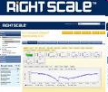

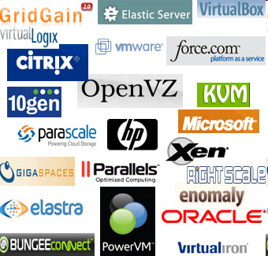

Slide 3
The Hype!
Forrester in 2010 – Cloud computing will go from $40.7 billion in 2010 to $241 billion in 2020.
Gartner in 2009 - Cloud computing revenue will soar faster than expected and will exceed $150 billion by 2013. It will represent 19% of IT spending by 2015.
IDC in 2009: “Spending on IT cloud services will triple in the next 5 years, reaching $42 billion.”
Companies and even Federal/state governments using cloud computing now: fedbizopps.gov

Slide 4
Many Cloud Providers
AWS: Amazon Web Services
  EC2: Elastic Compute Cloud
  S3: Simple Storage Service
  EBS: Elastic Block Storage
Microsoft Azure
Google Compute Engine
Rightscale, Salesforce, EMC, Gigaspaces, 10gen, Datastax, Oracle, VMWare, Yahoo, Cloudera
And many many more!

Slide 5
Two Categories of Clouds
Can be either a (i) public cloud, or (ii) private cloud
Private clouds are accessible only to company employees
Public clouds provide service to any paying customer:
  Amazon S3 (Simple Storage Service): store arbitrary datasets, pay per GB-month stored
  Amazon EC2 (Elastic Compute Cloud): upload and run arbitrary OS images, pay per CPU hour used
  Google AppEngine/Compute Engine: develop applications within their appengine framework, upload data that will be imported into their format, and run

Slide 6
Customers Save Time and $$$
Dave Power, Associate Information Consultant at Eli Lilly and Company: “With AWS, Powers said, a new server can be up and running in three minutes (it used to take Eli Lilly seven and a half weeks to deploy a server internally) and a 64-node Linux cluster can be online in five minutes (compared with three months internally). … It's just shy of instantaneous.”
Ingo Elfering, Vice President of Information Technology Strategy, GlaxoSmithKline: “With Online Services, we are able to reduce our IT operational costs by roughly 30% of what we’re spending”
Jim Swartz, CIO, Sybase: “At Sybase, a private cloud of virtual servers inside its datacenter has saved nearly $US2 million annually since 2006, Swartz says, because the company can share computing power and storage resources across servers.”
100s of startups in Silicon Valley can harness large computing resources without buying their own machines.

Slide 7
But what exactly IS a cloud?

Slide 8
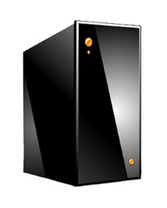
What is a Cloud?
It’s a cluster!
It’s a supercomputer!
It’s a datastore!
It’s superman!
None of the above
All of the above
Cloud = Lots of storage + compute cycles nearby
Notes:
In a computer system, a cluster is a group of servers and other resources that act like a single system and enable high availability, load balancing and parallel processing. These systems can range from a two-node system of two personal computers (PCs) to a supercomputer that has a cluster architecture.

Slide 9
What is a Cloud?
A single-site cloud (aka “Datacenter”) consists of
  Compute nodes (grouped into racks)
  Switches, connecting the racks
  A network topology, e.g., hierarchical
  Storage (backend) nodes connected to the network
  Front-end for submitting jobs and receiving client requests
  (Often called 3-tier architecture)
  Software Services
A geographically distributed cloud consists of
  Multiple such sites
  Each site perhaps with a different structure and services

Slide 10
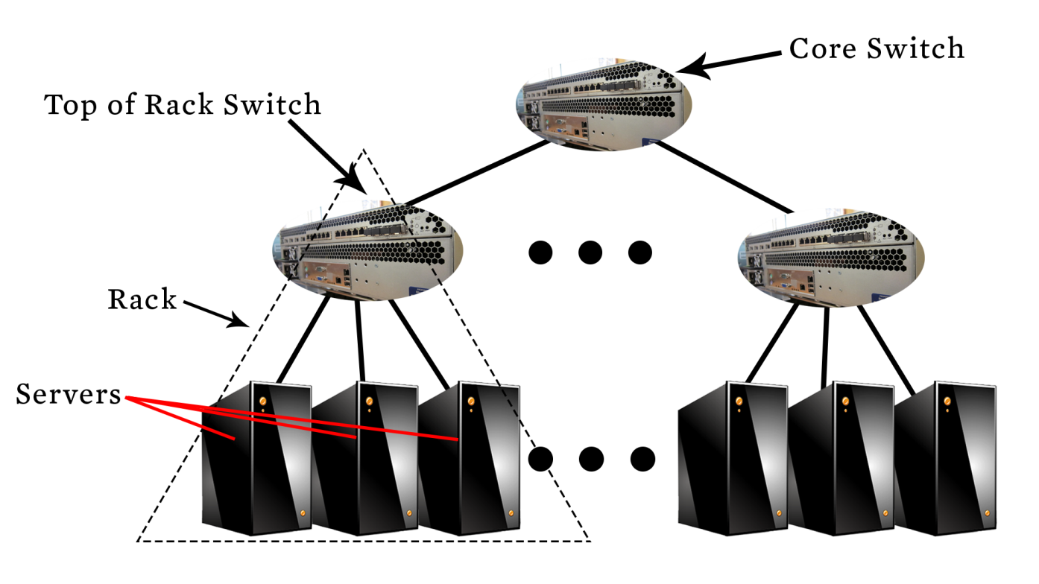
A Sample Cloud Topology
So then, what is a cluster?
Notes:
A computer cluster is a set of computers that work together so that they can be viewed as a single system. Unlike grid computers, computer clusters have each node set to perform the same task, controlled and scheduled by software. Cluster computing involves tightly coupled, homogeneous computers in one location acting as a single system for high performance, while grid computing links geographically dispersed, heterogeneous, and autonomous computers over a network to share resources. Clusters focus on speed and reliability, whereas grids focus on resource pooling and large-scale, parallel tasks.

Slide 11
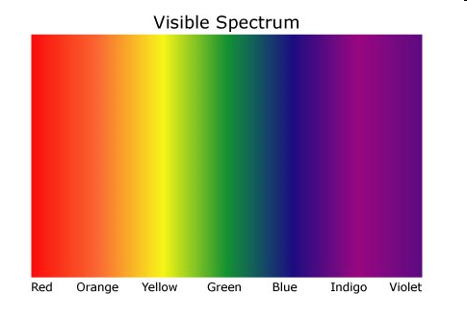
“A Cloudy History of Time”
The first datacenters!
Timesharing Companies
& Data Processing Industry
Clouds and datacenters
1940
1950
Clusters
1960
Grids
1970
1980
PCs
(not distributed!)
1990
2000
Peer to peer systems
2012

Slide 12
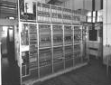

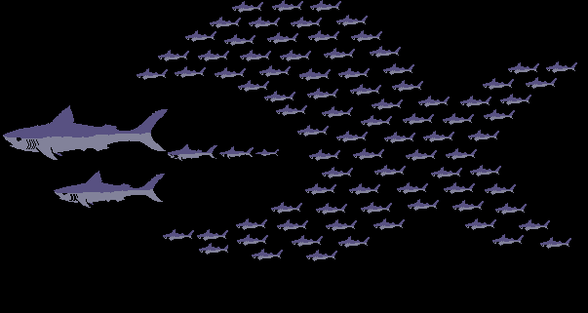
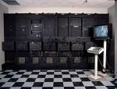





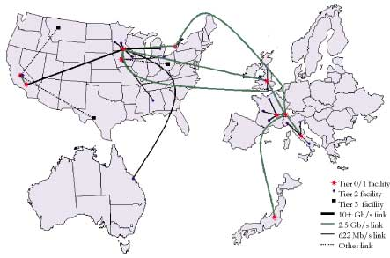

“A Cloudy History of Time”
First large datacenters: ENIAC, ORDVAC, ILLIAC
Many used vacuum tubes and mechanical relays
Berkeley NOW Project
Supercomputers
Server Farms (e.g., Oceano)
1940
1950
1960
P2P Systems (90s-00s)
Many Millions of users
Many GB per day
1970
1980
Data Processing Industry
- 1968: $70 M. 1978: $3.15 Billion
1990
Timesharing Industry (1975):
Market Share: Honeywell 34%, IBM 15%,
Xerox 10%, CDC 10%, DEC 10%, UNIVAC 10%
Honeywell 6000 & 635, IBM 370/168,
Xerox 940 & Sigma 9, DEC PDP-10, UNIVAC 1108
2000
Grids (1980s-2000s):
GriPhyN (1970s-80s)
Open Science Grid and Lambda Rail (2000s)
Globus & other standards (1990s-2000s)
Clouds
2012

Slide 13
Trends: Technology
Doubling Periods – storage: 12 mos, bandwidth: 9 mos, and (what law is this?) cpu compute capacity: 18 mos
Then and Now
  Bandwidth
    1985: mostly 56Kbps links nationwide
    2014: Tbps links widespread
  Disk capacity
    Today’s PCs have TBs, far more than a 1990 supercomputer

Slide 14
Trends: Users
Then and Now
Biologists:
  1990: were running small single-molecule simulations
  2012: CERN’s Large Hadron Collider producing many PB/year
Notes:
petabytes

Slide 15
Prophecies
In 1965, MIT's Fernando Corbató and the other designers of the Multics operating system envisioned a computer facility operating “like a power company or water company”.
Plug your thin client into the computing Utility and Play your favorite Intensive Compute & Communicate Application
  Have today’s clouds brought us closer to this reality? Think about it.
Notes:
Anticipate/vobissotbani

Slide 16
Four Features New in Today’s Clouds
Massive scale.
On-demand access: Pay-as-you-go, no upfront commitment.
  And anyone can access it
Data-intensive Nature: What was MBs has now become TBs, PBs and XBs.
  Daily logs, forensics, Web data, etc.
  Humans have data numbness: Wikipedia (large) compressed is only about 10 GB!
New Cloud Programming Paradigms: MapReduce/Hadoop, NoSQL/Cassandra/MongoDB and many others.
  High in accessibility and ease of programmability
  Lots of open-source
Combination of one or more of these gives rise to novel and unsolved distributed computing problems in cloud computing.

Slide 17
I. Massive Scale
Facebook [GigaOm, 2012]
  30K in 2009 -> 60K in 2010 -> 180K in 2012
Microsoft [NYTimes, 2008]
  150K machines
  Growth rate of 10K per month
  80K total running Bing
Yahoo! [2009]:
  100K
  Split into clusters of 4000
AWS EC2 [Randy Bias, 2009]
  40K machines
  8 cores/machine
eBay [2012]: 50K machines
HP [2012]: 380K in 180 DCs
Google: A lot
Notes:
Gigaom is a technology focused analyst firm and media company.

Slide 18
What does a datacenter look like from inside?
A virtual walk through a datacenter
Reference: http://gigaom.com/cleantech/a-rare-look-inside-facebooks-oregon-data-center-photos-video/

Slide 19
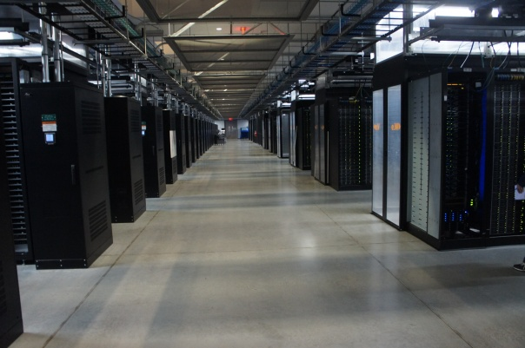
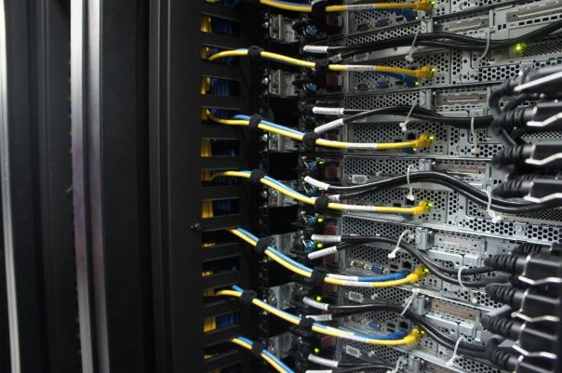
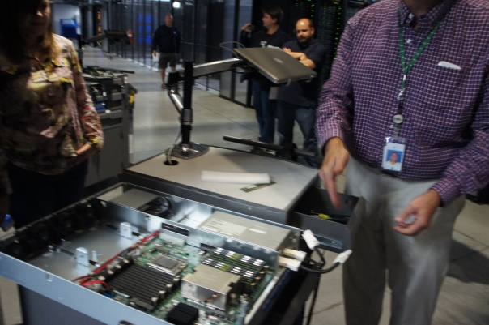
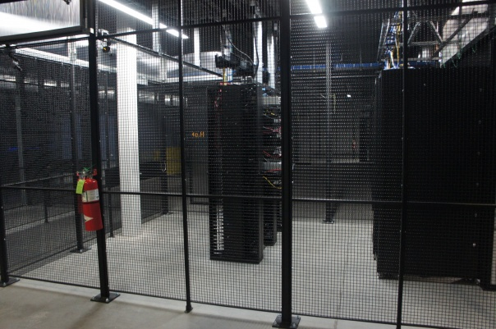
Servers
Front
Back
In
Some highly secure (e.g., financial info)
Notes:
Copyright?

Slide 20
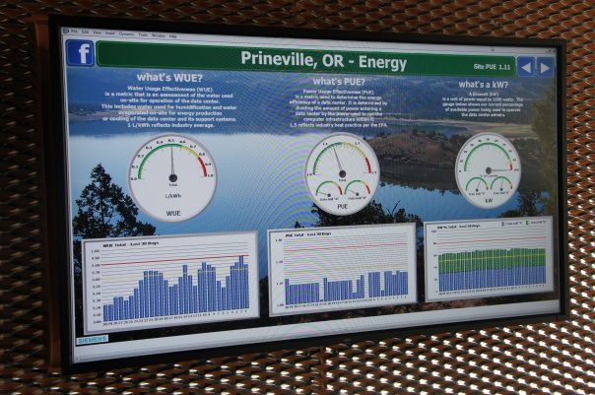
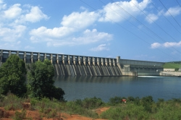
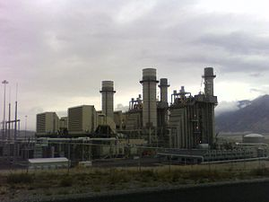
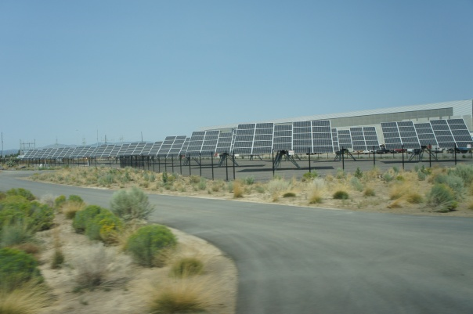
Power
Off-site
On-site
WUE = Annual Water Usage / IT Equipment Energy (L/kWh) – low is good
PUE = Total facility Power / IT Equipment Power – low is good
(e.g., Google~1.11)
Notes:
Copyright?

Slide 21
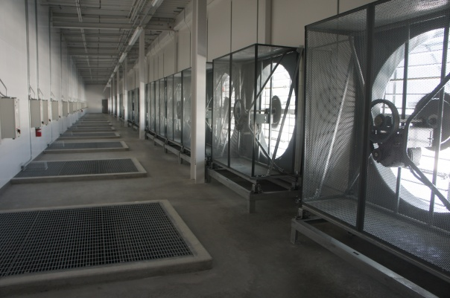
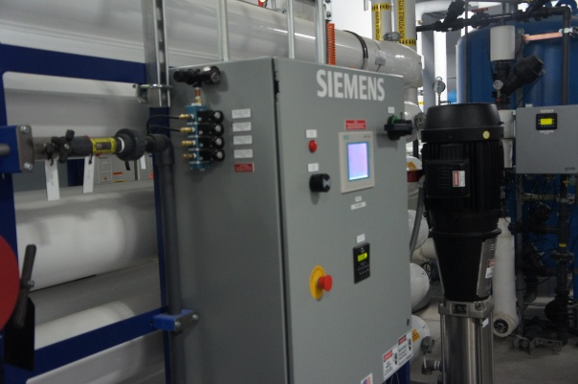
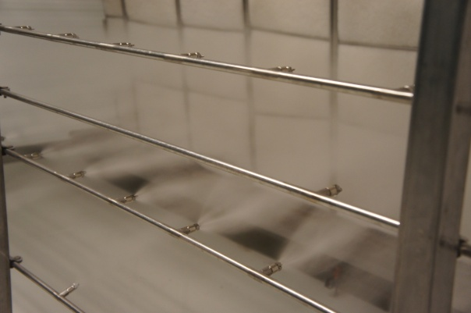
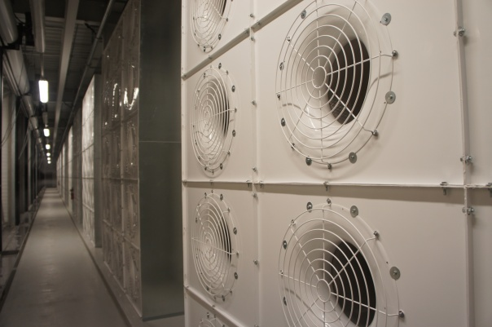
Cooling
Air sucked in from top (also, Bugzappers)
Water purified
Water sprayed into air
15 motors per server bank
Notes:
Copyright?

Slide 22
Extra - Fun Videos to Watch
Microsoft GFS Datacenter Tour (Youtube)
  http://www.youtube.com/watch?v=hOxA1l1pQIw
Timelapse of a Datacenter Construction on the Inside (Fortune 500 company)
  http://www.youtube.com/watch?v=ujO-xNvXj3g

Slide 23
II. On-demand access: *aaS Classification
On-demand: renting a cab vs. (previously) renting a car, or buying one. E.g.:
  AWS Elastic Compute Cloud (EC2): a few cents to a few $ per CPU hour
  AWS Simple Storage Service (S3): a few cents to a few $ per GB-month
HaaS: Hardware as a Service
  You get access to barebones hardware machines, do whatever you want with them, Ex: Your own cluster
  Not always a good idea because of security risks
IaaS: Infrastructure as a Service
  You get access to flexible computing and storage infrastructure. Virtualization is one way of achieving this (what’s another way, e.g., using Linux). Often said to subsume HaaS.
  Ex: Amazon Web Services (AWS: EC2 and S3), Eucalyptus, Rightscale, Microsoft Azure, Google Compute Engine.

Slide 24
II. On-demand access: *aaS Classification
PaaS: Platform as a Service
  You get access to flexible computing and storage infrastructure, coupled with a software platform (often tightly coupled)
  Ex: Google’s AppEngine (Python, Java, Go)
SaaS: Software as a Service
  You get access to software services, when you need them. Often said to subsume SOA (Service Oriented Architectures).
  Ex: Google docs, MS Office on demand

Slide 25
III. Data-intensive Computing
Computation-Intensive Computing
  Example areas: MPI (Message Passing Interface)-based, High-performance computing, Grids
  Typically run on supercomputers (e.g., NCSA Blue Waters)
Data-Intensive
  Typically store data at datacenters
  Use compute nodes nearby
  Compute nodes run computation services
In data-intensive computing, the focus shifts from computation to the data: CPU utilization no longer the most important resource metric, instead I/O is (disk and/or network)
Notes:
Blue Waters was a petascale supercomputer operated by the National Center for Supercomputing Applications (NCSA) at the University of Illinois at Urbana. About Blue Waters. Blue Waters is one of the most powerful supercomputers in the world.

Slide 26
IV. New Cloud Programming Paradigms
Easy to write and run highly parallel programs in new cloud programming paradigms:
  Google: MapReduce and Sawzall
  Amazon: Elastic MapReduce service (pay-as-you-go)
  Google (MapReduce)
    Indexing: a chain of 24 MapReduce jobs
    ~200K jobs processing 50PB/month (in 2006)
  Yahoo! (Hadoop + Pig)
    WebMap: a chain of several MapReduce jobs
    300 TB of data, 10K cores, many tens of hours
  Facebook (Hadoop + Hive)
    ~300TB total, adding 2TB/day (in 2008)
    3K jobs processing 55TB/day
  Similar numbers from other companies, e.g., Yieldex, eharmony.com, etc.
  NoSQL: MySQL is an industry standard, but Cassandra is 2400 times faster!
Notes:
Apache Pig is a platform for analyzing large data sets that consists of a high-level language for expressing data analysis programs, coupled with infrastructure for evaluating these programs.
Apache Hive is a distributed, fault-tolerant data warehouse system that enables analytics at a massive scale.
Sawzall (programming language)
A Sawzall script runs within the Map phase of a MapReduce and "emits" values to tables. ... Sawzall supports the compound data types lists, maps, and structs.

Slide 27
Two Categories of Clouds
Can be either a (i) public cloud, or (ii) private cloud
Private clouds are accessible only to company employees
Public clouds provide service to any paying customer
You’re starting a new service/company: should you use a public cloud or purchase your own private cloud?

Slide 28
Single site Cloud: to Outsource or Own?
Medium-sized organization: wishes to run a service for M months
  Service requires 128 servers (1024 cores) and 524 TB
  Same as UIUC CCT (Cloud Computing Test bed) cloud site
Outsource (e.g., via AWS): monthly cost
  S3 costs: $0.12 per GB month. EC2 costs: $0.10 per CPU hour (costs from 2009)
  Storage = $ 0.12 X 524 X 1000 ~ $62 K
  Total = Storage + CPUs = $62 K + $0.10 X 1024 X 24 X 30 ~ $136 K
Own: monthly cost
  Storage ~ $349 K / M
  Total ~ $ 1555 K / M + 7.5 K (includes 1 sys admin / 100 nodes)
    using 0.45:0.4:0.15 split for hardware: power: network and 3 year lifetime of hardware

Slide 29
Single site Cloud: to Outsource or Own?
Breakeven analysis: more preferable to own if:
  ^{- $349 K / M < $62 K (storage)}
  ⁻ $ 1555 K / M + 7.5 K < $136 K (overall)
  ^{Breakeven points}
  M > 5.55 months (storage) [349/6=58.16]
  M > 12 months (overall) [1555/12= 129.5+7.5=137, 1555/13=119.6+7.5=127]
^{As a result}
    ^{Startups use clouds a lot}
    Cloud providers benefit monetarily most from storage
Notes:
The break-even point in economics, business—and specifically cost accounting—is the point at which total cost and total revenue are equal, i.e. "even".
Break-even analysis determines the number of units or amount of revenue that's needed to cover your business's total costs. At the break-even point, you aren't losing or making any money, but all the costs associated with your business will have been covered.

Slide 30
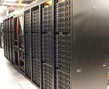

Academic Clouds: Emulab
A community resource open to researchers in academia and industry. Very widely used by researchers everywhere today.
https://www.emulab.net/
A cluster, with currently ~500 servers
Founded and owned by University of Utah (led by Late Prof. Jay Lepreau)
As a user, you can:
  Grab a set of machines for your experiment
  You get root-level (sudo) access to these machines
  You can specify a network topology for your cluster
  You can emulate any topology
All images © Emulab

Slide 31

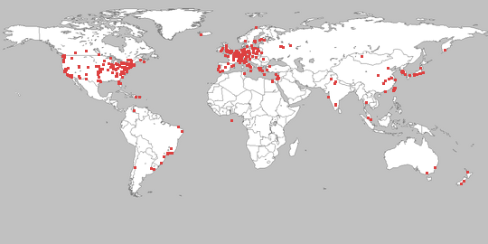
A community resource open to researchers in academia and
industry
http://www.planet-lab.org/
Currently, ~ 1077 nodes at ~500 sites across the world
Founded at Princeton University (led by Prof. Larry Peterson), but owned in a federated manner by the sites
Node: Dedicated server that runs components of PlanetLab services.
Site: A location, e.g., UIUC, that hosts a number of nodes.
Sliver: Virtual division of each node. Currently, uses VMs, but it could also other technology. Needed for timesharing across users.
Slice: A spatial cut-up of the PL nodes. Per user. A slice is a way of giving each user (Unix-shell like) access to a subset of PL machines, selected by the user. A slice consists of multiple slivers, one at each component node.
Thus, PlanetLab allows you to run real world-wide experiments.
Many services have been deployed atop it, used by millions (not just researchers): Application-level DNS services, Monitoring services, CoralCDN, etc.
All images © PlanetLab
Notes:
University of Illinois Urbana-Champaign

Slide 32
Summary
Clouds build on many previous generations of distributed systems
Especially the timesharing and data processing industry of the 1960-70s.
Need to identify unique aspects of a problem to classify it as a new cloud computing problem
  Scale, On-demand access, data-intensive, new programming
Otherwise, the solutions to your problem may already exist!

