Slide 1
CSE-719(Distributed and Cloud Computing)
Dr. Atiqur Rahman
ড. আতিকুর রহমান
Ph.D.(CQUPT, China), MS.Engg.(CU), B.Sc.(CU)
Associate Professor
Department of Computer Science and Engineering
University of Chittagong
Lecture 5: Networking and Routing

Slide 2
Our Distributed System Definition
Focus of this lecture
A distributed system is a collection of entities, each of which is autonomous, programmable, asynchronous and failure-prone, and communicating through an unreliable communication medium.
Our interest in distributed systems involves
  design and implementation, maintenance, study, algorithmics
Entity=a process on a device (PC, PDA)
Communication Medium=Wired or wireless network
Notes:
Designers and progammers interested in : algorithmics, maintenance.
(informal definition, for us programmers of distributed systems)
Ok: peer to peer systems
Contradiction: a computer without ROM or disk drives that needs to boot over the network. Is a collection of these computers a distributed system?

Slide 3
So far…
Abstract distributed system – collection of processes over a communication medium
Protocols/algorithms for synchronization, snapshots, multicast, election, mutual exclusion, failure detectors, p2p, Hadoop
Intended to work in any distributed group of processes
  E.g., Group of processes on computer hosts
  E.g., Group of processes on mobile devices
For most of this course, we’ll focus on (1): computer hosts over the Internet

Slide 4
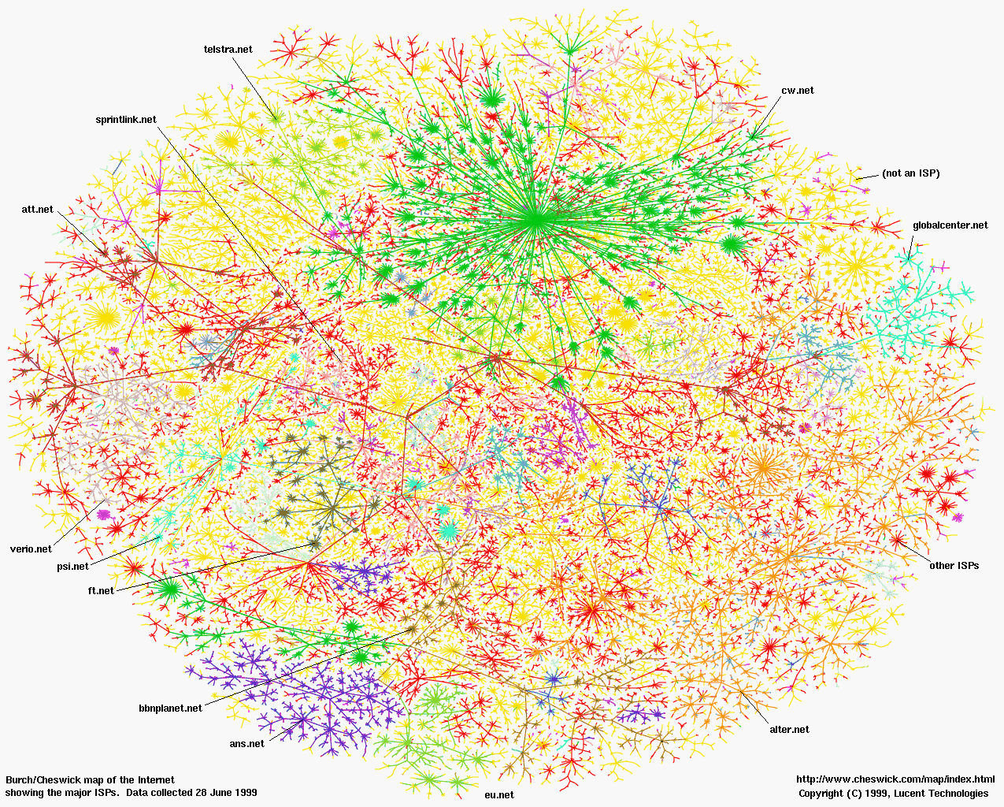
PCs,routers,
switches…
=nodes
links=
edges
The Internet (Internet Mapping Project, color coded by ISPs)
Notes:
Mercator map

Slide 5
Internet 5-Layer Networking Stack
This is where all of our distributed algorithms/techniques
run
Message
Layers
Application
Messages (UDP) or Streams (TCP)
Transport
UDP or TCP packets
Internet
IP datagrams
Data Link Layer
Network-specific frames
Underlying network

Slide 6
Routing Algorithms
NETWORK/INTERNET LAYER
Nodes connected in some topology. Routing algorithm runs at network layer in each node.
Goal of routing algorithm:
  given the destination IP address in packet, determine the “next hop”
  thus determine the route for each packet as it travels through the net
  dynamically update routing information to reflect failures, changes (e.g., router joins and leaves) and congestion (overloaded router)
Two approaches:
  Distance-vector (e.g., RIP)
    Every node knows, for each possible destination LAN, the next-hop
  Link-state (e.g., OSPF)
    Every node knows status of every “link” in the network
  In both, information maintained as a table
  Tables updated either
  Proactively – periodically, or
  Reactively – when a neighbor/some link status changes

Slide 7
Distance Vector Routing
Also termed as distributed Bellman-Ford algorithm or Ford-Fulkerson algorithm, included in RIP (Routing Information Protocol), AppleTalk, and Cisco routers.
  Each node/router maintains a table indexed by each destination node. Entry gives (best known distance to destination, best next-hop for destination)
  Once every T seconds, each router sends to each neighbor its own entire table. Neighbor uses this to update its own table. (proactive)

Slide 8
Distance Vector Routing
To Link Cost A 1 1 C 2 1 D 4 2 E 4 1
B local
Routing Table for A
Routing Table for B
To Link Cost B 1 1 C 1 2 D 3 1 E 1 2
A local
Routers
1
B
2
A
C
4
3
5
D
E
6
To Link Cost A 2 2 B 2 1 D 5 2 E 5 1
C local
Link number (all links have cost=1)
Hosts or LANs
Routing Table for C

Slide 9
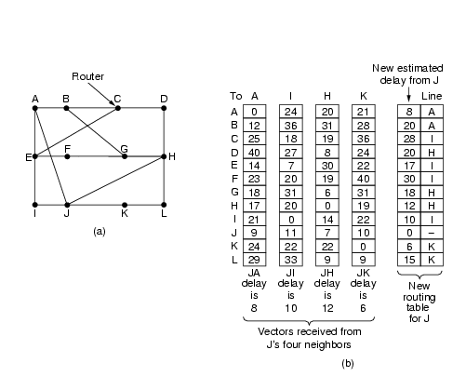
Distance Vector Routing: Node J
Costs only (next hop omitted)
+, then min across
neighbors

Slide 10
Pseudo-Code for RIP
Send: Each t seconds or when Tl changes, send Tl on each non-faulty outgoing link.
Receive: Whenever a routing table Tr is received on link n:
  for all rows Rr in Tr {
    if (Rr.link not equal n) {
      Rr.cost = Rr.cost + 1;
      Rr.link = n;
      if (Rr.destination is not in Tl) add Rr to Tl;
      // add new destination to Tl
      else for all rows Rl in Tl {
        if (Rr.destination = Rl.destination and
        (Rr.cost < Rl.cost or Rl.link = n)) Rl = Rr;
        // Rr.cost < Rl.cost : remote node has better route
        // Rl.link = n : remote node is more authoritative
      }
    }
  }

Slide 11
Link State Routing
Each router must
  Discover its neighbors and learn their network addresses
    When a router is booted up, it learns who its neighbors are by sending a special Hello packet on each point-to-point link.
    The router on the other end sends back a reply.
  Measure the delay or cost to each of its neighbors
    A router sends a special Echo packet over the link that the other end sends back immediately. By measuring the round-trip time, the sending router gets an RTT estimate.
  Construct a packet telling all it has just learned.
    Broadcast this packet

Slide 12
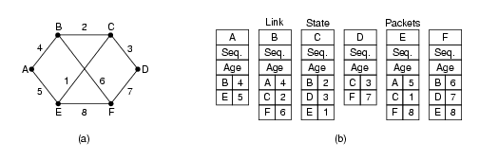
Link State Routing
A router broadcasts a link-state-advertisement (LSA) packet after booting, as well as periodically (or upon topology change). Packet forwarded only once, TTL-restricted
Initial TTL is very high, since need it to get to every router

Slide 13
Link State Routing
Broadcast the LSA packet to all other routers.
  Each packet contains a sequence number that is incremented for each new LSA packet sent by that source router.
  Each router keeps track of all the (source router, sequence) pairs it sees. When a new LSA packet comes in, it is checked against these pairs. If the received packet is new, it is forwarded on all the links except the one it arrived on. Old LSA packets are dropped.
  The age of each packet, being stored after reception, is decremented once per time unit. When the age hits zero, the information is discarded. Initial age = high. Such state is often called soft state.
For routing a packet, since the source knows the entire network graph, it simply computes the shortest path (actual sequence of nodes) locally using the Dijkstra’s algorithm. It can include the path in the packet, and intermediate nodes simply follow this route to decide their next hop for the packet.

Slide 14
Transport Layer =Transmission Control
Protocol
TRANSPORT LAYER
Function 0 – provide an application with a connection-oriented view of the network (IP is connectionless)
Function 1 (Message decomposition and reassembly): Breaks messages into packets at the transmitting end and reassembles packets into messages at the receiving end.
  E.g., using identification and fragment offset fields in IPv4 header
Function 2 (Multiplexing and demultiplexing): Multiplexes several lower-rate sessions, all from the same source and all going to the same destination, into one session at the network layer.
Function 3 (Reliable communication): Provides reliability to the application by acks + retransmissions in an end to end manner
Function 4 (End-to-end congestion/flow control): Reduces rate at which data is sent when congestion is detected in the network. (TCP-friendliness)
Function 5 (Ordering): Of packets within a stream -- FIFO
All these functionalities are a part of TCP.

Slide 15
DNS: Domain Name System
Domain Name System:
distributed database implemented in a hierarchy of many name servers
application-layer protocol that is responsible for resolving names (address/name translation)
People: many identifiers:
  Address: Mailing address, email address, telephone number
  Name: E.g., John Smith
Internet hosts, routers:
  Address: IP address (32/64 bit) - used for addressing datagrams
  Name: URL e.g., sal.cs.uiuc.edu – human-readable format
Q: given a resource name, how does a client find out the IP address of the service/server?

Slide 16
DNS: Domain Name System
Name Resolution: Name → Address
E.g.,: given a resource name, how does a client find out the IP address of the service/server
People: many identifiers:
  Address: Mailing address, email address, telephone number
  Name: E.g., John Smith
Internet hosts, routers:
  Address: IP address (32/64 bit) - used for addressing datagrams
  Name: URL e.g., sal.cs.uiuc.edu – human-readable format
Name: human-readable string
Address: machine-readable string

Slide 17
DNS: Domain Name System
Domain Name System:
distributed database implemented in a hierarchy of many name servers
application-layer protocol that is responsible for resolving names (address/name translation)
People: many identifiers:
  Address: Mailing address, email address, telephone number
  Name: E.g., John Smith
Internet hosts, routers:
  Address: IP address (32/64 bit) - used for addressing datagrams
  Name: URL e.g., sal.cs.uiuc.edu – human-readable format
Q: given a resource name, how does a client find out the IP address of the service/server?

Slide 18
DNS Name Servers
Why not have a central DNS server?
single point of failure
traffic volume
may be far
maintenance difficult
Doesn’t scale!
(WWW contains several billion pages today)
Alternative
no single server has all name-to-IP address mappings
Hierarchy of name servers
authoritative name servers:
  for a resource, definitively stores the mapped IP address for that resource
local name servers:
  each institution/company/ISP owns a local (default) name server
  Receives DNS queries from host
  Caches recently seen name→address mappings, and can answer queries quickly

Slide 19
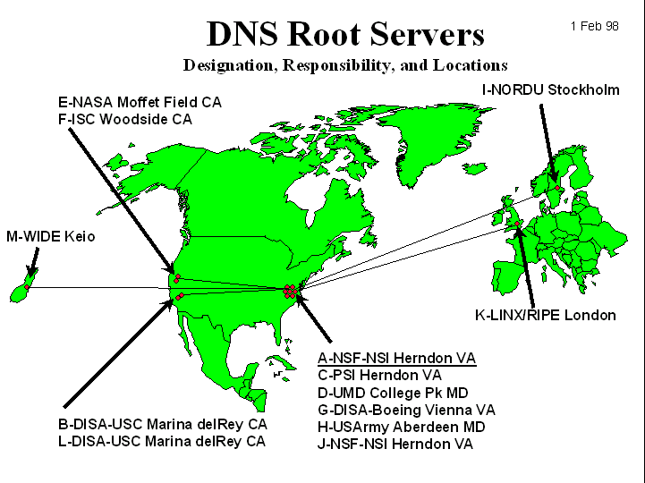
DNS: Root Name Servers
contacted by local name server that cannot resolve query
root name server:
  contacts authoritative name server if name mapping not known
  gets mapping
  returns mapping to local name server
~ 13 root name servers worldwide (as of ‘12)

Slide 20

Simple DNS Example
root name server
2
4
host surf.eurecom.fr wants IP address of dragon.cs.uiuc.edu
1. Contacts its local DNS server, dns.eurecom.fr
2. dns.eurecom.fr contacts root name server, if necessary
3. root name server contacts authoritative name server, dns.cs.uiuc.edu, if necessary
Answer returned by first server that is caching the mapping tuple
5
3
local name server
dns.eurecom.fr
authoritative name server
dns.cs.uiuc.edu
1
6
requesting host
surf.eurecom.fr
dragon.cs.uiuc.edu

Slide 21
DNS Example
root name server
Root name server:
may not know the authoritative name server
may know intermediate name server: whom to contact to find authoritative name server
Server Hierarchy parallels URL hierarchy
.
.edu .com .mil …
uiuc.edu mit.edu…
6
2
7
3
local name server
dns.eurecom.fr
intermediate name server
dns.uiuc.edu
4
5
1
8
authoritative name server
dns.cs.uiuc.edu
requesting host
surf.eurecom.fr
dragon.cs.uiuc.edu

Slide 22
DNS: Iterated Queries
root name server
recursive query:
puts burden of name resolution on servers along the way
may fail if a server does not know next server to contact, or if intermediate server fails
iterated query:
contacted server replies with name of server to querying server
“I don’t know this resource name, but ask this other server”
takes longer (more longer replies) but gives client more control
iterated query
2
3
4
7
local name server
dns.eurecom.fr
intermediate name server
dns.uiuc.edu
5
6
1
8
authoritative name server
dns.cs.uiuc.edu
requesting host
surf.eurecom.fr
dragon.cs.uiuc.edu

Slide 23
DNS: Caching and Updating Records
Once (any) name server learns mapping, it caches mapping
  cache entries timeout (disappear) after some time
Update/notify mechanisms: insert new DNS entries
  RFC 2136
  http://www.ietf.org/html.charters/dnsind-charter.html
  Akamai/CDNs used this extensively to redirect HTTP requests to nearby caching servers

Slide 24
ARP: Address Resolution Protocol between
IP and Underlying Networks
DATA LINK LAYER
Most hosts are attached to a LAN by an interface board that only understands LAN addresses. For example, every Ethernet board is equipped with a globally unique 48-bit Ethernet address.
The boards send and receive frames based on 48-bit Ethernet addresses. They know nothing about the 32-bit IP addresses.
Address Resolution Protocol (ARP) maps the IP addresses onto data link layer addresses (e.g., Ethernet).

Slide 25
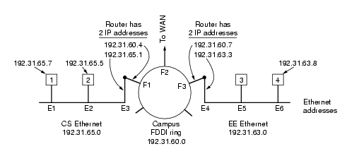
ARP Example
Routers have multiple network
Interface cards/devices. Each interface
has a different MAC/IP address.

Slide 26
ARP
Suppose host 1’s IP layer (192.31.65.7) gets a packet from its transport layer destined for
192.31.65.5 (host 2)?
Host 1’s IP layer broadcasts an ARP packet onto the Ethernet asking:
``Who owns IP address 192.31.65.5?''
Host 2 responds with its Ethernet address (E2).
The IP layer on host 1 builds an Ethernet frame addressed to E2, puts the IP packet
in the payload field, and transmits it on the Ethernet.
The Ethernet board of host 2 detects this frame and causes an interrupt, to deliver the packet to
the IP layer on host 2.
Thus, the packet is transmitted from host 1’s IP layer to host 2’s IP layer

Slide 27
ARP
The performance of ARP can be improved by caching the broadcast results.
Host 1 can include its own IP to Ethernet mapping in the ARP packet.

Slide 28
ARP
Suppose host 1’s IP layer (192.31.65.7) gets a packet from its transport layer with
destination address set to 192.31.63.8 (host 4)?
Host 1’s IP layer broadcasts an ARP packet onto the Ethernet asking:
``Who owns IP address 192.31.63.8?''
Router E3/F1 responds with its Ethernet address (E3).
The IP layer on host 1 transmits an Ethernet frame addressed to E3
The E3 Ethernet board of router F1 receives the frame and delivers it to the IP layer on F1
F1’s IP layer knows from the destination address of 192.31.63.8 in the packet that it has to
be next sent to 192.31.60.7.
F1’s IP layer sends an ARP on the FDDI ring for IP address 192.31.60.7.
Router E4/F3 replies.
F1’s IP layer transmits an FDDI frame (containing the packet) addressed to F3
The FDDI board of F3 receives the frame, and delivers it to the IP layer.
F3 knows from the destination address of 192.31.63.8 in the packet that it has to
be next sent out to 192.31.63.8 through the interface E4
F3 does an ARP on the EE Ethernet for IP address 192.31.63.8
Host 4 responds with E6
F3 transmits the packet inside an Ethernet frame addressed to E6, and it reaches host 4’s IP layer

