Slide 1

N8N TUTORIAL
Build Your First No-Code Automation Workflow, Step by Step
Based on the article by Rizwanhoda for Towards AI

Slide 2
What Is n8n?
› A visual, no-code workflow automation platform (pronounced ‘n-eight-n’)
› Connect apps and services by linking nodes on a canvas, no code required
› Free and open-source when you self-host it on your own machine

Slide 3
Why It Matters for Beginners
› No coding background needed: drag, drop, and connect nodes
› Scales from a two-step automation to a full backend workflow
› Tasks that used to take hours by hand now run in one click

Slide 4
Installing n8n: Two Paths
› Local (self-hosted): needs Node.js first, then full control and privacy
› n8n Cloud: sign up and start building in minutes, zero setup
› This tutorial uses the cloud version for every screenshot ahead
$ npm install -g n8n $ n8n start # then open http://localhost:5678 $ npm update -g n8n # to upgrade later

Slide 5
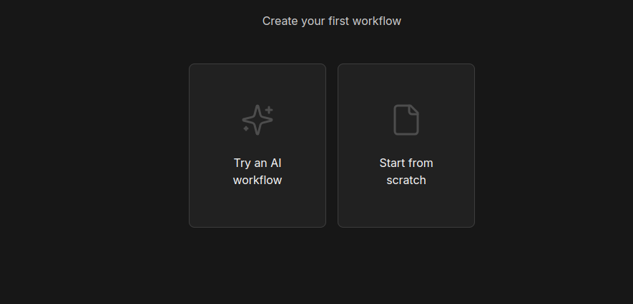
The Cloud Editor
After signing up and answering a few setup questions, click “Start Automating”. You land on a blank canvas with one node already placed, ready to build.

Slide 6
What We're Building
› 1. Form Trigger → 2. Google Sheets → 3. Switch
› 4. Gmail → 5. Duplicate Gmail → 6. Merge → 7. Test
› Form submission → data saved → the right email sent, automatically

Slide 7
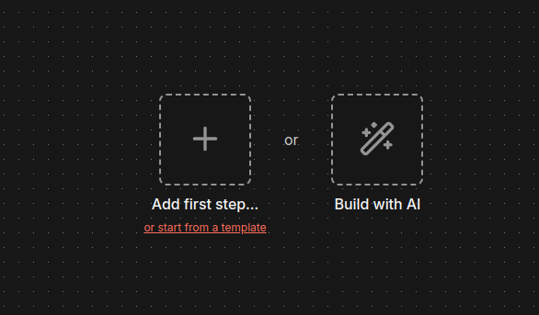
Step 1a
Start the Workflow
Click “Start from Scratch”, then “Add First Step” to open the node search panel and begin the flow.

Slide 8
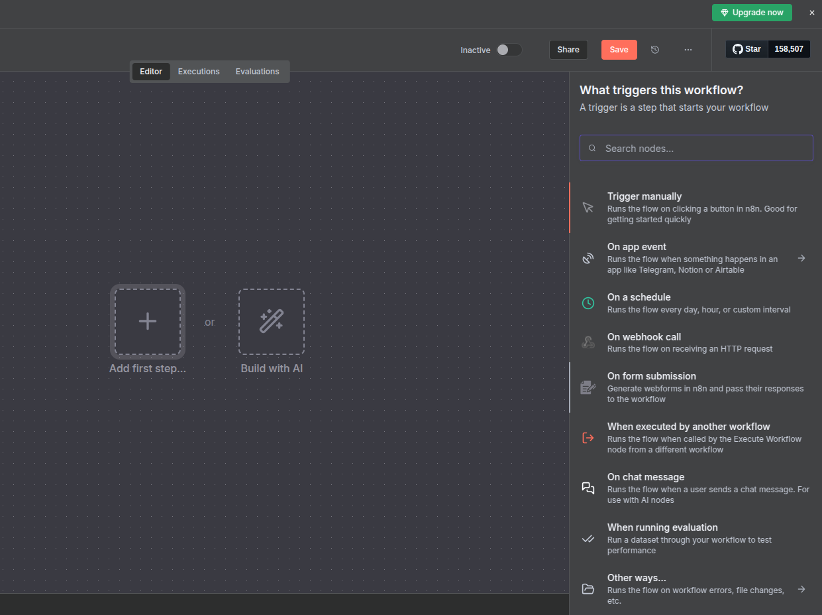
Step 1b
Add the Form Trigger
Search “On Submission of Form” in the panel and select it as the trigger for this workflow.

Slide 9
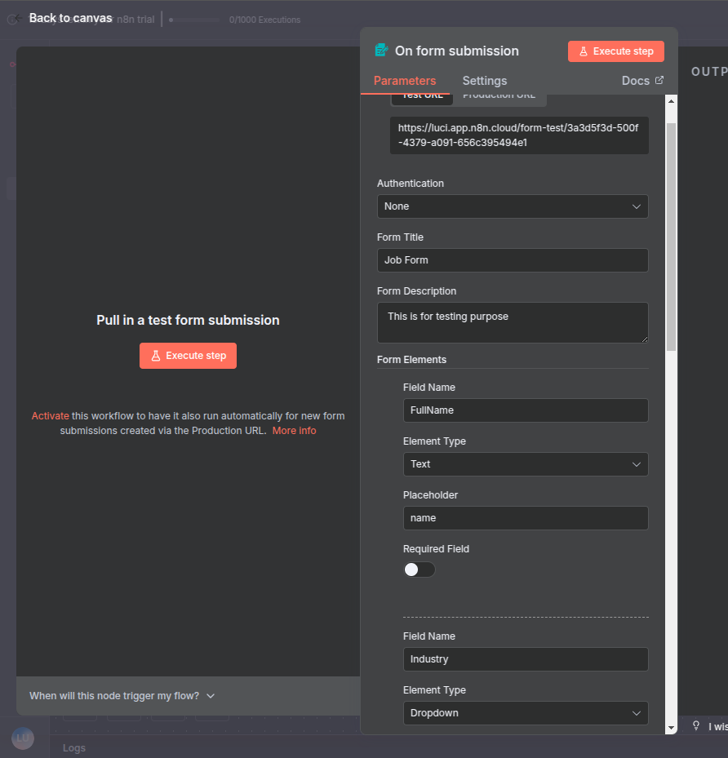
Step 1c
Define the Form Fields
Add the fields to collect from the user, for example Full Name, Industry, Qualification, and Job Title.

Slide 10
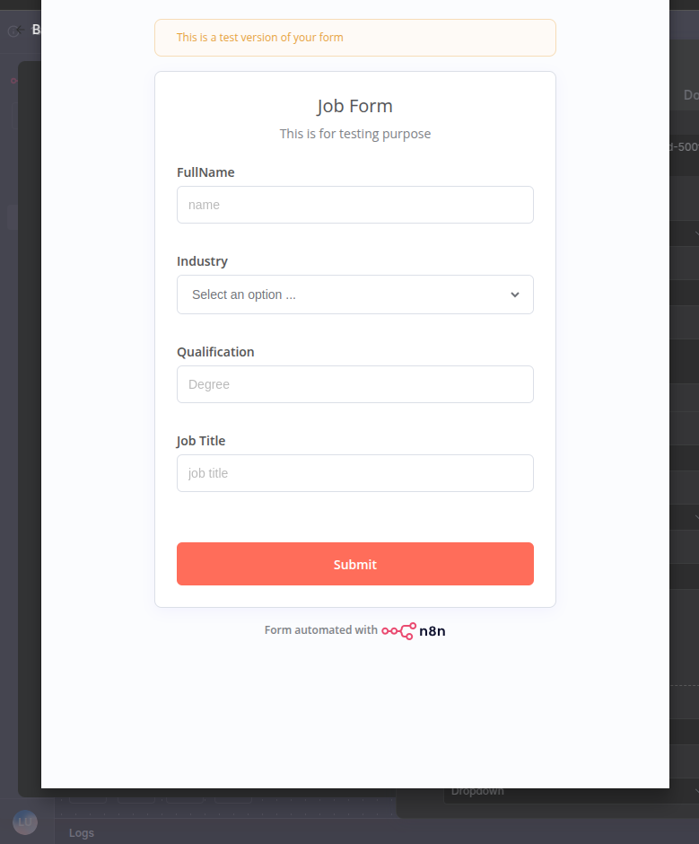
Step 1d
Run It, See the Form
Executing this step generates a live, working form based on the fields you just defined.

Slide 11
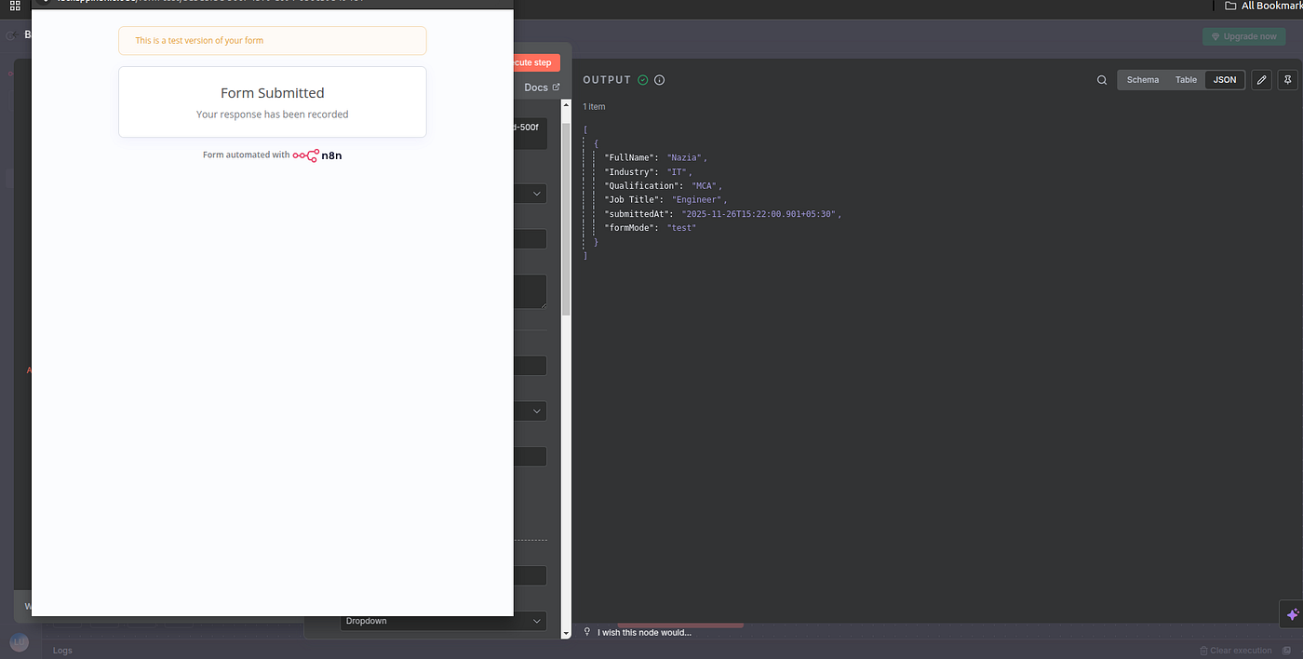
Step 1e
Inspect the Output
Submitted data appears as JSON in the output panel. Switch to Table or Schema view to explore it differently.

Slide 12
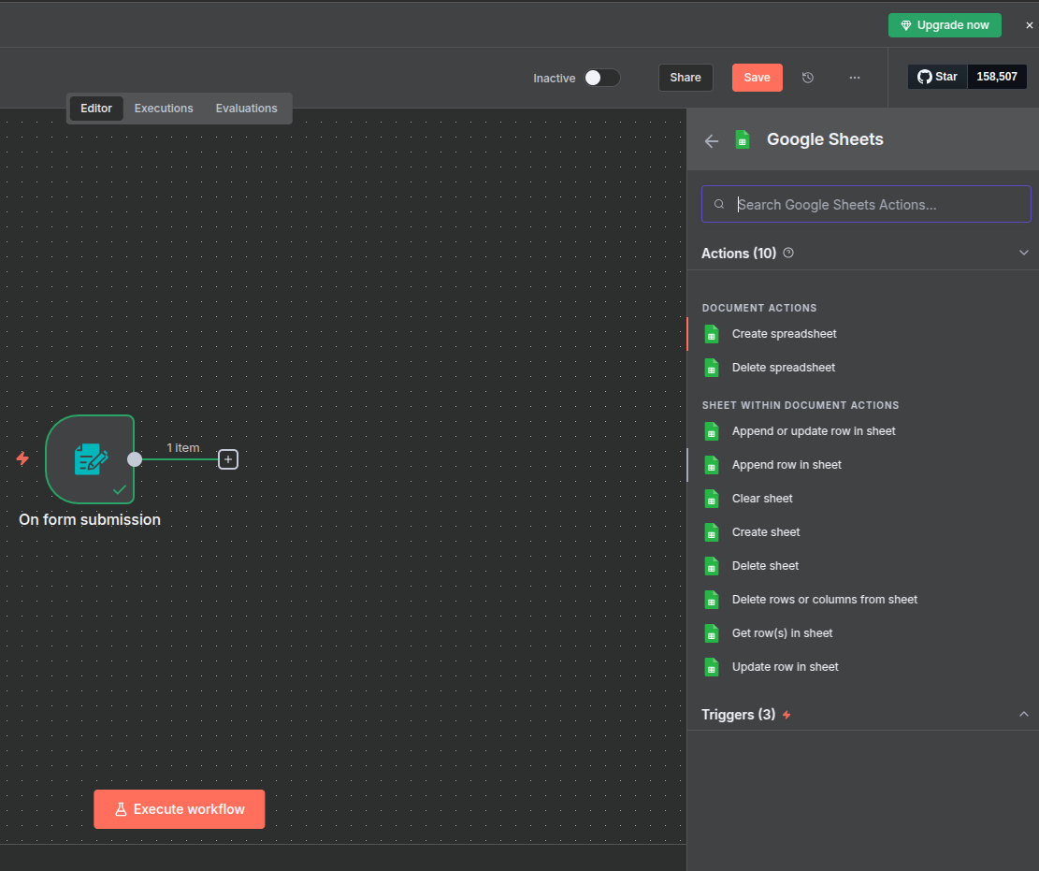
Step 2a
Add a Google Sheets Node
Search “Google Sheets” and choose the “Append Row” action, so every submission becomes a new row.

Slide 13
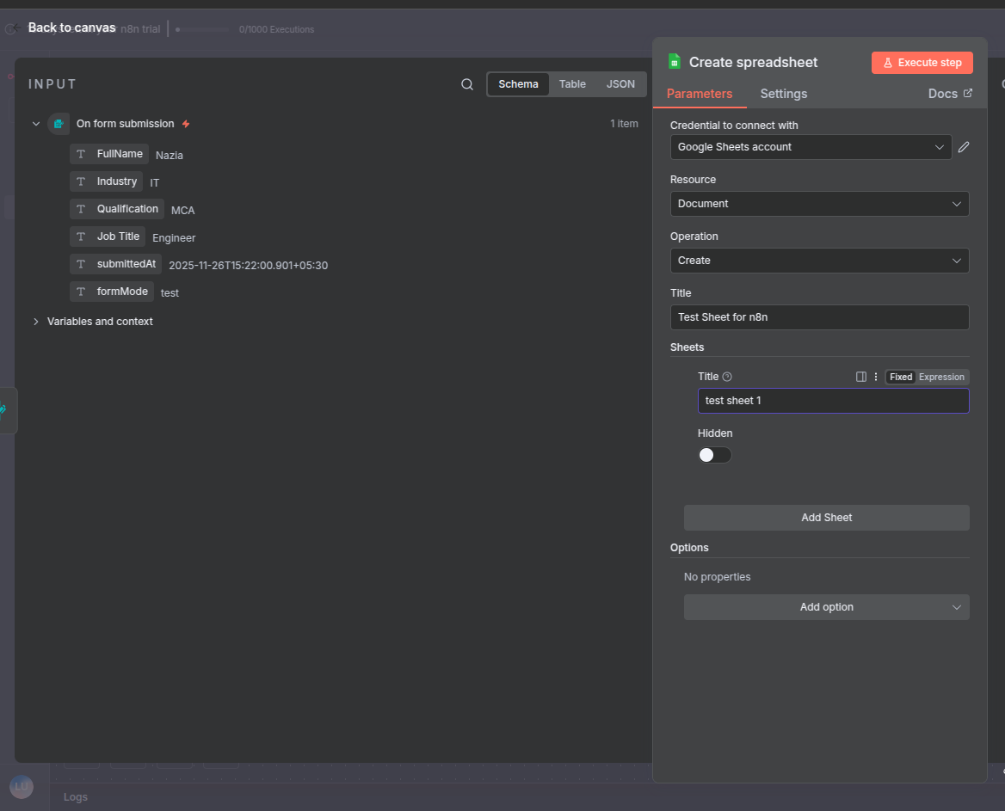
Step 2b
Point It at a Sheet
Set Resource to Document, pick the target spreadsheet, and connect your Google account under Credentials.

Slide 14
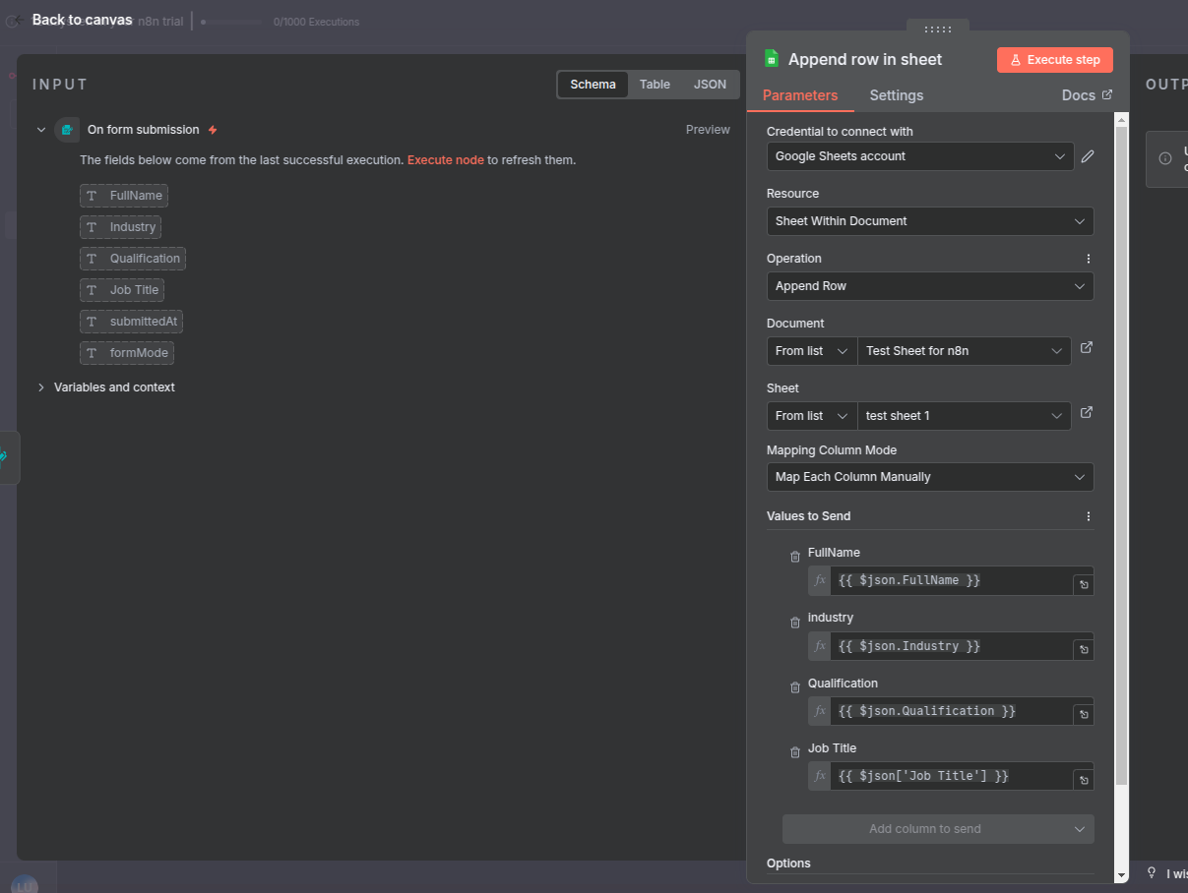
Step 2c
Map the Columns
Set Resource to Sheet, then drag each form field onto its matching column before executing.

Slide 15
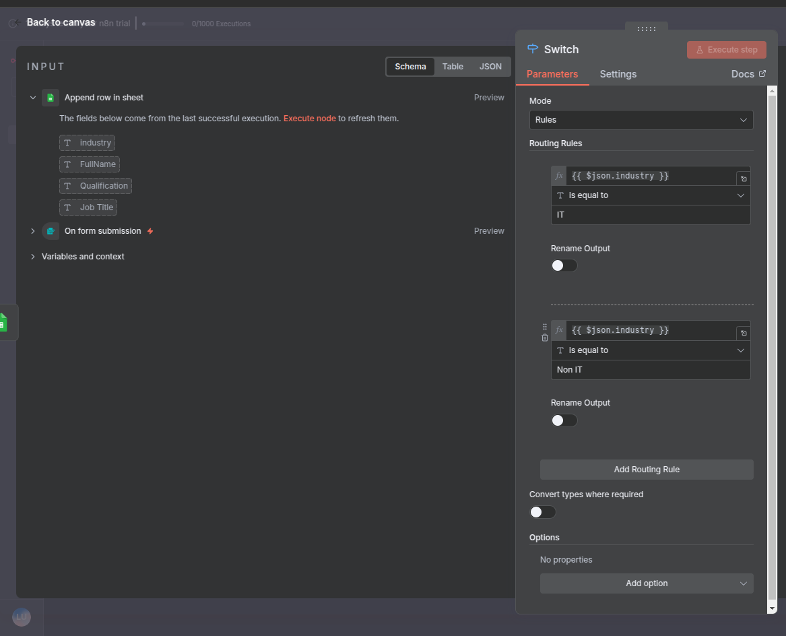
Step 3
Add a Switch Node
Add a Switch node and set routing rules so the flow branches based on a field value, like the selected option.

Slide 16
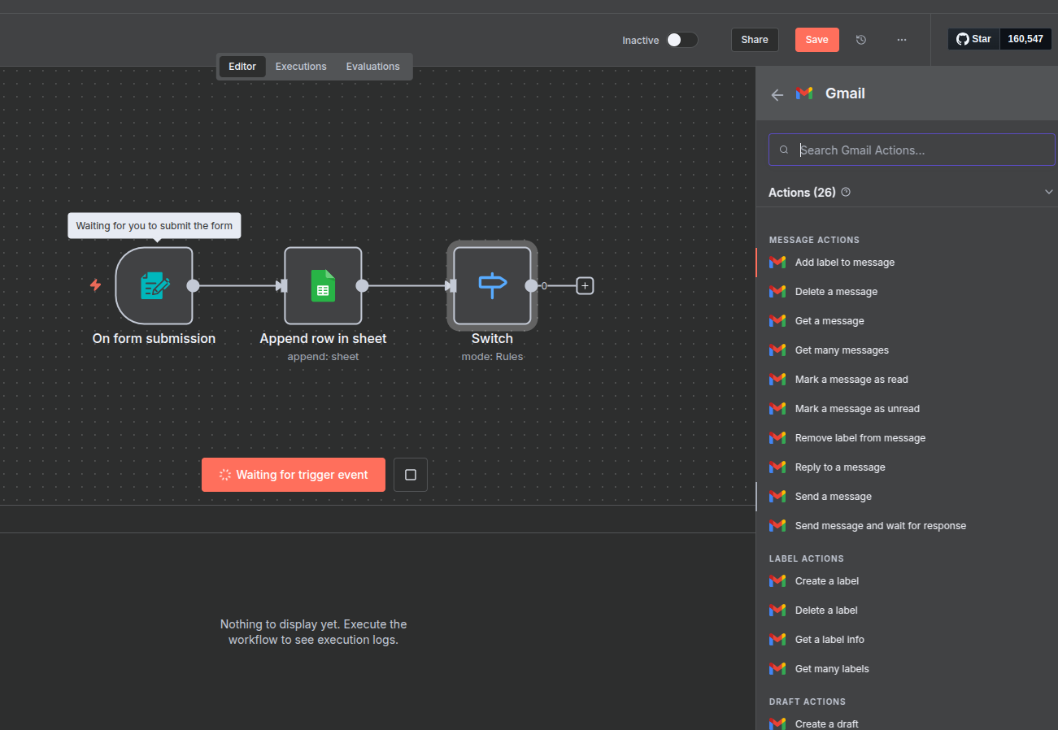
Step 4a
Add Gmail, Connect the Account
Search “Gmail”, choose “Send Message”, and authorize it via the pencil icon under Credentials.

Slide 17
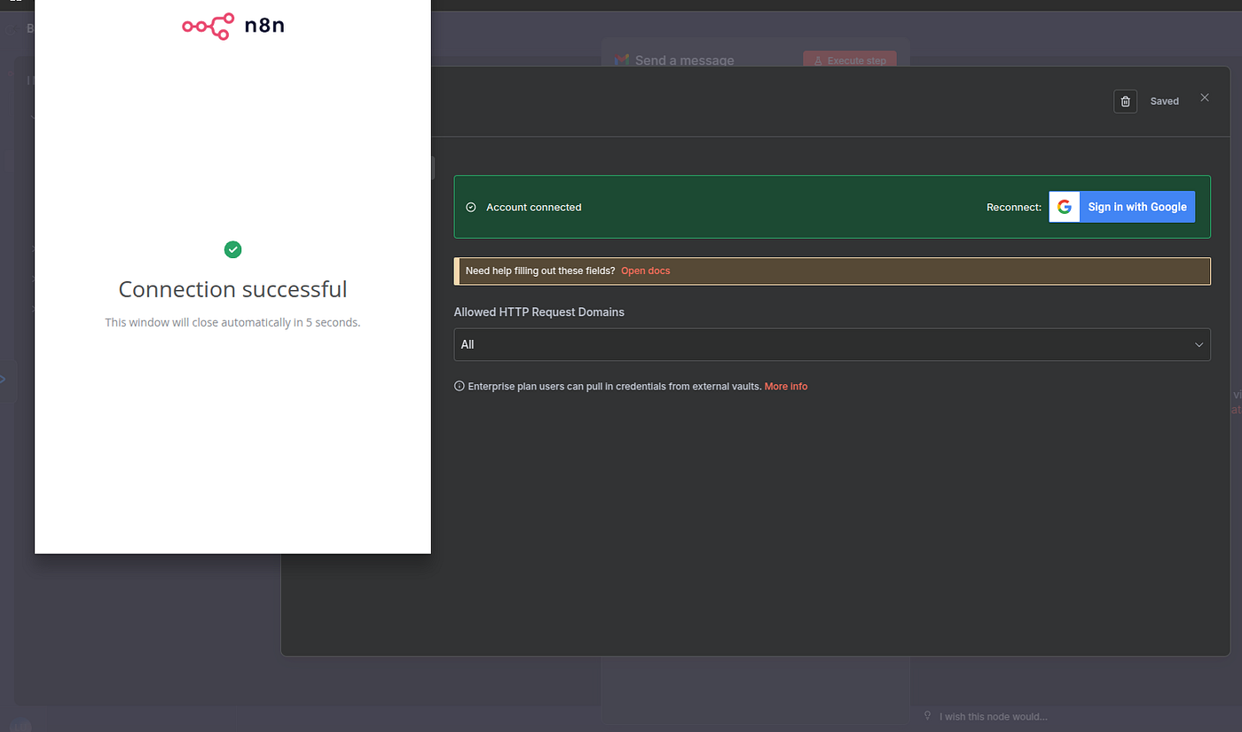
Step 4b
Write the Message
Set Resource to Message, enter the recipient's address, and write the email content to send.

Slide 18
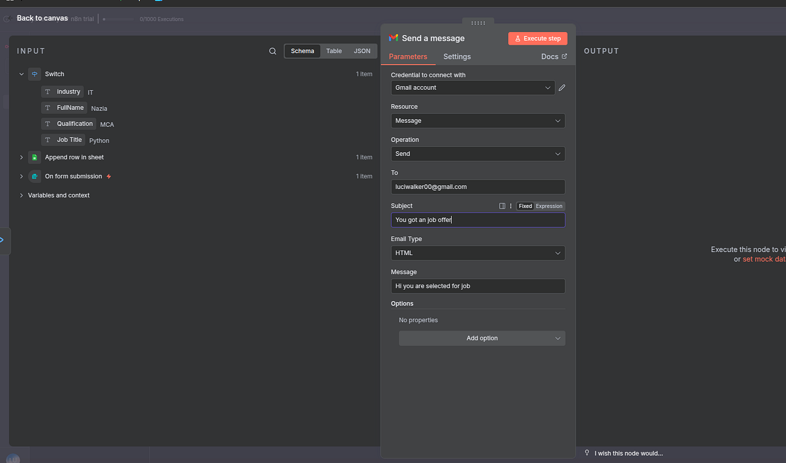
Step 4c
Send It
Execute the node and check the inbox. The email sent through the automation should be waiting there.

Slide 19
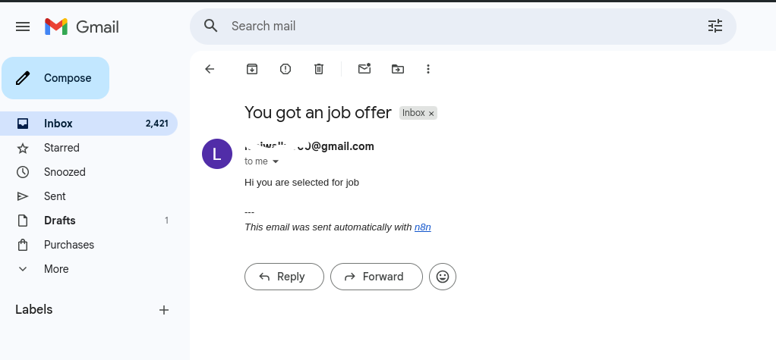
Step 4d
Configure the Second Branch
Return to the other Gmail node the Switch can route to, and fill in its message details as well.

Slide 20
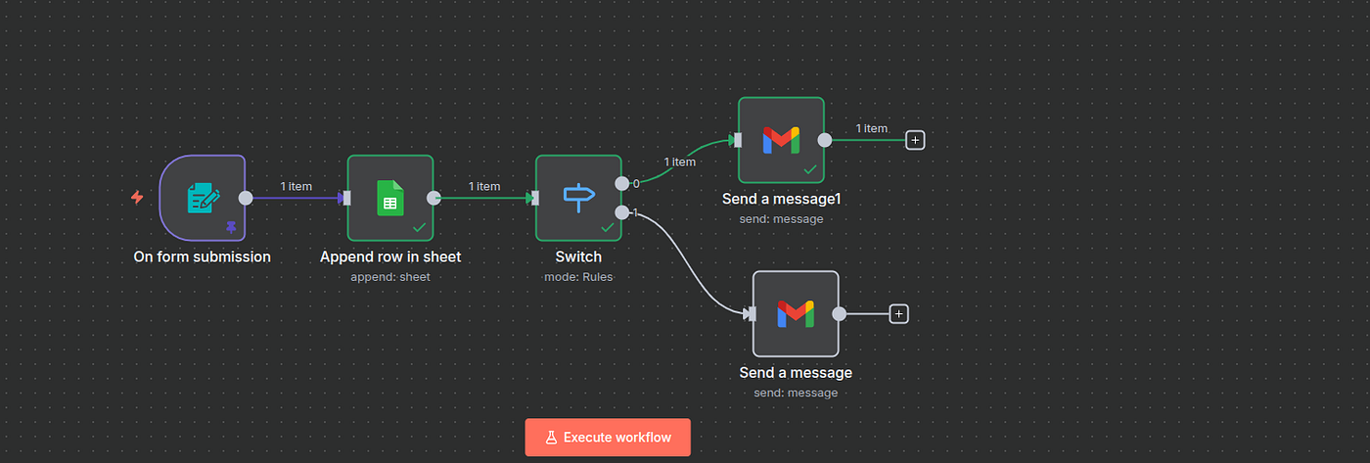
Step 5
Duplicate for a Second Response
Right-click the Gmail node, choose Duplicate, and change the message text to reflect the other outcome.

Slide 21
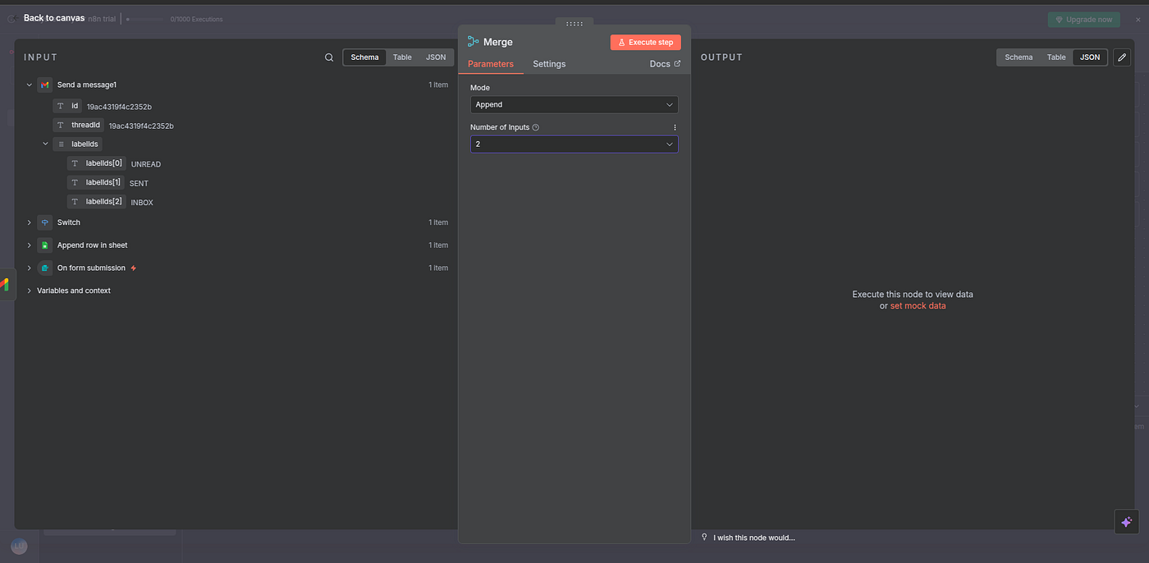
Step 6a
Add a Merge Node
Click the + icon on a Gmail node, search “Merge”, and add it to combine both branches into one path.

Slide 22
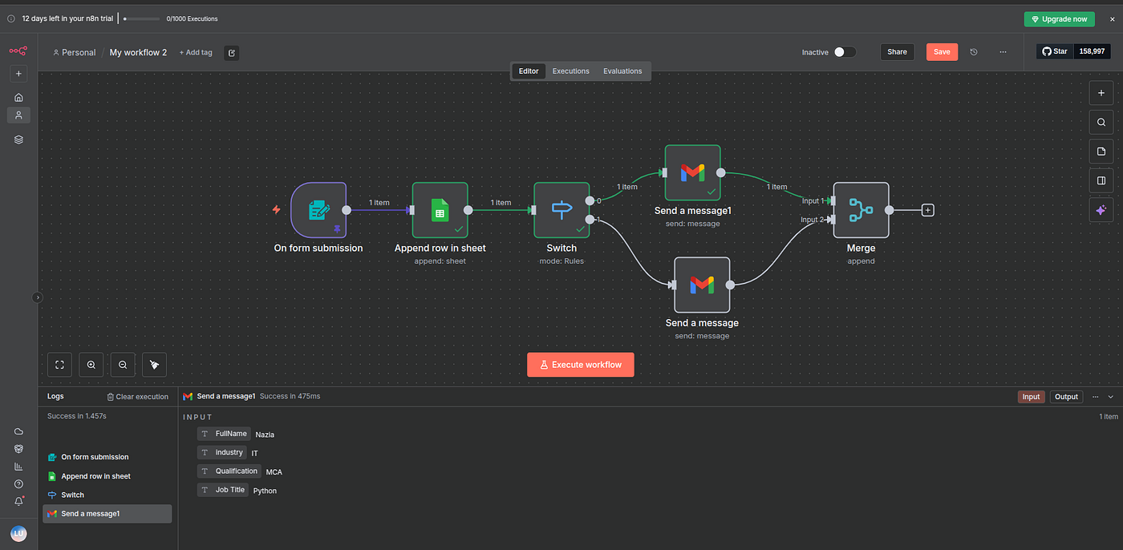
Step 6b
Connect Both Branches
Drag both Gmail outputs into the Merge node. Form submission, sheet update, and the right email are now one flow.

Slide 23
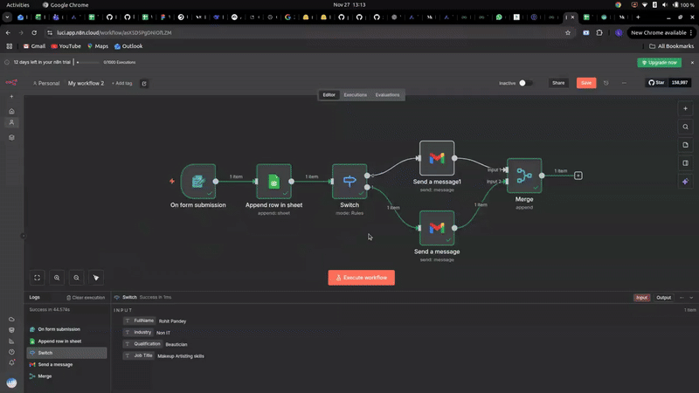
Step 7
Test End to End
Resubmit the form and confirm two things: the row lands in Google Sheets, and the correct email arrives in the inbox.

Slide 24
Conclusion
› One trigger, seven nodes, zero code: a complete, working automation
› The same pattern (trigger, act, branch, notify) fits almost any repetitive task
› Next: try automating something from your own daily work

Slide 25
Source
n8n Tutorial for Beginners: Build Your First No-Code Automation Workflow Step by Step by Rizwanhoda, published on Towards AI (Medium)
pub.towardsai.net

