Slide 1
Alzheimer's Disease Classification
from Brain MRI
Capstone Project — Medical Image Processing
Deep Learning · CNN · TensorFlow / Keras ·
- By Harsha Lakkireddy

Slide 2
Agenda
1
Problem Statement & Motivation
2
Dataset Overview
3
Handling Class Imbalance
4
Tools & Libraries
5
Data Pipeline & Augmentation
6
Model Architecture
7
Training Configuration
8
Results & Metrics
9
The Bug We Found & Fixed
10
Limitations
11
Future Work
12
Conclusion
Alzheimer's MRI Classification

Slide 3
Problem Statement
Alzheimer's disease is usually found late — after real brain damage has already happened. Early signs are hard to see by eye in a routine scan.
Goal
Build a CNN that reads a brain MRI scan and classifies it into one of four stages, to support faster, more consistent early screening — not to replace a doctor's diagnosis.
NonDemented
VeryMildDemented
MildDemented
ModerateDemented
No signs of the disease
Very early signs
Mild signs
Moderate signs
Alzheimer's MRI Classification

Slide 4
Dataset Overview
Alzheimer's Dataset (4 class of Images) — Kaggle
Class | Images | Share
NonDemented | 3,200 | 50%
VeryMildDemented | 2,240 | 35%
MildDemented | 896 | 14%
ModerateDemented | 64 | 1%
Data Split Used
80% training data → of which 85% train / 15% validation 20% held-out test data (never seen during training)
Total: 6,400 images across 4 classes
Alzheimer's MRI Classification

Slide 5
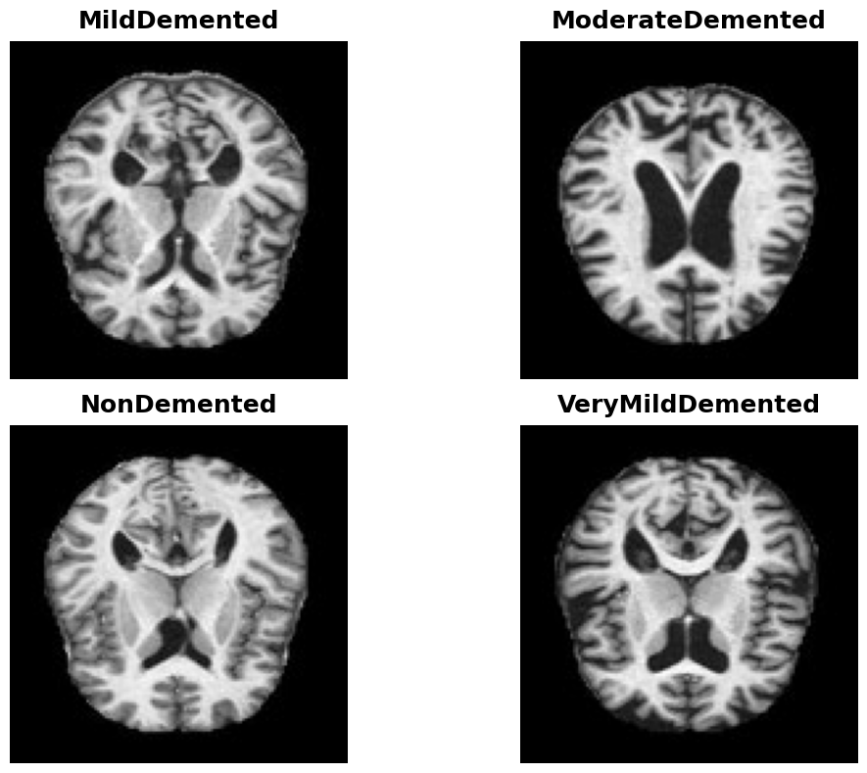
Sample MRI Scans
One example image per class
Alzheimer's MRI Classification

Slide 6
Handling Class Imbalance
The Problem
The Solution: Class Weights
ModerateDemented has only 64 images — 50x fewer than NonDemented (3,200). Left as-is, the model would learn to mostly ignore the rare class, since predicting the majority class already looks 'accurate' on paper.
scikit-learn's compute_class_weight('balanced', ...) gives each class a weight inverse to its size. During training, mistakes on rare classes (like ModerateDemented) are penalized more heavily, pushing the model to actually learn their patterns instead of ignoring them.
Data augmentation (rotation, zoom, horizontal flip) is also applied to training images, which further helps the model generalize with limited examples.
Alzheimer's MRI Classification

Slide 7
Tools & Libraries
Python
TensorFlow / Keras
Main programming language
Build and train the CNN
OpenCV (cv2)
NumPy
Read and resize MRI images
Array and number operations
Matplotlib
scikit-learn
Charts: accuracy, loss, confusion matrix
Data split, class weights, metrics
Alzheimer's MRI Classification

Slide 8
Project Pipeline
1
2
3
4
5
6
Load &
Split Data
Resize &
Augment
→
Class
Weighting
→
Train
CNN
→
Evaluate
on Test Set
→
Save
Model
→
The dataset must be separated into training and test data before the image data generators are created.
Training data is used to learn CNN parameters; test data is reserved for final evaluation.
The first run created the data loaders before the train/test split folders existed.
As a result, the training pipeline operated on the wrong data and produced an initial test accuracy of 52.15%.
The issue was identified as a data-pipeline ordering problem rather than evidence that the CNN architecture itself was ineffective.
Training images are randomly rotated (±10°), zoomed (10%), and horizontally flipped on the fly. This teaches the model general shape patterns instead of memorizing exact pixel positions — important with a modest dataset size, especially for the rare ModerateDemented class.
A standard image-classification pipeline, from raw MRI scans to a saved, reusable model.

Slide 9
Model Architecture — CNN
Input
150 × 150 × 3 image
At a Glance
Conv2D
32 filters, 3×3, ReLU + MaxPooling
3 conv blocks 4 output classes 30% dropout rate
Conv2D
64 filters, 3×3, ReLU + MaxPooling
Conv2D
128 filters, 3×3, ReLU + MaxPooling
Flatten
Convert feature maps to a 1D vector
Dropout
30% — randomly drops units to reduce overfitting
Dense
128 units, ReLU
Output
Dense, 4 units, Softmax → class probabilities
Alzheimer's MRI Classification

Slide 10
Training Configuration
Optimizer
Loss Function
Batch Size
Adam
Categorical Cross-Entropy
32
Adapts the learning rate automatically as training goes
Standard choice for multi-class classification
Number of images processed together per training step
Max Epochs
Early Stopping
Class Weights
20
Patience = 5
Balanced
Upper limit on training rounds
Stops training if validation loss doesn't improve for 5 rounds, and restores the best weights
Rare classes (like ModerateDemented) get more weight in the loss
Alzheimer's MRI Classification

Slide 11
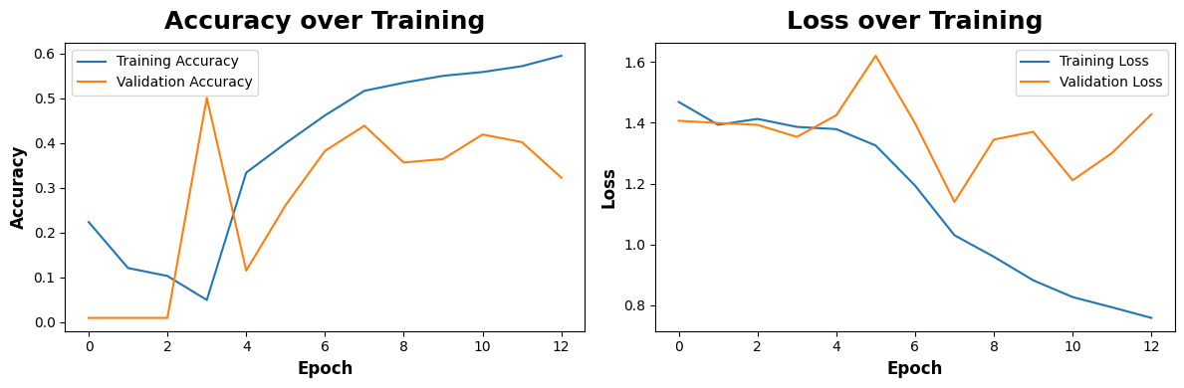
Training Progress
13 epochs (early stopping triggered)
Validation accuracy is noisy epoch-to-epoch (small validation set: 766 images) but the overall trend climbs alongside training accuracy — a sign of genuine learning, not memorization.
Alzheimer's MRI Classification

Slide 12
Results Overview
52.15%
1.0026
15×
Test Accuracy
Test Loss
Improvement over the buggy
first run (3.43% → 52.15%)
Class | Precision | Recall | F1-score | Support
MildDemented | 0.31 | 0.59 | 0.40 | 180
ModerateDemented | 0.38 | 0.23 | 0.29 | 13
NonDemented | 0.75 | 0.56 | 0.64 | 640
VeryMildDemented | 0.45 | 0.45 | 0.45 | 448
Alzheimer's MRI Classification

Slide 13
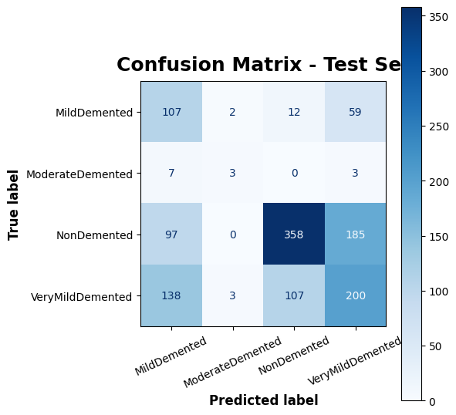
Confusion Matrix
Rows = true class, Columns = predicted class
Alzheimer's MRI Classification

Slide 14
Reading the Results in Plain Words
Strongest class
NonDemented (75% precision)
When the model says 'no signs', it is usually right.
Weakest class
ModerateDemented (23% recall)
Only 64 training images total — not enough examples to learn from.
Most confusion
MildDemented ↔ VeryMildDemented
Early-stage brain changes look visually similar, even to the model.
Overall
52.15% test accuracy
A solid proof of concept for a from-scratch CNN — not yet clinical-grade.
Alzheimer's MRI Classification

Slide 15
The Bug We Found & Fixed
Before
After
3.43%
52.15%
test accuracy — no better than random guessing across 4 classes
test accuracy — a real, working result
Cause: the train/validation data generators were built before the code that creates the train/test folders had run. The model trained on empty or mismatched data.
Fix: reordered the code (in train_model.py) so the train/test split always runs first, before the data generators are built. Confirmed by re-running the notebook end-to-end.
Alzheimer's MRI Classification

Slide 16
Limitations
!
Screening/support tool only — not a medical diagnosis tool.
!
ModerateDemented predictions are unreliable (only 23% recall) due to very few training images (64 total).
!
52.15% accuracy is a proof of concept, not yet clinical-grade.
!
Trained and tested on one dataset — unknown how well it generalizes to scans from other hospitals or scanners.
!
Small validation set (766 images) makes epoch-to-epoch validation metrics noisy.
Alzheimer's MRI Classification

Slide 17
Future Improvements
Collect more ModerateDemented images
Try transfer learning (e.g. InceptionV3)
or use targeted augmentation for just that class
needs far fewer images to reach good accuracy
Add Grad-CAM explainability
Test on scans from other hospitals/scanners
shows doctors which part of the scan drove a prediction
checks how well the model generalizes
Train longer with a learning-rate schedule
validation accuracy was still moving when training stopped
Alzheimer's MRI Classification

Slide 18
Conclusion
This project delivers a complete pipeline for classifying Alzheimer's disease stages from brain MRI scans — from raw images to a trained, saved model that predicts on new scans.
After fixing a data-pipeline ordering bug, the model reached 52.15% test accuracy across 4 classes, with especially strong performance on NonDemented scans.
Key Takeaway
Data pipeline order matters as much as model design. The same CNN silently scored 3% and later 52% (real learning) purely based on a code-ordering fix — always verify your data loaders are actually pointing at real, non-empty data.
Alzheimer's MRI Classification

Slide 19
Thank You
Questions & Discussion

