Slide 1
Transformation Tools

Slide 2
Transformation Tools
Def: A transformation tool converts programs between different forms of representations, usually between text and graphics.
For example,
Transforming code to visual form and vice versa
Because of the impact that visual representations can have on comprehension, use of a transformation tool can help the maintainer view and understand the system in a way that would not be possible with only source code.

Slide 3
Loguru
Loguru is a library which aims to bring enjoyable logging in Python.
Github link: https://github.com/Delgan/loguru
Command to install: pip install loguru
Notes:
from itertools import combinations
def division(num1: int, num2: int):
return num1 / num2
def divide_numbers(num_list: list):
for comb in combinations(num_list, 2):
num1, num2 = comb
print(f"{num1} divided by {num2}.")
res = division(num1, num2)
print(f"{num1} divided by {num2} is equal to {res}.")
if __name__ == '__main__':
num_list = [ 2, 1, 0]
divide_numbers(num_list)

Slide 4
Loguru Example
from itertools import combinations
def division(num1: int, num2: int):
return num1 / num2
def divide_numbers(num_list: list):
for comb in combinations(num_list, 2):
num1, num2 = comb
print(f"{num1} divided by {num2}.")
res = division(num1, num2)
print(f"{num1} divided by {num2} is equal to {res}.")
if __name__ == '__main__':
num_list = [ 2, 1, 0]
divide_numbers(num_list)

Slide 5
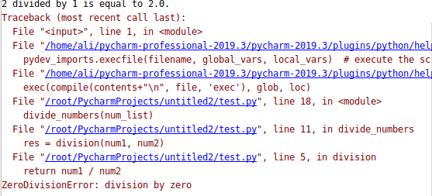

Slide 6
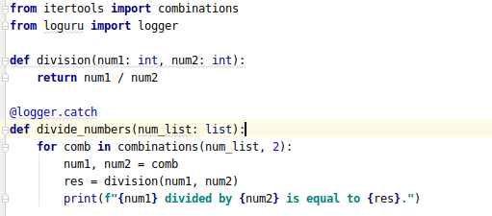

Slide 7
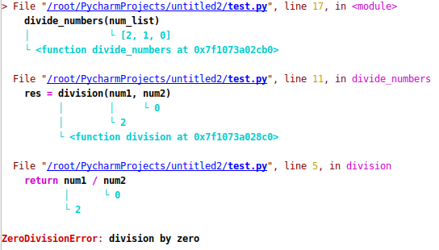

Slide 8
Snoop
snoop is a Python package that prints the lines of code being executed along with the values of each variable by adding only one decorator.
Command to install: pip install snoop
Website link: https://pypi.org/project/snoop/

Slide 9
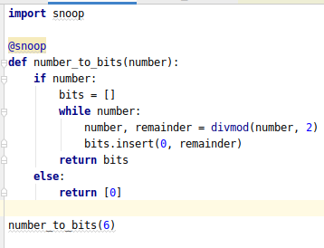

Slide 10
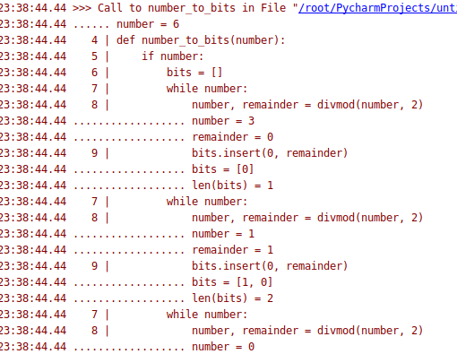

Slide 11
Heartrate
This library offers a simple real time visualisation of the execution of a Python program:
Command to install: pip install heartrate
Website link: https://github.com/alexmojaki/heartrate

Slide 12
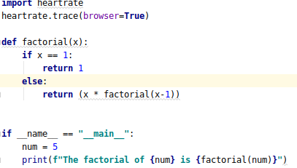

Slide 13
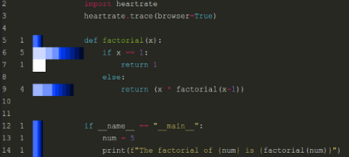

Slide 14
Pyheat
A heatmap visualization, to make the time distribution in the given program much easier and quicker.
Command to install: Pip Install py-heat
Website link: https://github.com/csurfer/pyheat

Slide 15
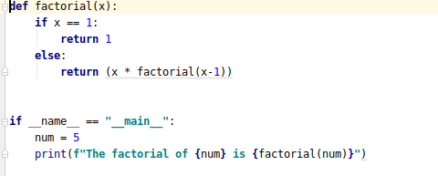

Slide 16
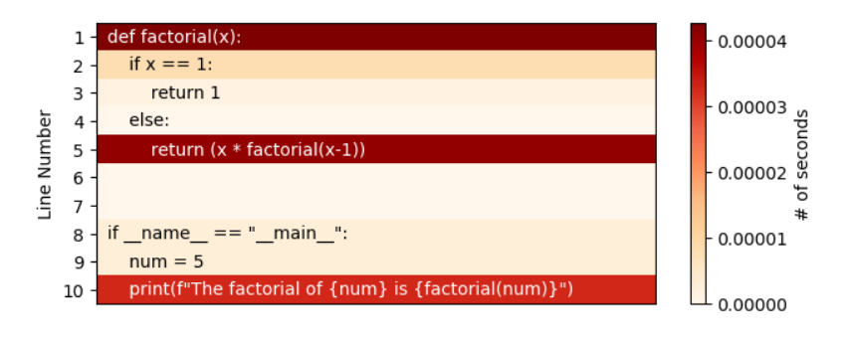

Slide 17
Viztracer
VizTracer is a tool to help you understand Python code by tracing and visualizing its execution. Without making any changes to your source code.
Command to install: pip install viztracer
Website link: https://github.com/gaogaotiantian/viztracer

Slide 18
