Slide 1
CSE230: Discrete Mathematics
Set Theory
Prepared by: Rabeeb Ibrat

Slide 2
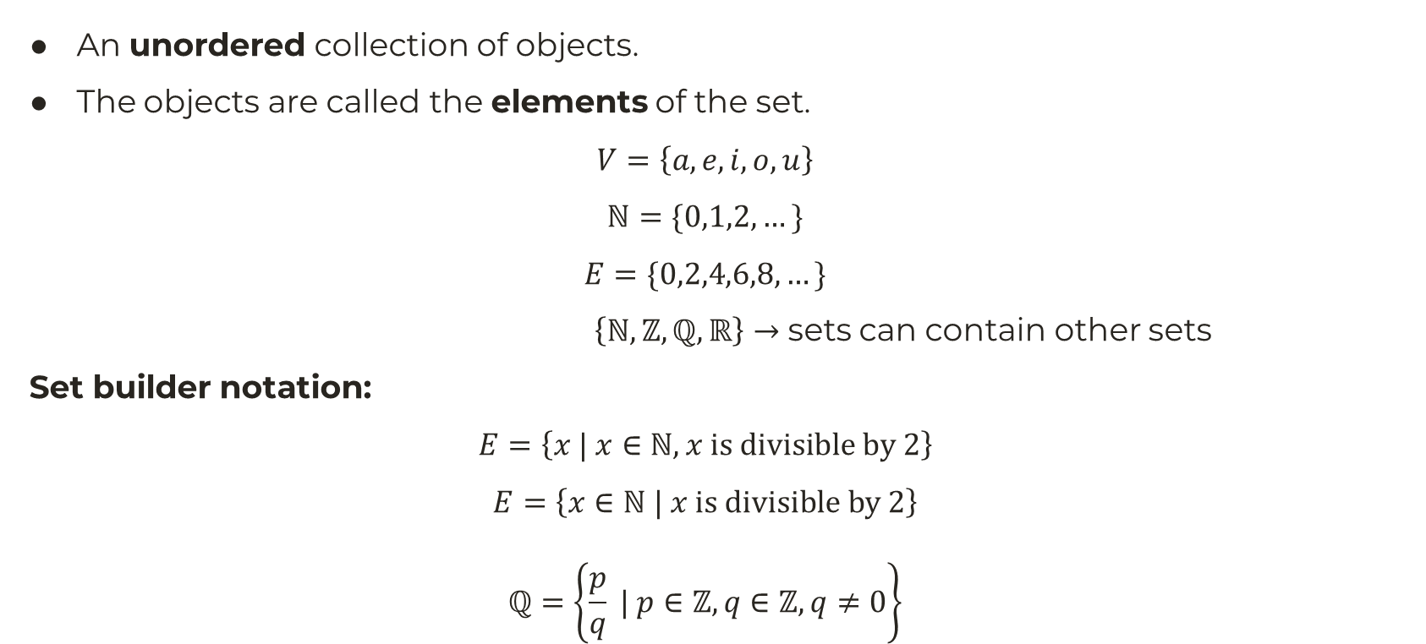
Set
An unordered collection of objects.
The objects are called the elements of the set.
$$V=\left\{a,e,i,o,u\right\}$$
$$ℕ=\{0,1,2,…\}$$
$$E=\{0,2,4,6,8,…\}$$
$\left\{ℕ, ℤ,ℚ,ℝ\right\}→$ sets can contain other sets
Set builder notation:
$$E=\left\{x | x∈ℕ,x is divisible by 2\right\}$$
$$E=\left\{x∈ℕ | x is divisible by 2\right\}$$
$$ℚ=\left\{\frac{p}{q} | p∈ℤ,q∈ℤ, q≠0\right\}$$

Slide 3
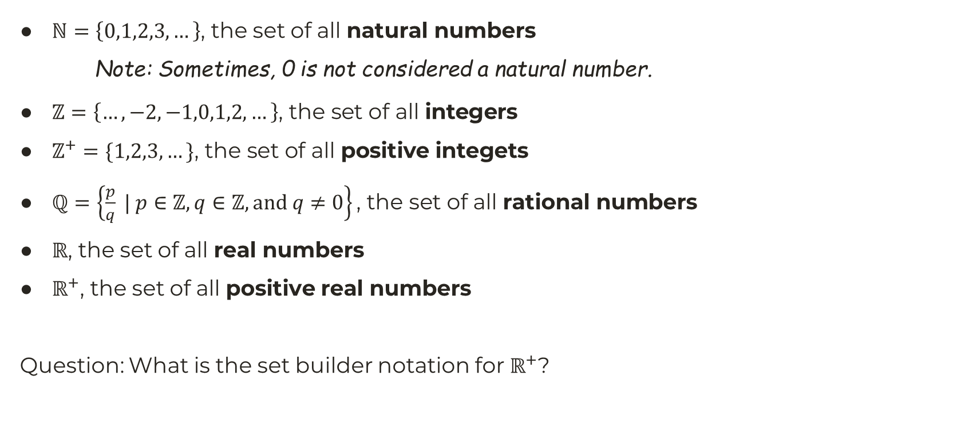
Some Common Sets
$ℕ=\left\{0,1,2,3,…\right\}$, the set of all natural numbers
Note: Sometimes, 0 is not considered a natural number.
$ℤ=\left\{…,−2,−1,0,1,2,…\right\}\text{, }\text{the} \text{set} \text{of} \text{all} \text{integers}$
$ℤ^{+}=\{1,2,3,…\}\text{, }\text{the} \text{set} \text{of} \text{all} \text{positive} \text{integets}$
$ℚ=\left\{\frac{p}{q} | p∈ℤ,q∈ℤ, and q≠0\right\}\text{, }\text{the} \text{set} \text{of} \text{all} \text{rational} \text{numbers}$
$ℝ$, the set of all real numbers
$ℝ^{+}$, the set of all positive real numbers
Question: What is the set builder notation for $ℝ^{+}$?

Slide 4
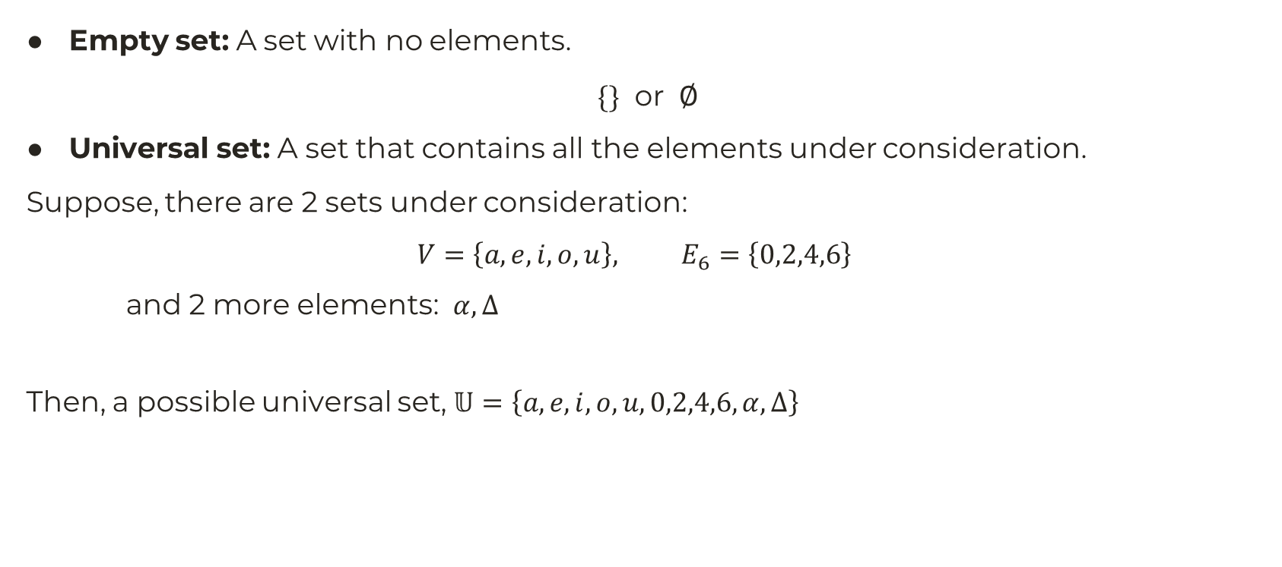
Common Types of Sets
Empty set: A set with no elements.
$\{\}$ or $∅$
Universal set: A set that contains all the elements under consideration.
Suppose, there are 2 sets under consideration:
$$V=\left\{a,e,i,o,u\right\}, E_{6}=\left\{0,2,4,6\right\}$$
and 2 more elements: $α,Δ$
Then, a possible universal set, $𝕌=\left\{a,e,i,o,u,0,2,4,6,α, Δ\right\}$

Slide 5

Intervals are Sets
$\left[0,1\right] =\left\{x∈ℝ | 0≤x≤1\right\}$
$\left(a,b\right)=\left\{x∈ℝ | a<x<b\right\}$
$\left[2,4\right)=\left\{x∈ℝ | 2≤x<4\right\}$
Question: What is a set builder notation for $(a,b]$?

Slide 6

Equality of Sets
Two sets are equal if they have the same elements.
$$\left\{2,3,5\right\}=\left\{5,3,2\right\}=\left\{2,5,3,5\right\}$$
whereas,
$$\left\{1,2,7\right\}≠\{3,5,7\}$$
Note that set equality if transitive. This means that:
If $A=B$ and $B=C$, then $A=C$.
Question: Why is set equality transitive?

Slide 7

Cardinality (or Size) of a Set
The number of distinct elements in a set.
Given any set $A$, its cardinality is represented by $\left|A\right|$.
$V=\{a,e,i,o,u\}$, $\left|V\right|=5$
$$\left|\{2,5,3,5\}\right|=3$$
$$|∅|=0$$
Sets can be infinite as well, such as $ℕ, ℝ$.
Cardinality of infinite sets is out of the scope of this course.

Slide 8
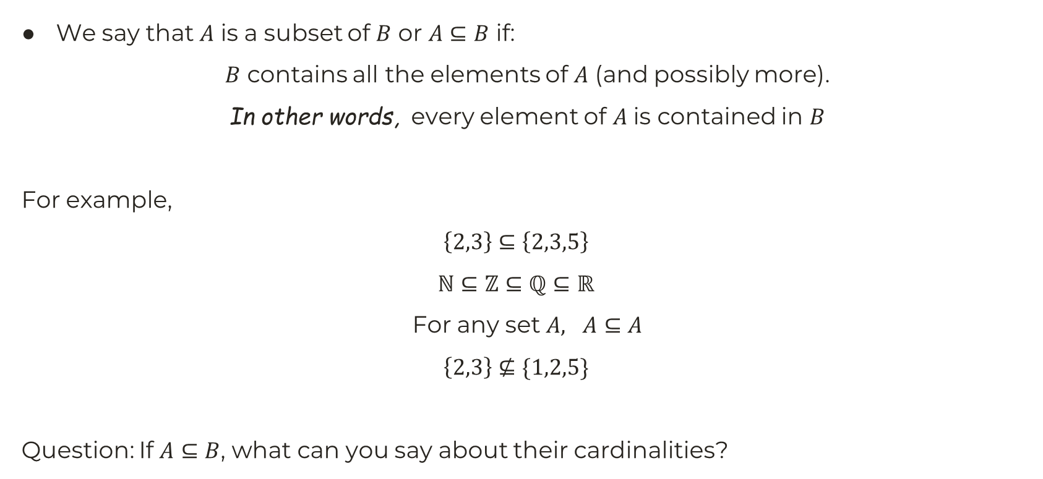
Subsets
We say that $A$ is a subset of $B$ or $A⊆B$ if:
$B$ contains all the elements of $A$ (and possibly more).
In other words, every element of $A$ is contained in $B$
For example,
$$\left\{2,3\right\}⊆\left\{2,3,5\right\}$$
$$ℕ⊆ℤ⊆ℚ⊆ℝ$$
For any set $A, A⊆A$
$$\left\{2,3\right\}⊈\{1,2,5\}$$
Question: If $A⊆B$, what can you say about their cardinalities?

Slide 9

Power Set
Given any set $A$, the power set of $A$ or $P(A)$ is:
The set of all subsets of $A$.
If $A=\left\{1,2,3\right\}$, then:
$$P\left(A\right)=\left\{∅,\left\{1\right\}, \left\{2\right\},\left\{3\right\}, \left\{1,2\right\}, \left\{2,3\right\}, \left\{1,3\right\}, \left\{1,2,3\right\}\right\}$$
$$P\left(∅\right)=∅$$
Question: If $A⊆B$, then is it always true that $P\left(A\right)⊆P(B)$?

Slide 10

Tuple
An ordered $n$-tuple (or simply $n$-tuple) is:
An ordered collection of $n$ objects.
For example,
$3$-tuple: $(2,3,5)$.
$5$-tuple: $(1,2,4,1,4)$
Two tuples are equal if they contain the same number of objects in the same order.
$$\left(2,3,5\right)≠(3,2,5)$$
$$\left(1,2,5\right)≠(1,2)$$

Slide 11
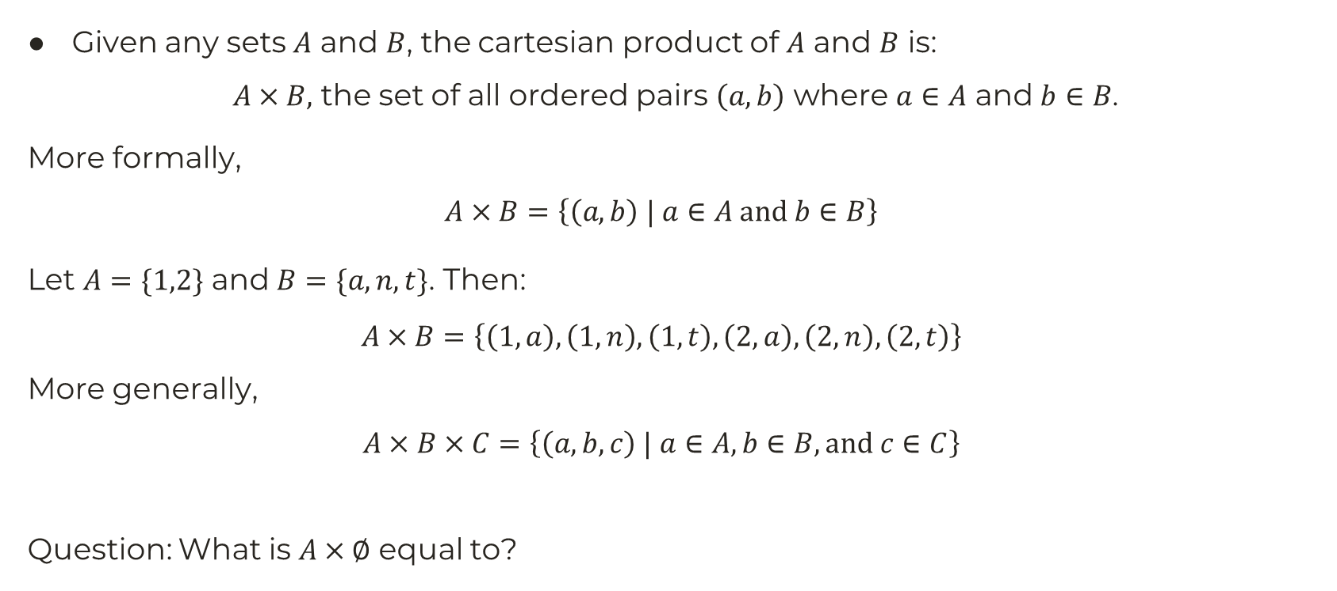
Cartesian Product
Given any sets $A$ and $B$, the cartesian product of $A$ and $B$ is:
$A×B,$ the set of all ordered pairs $\left(a,b\right)$ where $a∈A$ and $b∈B$.
More formally,
$$A×B=\left\{\left(a,b\right) | a∈A and b∈B\right\}$$
Let $A=\{1,2\}$ and $B=\{a,n,t\}$. Then:
$$A×B=\left\{\left(1,a\right),\left(1,n\right),\left(1,t\right),\left(2,a\right),\left(2,n\right), \left(2,t\right)\right\}$$
More generally,
$$A×B×C=\left\{\left(a,b,c\right) | a∈A, b∈B, and c∈C\right\}$$
Question: What is $A×∅$ equal to?

Slide 12

Union of Sets
Given any sets $A$ and $B$, the union of $A$ and $B$ is:
$A∪B,$ the set of all elements which are either in $A$, or in $B$, or both.
Let $A=\left\{1,5\right\}$ and $B=\{3,5,7\}$. Then:
$$A∪B=\left\{1,5,3,5,7\right\}=\{1,5,3,7\}$$
$E=\left\{0,2,4,6,…\right\}, O=\left\{1,3,5,7,…\right\}$. Then, $E∪O=ℕ$
Question: If $A⊆B$ then what is $A∪B$ equal to?

Slide 13

Intersection of Sets
Given any sets $A$ and $B$, the intersection of $A$ and $B$ is:
$A∩B,$ the set of all elements which are in both $A$ and $B$
Let $A=\left\{1,5\right\}$ and $B=\{3,5,7\}$. Then:
$$A∩B=\left\{5\right\}$$
$E=\left\{0,2,4,6,…\right\}, O=\left\{1,3,5,7,…\right\}$. Then, $E∩O=∅$
Question: If $A⊆B$ then what is $A∩B$ equal to?

Slide 14

Difference of Sets
Given any sets $A$ and $B$, the difference of $A$ and $B$ is:
$A\backslash B$ or $A−B$, the set of all elements which are in $A$, but not in $B$.
Let $A=\left\{1,5\right\}$ and $B=\{3,5,7\}$. Then:
$$A−B=\left\{1\right\}$$
$E=\left\{0,2,4,6,…\right\}, O=\left\{1,3,5,7,…\right\}$. Then, $ℕ−E=O$
Question: If $A⊆B$ then what is $A−B$ equal to?

Slide 15
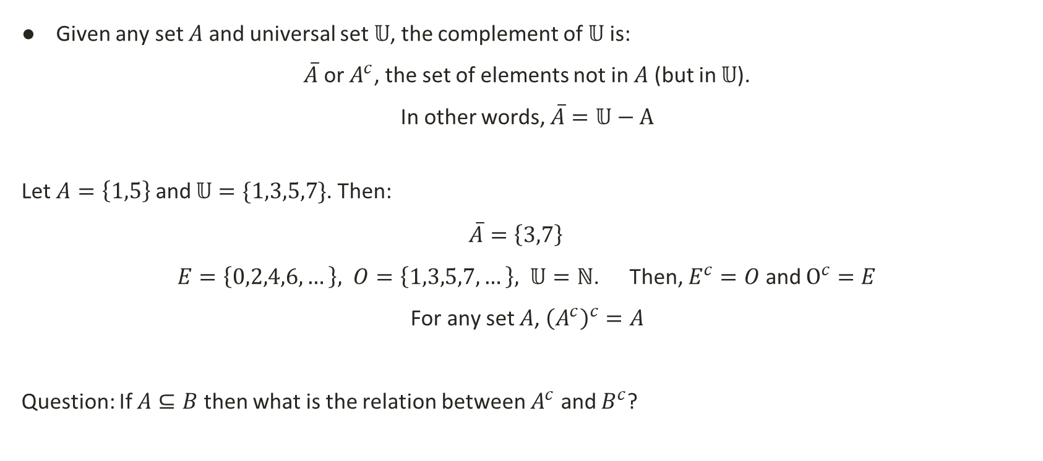
Complement of Set
Given any set $A$ and universal set $𝕌$, the complement of $𝕌$ is:
$\overline{A}$ or $A^{c}$, the set of elements not in $A$ (but in $𝕌$).
In other words, $\overline{A}=𝕌−A$
Let $A=\left\{1,5\right\}$ and $𝕌=\{1,3,5,7\}$. Then:
$$\overline{A}=\left\{3,7\right\}$$
$E=\left\{0,2,4,6,…\right\}, O=\left\{1,3,5,7,…\right\}, 𝕌=ℕ$. Then, $E^{c}=O$ and $Ο^{c}=E$
For any set $A$, ${\left(A^{c}\right)}^{c}=A$
Question: If $A⊆B$ then what is the relation between $A^{c}$ and $B^{c}$?

Slide 16

Disjoint Sets
Two sets $A$ and $B$ are disjoint if:
$A$ and $B$ have no element in common.
In other words, $A∩B=∅$
If $A=\left\{1,5\right\}$ and $B=\left\{3,7\right\}$, then $A$ and $B$ are disjoint.
$E=\left\{0,2,4,6,…\right\}, O=\left\{1,3,5,7,…\right\}$. Then, $E$ and $O$ are disjoint,
Question: Are $A$ and $A^{c}$ disjoint?

Slide 17

De Morgan’s Law
Given any sets $A$ and $B$,
${\left(A∪B\right)}^{c}=A^{c}∩B^{c}$
${\left(A∩B\right)}^{c}=A^{c}∪B^{c}$
Proof: …
For example, let $A=\{1,3,5\}$, $B=\left\{2,5\right\}$, $𝕌=\{1,2,3,4,5,6\}$.
Then ${\left(A∪B\right)}^{c}={\left\{1,3,5,2\right\}}^{c}=\left\{4,6\right\}$
Again, $A^{c}=\left\{2,4,6\right\}$, $B^{c}=\left\{1,3,4,6\right\}$. $∴A^{c}∩B^{c}=\left\{4,6\right\}$.
$∴$ Here, ${\left(A∪B\right)}^{c}=A^{c}∩B^{c}$

Slide 18
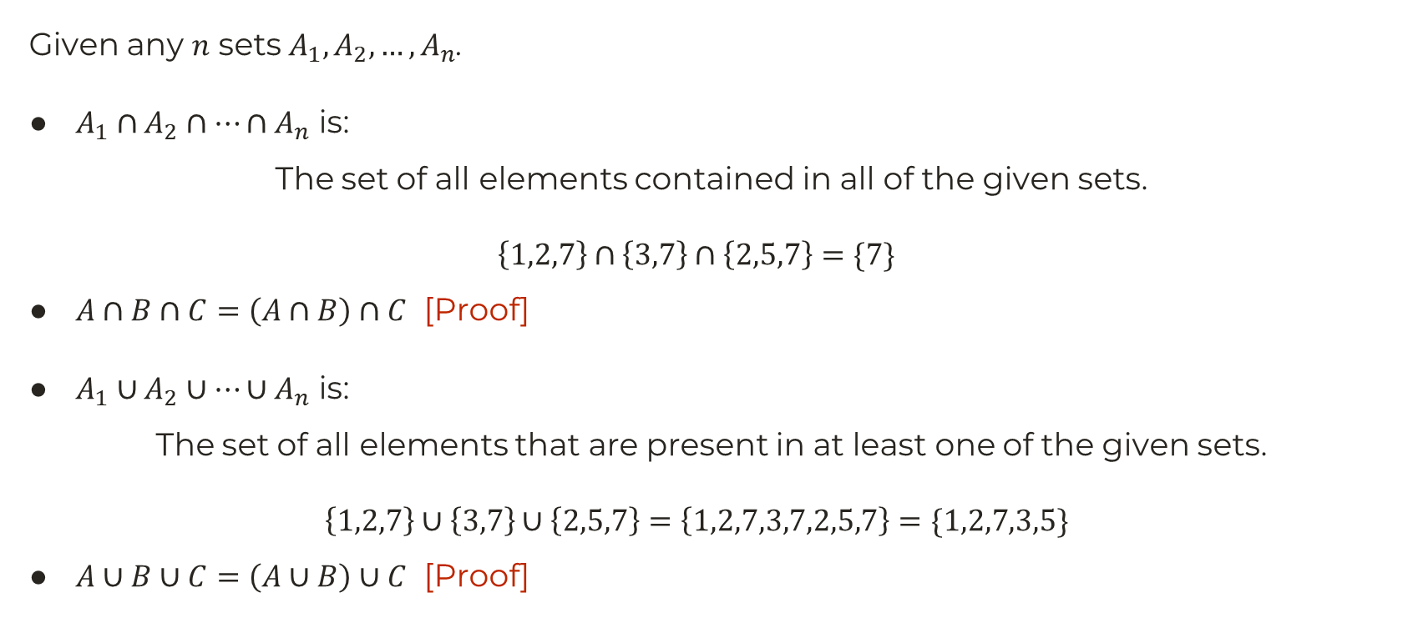
Generalized Union and Intersection
Given any $n$ sets $A_{1},A_{2},…,A_{n}$.
$A_{1}∩A_{2}∩…∩A_{n}$ is:
The set of all elements contained in all of the given sets.
$$\left\{1,2,7\right\}∩\left\{3,7\right\}∩\left\{2,5,7\right\}=\{7\}$$
$A∩B∩C=\left(A∩B\right)∩C$ [Proof]
$A_{1}∪A_{2}∪…∪A_{n}$ is:
The set of all elements that are present in at least one of the given sets.
$$\left\{1,2,7\right\}∪\left\{3,7\right\}∪\left\{2,5,7\right\}=\left\{1,2,7,3,7,2,5,7\right\}=\{1,2,7,3,5\}$$
$A∪B∪C=\left(A∪B\right)∪C$ [Proof]

Slide 19

Generalized De Morgan’s Law
$\overline{A∪B∪C}=\overline{A∪B}∩\overline{C}=\overline{A}∩\overline{B}∩\overline{C}$
$\overline{A∩B∩C}=\overline{A∩B}∪\overline{C}=\overline{A}∪\overline{B}∪\overline{C}$
In general,
$${\left(A_{1}∪A_{2}∪…∪A_{n}\right)}^{c}=A_{1}^{c}∩A_{2}^{c}∩…∩A_{n}^{c}$$
$${\left(A_{1}∩A_{2}∩…∩A_{n}\right)}^{c}=A_{1}^{c}∪A_{2}^{c}∪…∪A_{n}^{c}$$

Slide 20
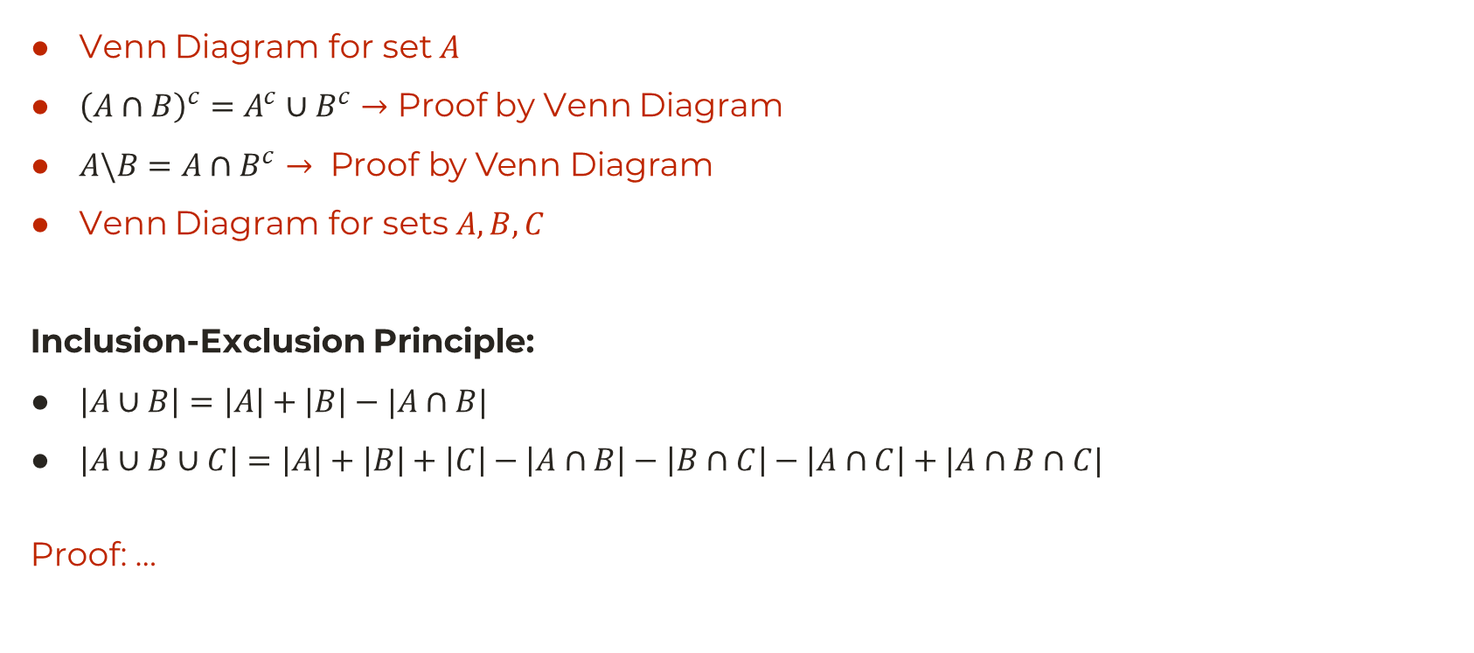
Venn Diagram
Venn Diagram for set $A$
${\left(A∩B\right)}^{c}=A^{c}∪B^{c}→$ Proof by Venn Diagram
$A\backslash B=A∩B^{c}→ \text{Proof} \text{by} \text{Venn} \text{Diagram}$
Venn Diagram for sets $A,B,C$
Inclusion-Exclusion Principle:
$\left|A∪B\right|=\left|A\right|+\left|B\right|−|A∩B|$
$\left|A∪B∪C\right|=\left|A\right|+\left|B\right|+\left|C\right|−\left|A∩B\right|−\left|B∩C\right|−\left|A∩C\right|+|A∩B∩C|$
Proof: …

Slide 21

Some Final Problems
$A∪\left(B∩C\right)=\left(A∪B\right)∩\left(A∪C\right)$
How many numbers are there between $0$ and $100$ that are divisible by:
  $3$ or $5$
  $3$ or $5$, but not both
  $5$ but not 3
  neither $5$ nor $3$
Solution: …

