Slide 1
CSE230: Discrete Mathematics
Function
Prepared by: Rabeeb Ibrat

Slide 2
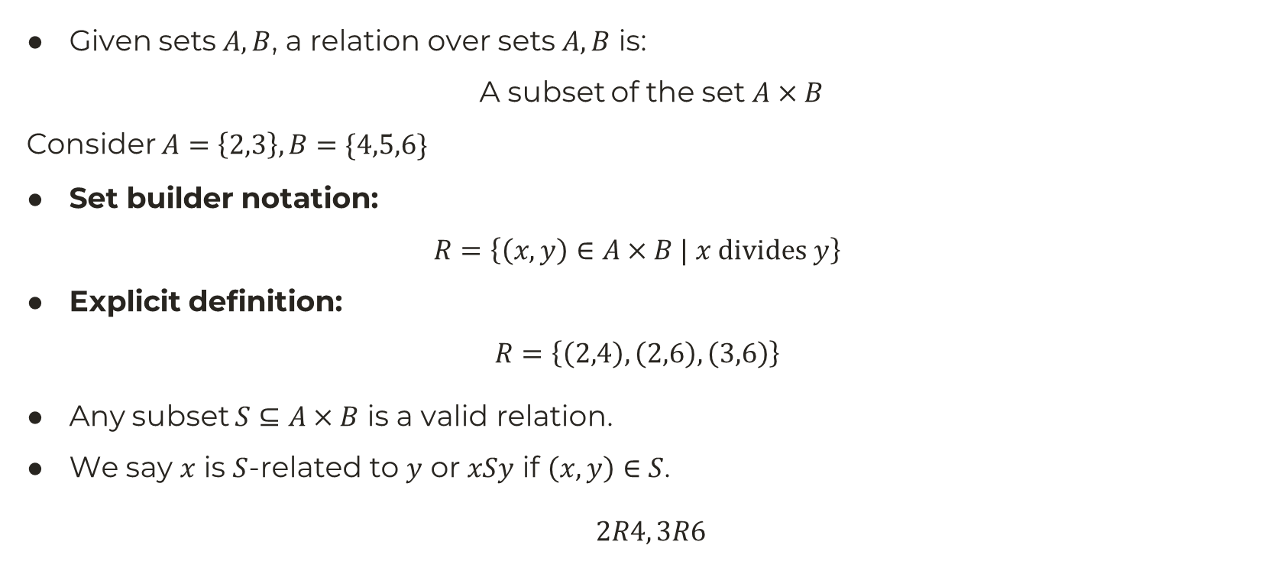
Relation
Given sets $A,B$, a relation over sets $A,B$ is:
A subset of the set $A×B$
Consider $A=\left\{2,3\right\}, B=\{4,5,6\}$
Set builder notation:
$$R=\left\{\left(x,y\right)∈A×B | x divides y\right\}$$
Explicit definition:
$$R=\left\{\left(2,4\right),\left(2,6\right), \left(3,6\right)\right\}$$
Any subset $S⊆A×B$ is a valid relation.
We say $x$ is $S$-related to $y$ or $xSy$ if $\left(x,y\right)∈S$.
$2R4, 3R6$

Slide 3
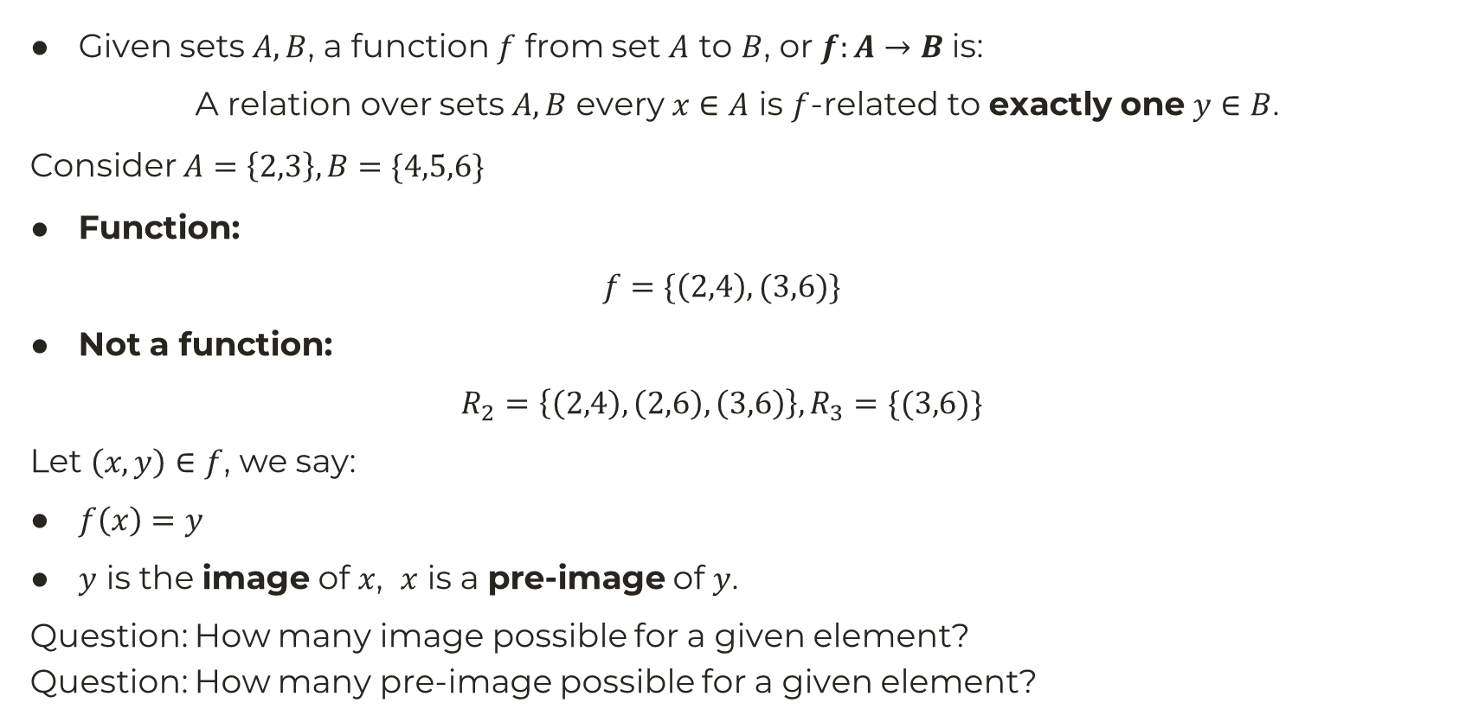
Function
Given sets $A,B$, a function $f$ from set $A$ to $B$, or $f:A→B$ is:
A relation over sets $A,B$ every $x∈A$ is $f$-related to exactly one $y∈B$.
Consider $A=\left\{2,3\right\}, B=\{4,5,6\}$
Function:
$$f=\{\left(2,4\right),(3,6)\}$$
Not a function:
$$R_{2}=\left\{\left(2,4\right),\left(2,6\right), \left(3,6\right)\right\}, R_{3}=\{(3,6)\}$$
Let $\left(x,y\right)∈f$, we say:
$f\left(x\right)=y$
$y$ is the image of $x$, $x$ is a pre-image of $y$.
Question: How many image possible for a given element?
Question: How many pre-image possible for a given element?

Slide 4
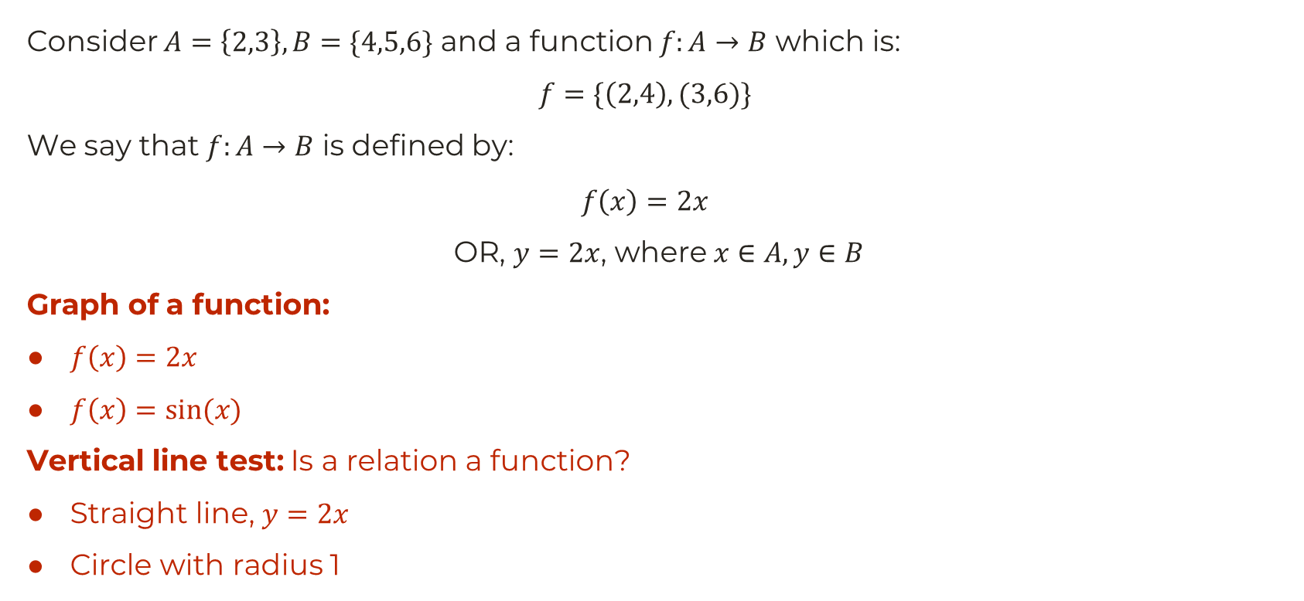
Function by formula, Graph of a function
Consider $A=\left\{2,3\right\}, B=\{4,5,6\}$ and a function $f:A→B$ which is:
$$f=\{\left(2,4\right),(3,6)\}$$
We say that $f:A→B$ is defined by:
$$f\left(x\right)=2x$$
OR, $y=2x$, where $x∈A, y∈B$
Graph of a function:
$f\left(x\right)=2x$
$f\left(x\right)=sin⁡(x)$
Vertical line test: Is a relation a function?
Straight line, $y=2x$
Circle with radius 1

Slide 5

Domain, Co-domain, Range of a Function
Consider $A=\left\{2,3\right\}, B=\{4,5,6\}$ and a function $f:A→B$ defined as:
$$f=\{\left(2,4\right),(3,6)\}$$
OR, $f\left(x\right)=2x$
$\operatorname{dom}{f}=A=\left\{2,3\right\}$
$\operatorname{codomain}{f}=B=\{4,5,6\}$
$\operatorname{range}{f} =\{4,6\}$
More formally,
For any function $g:X→Y$,
$\operatorname{dom}{g}=X, \operatorname{codomain}{g}=Y$
$\operatorname{range}{g}=\{f\left(x\right):x∈X\}$

Slide 6

Domain & Range of some functions
Consider functions with universal set $𝕌=ℝ$.
$f\left(x\right)=\sin{x}, g\left(x\right)=\cos{x}, h\left(x\right)=cos⁡(x−45°)$
$f\left(x\right)=\sin{x}+\cos{x}$
$y=\frac{1}{x}, z=\frac{1}{x−2}, w=\frac{x−2}{x−3}$
Question: What is the pre-image for $z=\sqrt{2}$?
$y=\frac{1}{1−x^{2}}$
$y=\log{x}, z=log\left(1−x^{2}\right), w=8+log⁡(1−x^{2})$

Slide 7
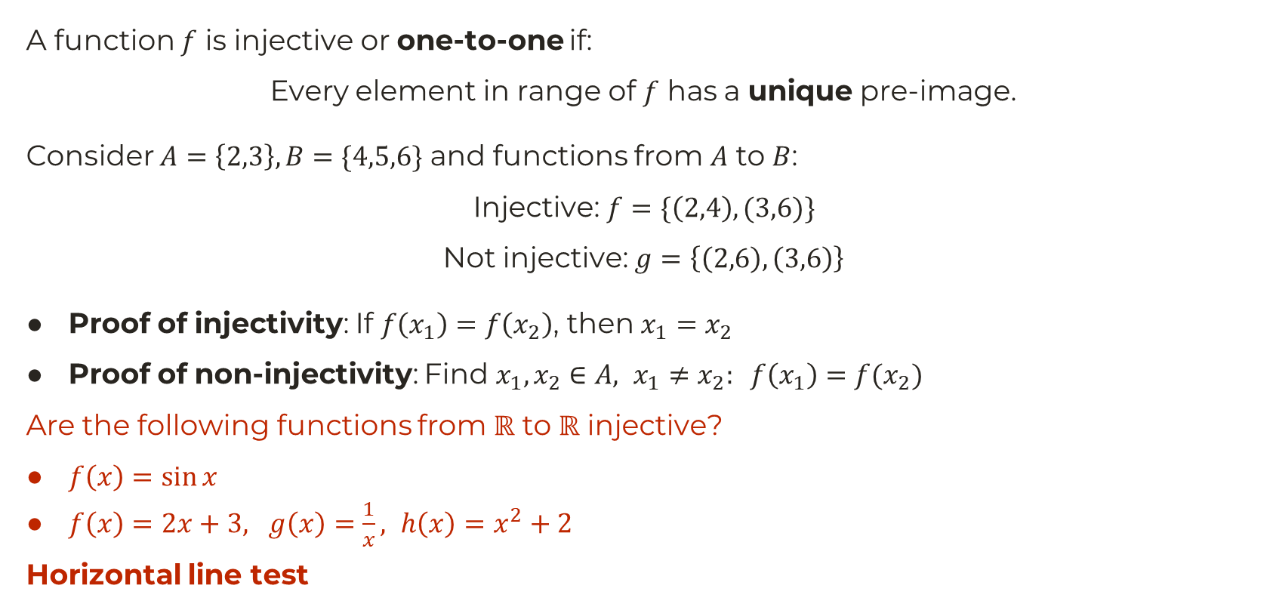
Injective Function
A function $f$ is injective or one-to-one if:
Every element in range of $f$ has a unique pre-image.
Consider $A=\left\{2,3\right\}, B=\{4,5,6\}$ and functions from $A$ to $B$:
Injective: $f=\{\left(2,4\right),(3,6)\}$
Not injective: $g=\left\{\left(2,6\right),\left(3,6\right)\right\}$
Proof of injectivity: If $f\left(x_{1}\right)=f\left(x_{2}\right)$, then $x_{1}=x_{2}$
Proof of non-injectivity: Find $x_{1},x_{2}∈A, x_{1}≠x_{2}: f\left(x_{1}\right)=f(x_{2})$
Are the following functions from $ℝ$ to $ℝ$ injective?
$f\left(x\right)=\sin{x}$
$f\left(x\right)=2x+3, g\left(x\right)=\frac{1}{x}, h\left(x\right)=x^{2}+2$
Horizontal line test

Slide 8
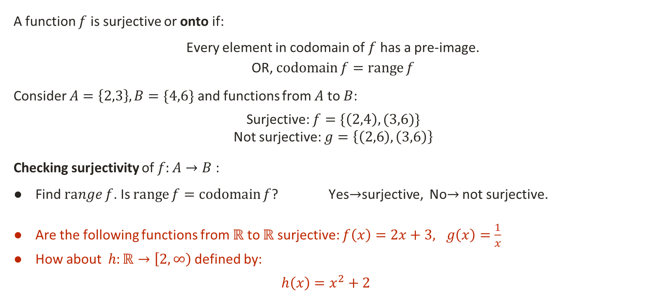
Surjective Function
A function $f$ is surjective or onto if:
Every element in codomain of $f$ has a pre-image.
OR, $\operatorname{codomain}{f}=\operatorname{range}{f}$
Consider $A=\left\{2,3\right\}, B=\{4,6\}$ and functions from $A$ to $B$:
Surjective: $f=\{\left(2,4\right),(3,6)\}$
Not surjective: $g=\left\{\left(2,6\right),\left(3,6\right)\right\}$
Checking surjectivity of $f:A→B$ :
Find $\operatorname{range}{f}$. Is $\operatorname{range}{f}=\operatorname{codomain}{f}$? Yes$→$surjective, No$→$ not surjective.
Are the following functions from $ℝ$ to $ℝ$ surjective: $f\left(x\right)=2x+3, g\left(x\right)=\frac{1}{x}$
How about $h:ℝ→\left[2,∞\right)$ defined by:
$$h\left(x\right)=x^{2}+2$$

Slide 9
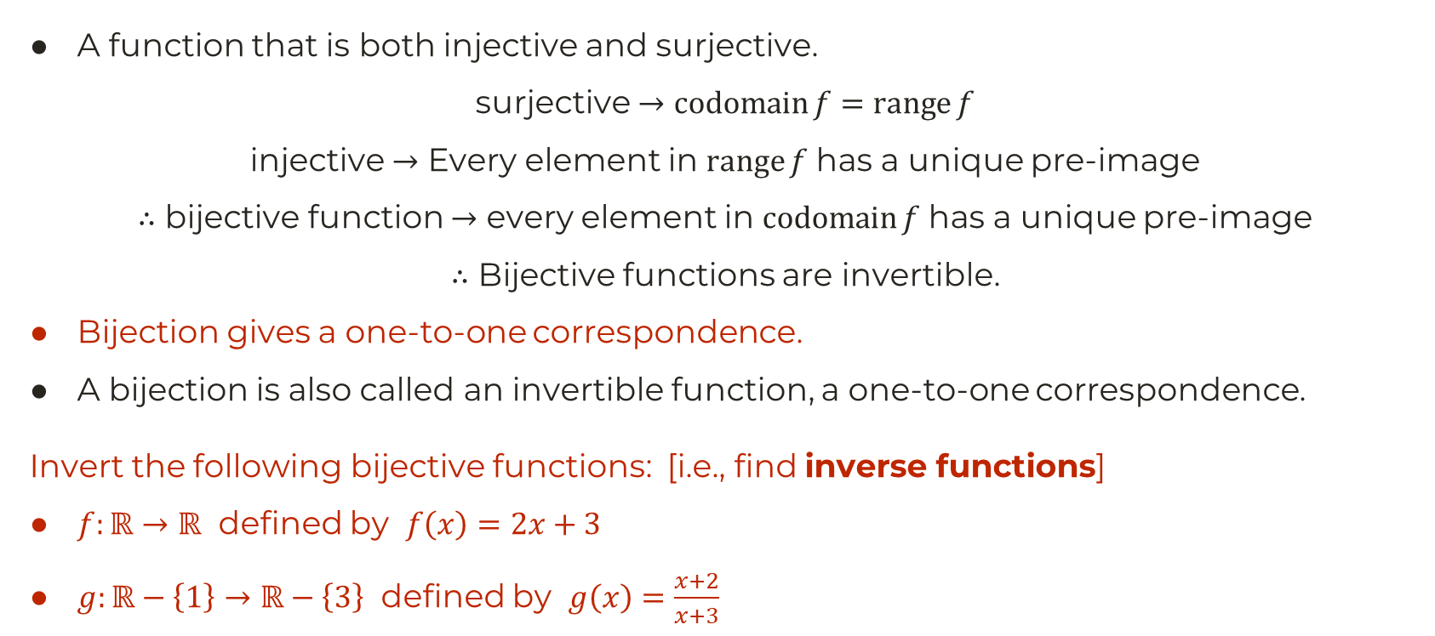
Bijective Function
A function that is both injective and surjective.
surjective $→$ $\operatorname{codomain}{f}=\operatorname{range}{f}$
injective $→$ Every element in $\operatorname{range}{f}$ has a unique pre-image
$∴$ bijective function $→$ every element in $\operatorname{codomain}{f}$ has a unique pre-image
$∴$ Bijective functions are invertible.
Bijection gives a one-to-one correspondence.
A bijection is also called an invertible function, a one-to-one correspondence.
Invert the following bijective functions: [i.e., find inverse functions]
$f:ℝ→ℝ$ defined by $f\left(x\right)=2x+3$
$g:ℝ−\left\{1\right\}→ℝ−\left\{3\right\}$ defined by $g\left(x\right)=\frac{x+2}{x+3}$

Slide 10
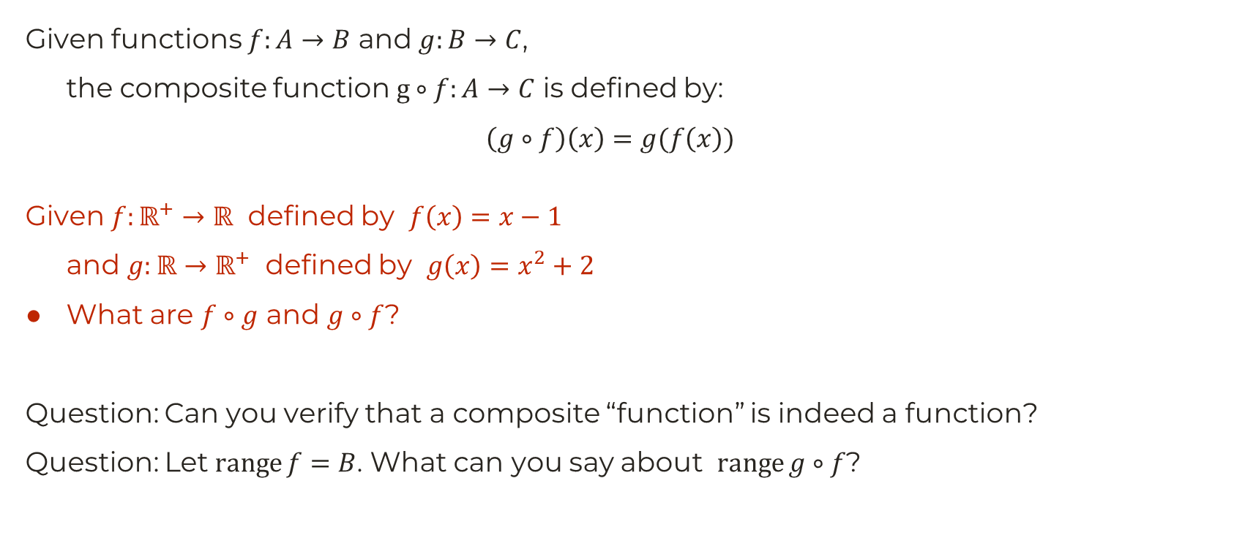
Composite Function
Given functions $f:A→B$ and $g:B→C$,
the composite function $g∘f:A→C$ is defined by:
$$\left(g∘f\right)\left(x\right)=g(f\left(x\right))$$
Given $f:ℝ^{+}→ℝ$ defined by $f\left(x\right)=x−1$
and $g:ℝ→ℝ^{+}$ defined by $g\left(x\right)=x^{2}+2$
What are $f∘g$ and $g∘f$?
Question: Can you verify that a composite “function” is indeed a function?
Question: Let $\operatorname{range}{f}=B$. What can you say about $\operatorname{range}{g∘f}$?

