Slide 1
CSE230: Discrete Mathematics
Combinatorics
Prepared by: Rabeeb Ibrat

Slide 2
Sum Rule & Product Rule
One can travel from Dhaka to Sylhet by: 3 airlines, 5 bus services, 2 train services.
How many total ways to travel?
You can go from A to B in 3 ways and from B to C in 5 ways. In how many ways can you go from A to C via B?
Group A consists of 5 persons and group B consists of 7 persons.
In how many ways can you interview 1 person from them?
In how many ways can you interview 1 person from each group?

Slide 3
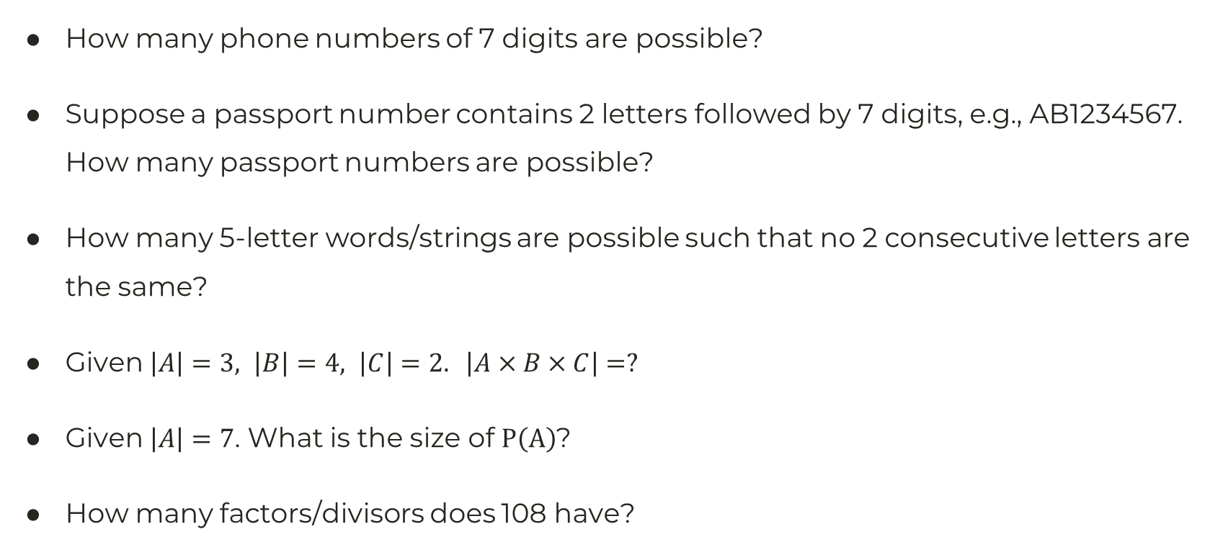
Applications of the Product Rule
How many phone numbers of 7 digits are possible?
Suppose a passport number contains 2 letters followed by 7 digits, e.g., AB1234567.
How many passport numbers are possible?
How many 5-letter words/strings are possible such that no 2 consecutive letters are the same?
Given $\left|A\right|=3, \left|B\right|=4, \left|C\right|=2. \left|A×B×C\right|=?$
Given $\left|A\right|=7$. What is the size of $P\left(A\right)$?
How many factors/divisors does 108 have?

Slide 4
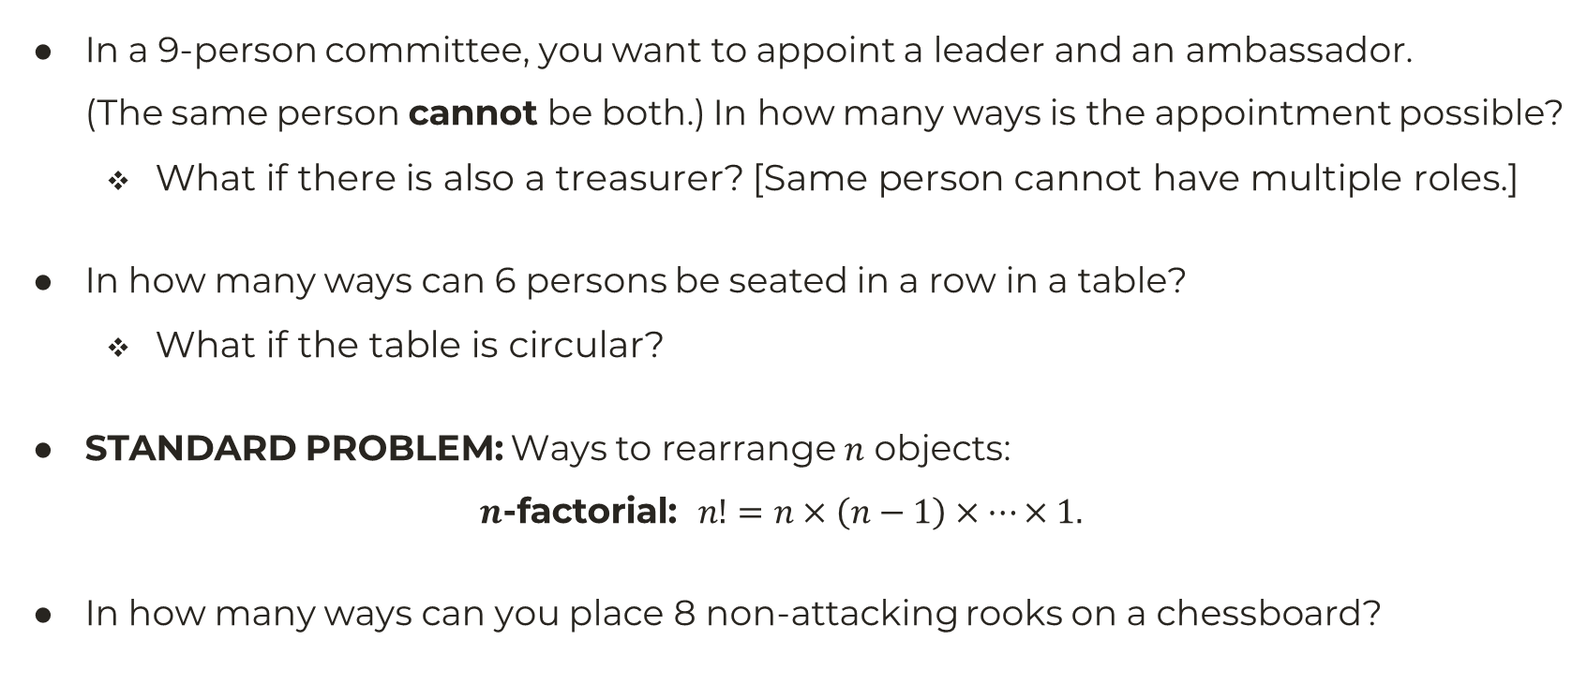
Permutations
In a 9-person committee, you want to appoint a leader and an ambassador. (The same person cannot be both.) In how many ways is the appointment possible?
What if there is also a treasurer? [Same person cannot have multiple roles.]
In how many ways can 6 persons be seated in a row in a table?
What if the table is circular?
STANDARD PROBLEM: Ways to rearrange $n$ objects:
$$n\text{−}\text{factorial}\text{:} n!=n×\left(n−1\right)×…×1.$$
In how many ways can you place 8 non-attacking rooks on a chessboard?

Slide 5
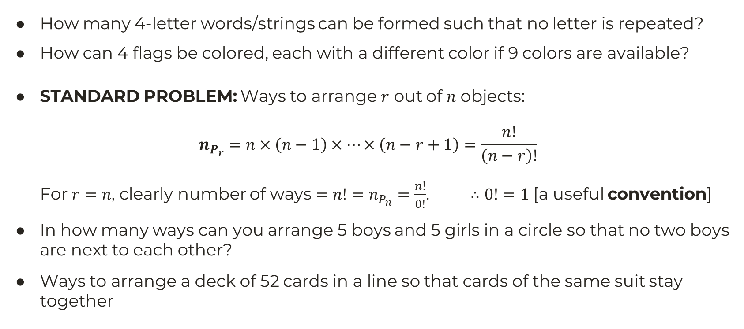
Permutations (2)
How many 4-letter words/strings can be formed such that no letter is repeated?
How can 4 flags be colored, each with a different color if 9 colors are available?
STANDARD PROBLEM: Ways to arrange $r$ out of $n$ objects:
$$n_{P_{r}}=n×\left(n−1\right)×…×\left(n−r+1\right)=\frac{n!}{\left(n−r\right)!}$$
For $r=n$, clearly number of ways $=n!=n_{P_{n}}=\frac{n!}{0!}$. $∴0!=1$ [a useful convention]
In how many ways can you arrange 5 boys and 5 girls in a circle so that no two boys are next to each other?
Ways to arrange a deck of 52 cards in a line so that cards of the same suit stay together

Slide 6
Permutation with Repeated Elements
In how many ways can the letters of the word “Mendeleev” be rearranged so that the vowels stay together?
How many rearrangements of the following words are possible?
tarot, carrier, mississippi
betterment, so that the vowels stay together.
endeavour, so that the vowels stay together.
In how many ways can 18 people be divided into team A,B,C, with each team containing 6 members?
Grid problem [U,L movements]

Slide 7
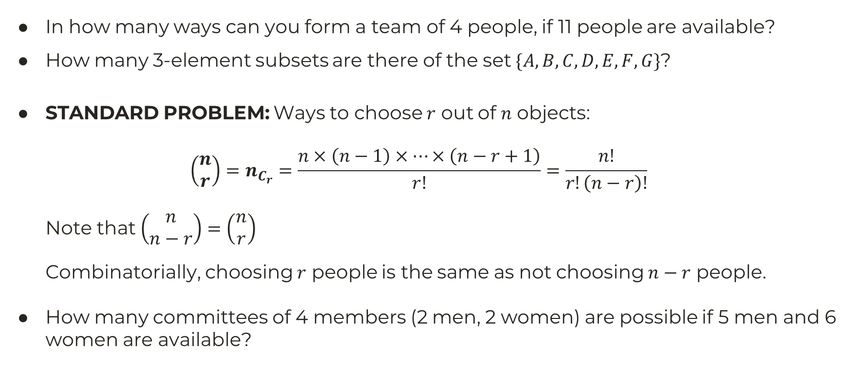
Combinations
In how many ways can you form a team of 4 people, if 11 people are available?
How many 3-element subsets are there of the set $\{A,B,C,D,E,F,G\}$?
STANDARD PROBLEM: Ways to choose $r$ out of $n$ objects:
$$\left(\begin{matrix}n \\ r\end{matrix}\right)=n_{C_{r}}=\frac{n×\left(n−1\right)×…×\left(n−r+1\right)}{r!}=\frac{n!}{r!\left(n−r\right)!}$$
Note that $\left(\begin{matrix}n \\ n−r\end{matrix}\right)=\left(\begin{matrix}n \\ r\end{matrix}\right)$
Combinatorially, choosing $r$ people is the same as not choosing $n−r$ people.
How many committees of 4 members (2 men, 2 women) are possible if 5 men and 6 women are available?

Slide 8
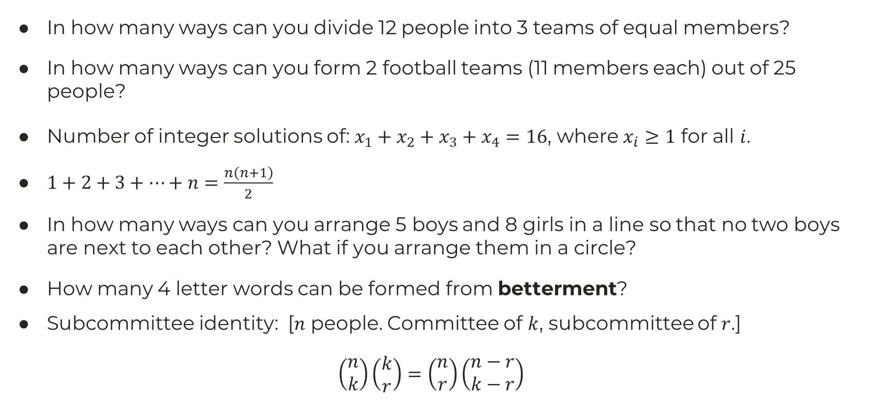
Application of Combinations
In how many ways can you divide 12 people into 3 teams of equal members?
In how many ways can you form 2 football teams (11 members each) out of 25 people?
Number of integer solutions of: $x_{1}+x_{2}+x_{3}+x_{4}=16$, where $x_{i}≥1$ for all $i$.
$1+2+3+…+n=\frac{n\left(n+1\right)}{2}$
In how many ways can you arrange 5 boys and 8 girls in a line so that no two boys are next to each other? What if you arrange them in a circle?
How many 4 letter words can be formed from betterment?
Subcommittee identity: [$n$ people. Committee of $k$, subcommittee of $r$.]
$$\left(\begin{matrix}n \\ k\end{matrix}\right)\left(\begin{matrix}k \\ r\end{matrix}\right)=\left(\begin{matrix}n \\ r\end{matrix}\right)\left(\begin{matrix}n−r \\ k−r\end{matrix}\right)$$

Slide 9
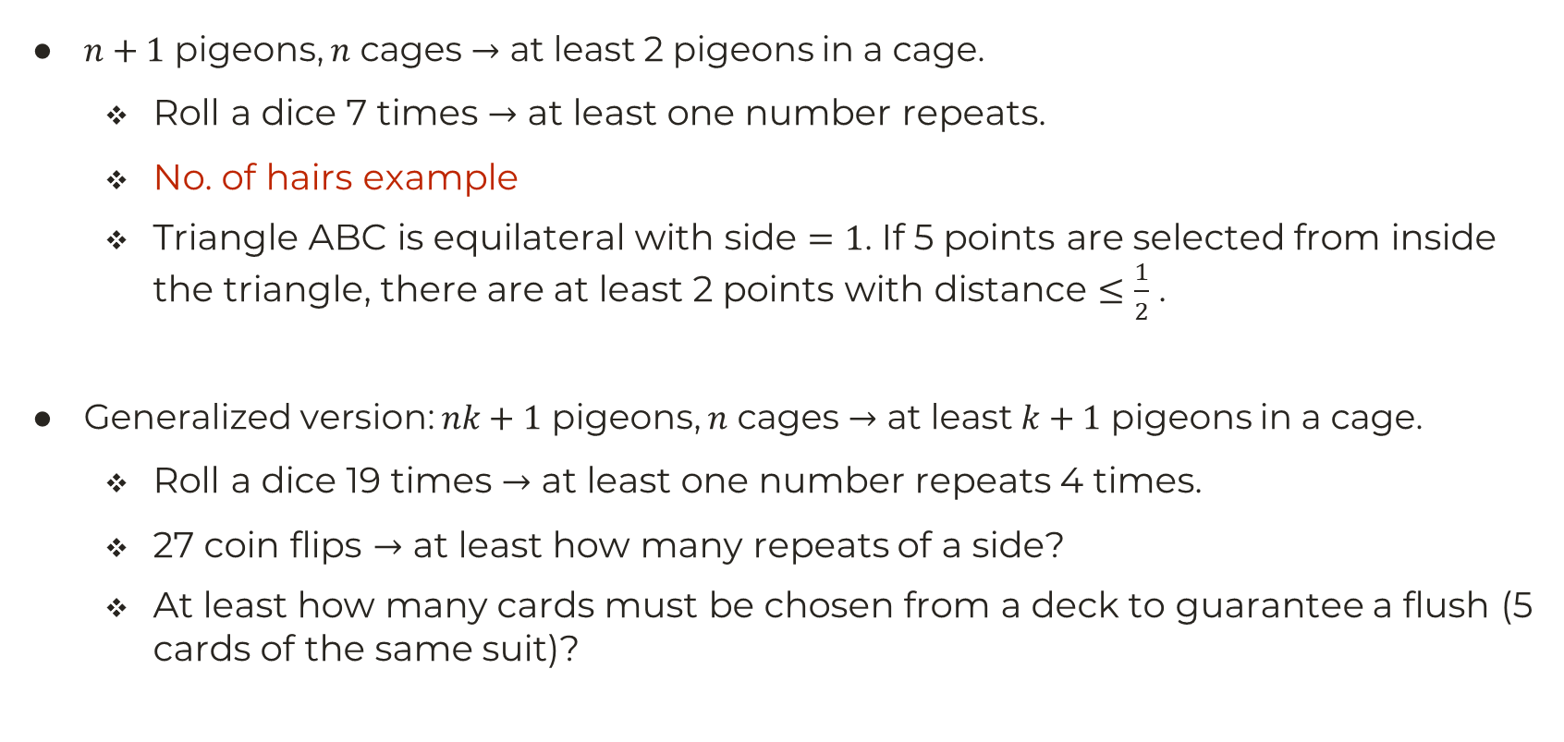
Pigeonhole Principle
$n+1$ pigeons, $n$ cages $→$ at least 2 pigeons in a cage.
Roll a dice 7 times $→$ at least one number repeats.
No. of hairs example
Triangle ABC is equilateral with side $=1$. If 5 points are selected from inside the triangle, there are at least 2 points with distance $≤\frac{1}{2}$ .
Generalized version: $nk+1$ pigeons, $n$ cages $→$ at least $k+1$ pigeons in a cage.
Roll a dice 19 times $→$ at least one number repeats 4 times.
27 coin flips $→$ at least how many repeats of a side?
At least how many cards must be chosen from a deck to guarantee a flush (5 cards of the same suit)?

