Slide 1
CSE230: Discrete Mathematics
Binomial & Multinomial Theorems
Prepared by: Rabeeb Ibrat

Slide 2
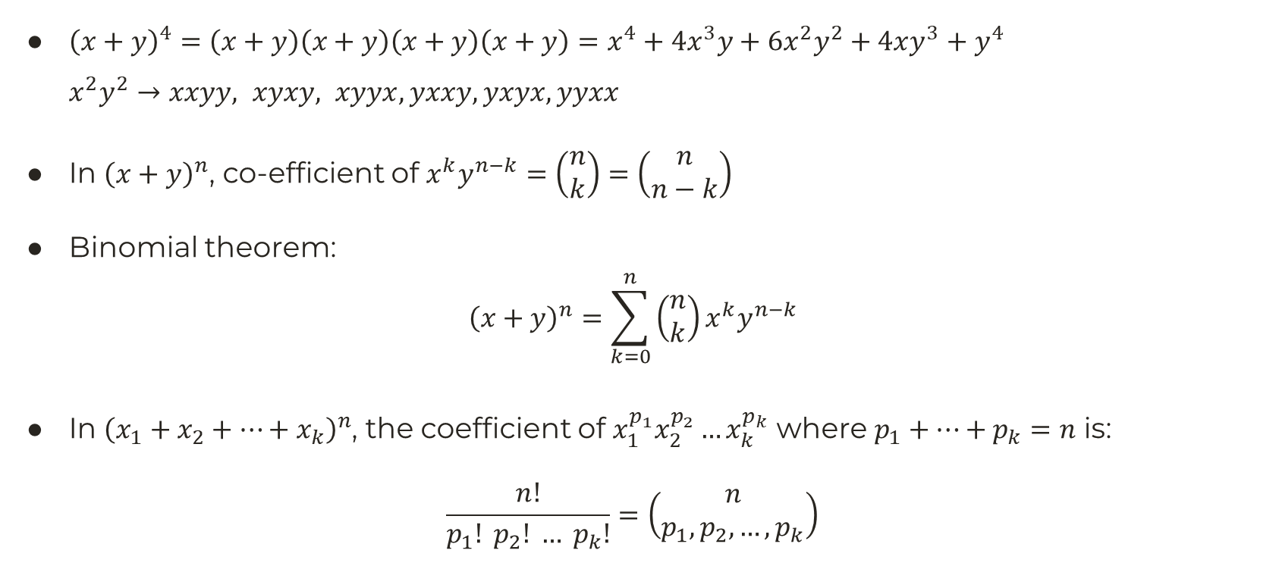
Binomial & Multinomial Theorems
${\left(x+y\right)}^{4}=\left(x+y\right)\left(x+y\right)\left(x+y\right)\left(x+y\right)=x^{4}+4x^{3}y+6x^{2}y^{2}+4xy^{3}+y^{4}$
$x^{2}y^{2}→xxyy, xyxy, xyyx, yxxy, yxyx, yyxx$
In ${\left(x+y\right)}^{n}$, co-efficient of $x^{k}y^{n−k}=\left(\begin{matrix}n \\ k\end{matrix}\right)=\left(\begin{matrix}n \\ n−k\end{matrix}\right)$
Binomial theorem:
$${\left(x+y\right)}^{n}=\sum_{k=0}^{n}{\left(\begin{matrix}n \\ k\end{matrix}\right)x^{k}y^{n−k}}$$
In ${\left(x_{1}+x_{2}+…+x_{k}\right)}^{n}$, the coefficient of $x_{1}^{p_{1}}x_{2}^{p_{2}}…x_{k}^{p_{k}}$ where $p_{1}+…+p_{k}=n$ is:
$$\frac{n!}{p_{1}! p_{2}! … p_{k}!}=\left(\begin{matrix}n \\ p_{1},p_{2},…,p_{k}\end{matrix}\right)$$

Slide 3


Pascal’s Triangle
Formed by the binomial coefficients.
$${\left(x+y\right)}^{0}→$$
$${\left(x+y\right)}^{1}→$$
$${\left(x+y\right)}^{2}→$$
$${\left(x+y\right)}^{3}→$$
$${\left(x+y\right)}^{4}→$$
$${\left(x+y\right)}^{5}→$$
…
$$1$$
$$1 1$$
$$1 2 1$$
$$1 3 3 1$$
$$1 4 6 4 1$$
$$1 5 10 10 5 1$$
…

Slide 4

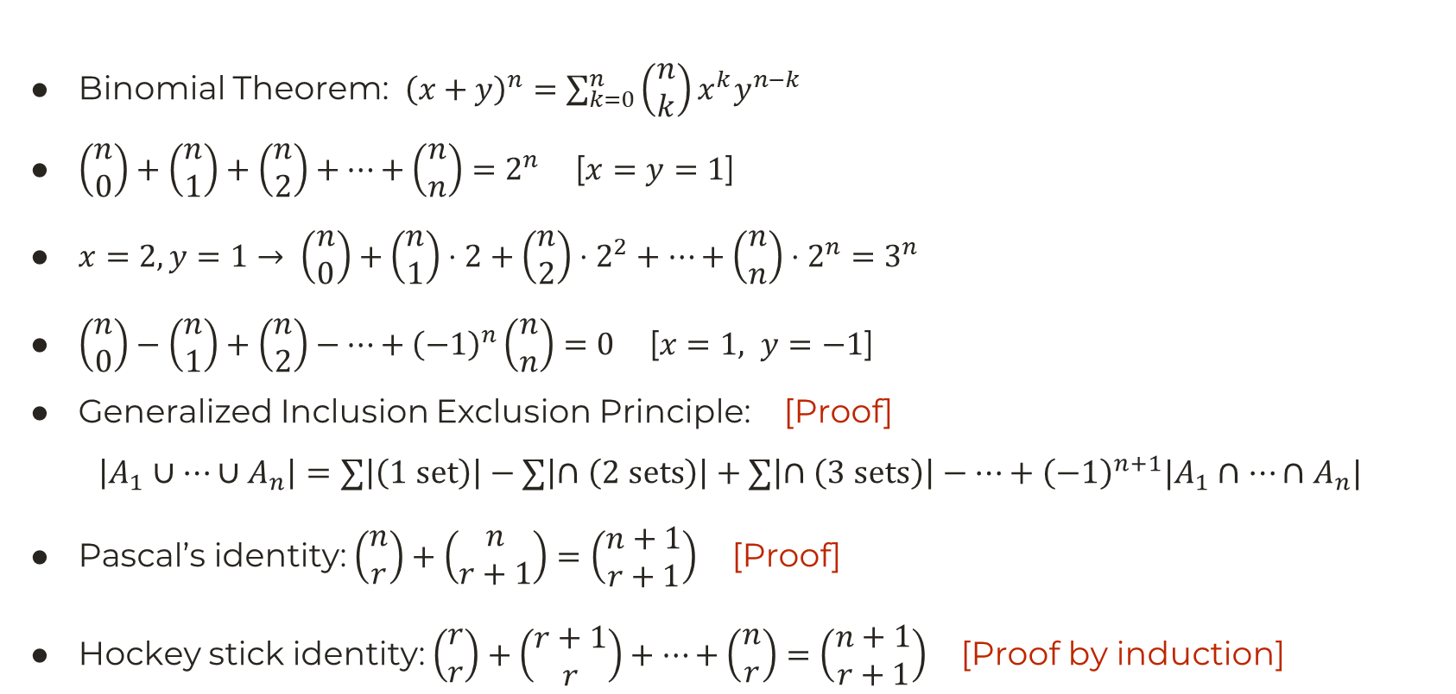
Binomial Identities
$$1$$
$$1 1$$
$$1 2 1$$
$$1 3 3 1$$
$$1 4 6 4 1$$
$$1 5 10 10 5 1$$
…
Binomial Theorem: ${\left(x+y\right)}^{n}=\sum_{k=0}^{n}{\left(\begin{matrix}n \\ k\end{matrix}\right)x^{k}y^{n−k}}$
$\left(\begin{matrix}n \\ 0\end{matrix}\right)+\left(\begin{matrix}n \\ 1\end{matrix}\right)+\left(\begin{matrix}n \\ 2\end{matrix}\right)+…+\left(\begin{matrix}n \\ n\end{matrix}\right)=2^{n}$ [$x=y=1$]
$x=2, y=1→ \left(\begin{matrix}n \\ 0\end{matrix}\right)+\left(\begin{matrix}n \\ 1\end{matrix}\right)⋅2+\left(\begin{matrix}n \\ 2\end{matrix}\right)⋅2^{2}+…+\left(\begin{matrix}n \\ n\end{matrix}\right)⋅2^{n}=3^{n}$
$\left(\begin{matrix}n \\ 0\end{matrix}\right)−\left(\begin{matrix}n \\ 1\end{matrix}\right)+\left(\begin{matrix}n \\ 2\end{matrix}\right)−…+{\left(−1\right)}^{n}\left(\begin{matrix}n \\ n\end{matrix}\right)=0$ [$x=1, y=−1$]
Generalized Inclusion Exclusion Principle: [Proof]
  $$\left|A_{1}∪…∪A_{n}\right|=∑\left|\left(1 set\right)\right|−∑\left|∩\left(2 sets\right)\right|+∑\left|∩\left(3 sets\right)\right|−…+{\left(−1\right)}^{n+1}|A_{1}∩…∩A_{n}|$$
Pascal’s identity: $\left(\begin{matrix}n \\ r\end{matrix}\right)+\left(\begin{matrix}n \\ r+1\end{matrix}\right)=\left(\begin{matrix}n+1 \\ r+1\end{matrix}\right)$ [Proof]
Hockey stick identity: $\left(\begin{matrix}r \\ r\end{matrix}\right)+\left(\begin{matrix}r+1 \\ r\end{matrix}\right)+…+\left(\begin{matrix}n \\ r\end{matrix}\right)=\left(\begin{matrix}n+1 \\ r+1\end{matrix}\right)$ [Proof by induction]

