Slide 1
CSE230: Discrete Mathematics
Introduction to Probability
Prepared by: Rabeeb Ibrat

Slide 2
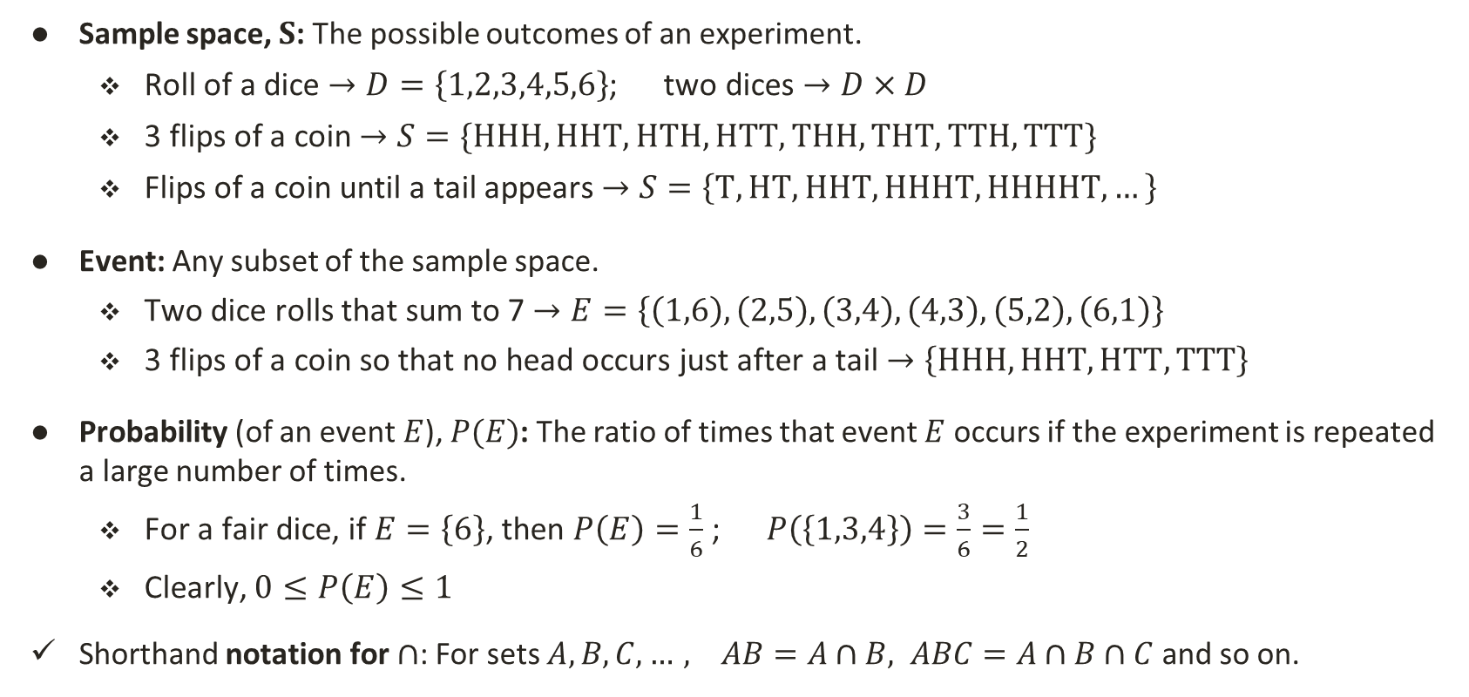
Sample Space, Event and Probability
Sample space, $S$: The possible outcomes of an experiment.
  Roll of a dice $→D=\left\{1,2,3,4,5,6\right\}$; two dices $→D×D$
  3 flips of a coin $→S=\{HHH,HHT,HTH,HTT,THH,THT,TTH,TTT\}$
  Flips of a coin until a tail appears $→S=\left\{T,HT,HHT,HHHT,HHHHT,…\right\}$
Event: Any subset of the sample space.
  Two dice rolls that sum to 7 $→E=\left\{\left(1,6\right),\left(2,5\right),\left(3,4\right),\left(4,3\right),\left(5,2\right),\left(6,1\right)\right\}$
  3 flips of a coin so that no head occurs just after a tail $→\left\{HHH,HHT,HTT,TTT\right\}$
Probability (of an event $E$), $P(E)$: The ratio of times that event $E$ occurs if the experiment is repeated a large number of times.
  For a fair dice, if $E=\left\{6\right\}$, then $P\left(E\right)=\frac{1}{6}$ ; $P\left(\left\{1,3,4\right\}\right)=\frac{3}{6}=\frac{1}{2}$
  Clearly, $0≤P\left(E\right)≤1$
Shorthand notation for $∩$: For sets $A,B,C,…, AB=A∩B, ABC=A∩B∩C$ and so on.

Slide 3
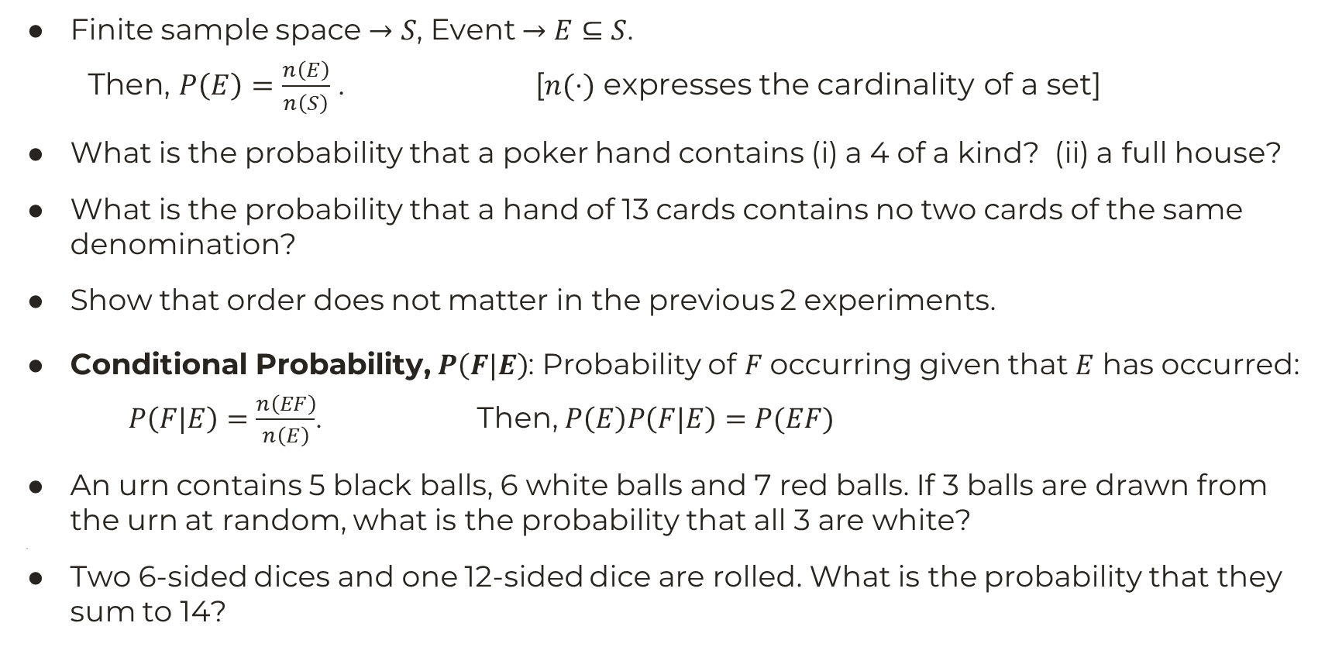
Equally Likely Outcomes
Finite sample space $→S$, Event $→E⊆S$.
  Then, $P\left(E\right)=\frac{n\left(E\right)}{n\left(S\right)}$ . [$n(⋅)$ expresses the cardinality of a set]
What is the probability that a poker hand contains (i) a 4 of a kind? (ii) a full house?
What is the probability that a hand of 13 cards contains no two cards of the same denomination?
Show that order does not matter in the previous 2 experiments.
Conditional Probability, $P\left(F|E\right)$: Probability of $F$ occurring given that $E$ has occurred:
$P\left(F|E\right)=\frac{n\left(EF\right)}{n\left(E\right)}$. Then, $P\left(E\right)P\left(F|E\right)=P(EF)$
An urn contains 5 black balls, 6 white balls and 7 red balls. If 3 balls are drawn from the urn at random, what is the probability that all 3 are white?
[[
Two 6-sided dices and one 12-sided dice are rolled. What is the probability that they sum to 14?

Slide 4
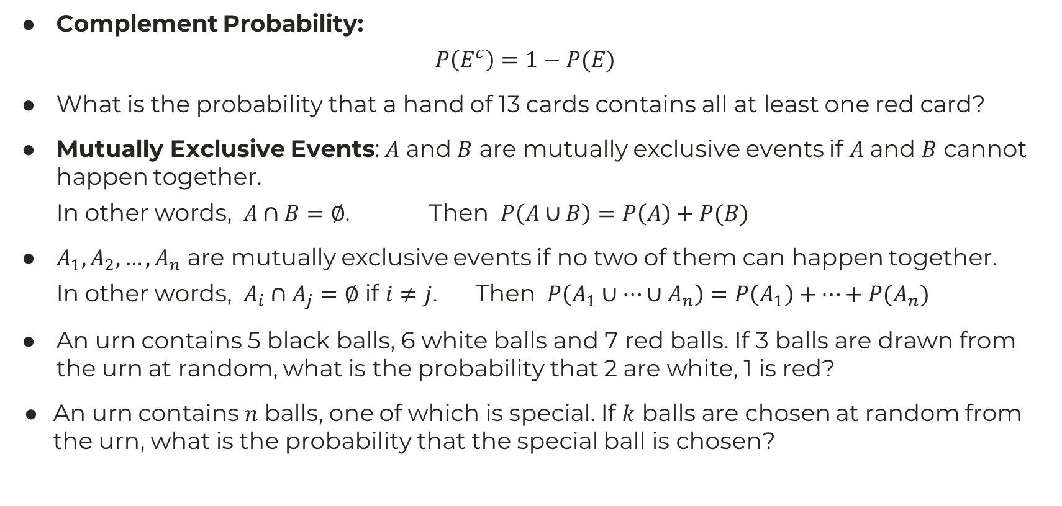
Equally Likely Outcomes (2)
Complement Probability:
$$P\left(E^{c}\right)=1−P(E)$$
What is the probability that a hand of 13 cards contains all at least one red card?
Mutually Exclusive Events: $A$ and $B$ are mutually exclusive events if $A$ and $B$ cannot happen together.
In other words, $A∩B=∅$. Then $P\left(A∪B\right)=P\left(A\right)+P(B)$
$A_{1},A_{2},…,A_{n}$ are mutually exclusive events if no two of them can happen together.
In other words, $A_{i}∩A_{j}=∅$ if $i≠j$. Then $P\left(A_{1}∪…∪A_{n}\right)=P\left(A_{1}\right)+…+P(A_{n})$
An urn contains 5 black balls, 6 white balls and 7 red balls. If 3 balls are drawn from the urn at random, what is the probability that 2 are white, 1 is red?
An urn contains $n$ balls, one of which is special. If $k$ balls are chosen at random from the urn, what is the probability that the special ball is chosen?

Slide 5
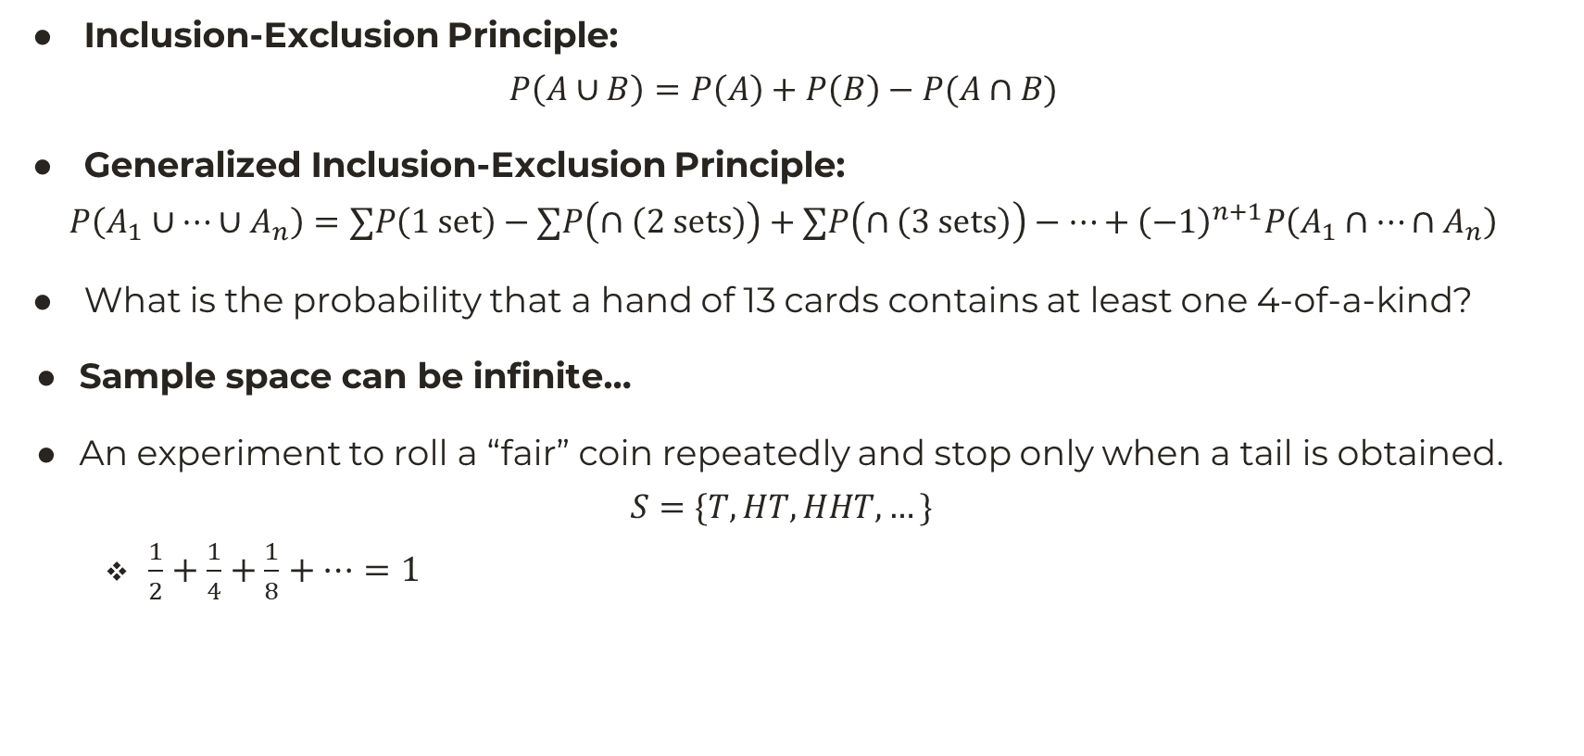
Equally Likely Outcomes (3)
Inclusion-Exclusion Principle:
$$P\left(A∪B\right)=P\left(A\right)+P\left(B\right)−P(A∩B)$$
Generalized Inclusion-Exclusion Principle:
$$P\left(A_{1}∪…∪A_{n}\right)=∑P\left(1 set\right)−∑P\left(∩\left(2 sets\right)\right)+∑P\left(∩\left(3 sets\right)\right)−…+{\left(−1\right)}^{n+1}P\left(A_{1}∩…∩A_{n}\right)$$
What is the probability that a hand of 13 cards contains at least one 4-of-a-kind?
Sample space can be infinite…
An experiment to roll a “fair” coin repeatedly and stop only when a tail is obtained.
$$S=\{T,HT,HHT,…\}$$
  $\frac{1}{2}+\frac{1}{4}+\frac{1}{8}+…=1$

