Slide 1

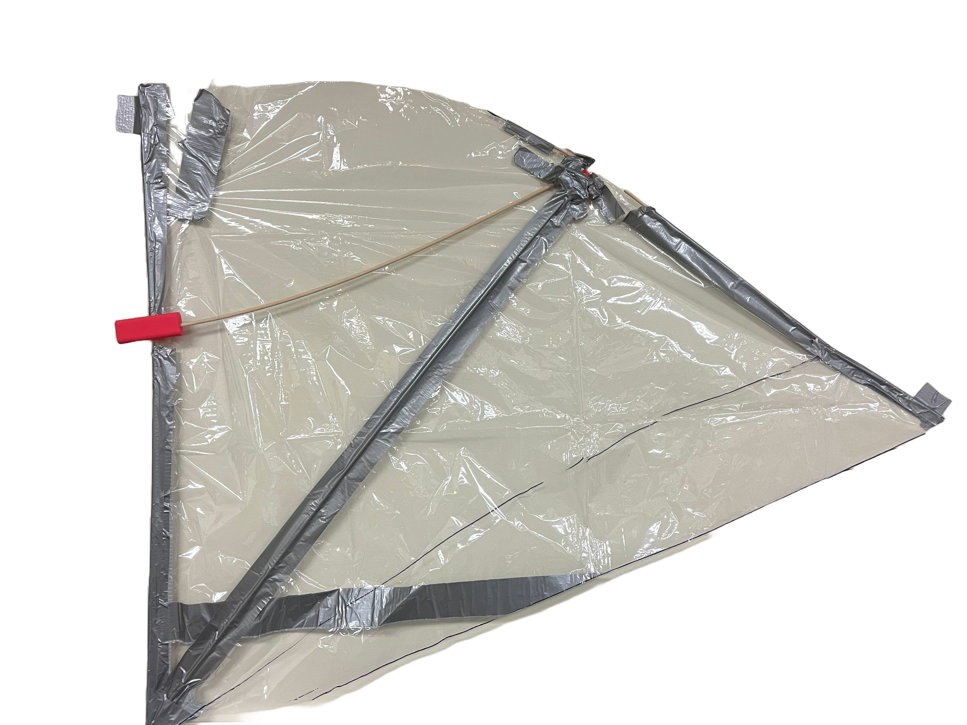
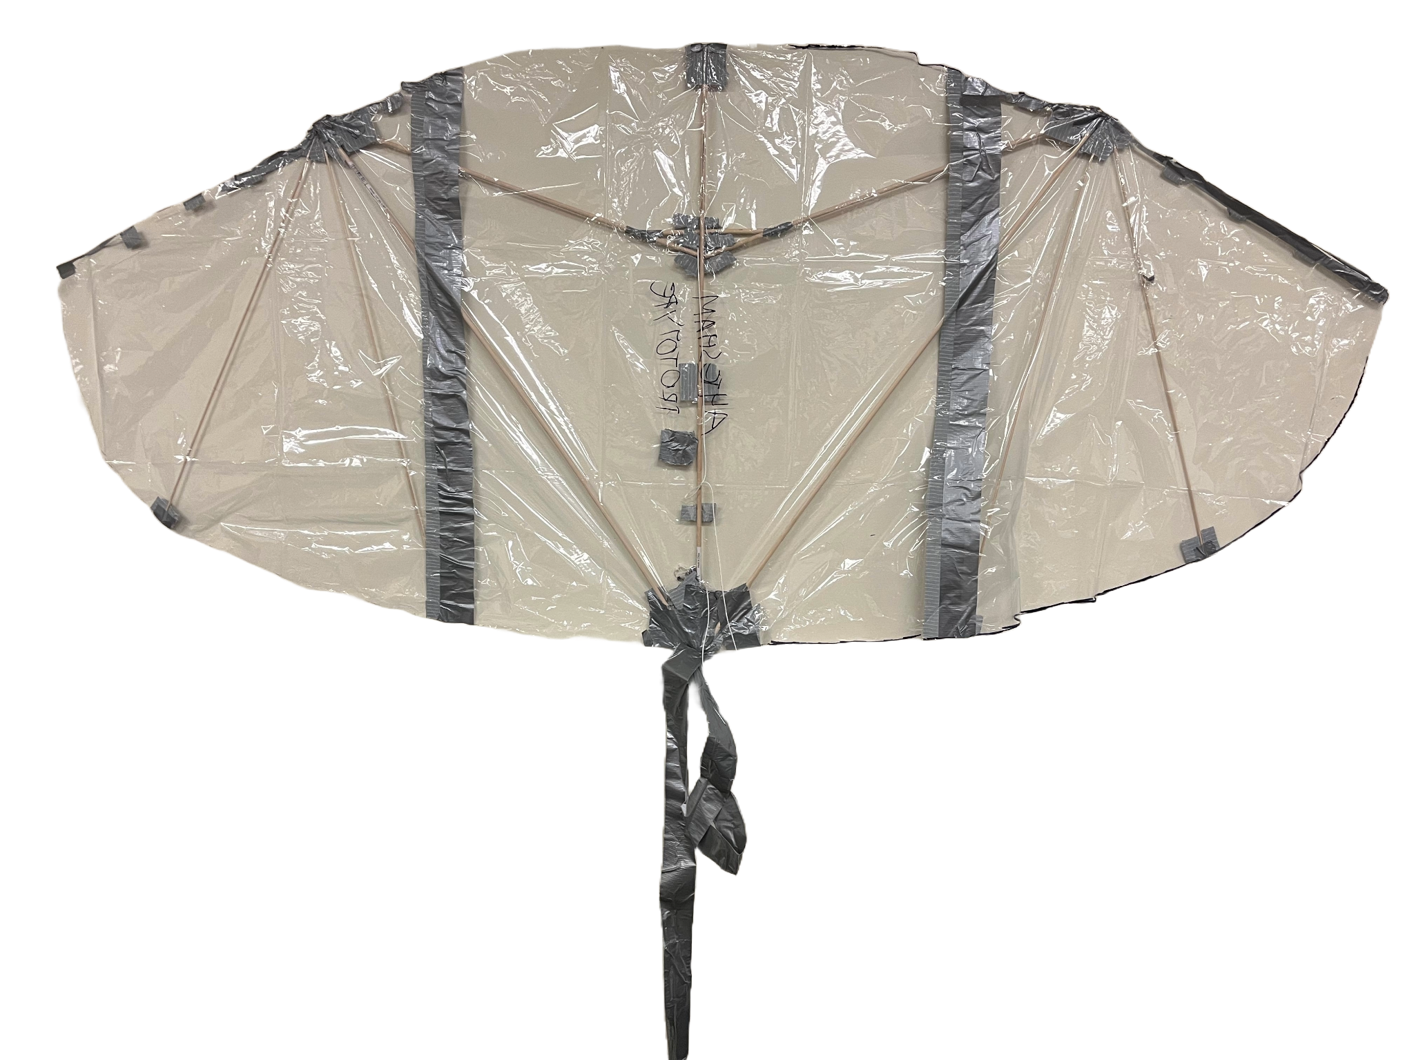
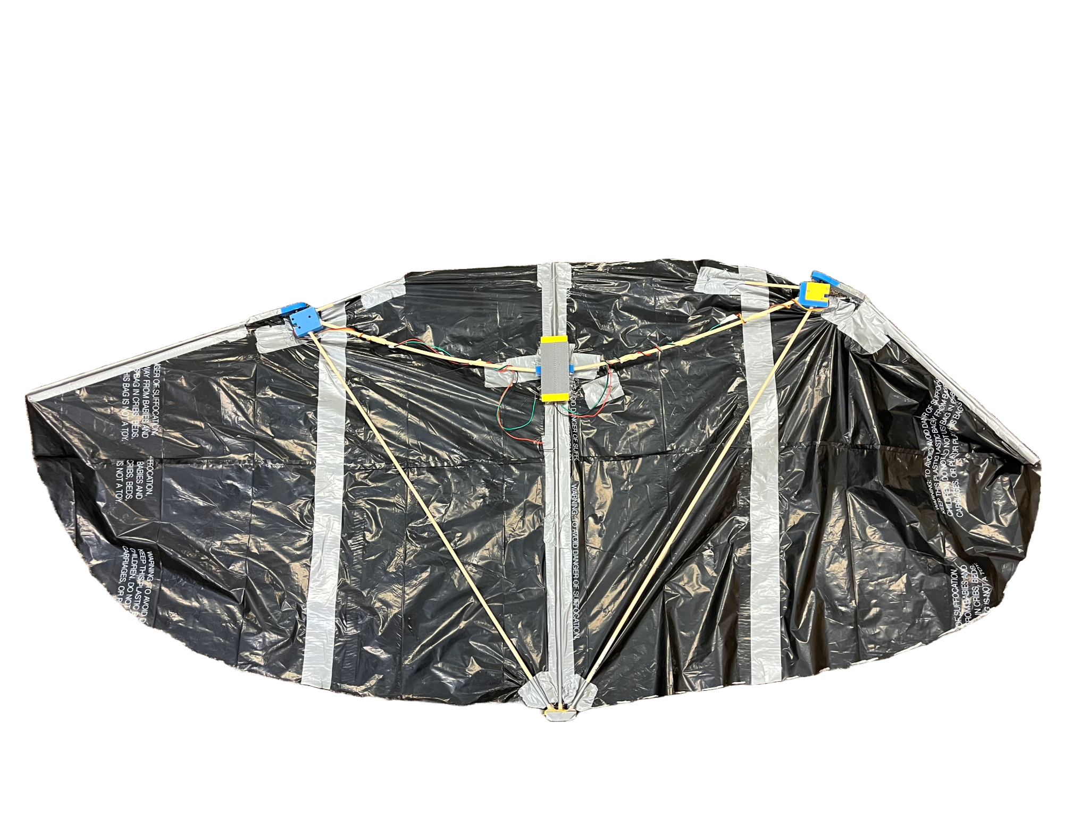
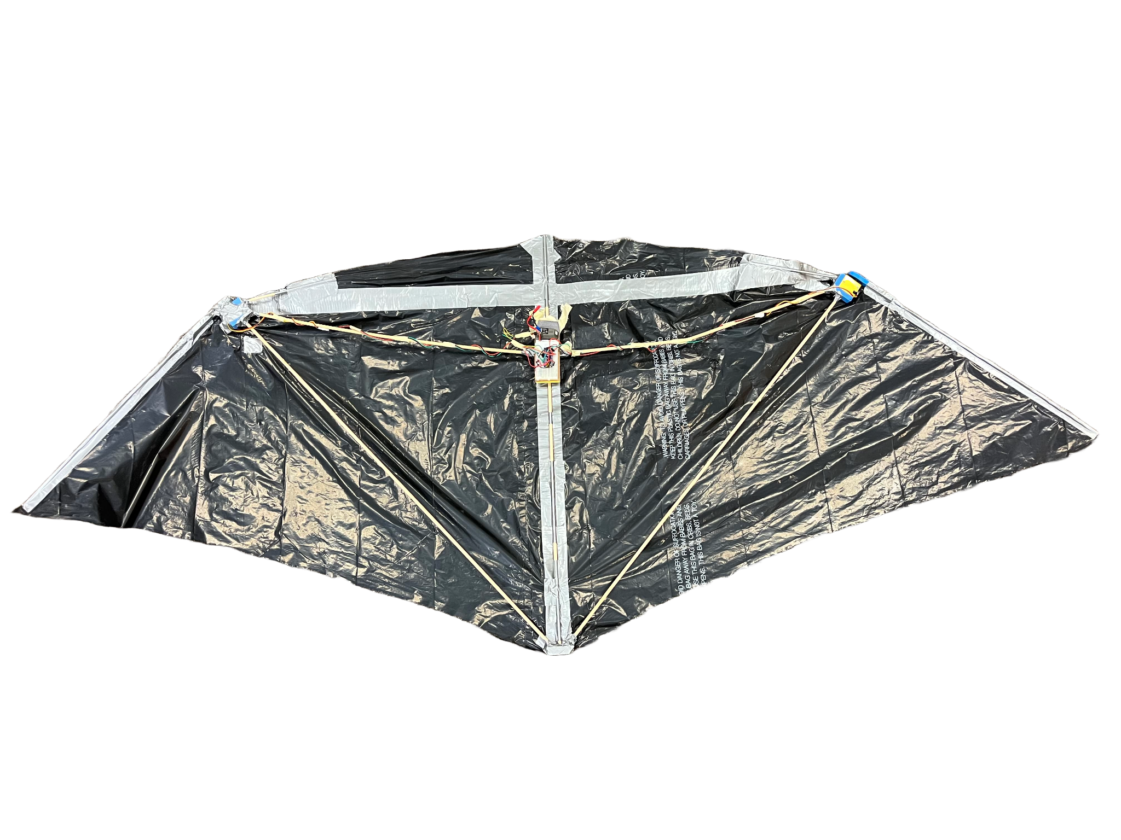
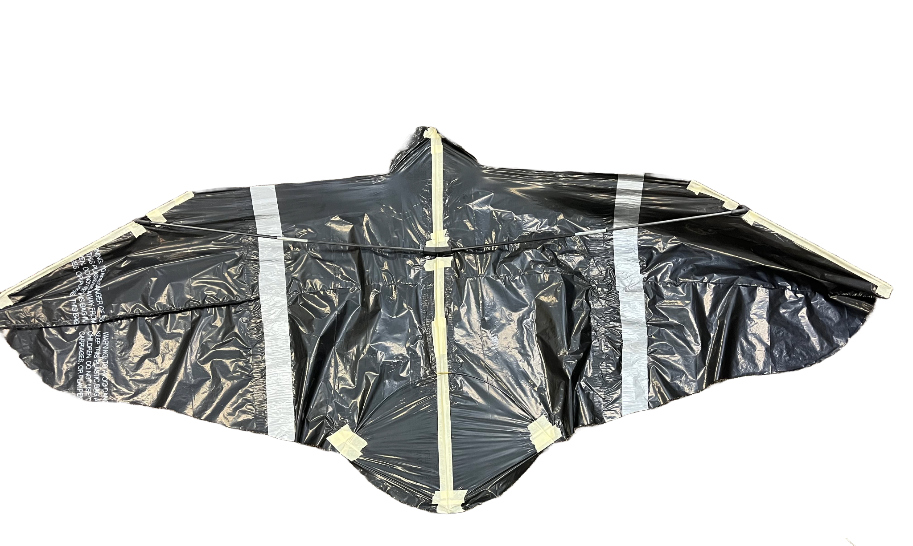
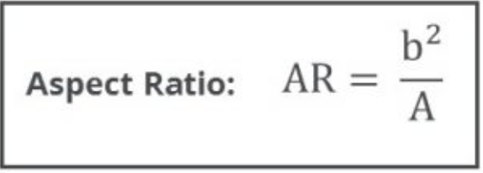
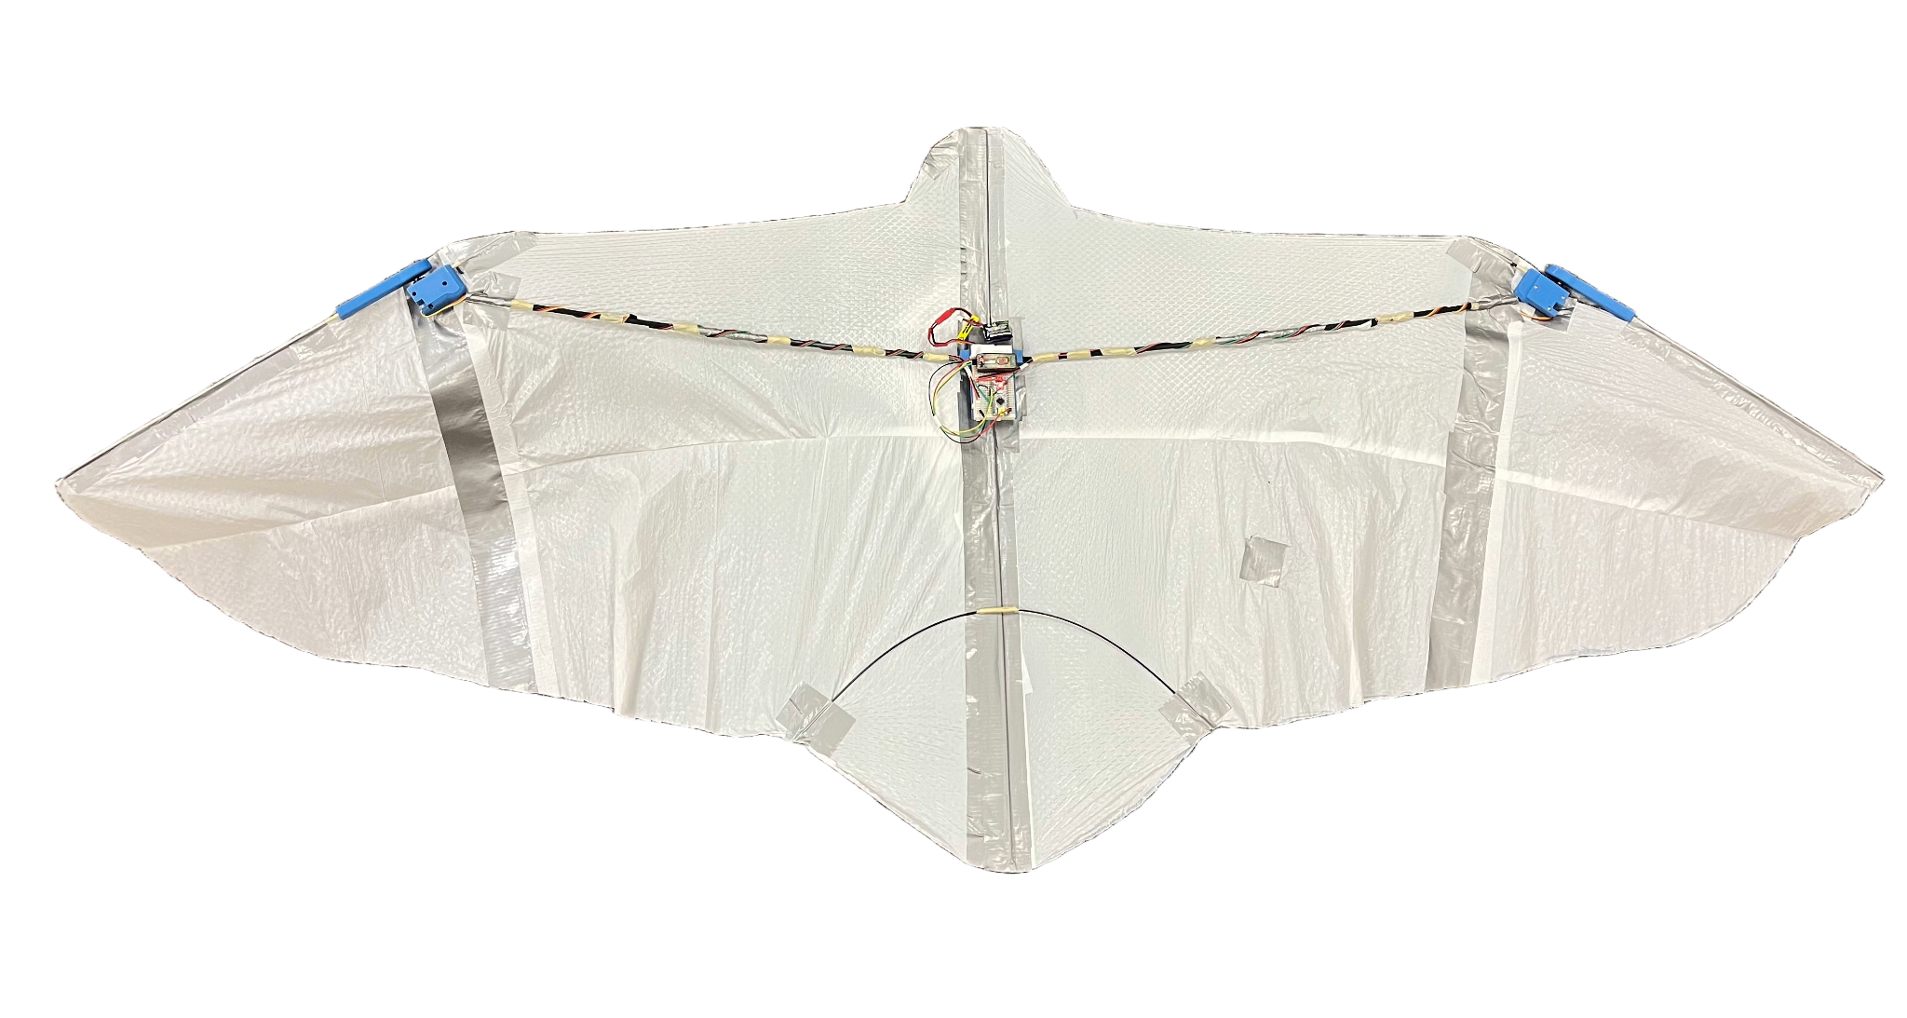
RoboRaptor: Articulated Wing Glider
Ahtesham Alvi, Piyush Sethy, Saiarun Jayanthi, and Dr. Lena Johnson
Goal
This project aims to create a bird-inspired, tethered gliding robot (kite) with articulating flapping wings capable of measuring and characterizing the effects of atmospheric behavior and wind on mechanical flapping and gliding robots.
Prototype 1: Sparrow & Falcon
Large wings made with plastic film and a lightweight frame made up of wooden dowels
Failure: Unable to fly due to unstable joints and fragile plastic body
Prototype 2: Sparrow & Falcon with Actuating Wings
Background
Unlike traditional drones which require a constant external power source for propulsion, gliding robots leverage aerodynamic efficiency to sustain flight by using the gliding and soaring behavior of birds. [1] This enables them to fly without requiring continuous power input, making them especially valuable for environmental monitoring and data collection. [2]
Improved design with 3D printed servo mounts, end connectors, servo wing spars, and a middle hinge connector
Used flexible black film, which was more resistant to wind
Incorporated electronics and servos into the kite
Failure: Wooden dowels were too stiff and broke during flight test
Prototype 3: Eagle
Transitioned the frame from wooden dowels to carbon fiber and aluminum
Adjusted the wing shape based on dimensions of an eagle
Success: Was able to take flight with winds above 7 mph
Governing Principles
Aspect Ratio: The ratio of the length of the wings to their width. It is calculated by dividing the square of the wingspan by the area of the wing. [3] Our kite has a high aspect ratio, which enables it to glide without relying exclusively on flapping
to generate lift.
Prototype 4: Eagle with Actuating Wings
Added servos and actuating wings with 3D printed wing arms and mounts
Used a white film as it is lighter and better suited for hotter climates
Used a 3D printed plate to incorporate all electronics, including wind sensor
Success: Was able to fly with the ability to flap and turn
Wind Data:
References
[1] A. Mohamed, G. K. Taylor, S. Watkins, and S. P. Windsor, “Opportunistic soaring by birds suggests new opportunities for atmospheric energy harvesting by Flying Robots,” Journal of The Royal Society Interface, vol. 19, no. 196, Nov. 2022. doi:10.1098/rsif.2022.0671
[2] A. Khaheshi, H. T. Tramsen, S. N. Gorb, and H. Rajabi, “Against the wind: A load-bearing, yet durable, kite inspired by insect wings,” Materials &amp; Design, vol. 198, p. 109354, Jan. 2021. doi:10.1016/j.matdes.2020.109354
[3] “Aircraft Wing area and aspect ratio,” AeroToolbox, https://aerotoolbox.com/intro-wing-design/ (accessed Jul. 17, 2024).
[4] D. B. Savile, “Adaptive evolution in the avian wing,” Evolution, vol. 11, no. 2, p. 212, Jun. 1957. doi:10.2307/2406051
[5] “House Sparrow Overview, all about birds, Cornell Lab of Ornithology,” Overview, All About Birds, Cornell Lab of Ornithology, https://www.allaboutbirds.org/guide/House_Sparrow/overview (accessed Jul. 17, 2024).
[6] “Peregrine Falcon Overview, all about birds, Cornell Lab of Ornithology,” Overview, All About Birds, Cornell Lab of Ornithology, https://www.allaboutbirds.org/guide/Peregrine_Falcon/ (accessed Jul. 17, 2024).
[7] “Golden Eagle Overview, all about birds, Cornell Lab of Ornithology,” Overview, All About Birds, Cornell Lab of Ornithology, https://www.allaboutbirds.org/guide/Golden_Eagle/ (accessed Jul. 17, 2024).
House Sparrow [4,5]
Peregrine Falcon [4,6]
Golden Eagle [4,7]
Scientific Name: Passer domesticus
Wing Shape: Elliptical Wing
Wingspan: 25.4 cm
Sparrow Aspect Ratio: 5.5
Model’s Aspect Ratio: 2.92
Scientific Name: Falco peregrinus
Wing Shape: High Speed Wing
Wingspan: 81.8 cm
Falcon Aspect Ratio: 7.9
Model’s Aspect Ratio: 4.29
Scientific Name: Aquila chrysaetos
Wing Shape: Slotted High Lift Wing
Wingspan: 194 cm
Eagle Aspect Ratio: 7.4
Model’s Aspect Ratio: 6.24
Sparrows have wide, rounded wings, which allow for greater control
The larger wing width allows for the model to generate greater lift
The wider wings also tend to increase the drag force on the kite
Falcons have a keeled sternum and powerful wing muscles
They have adaptive wings that can adjust shape for various flight conditions
The model’s curved wing shape aids in reducing drag
Their wings are more rounded than a falcon’s but are narrower than a sparrow’s
Allows for reduced drag, increased lift, and cutting through the air
The model’s wing contains an inward curve despite its narrower wings

