Slide 1
🤖 DEEP LEARNING • COMPUTER VISION • DOCKER
AI-Based Smart Product
Identification System
Automated Room Object Detection & Classification using YOLO11 Deep Neural Network
Docker Hub: ahtishamijaz55/smart-product-identification | Port 5050 | Gunicorn + ONNX Runtime
1

Slide 2
Project Overview
What is this system and what problem does it solve?
🎯
🏠
⚡
Purpose
Domain
Approach
Automatically identify and count every furniture item and object inside a room photo using AI.
Real-estate, interior design, hospitality & smart home applications requiring instant room audits.
Upload an image → YOLO11 detects objects → system classifies room type → annotated report generated.
27+
80
YOLO11m
Flask+Gunicorn
Object Categories
COCO Classes
Model Used
Web Server
2

Slide 3
Problem Statement
Challenges this system was built to solve
❌
Manual room audits are slow, expensive and error-prone — requiring human inspectors for every property.
❌
Real-estate platforms cannot automatically tag listings with furniture counts or room type metadata.
❌
Interior designers waste hours cataloguing existing furniture before planning new layouts.
❌
Hospitality management lacks scalable tooling to verify room inventory across hundreds of properties.
❌
Existing vision APIs are generic — no focused, lightweight solution for indoor furniture detection.
✅ Our Solution: A lightweight, containerised AI web-app that returns instant, structured results from a single room photo — no cloud API keys, no per-call billing, runs fully offline.
3

Slide 4
Technology Stack
Every component that powers the system
🧠
YOLO11 (ONNX)
🚀
Gunicorn
State-of-the-art real-time object detection model exported to ONNX format for cross-platform inference.
Production-grade WSGI server with 2 workers and 120-second timeout for heavy image inference.
⚙️
ONNX Runtime
📦
OpenCV (headless)
Hardware-accelerated inference engine — runs YOLO11 efficiently on CPU without GPU requirement.
Image preprocessing — letterbox resizing, BGR→RGB, bounding-box drawing, JPEG encoding.
🌐
Flask 3.0
🐳
Docker
Lightweight Python web framework serving the REST API (/analyze, /sample) and HTML front-end.
Full containerisation — single image bundles model, app and assets. Runs anywhere with one command.
4

Slide 5
System Architecture
End-to-end pipeline from image input to structured output
📸
🔬
🧠
📊
🏷️
📄
User
Input
Preprocess
YOLO11
Inference
NMS +
Filter
Classify &
Count
Report
+ Image
▶
▶
▶
▶
▶
Upload image
or select sample
Letterbox pad
640×640
ONNX Runtime
CPU forward pass
IoU 0.45
Conf 0.18–0.25
Object inventory
& room scoring
JSON response
+ annotated JPEG
All processing happens server-side inside Docker. The browser receives a JSON payload with annotated base64 JPEG + structured item list — no disk writes required.
Input Formats
Output Payload
JPEG · PNG · WEBP | Max 32 MB | Any resolution
base64 annotated image · item counts · room predictions · supervisor report
5

Slide 6
YOLO11 Deep Learning Model
The AI engine at the core of detection
🏗️
Architecture: YOLO11-Medium (CSPNet backbone, PAN-FPN neck, Detect head)
Model Variants Available
📐
Input Size: 640 × 640 px with aspect-ratio letterbox padding
Model
Size
Used?
YOLO11n
10 MB
Fallback
🎯
Classes: 80 COCO object classes — 27 mapped to indoor furniture categories
YOLO11m ✓
80 MB
Primary
🔄
Format: ONNX (Open Neural Network Exchange) — runs on any OS without GPU
⚡
Inference: ONNX Runtime CPU — ~150–400 ms per image depending on hardware
System auto-selects yolo11m.onnx if present;
falls back to yolo11n.onnx automatically.
📉
NMS: Non-Maximum Suppression · IoU threshold 0.45 · Conf threshold 0.18
6

Slide 7
Object Detection & Categories
27 indoor objects across 9 semantic categories
🪑
Seating
🛏️
Sleeping
🪵
Surfaces
Chair · Sofa / Couch
Bed
Dining Table
📺
Electronics
📦
Appliances
🚰
Fixtures
TV · Laptop · Keyboard · Mouse · Phone
Microwave · Oven · Toaster · Refrigerator
Sink · Toilet
🪴
Decor & Study
☕
Dining & Kitchen
🎒
Personal Items
Book · Clock · Vase · Plant
Bottle · Wine Glass · Cup · Bowl
Backpack · Handbag · Suitcase
7

Slide 8
Room Type Prediction Algorithm
Multivariate weighted scoring model with probabilistic ranking
How the Algorithm Works
Scoring Weights
1️⃣
Count detected objects per category (beds, chairs, sofas, appliances…)
Room Type
Key Signal
Weight
2️⃣
Apply weighted score formula — e.g. each bed = 30 pts, each sofa = 25 pts
Living Room
Sofa
+25 pts
3️⃣
Sum scores across all 6 room types and compute probability percentages
Bedroom
Bed
+30 pts
Boost top room to minimum 68% confidence for realistic output
Dining Room
Table
+20 pts
4️⃣
Kitchen
Refrigerator
+25 pts
5️⃣
Return ranked list of all room types with probabilities to the UI
Study / Office
Laptop
+22 pts
Bathroom
Toilet
+35 pts
8

Slide 9
Web Interface & Features
Modern dark-themed single-page application
📤
Image Upload
🖼️
Sample Images
Drag-and-drop or click-to-browse. Supports JPEG, PNG, WEBP up to 32 MB.
3 built-in demo images (living room, bedroom, dining) — one-click testing.
🎚️
Confidence Slider
🏷️
Object Chips
Real-time sensitivity control from 0.10 to 0.95 — fine-tune detection threshold.
Colour-coded category chips for every detected item with icon and count badge.
📊
Room Probability Bar
📝
Supervisor Report
Visual probability bar chart for all 6 room classifications.
AI-generated analytical narrative: inventory, capacity, model info.
🖼️
Annotated Preview
💾
Download Button
Bounding boxes with category-colour tags and confidence % overlaid on image.
Save the annotated image directly from the browser with one click.
9

Slide 10
Docker Deployment
Fully containerised — runs anywhere with a single command
docker run -d -p 5050:5050 --name smart-product-app ahtishamijaz55/smart-product-identification:latest
What's bundled in the image:
Deployment Details
✅
YOLO11-Medium ONNX model (~80 MB) — no download needed
Base Image
python:3.11-slim
✅
Flask app + all Python dependencies pre-installed
Port
5050 (HTTP)
✅
3 sample room images for instant testing
WSGI
Gunicorn 2 workers
static/ templates/ directories with full UI
Health Check
GET / every 30s
✅
Hub Repo
ahtishamijaz55/smart-product-identification
✅
Gunicorn WSGI server (2 workers, 120s timeout)
Tag
latest
✅
HEALTHCHECK — Docker monitors app liveness automatically
Digest
sha256:b9e593c3…
10

Slide 11
API Reference
REST endpoints exposed by the Flask application
/
GET
Serve the main HTML single-page application
/analyze
POST
Core inference endpoint — returns JSON with detections, room predictions and annotated image
/sample/<name>
GET
Serve a built-in sample image (living / bedroom / dining) as JPEG
POST /analyze — Form Parameters:
file (multipart image) | sample_name (living / bedroom / dining) | confidence_threshold (float 0.10–0.95, default 0.18)
11

Slide 12
Results, Use Cases & Conclusion
Impact, applications and next steps
Real-World Use Cases
Key Achievements
🏡
Real Estate — auto-tag property listings with furniture inventory
✅
27 furniture/object types detected out of 80 COCO classes
🏨
Hospitality — verify hotel room standards at scale
✅
6 room types classified with probabilistic confidence scores
🎨
Interior Design — instant existing-layout audit before redesign
✅
Full Docker image — runs offline, no API keys required
📦
Insurance — automated room-content documentation for claims
✅
Sub-400ms inference on standard CPU hardware
🏫
Education — demo platform for object-detection courses
✅
Production WSGI server, health-checked, ready to scale
Conclusion
The AI-Based Smart Product Identification System demonstrates how a lightweight, fully containerised deep-learning pipeline can deliver production-ready room analysis — making object detection accessible to anyone with Docker.
🐳 docker pull ahtishamijaz55/smart-product-identification:latest
12

Slide 13
Live Detection Results
Real annotated outputs from YOLO11 running inside Docker
ahtishamijaz55/smart-product-identification:latest
13

Slide 14
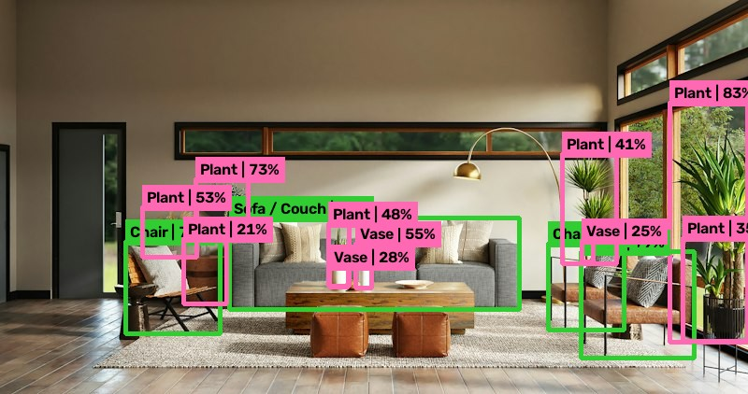
Detection Result: Living Room
YOLO11-Medium | Confidence threshold: 0.20 | IoU NMS: 0.45
AI Classification
🏠 Room Type
Living Room
📊 Confidence
68.0%
🪴 Plants
7 detected
🪑 Chairs
3 detected
🏺 Vases
3 detected
🛋️ Sofa / Couch
1 detected
Other predictions:
Dining Room 19.7%
Study / Home Office 12.3%
14

Slide 15
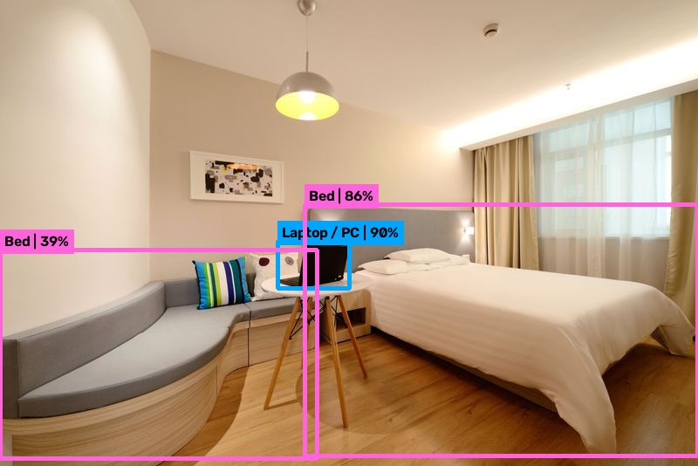
Detection Result: Bedroom
YOLO11-Medium | Confidence threshold: 0.20 | IoU NMS: 0.45
AI Classification
🏠 Room Type
Bedroom
📊 Confidence
73.8%
🛏️ Beds
2 detected
💻 Laptop / PC
1 detected
👥 Capacity
Sleeping for 2
Other predictions:
Study / Home Office 26.2%
Model auto-selected yolo11m.onnx
for maximum accuracy.
15

Slide 16
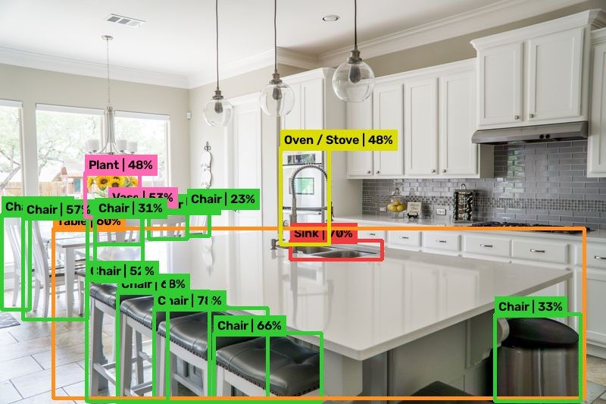
Detection Result: Dining Room
YOLO11-Medium | Confidence threshold: 0.20 | IoU NMS: 0.45
AI Classification
🍽️ Room Type
Dining Room
📊 Confidence
68.0%
🪑 Chairs
11 detected
🪵 Table
1 detected
🚰 Sink
1 detected
🍳 Oven/Stove
1 detected
👥 Capacity
~14 persons
Other predictions:
Study/Office 13.4% | Living Room 8.5%
16

