Slide 1
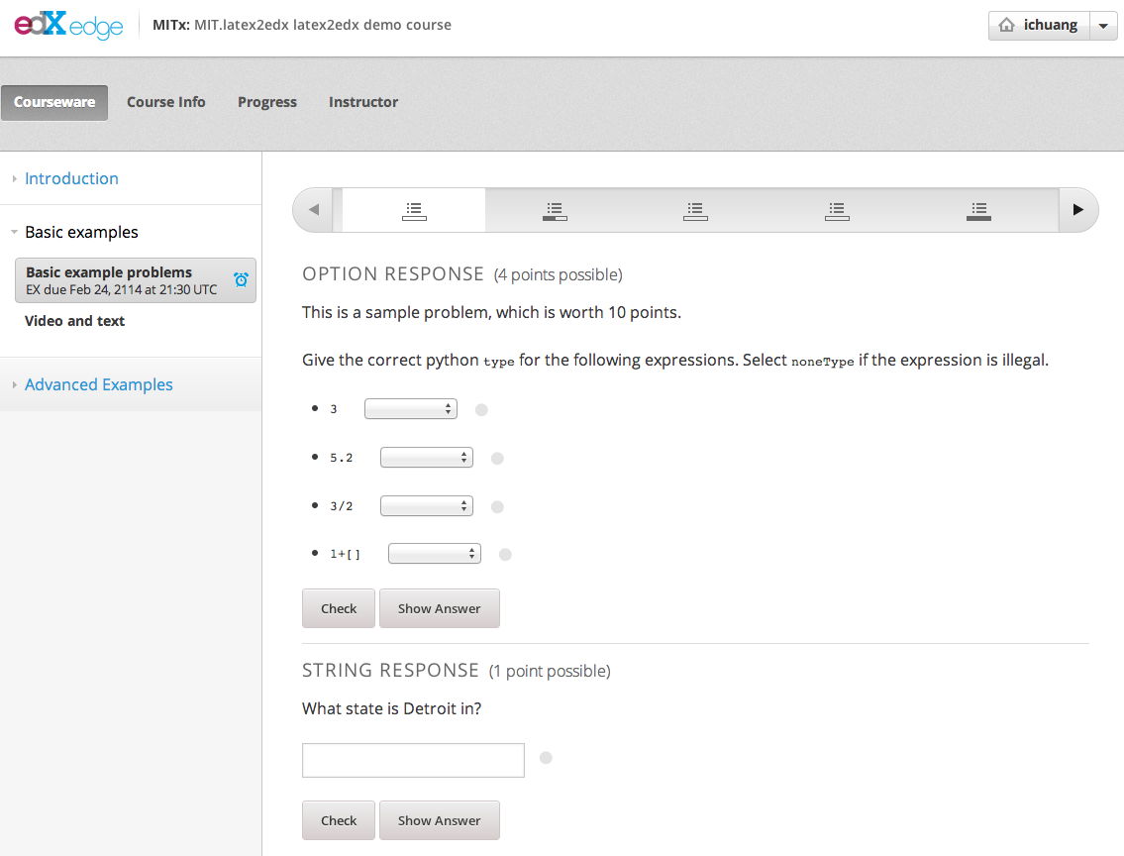
Chapters
Six verticals within this sequential
Two problems in this vertical
Two sequentials
in this chapter

