Slide 1

Show Business Kazakhstan
Aibolat Batyrov & Doszhan Turar

Slide 2
Project Explanation
A project about the music of Kazakhstan. That is, the music portal of Kazakhstan. The user will be able to choose musicians, genres and listen to their music. And can also see the lyrics of the song.
The project contains one application: qazmusic

Slide 3
Project includes:
12 template: 1 base template, others extends it
5 models
Static files: CSS files, image files
utils.py
forms.py

Slide 4
Templates
Our project includes 12 template.
One base template and others extends it.
Uses Django Template Language

Slide 5
Models
Our project includes 5 model: Tracks, Artists, Genres, Charts, Lyrics
Uses SQLite Database
Models contains CharField, IntegerField, FileField, ImageField, DateField, TextField, ManyToManyField, ForeignKey

Slide 6
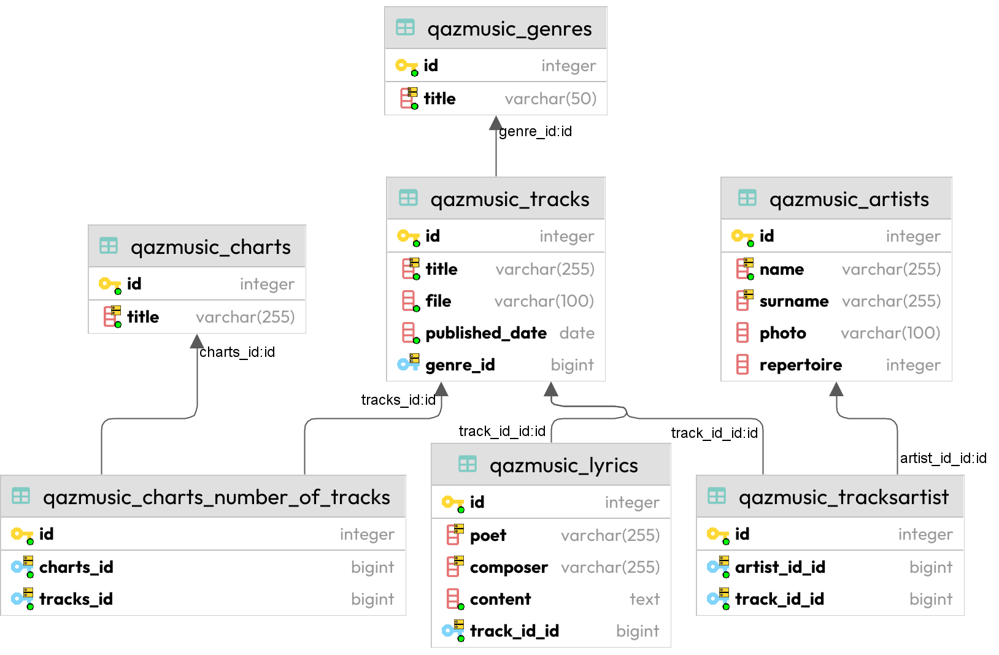
Entity Relation Diagram

Slide 7
CRUD functions
Select
Insert
Update
Delete

Slide 8
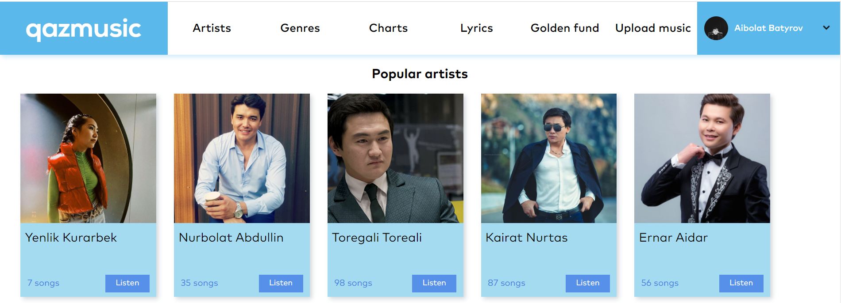
Select
User can see the information from the database in web-page. Therefore, we will not modify the select operation.

Slide 9
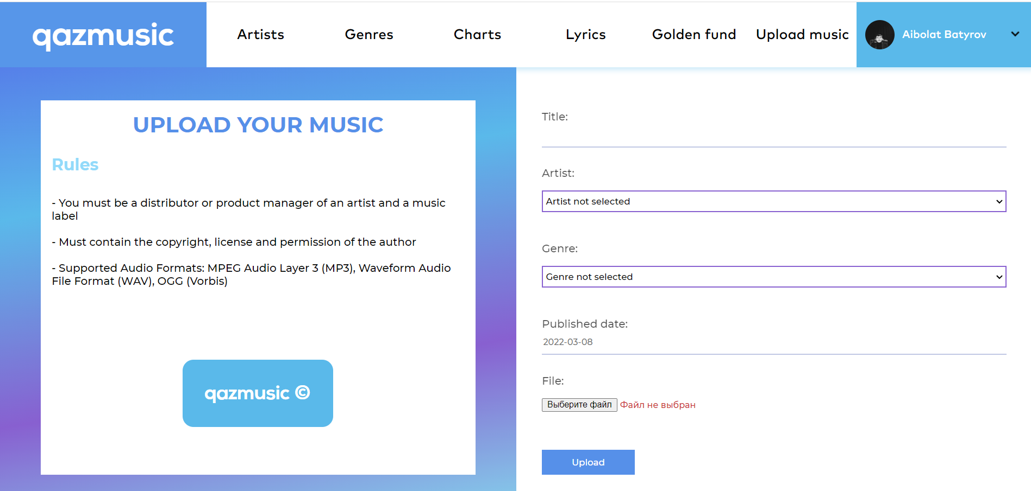
Insert
User can upload their music to the database

Slide 10
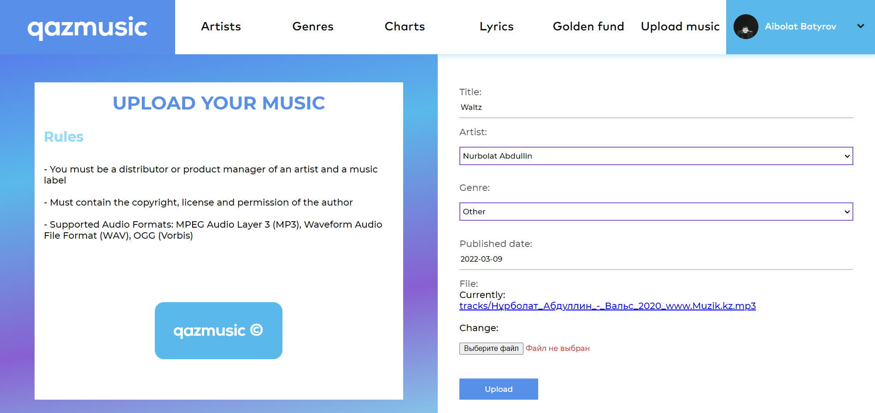
Update
User can update fields of Track table in database in web-site

Slide 11
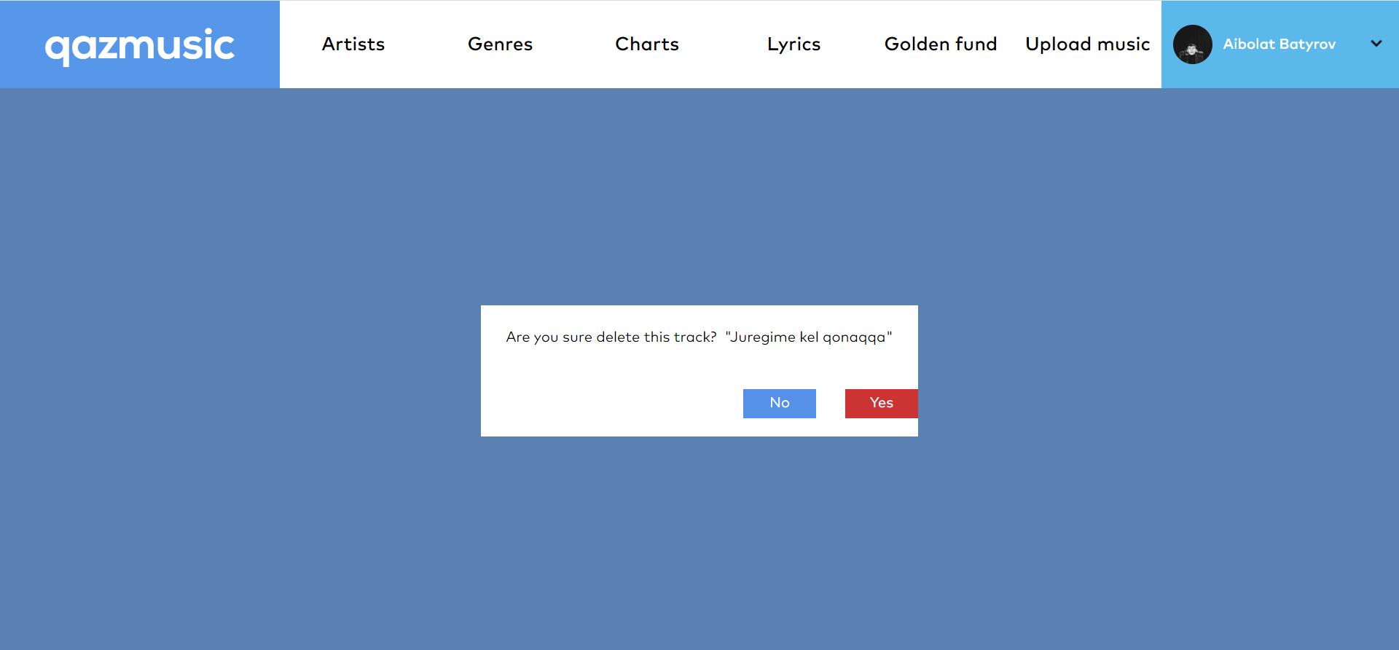
Delete
User can delete tracks from database in web-site

Slide 12
Thanks for attention!
visit our website!

