Slide 1
Diabetes Prediction using Machine Learning
Raghavendra
Brahma Vamsi Madasu

Slide 2
About Diabetes
Diabetes, is a group of metabolic disorders in which there are high blood sugar levels over a prolonged period. Symptoms of high blood sugar include frequent urination, increased thirst, and increased hunger.
If left untreated, diabetes can cause many complications. Acute complications can include diabetic ketoacidosis, hyperosmolar hyperglycemic state, or death. Serious long-term complications include cardiovascular disease, stroke, chronic kidney disease, foot ulcers, and damage to the eyes.

Slide 3
Objective
We will try to build a machine learning model to accurately predict whether or not the patients in the dataset have diabetes or not?

Slide 4
About Dataset
This dataset is originally from the National Institute of Diabetes and Digestive and Kidney Diseases. The objective of the dataset is to diagnostically predict whether or not a patient has diabetes, based on certain diagnostic measurements included in the dataset.
Several constraints were placed on the selection of these instances from a larger database. In particular, all patients here are females at least 21 years old of Pima Indian heritage.

Slide 5
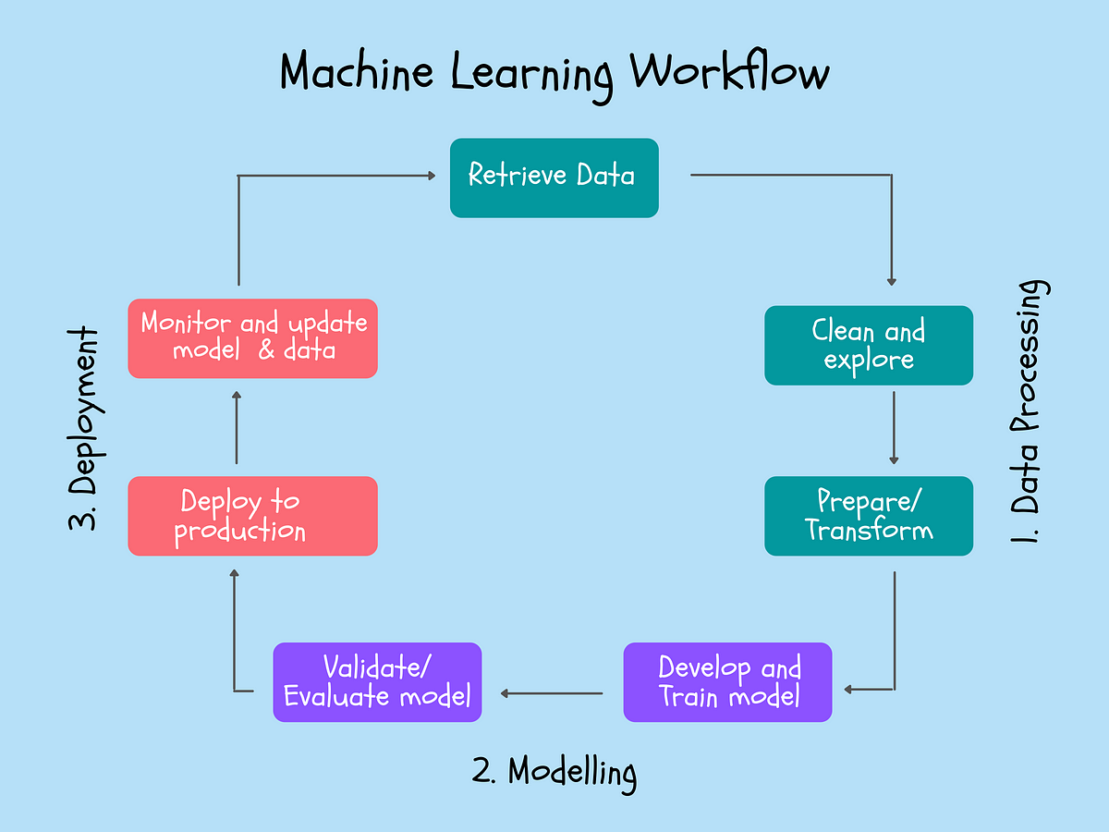
Machine Learning flow
1)Retrieve Data
Collected data from Kaggle
2)Clean and Explore
Explored the dataset using various EDA techniques
Impute missing values by median
Removing outliers from the dataset
Feature scaling using sklearn Robust scalar
3)Train models
Random forest
GradientBoostingClassifier
Logistic Regression

Slide 6
1)Evaluation of model
Accuracy score
Confusion matrix , precision , Recall

Slide 7
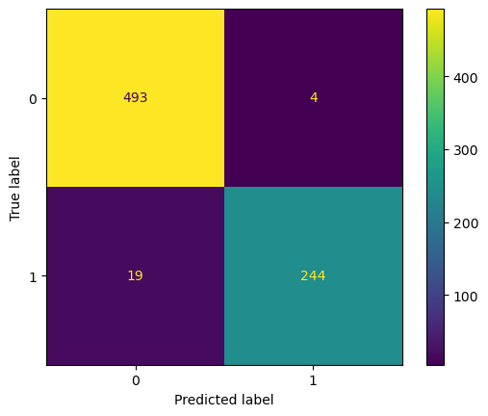
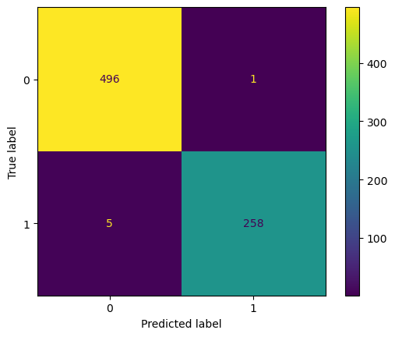
Comparison
 | Random Forest |  |  | GradientBoosting
 | Acuracy | Precision | Recall | Acuracy | Precision | Recall
Score | 0.89 | 0.98 | 0.92 | 0.90 | 0.99 | 0.98

Slide 8
Reporting
The aim of this study was to create classification models for the diabetes data set and to predict whether a person is sick by establishing models and to obtain maximum validation scores in the established models. The work done is as follows:
Result;
The model created as a result of XGBoost hyperparameter optimization became the model with the high Cross Validation Score value. (0.90)

Slide 9
Thank you

