Slide 1




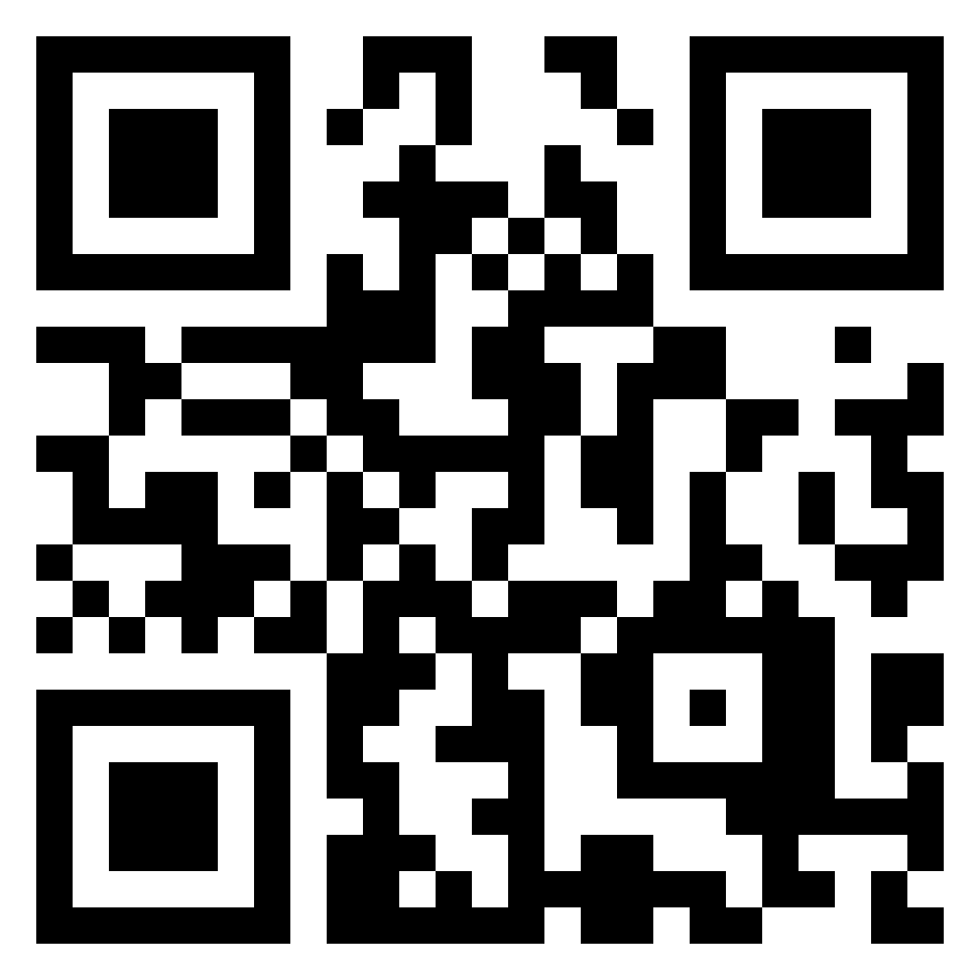
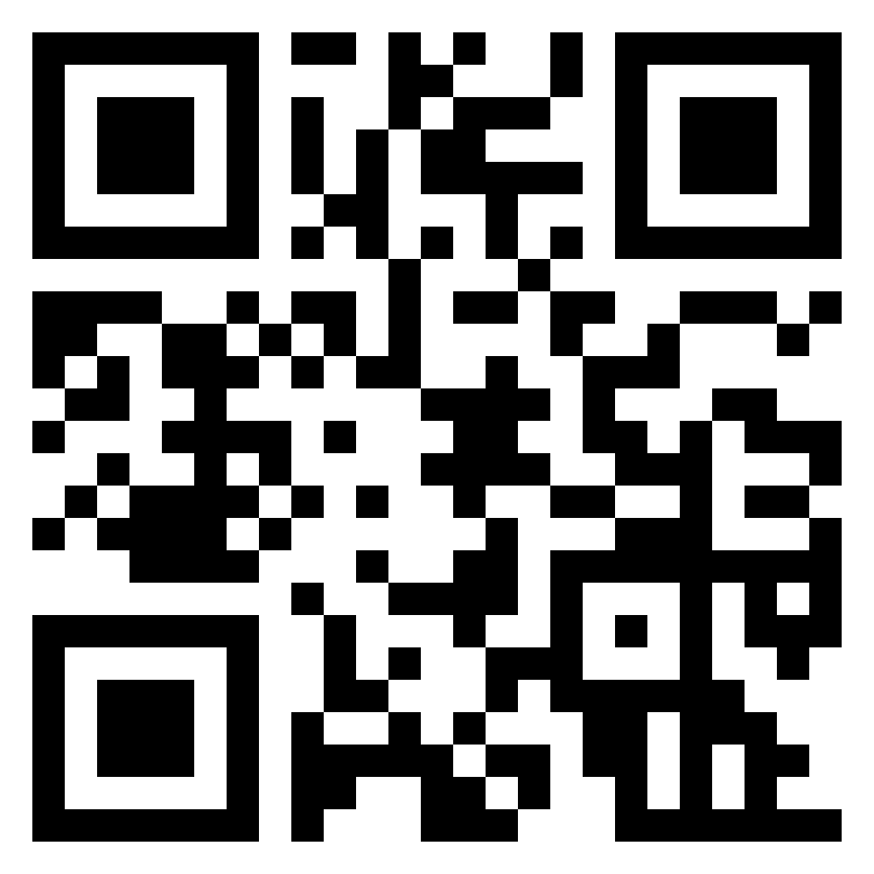
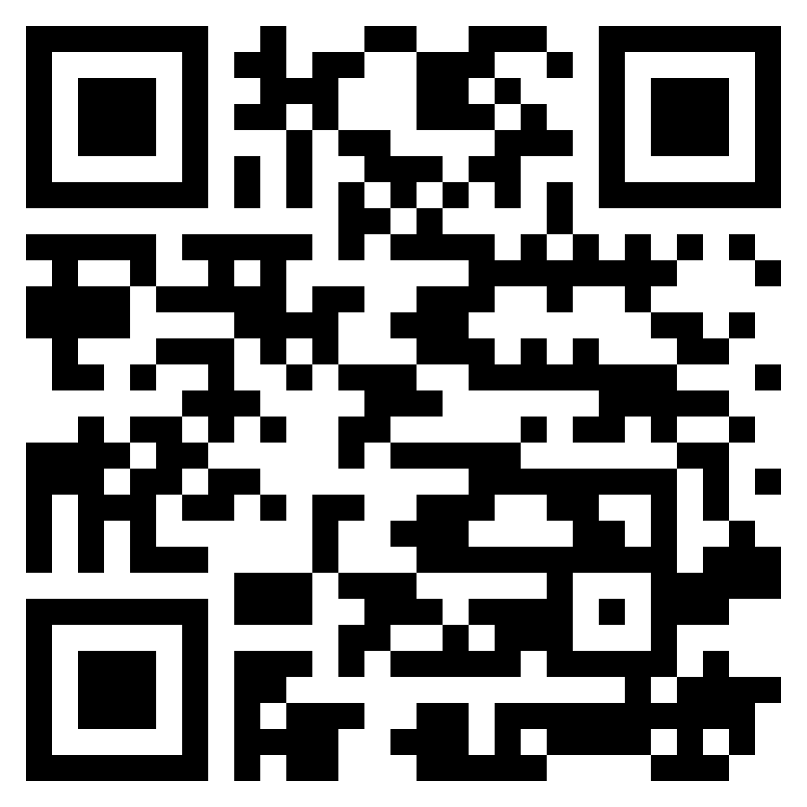
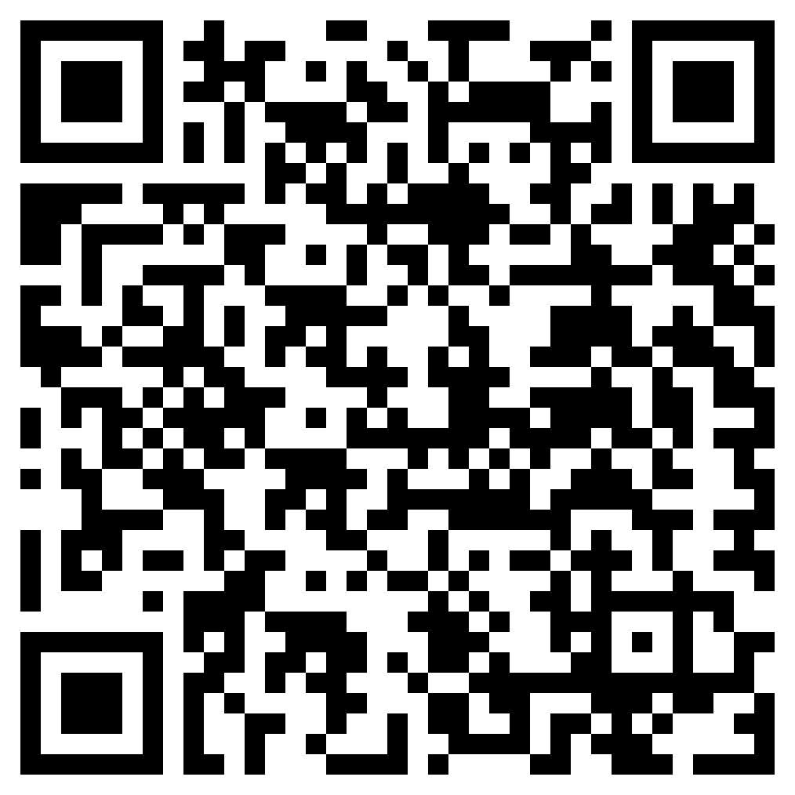
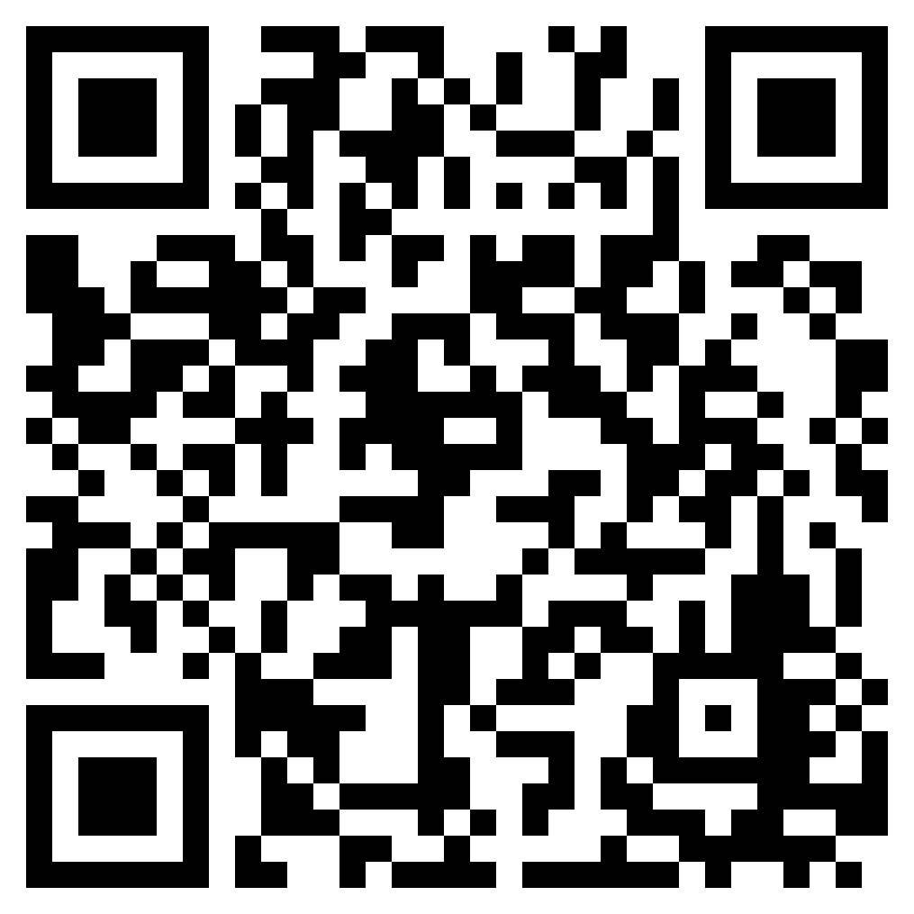
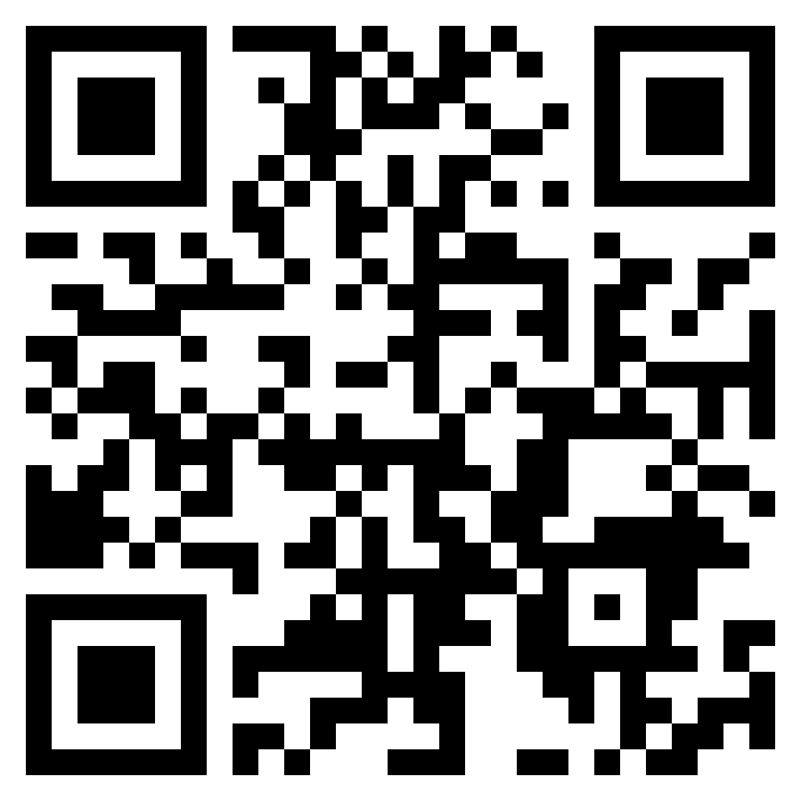
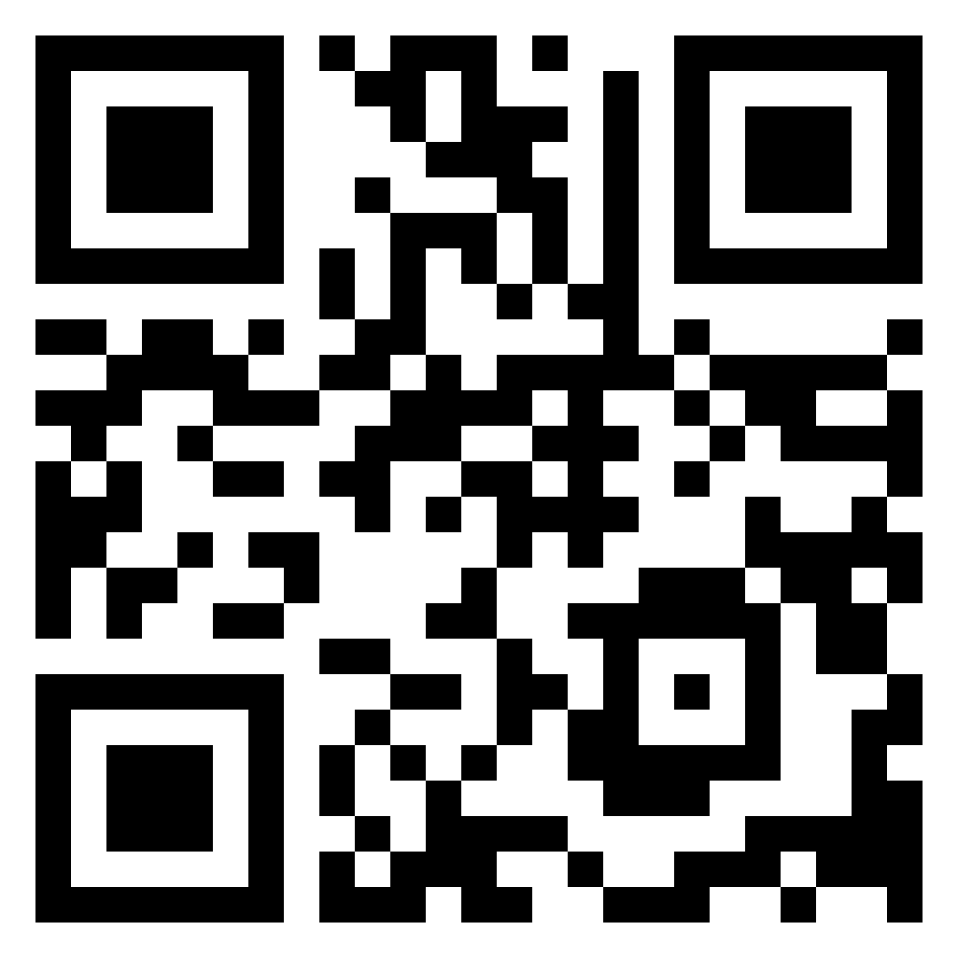

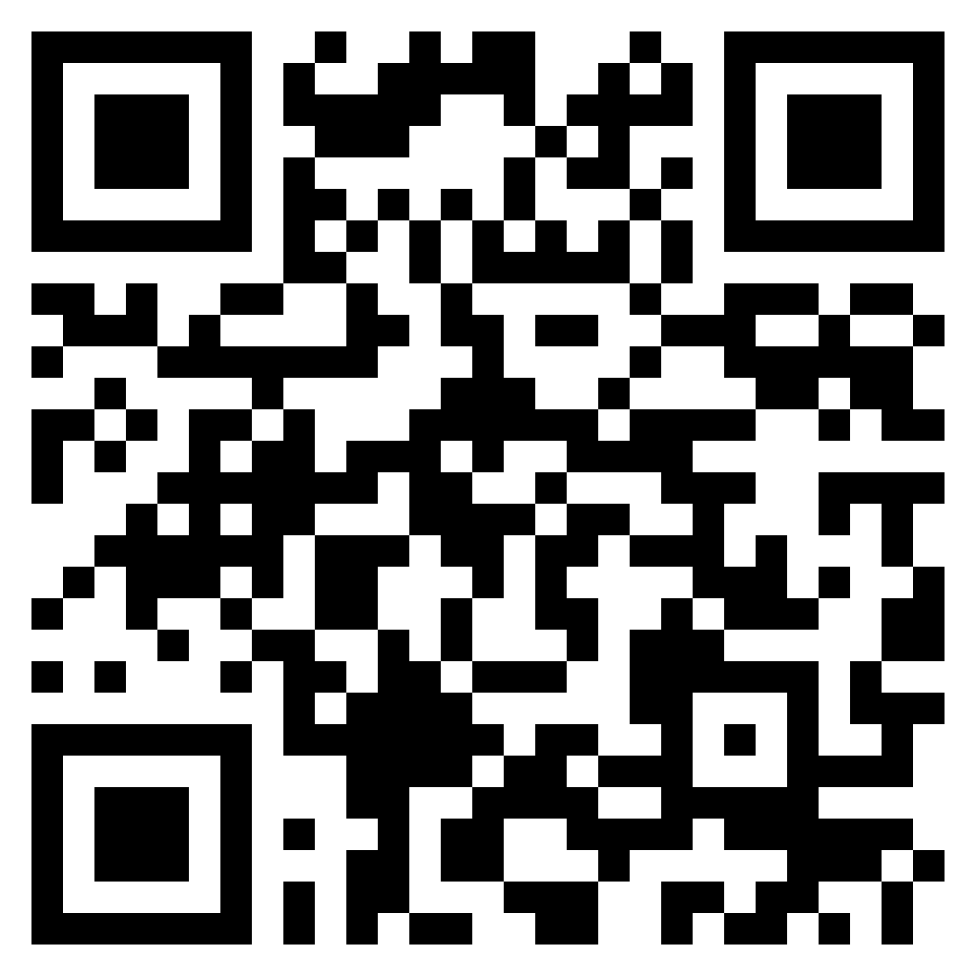
Society of artificial intelligence Research (SAIR)
SAIR
https://ai2healthcare.github.io/ https://github.com/Ai2healthcare ai2healthcareweeklyonlinem899 https://space.bilibili.com/2056525058
人工智能群2
人工智能群3
制药群2
制药群3

Slide 2
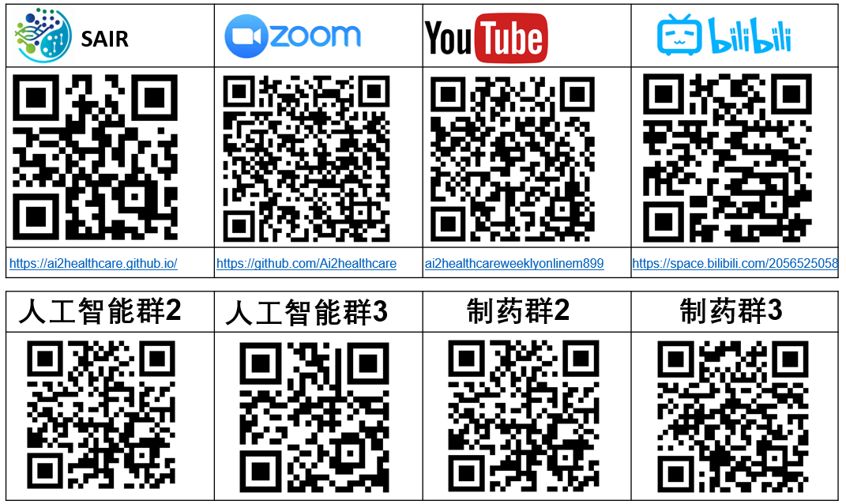
Society of artificial intelligence Research (SAIR)

