Slide 1
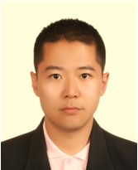
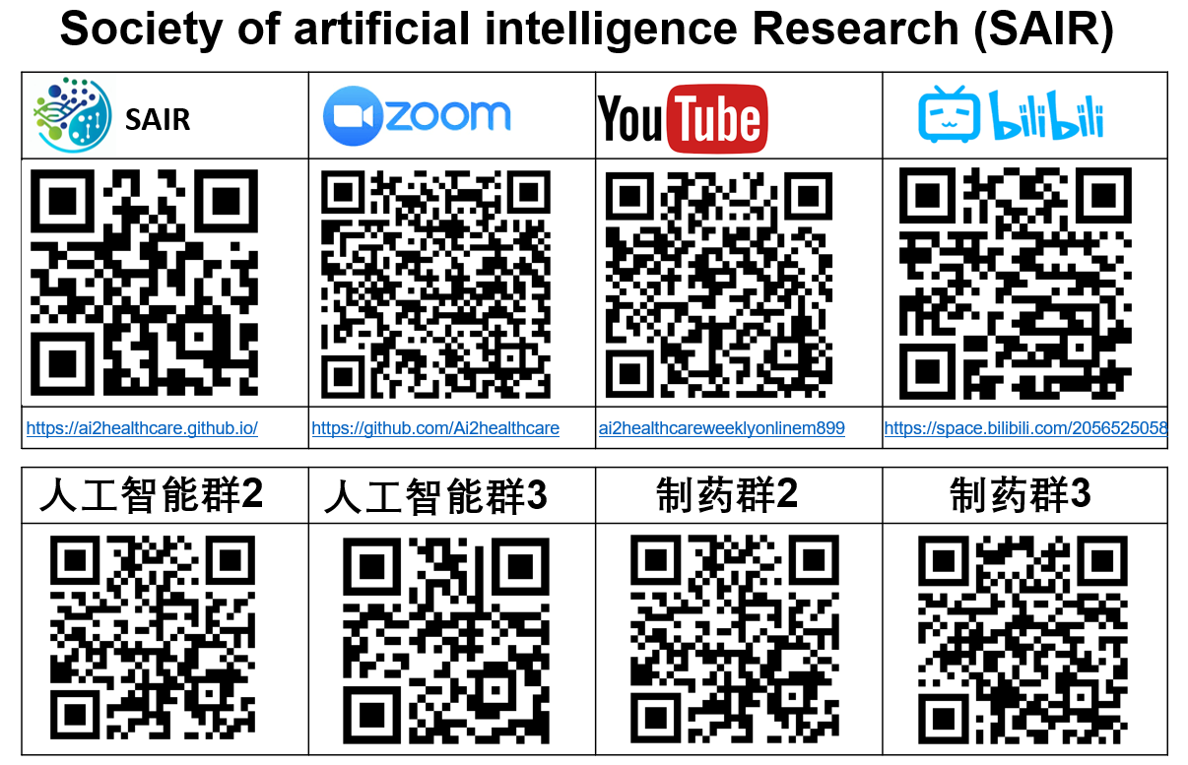
MAIB-Class-016: Foundation of Quantum Mechanism
Background
Quantum computing is a rapidly accelerating field with the power to revolutionize artificial intelligence (AI) and machine learning (ML).
Rooted in parallelization and able to manage far more complex algorithms, quantum computers will be the key to unlocking the next generation of AI and ML models.
Quantum computing grows very quickly. It is reported that IBM has over 20 quantum systems available on the cloud from their Poughkeepsie and Yorktown locations. In 2024, IBM will add a new cloud data center with 100+ qubit quantum systems in Ehningen, Germany.
Quantum computing can significantly accelerate the drug discovery process. Its computational power allows for complex molecular simulations, predicting drug-target interactions, understanding mechanisms of action, and designing more effective drugs.
In summary, quantum computing will redefine the drug discovery.
The first lecture discuss the basics of quantum computing, how it differs from classical computing, and its potential applications in addressing current challenges.
Dr. Jun Qi
Research Assistant Professor in the Department of Computer Science at Hong Kong Baptist University

