Slide 1




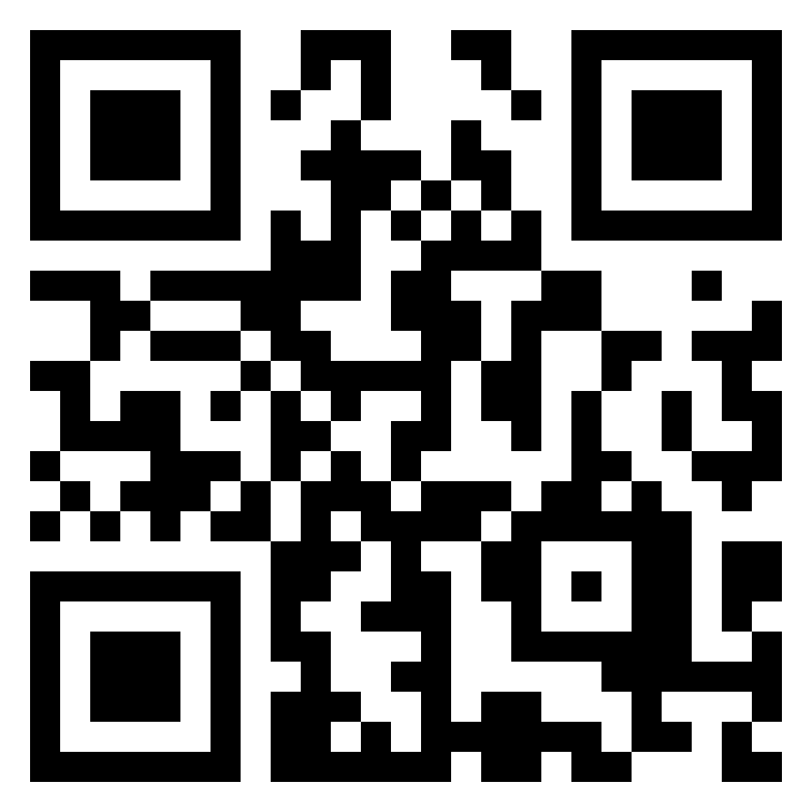
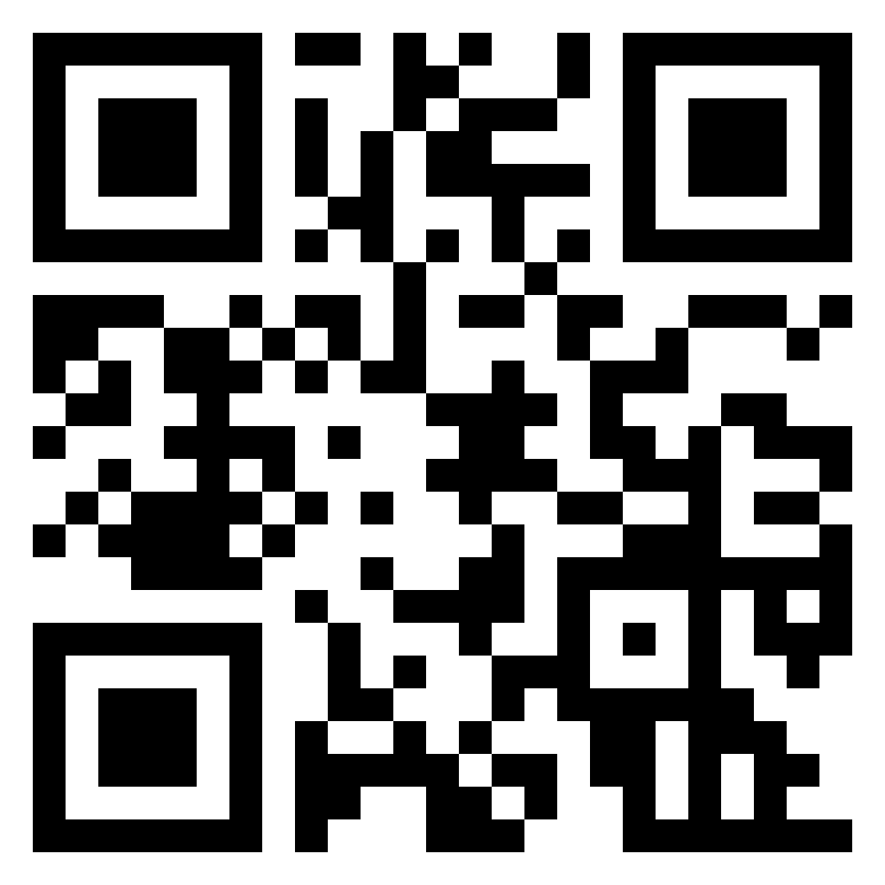
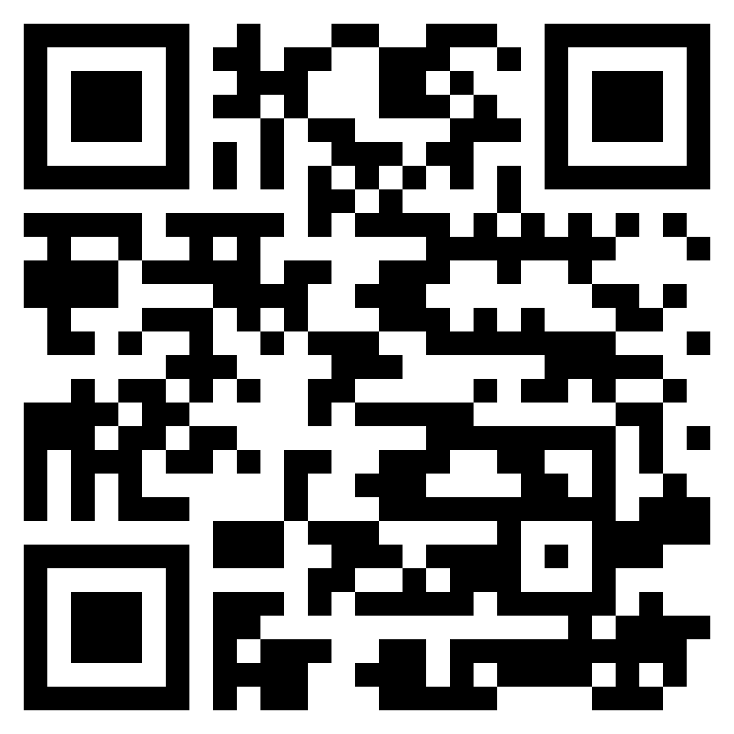
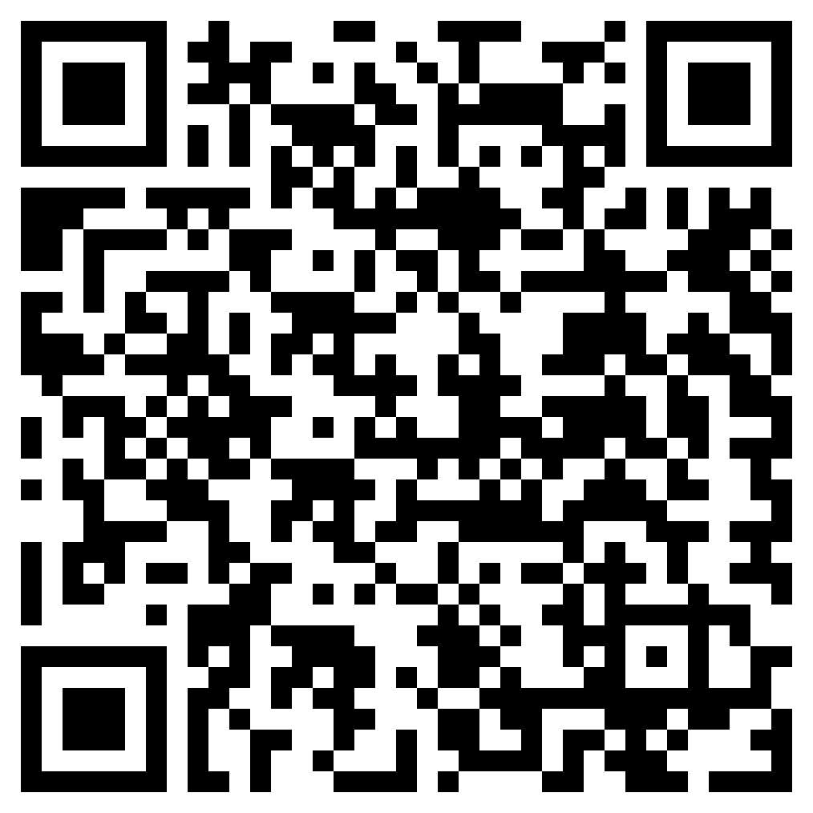
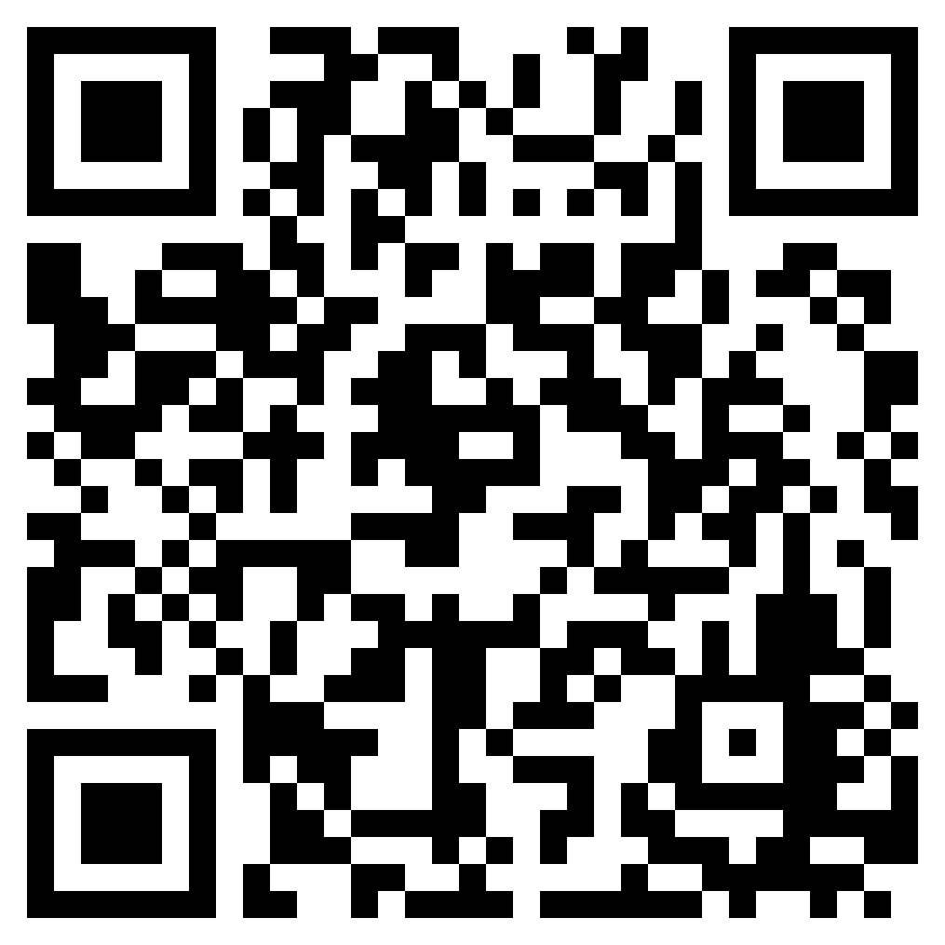
Society of artificial intelligence Research (SAIR)
Online Weekend Seminar Events - MAIB-Talk-025. Dr. Yucong Duan
SAIR
https://ai2healthcare.github.io/ https://github.com/Ai2healthcare ai2healthcareweeklyonlinem899 https://space.bilibili.com/2056525058
Time: Saturday 10:00pm EST / Sunday 10:00am Beijing Time
Zoom ID: 933 1613 9423
Zoom Passwd: 416262

