Slide 1
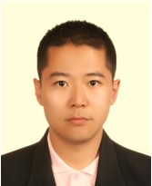
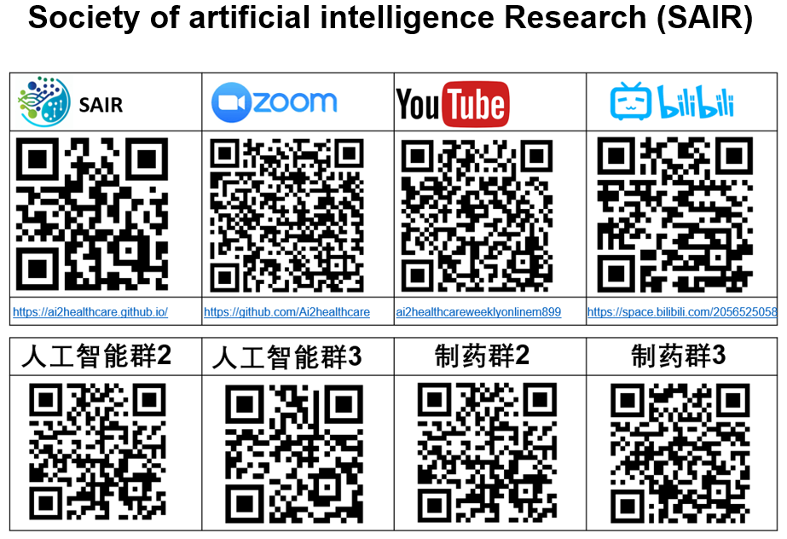
MAIB-Class-015: Foundation of Quantum Mechanism
Dr. Jun Qi is now a Research Assistant Professor in the Department of Computer Science at Hong Kong Baptist University. Previously, he received a Ph.D. from the School of Electrical and Computer Engineering at Georgia Institute of Technology, advised by Prof. Chin-Hui Lee and Prof. Xiaoli Ma for the Speech, Language, and Signal Processing research. His current study focuses on (1) Quantum Machine Learning Theory, which investigates the interplay of trainability, generalization, and expressive power in quantum machine learning models as we explore paths to practical quantum advantage in Artificial Intelligence; (2) Quantum Optimization Algorithms, which involve the development of quantum-aware optimization techniques tailored for quantum neural networks and the design of quantum approximate algorithms addressing combinatorial optimization problems; (3) Speech Signal and Natural Language Processing, which employs efficient deep learning computing techniques that enable speech and language processing on resource-constrained devices.
Background
Quantum computing is a rapidly accelerating field with the power to revolutionize artificial intelligence (AI) and machine learning (ML). Rooted in parallelization and able to manage far more complex algorithms, quantum computers will be the key to unlocking the next generation of AI and ML models. Quantum computing grows very quickly. It is reported that IBM has over 20 quantum systems available on the cloud from their Poughkeepsie and Yorktown locations. In 2024, IBM will add a new cloud data center with 100+ qubit quantum systems in Ehningen, Germany. Quantum computing can significantly accelerate the drug discovery process. Its computational power allows for complex molecular simulations, predicting drug-target interactions, understanding mechanisms of action, and designing more effective drugs. In summary, quantum computing will redefine the drug discovery. The first lecture discuss the basics of quantum computing, how it differs from classical computing, and its potential applications in addressing current challenges.
Dr. Jun Qi
Research Assistant Professor in the Department of Computer Science at Hong Kong Baptist University
New York Time: 10pm, Sept, 2nd, 2023

