Slide 1
Linux 0.11进程调度
张延慈

Slide 2
输出进程的信息
schedule is called by do_exit.
Maybe 15 is the longest counter and 3 is the chosen one?
The chosen task:
3: pid=3, state=0, counter = 15, father=1
jiffies is 4
all tasks as follows:
0: pid=0, state=1, counter = 14, father=-1
jiffies is 4
1: pid=1, state=0, counter = 14, father=0
jiffies is 4
2: pid=2, state=3, counter = 13, father=1
jiffies is 4
3: pid=3, state=0, counter = 15, father=1
jiffies is 4

Slide 3
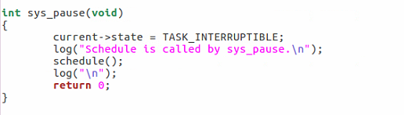
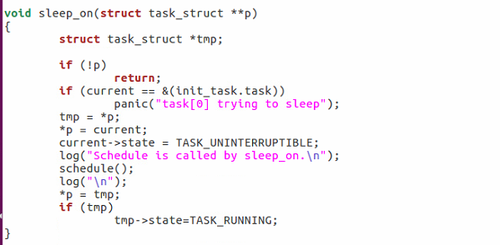
输出调用进程调度函数的位置
在exit.c和schedule.c中，schedule.c被调用

Slide 4
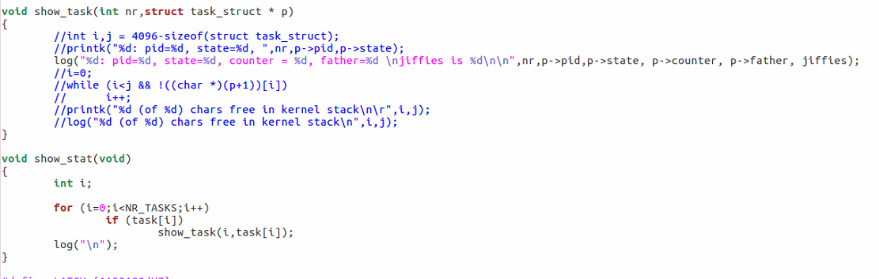

Slide 5
3: pid=3, state=0, counter = 15, father=1
jiffies is 4
all tasks as follows:
0: pid=0, state=1, counter = 14, father=-1
jiffies is 4
1: pid=1, state=0, counter = 14, father=0
jiffies is 4
2: pid=2, state=3, counter = 13, father=1
jiffies is 4
3: pid=3, state=0, counter = 15, father=1
jiffies is 4
Pid = 0
Pid = 1
Pid = 2
Pid = 3

Slide 6
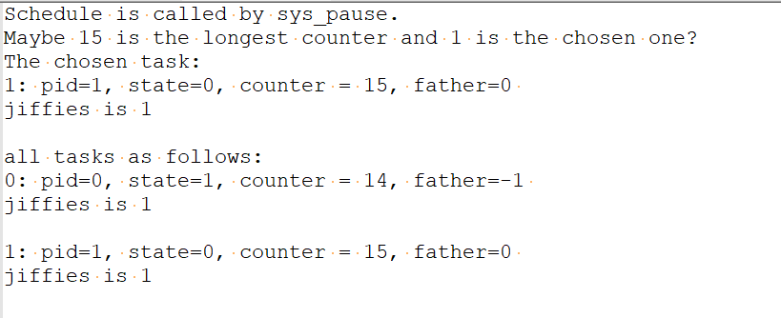

Slide 7
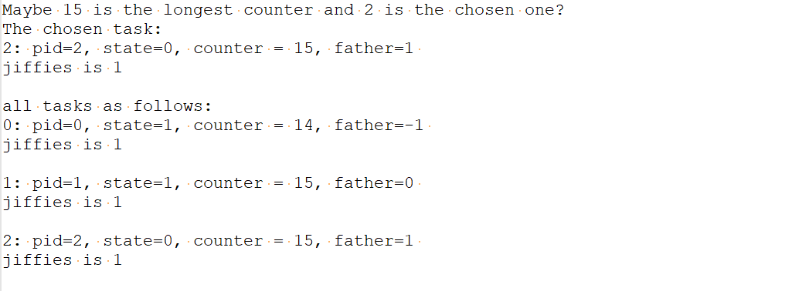

Slide 8
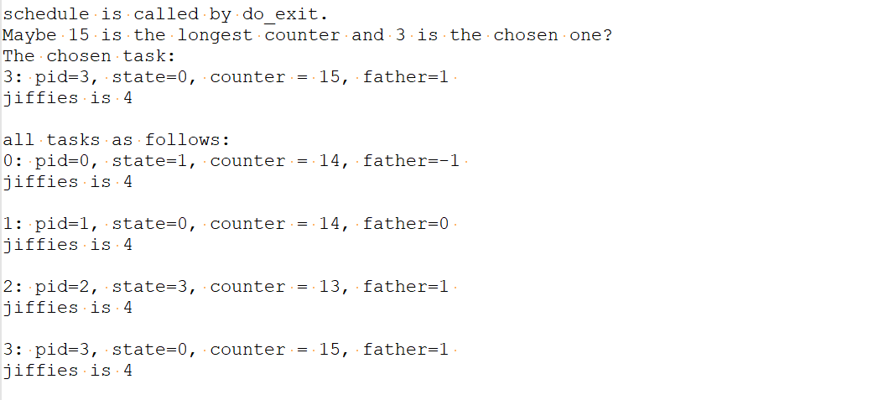

Slide 9
