Slide 1



Generative AI
www.aiqsofttech.com

Slide 2
AGENDA
Introduction to Gen AI and Prompting
Embedding & Chunking
Vector DB
Semantic Search
Retrieval Augmented Generation – Architecture
Cost Evaluation
www.aiqsofttech.com

Slide 3
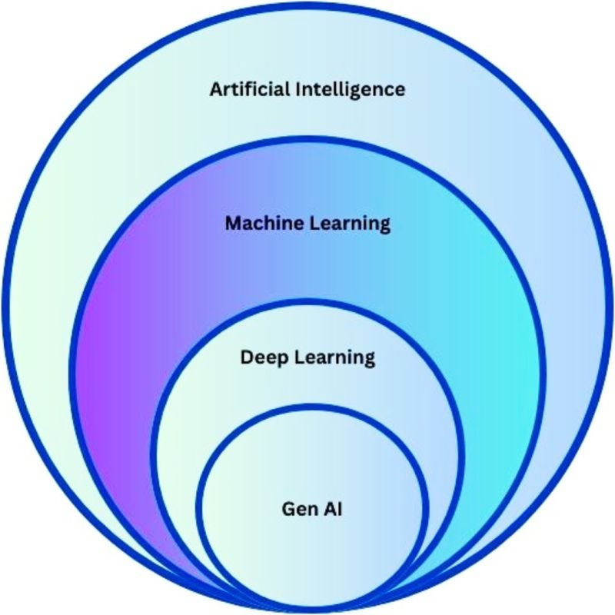



History of AI
AI
Artificial intelligence, or AI, is technology that enables computers and machines to simulate human intelligence and problem-solving capabilities..
ML
It’s a subfield of AI, allows computers to learn patterns from data and make predictions without explicit programming
Deep Learning
Deep learning is the branch of machine learning which is based on artificial neural network architecture.
www.aiqsofttech.com

Slide 4

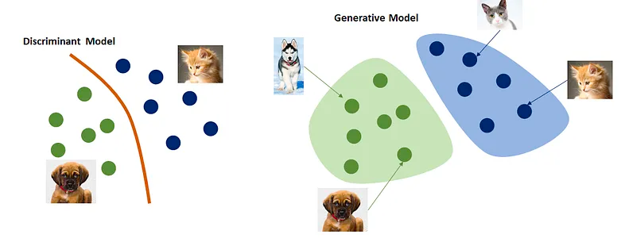
What is Generative AI ?
Discriminative models, also referred to as conditional models, are a class of logistical models used for classification or regression.
Generative AI is a branch of artificial intelligence (AI) that focuses on creating new content, such as text, images, code, or music. It uses algorithms to learn the patterns and features of existing data, and then to generate new data that is similar but also original.
www.aiqsofttech.com

Slide 5

Application of Gen AI
Customer support
Language translation
Content generation
Image classification
Document extraction
Robotics
Healthcare
Autonomous vehicles
www.aiqsofttech.com

Slide 6
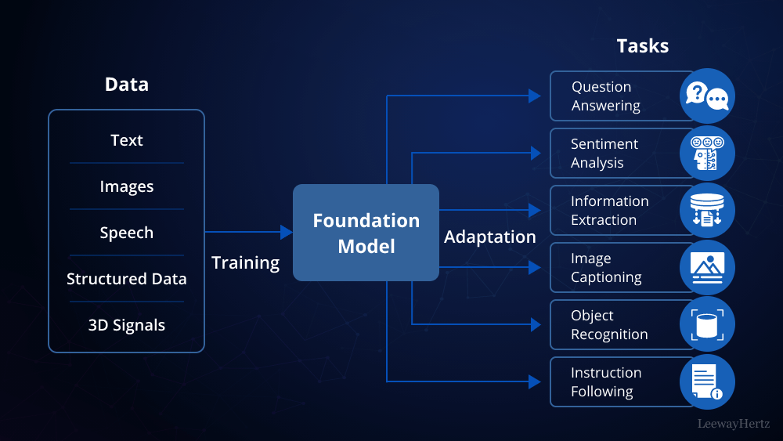
Foundational Models
Foundation models are AI neural networks trained on massive unlabeled datasets to handle a wide variety of jobs from translating text to analyzing medical images.

Slide 7



ANATOMY OF AN EFFECTIVE PROMPT
Contextual information
Clarity
Specificity
Desired format
Length constraints
Examples
or Hints

Slide 8
A clear prompt is easy for both humans and AI models to understand
Clarity
It should convey your request or question without ambiguity
Specificity
An effective prompt is specific and well-defined
It should clearly state the information or data you want from the AI model
Contextual Information
Including relevant context can help the AI model generate more accurate responses
Desired Format
Specify the format you want the answer in
It can be a list, paragraph, chart, or any other format that suits your needs
Length Constraints
Specify the desired length, as a guide for the AI model
Providing examples or hints can clarify your request and guide the AI model
Examples or Hints

Slide 9
Prompting Techniques
Zero Shot Prompting
Language Translation
Sentiment Analysis
Few Shot Prompting
Content Classification
Text / Data Summarization
CoT Prompting
Customer Assistant
Virtual assistant
www.aiqsofttech.com

Slide 10
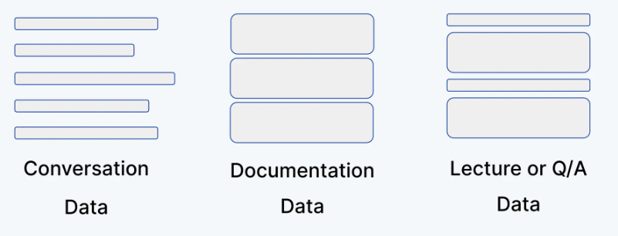
Chunking
Data / Context Structure
Chunk Size
Chunk Overlap
Character Splitters
www.aiqsofttech.com

Slide 11
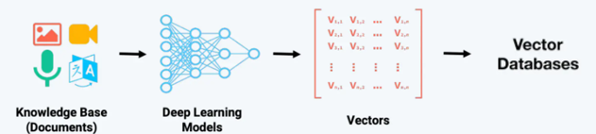




Embedding & Vector DB
Embedding Strategies
Embedding Chunks Directly
Embedding Sub and super chunks
Incorporating Chunking & Non-Chunking Metadata
Picking a Model
Content to Embed
Metadata
www.aiqsofttech.com

Slide 12
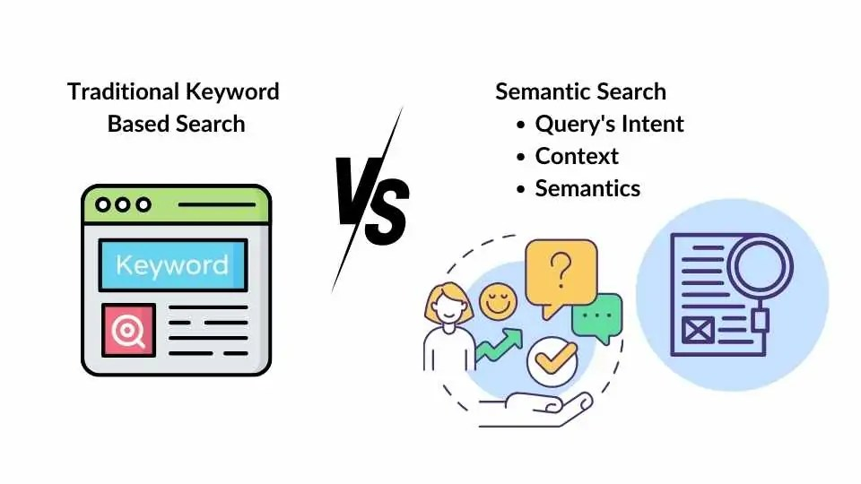
Semantic Similarity Search
Semantic similarity measures the likeness between two pieces of text based on their meaning and context

Slide 13
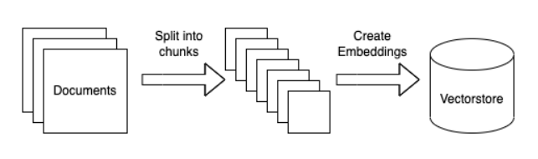
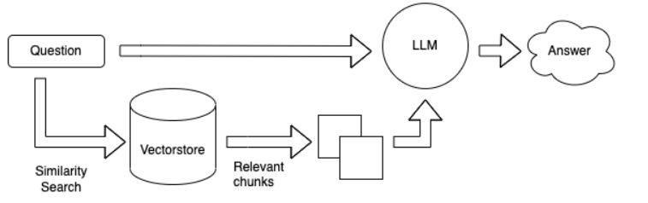
High Performance RAG – Architecture
Context Preparation
Types of Chunking
Embeddings
Document Store
Vector DB Store
Model Realtime Flow
Cost evaluation
Optimal RAG
Guardrails
www.aiqsofttech.com

Slide 15
Cost Evaluation
 | Total Number of Documents | 10
 | Total Pages in a Document | 50
 | Words per Page in a document | 200
 | No of Users per day | 10
 | No of Questions per User | 20
 | Input Words in a question | 30
 | Output / Responses | 2000
Claude 3.5 Sonnet | Price per 1,000 input tokens | 0.003
 | Price per 1,000 output tokens | 0.015
 | Total Input Tokens Per day | 900000000
 | Input Operational Cost Per Day | 2700
 | Total Output Tokens PerDay | 600000
 | Output Operational Cost | 9

