Slide 1
Pneumonia detection and localization
Project group 25
Sandra Sandström, Felix Hessinger, Christos Michail

Slide 2
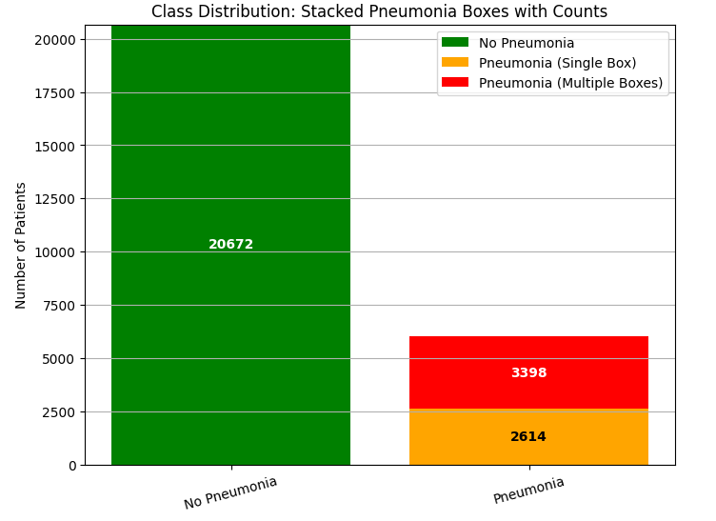
Data-set presentation and exploration
LAYOUT GUIDE
The layout guide looks like this. It appears on some of the slides to help you understand how the slide is intended to be used.
--------------
This info box will not appear when you present your slide.
Data-set used: RSNA pneumonia detection challenge
RSNA Pneumonia Detection Challenge | Kaggle
Chest X-rays in DICOM format (grayscale), ~27 000 training images

Slide 3
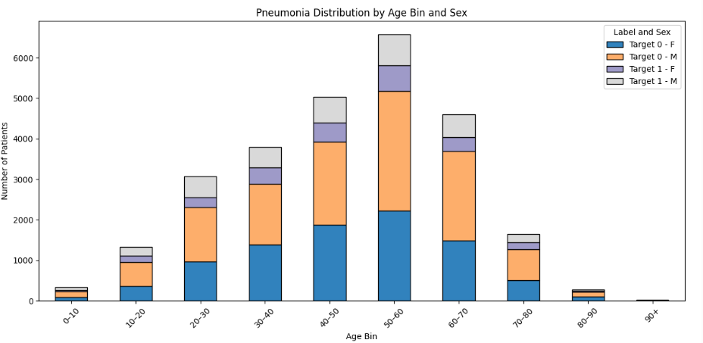
Data-set distribution

Slide 4
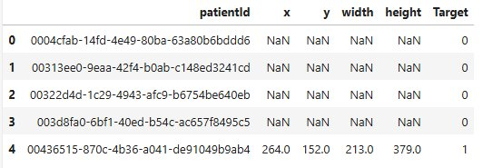
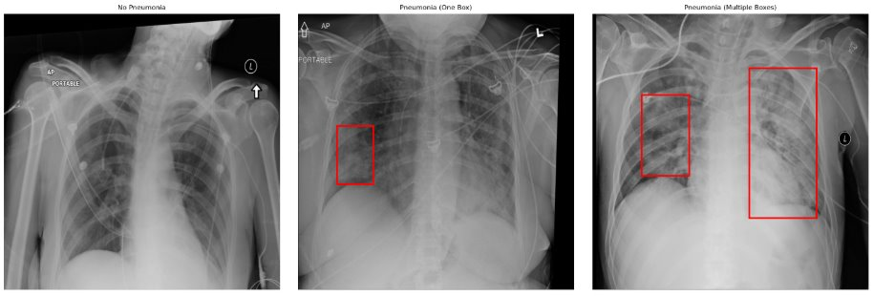
Labelling in form of pneumonia/ non- pneumonia and bounding boxes of pneumonia affected areas

Slide 5
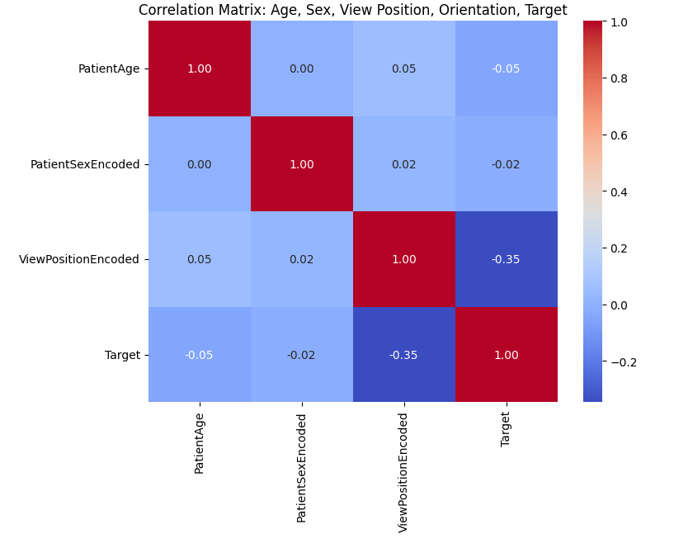

Correlation-matrix
Pneumonia rate per view position
Notes:
AP – Anteroposterior – generally for sick patient or patients who otherwise can't stand up for the examination, the higher prevalence of pneumonia in this group is therefore not a good predictor.
PA – Posteroanterior. The best practice examination technique, the patient stands with their front pressed to the detector and x-rays coming from the back.

Slide 6
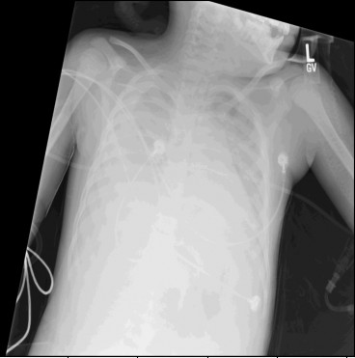
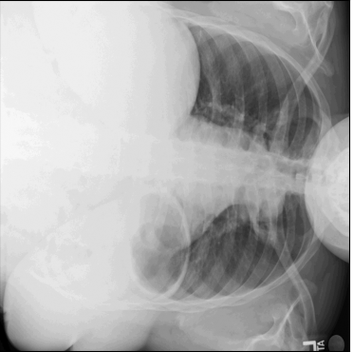
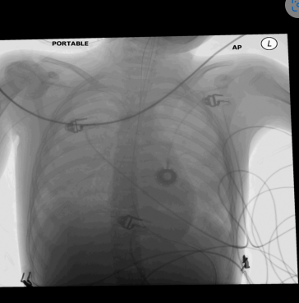
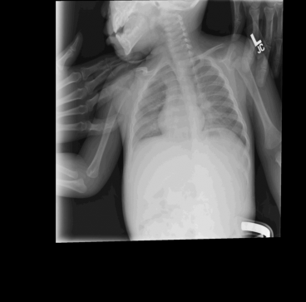
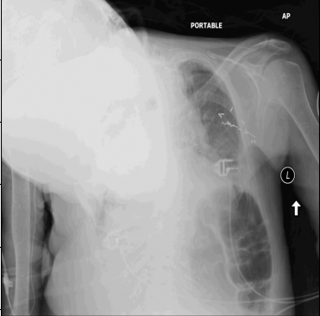
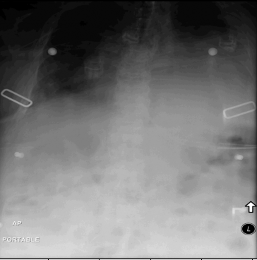
Exclusion of 32 images
Notes:
Low contrast 2. Rotated 3. Inverted 4. Small children/other objects in image 5. Cyphotic patient 6. Lousy image quality overall. 31 / 32 excluded images were AP viewposition

Slide 7
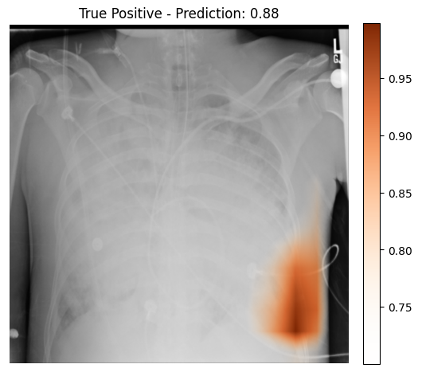
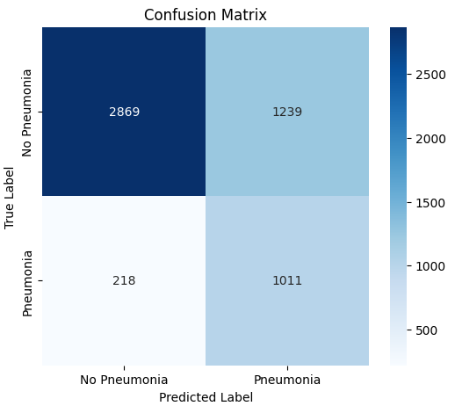
First attempt, pretrained Resnet-18
Classification only
Achieved accuracy ~ 72%
Notes:
Right image is gradcam that shows what part of the image has made the biggest contribution to a positive (pneumonia) result.

Slide 8
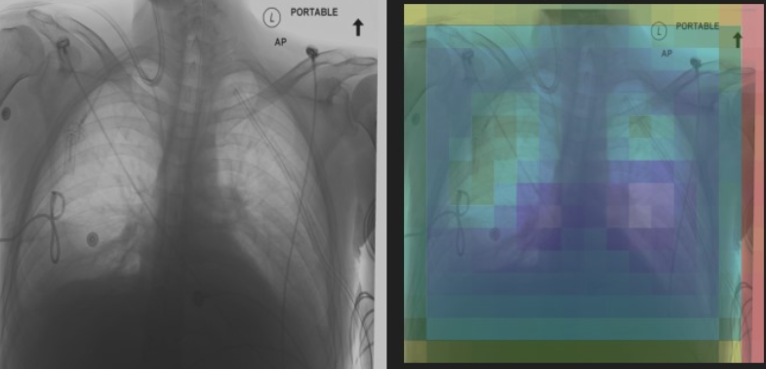
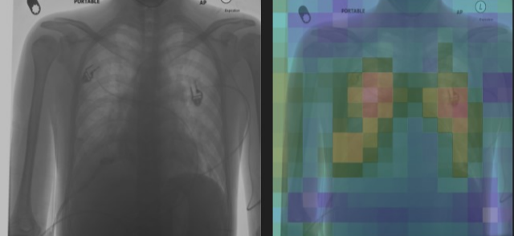
Different models – Single Classifier Brute Force
Single Classifier
Pretrained models:
Efficientnet B0
ResNet18
SeResNet18
ResNet50
SeResNet50
Modification
Input layer: To fit the input data
Pixel head: reshape, add complex learning, dropout, convolution
Upsampling: increases resolution map
Classification
Classifier
Dimension reduction, dropout, fully connected layer.
Efficientnet B0 Pre trained 2nd Epoch
Efficientnet B0 Pre trained 48th Epoch​
Notes:
I would actually prefer a comparison with the resnet-50 you trained felix, but this is a good start anyways

Slide 9
Division and pre-processing of data-set
Training 90%, Validation 7.5%, Test 2.5%
Random pre-processing (training data only)
Rotation (max 10°)
Small translations
Contrast-, brightness- and gamma-modifications
Training data, sampler to up-sample pneumonia cases to get even distribution in each batch
Notes:
I would actually prefer a comparison with the resnet-50 you trained felix, but this is a good start anyways

Slide 10
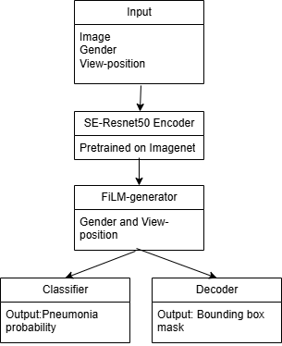
Final model
Dual head model
Backbone shared encoder: pretrained SE-Resnet50
The features generated by the encoder multiplied by film generator for gender and view position
Decoder to bounding box- image
Classifier

Slide 11
Training scheme
Optimizer: AdamW
Loss-function - Combination of bounding box-loss and classification loss
The ratio of each loss changing over training, start with high bbox-loss
Scheduler: CosineAnnealingLR over 30 epochs
Notes:
I would actually prefer a comparison with the resnet-50 you trained felix, but this is a good start anyways

Slide 12
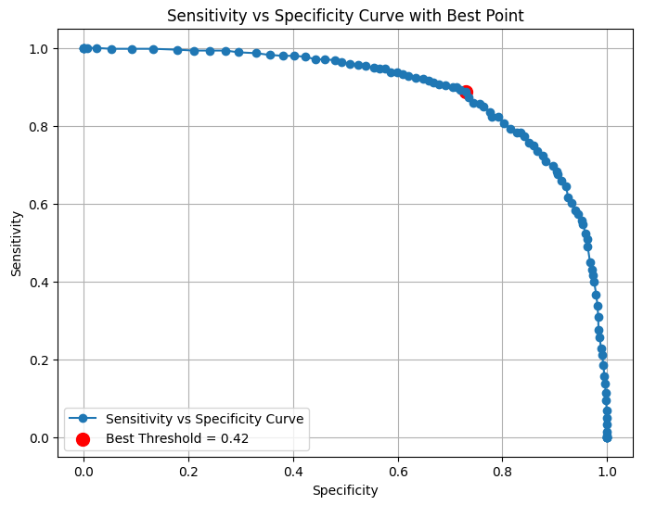

Results, Validation data
Decide best prediction threshold based on Youden index:
Sensitivity = TP / (TP + FN)
Specificity = TN / (TN + FP)
Notes:
I would actually prefer a comparison with the resnet-50 you trained felix, but this is a good start anyways

Slide 13
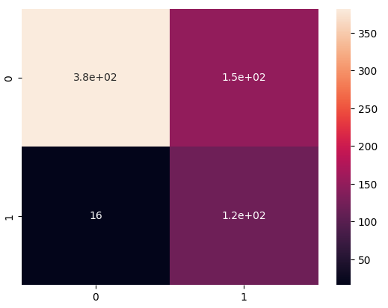
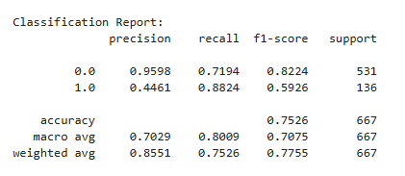
Results, Test data
Notes:
I would actually prefer a comparison with the resnet-50 you trained felix, but this is a good start anyways

Slide 14
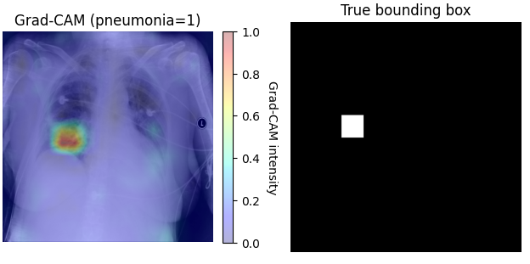
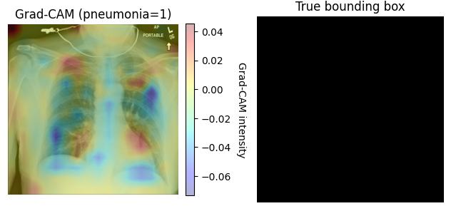
So... Did it work? Grad-CAM on final model
Pneumonia
Non-Pneumonia

Slide 15
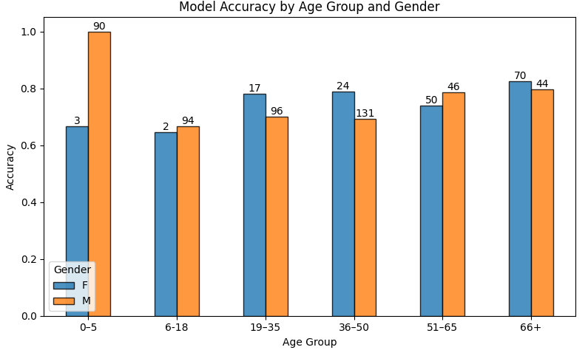
Discussion
Other Dicom-data that could be included
Pixel-size – included in this dataset
Age
Exposure Index – not included
Exposure details – not included
Using view-position and gender – right or wrong?
Notes:
I would actually prefer a comparison with the resnet-50 you trained felix, but this is a good start anyways

Slide 16
Data repository
All code can be found here: marsan-4/Project_D7047E
Notes:
I would actually prefer a comparison with the resnet-50 you trained felix, but this is a good start anyways

Slide 17
Luleå University of Technology Logotype

Slide 18
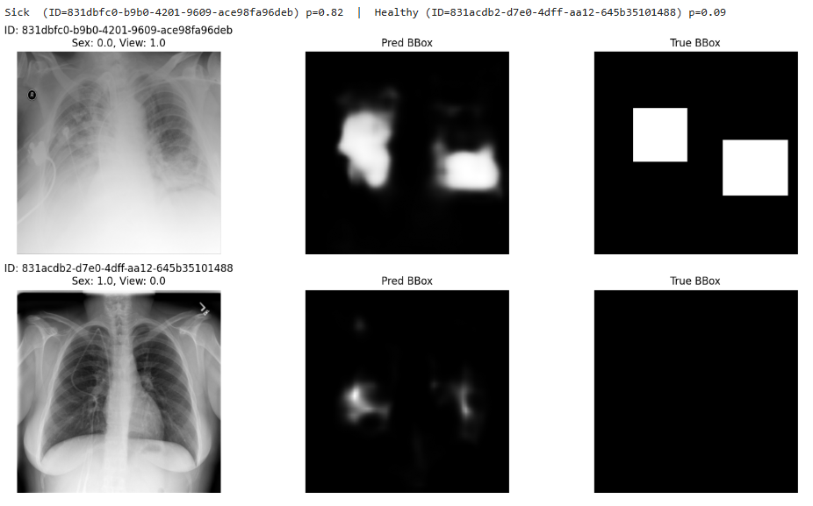
Final model
Notes:
I would actually prefer a comparison with the resnet-50 you trained felix, but this is a good start anyways

Slide 19
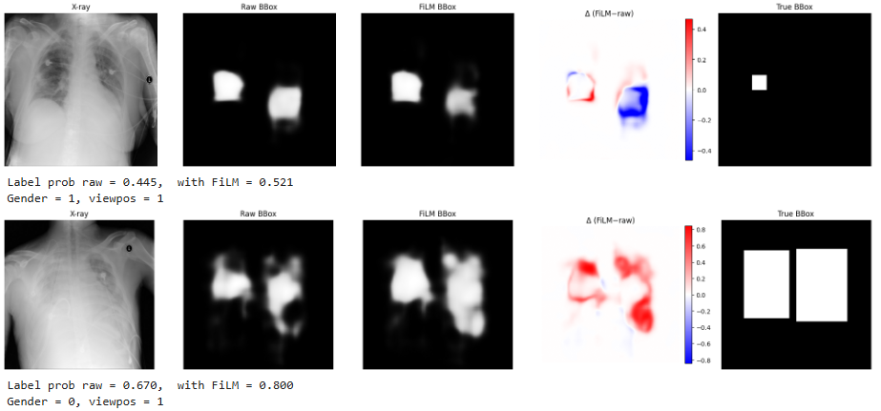
Film effect
Notes:
I would actually prefer a comparison with the resnet-50 you trained felix, but this is a good start anyways

