Slide 1
Programming languages A KiCK-OFF

Slide 2
Programming languages
Enable constructing representations of a computational process; well-defined algorithms processing information
Mapping to machine instructions
Syntax and associated semantics
Fundamentally just like human languages and form of expression
Non-functional properties become critical

Slide 3
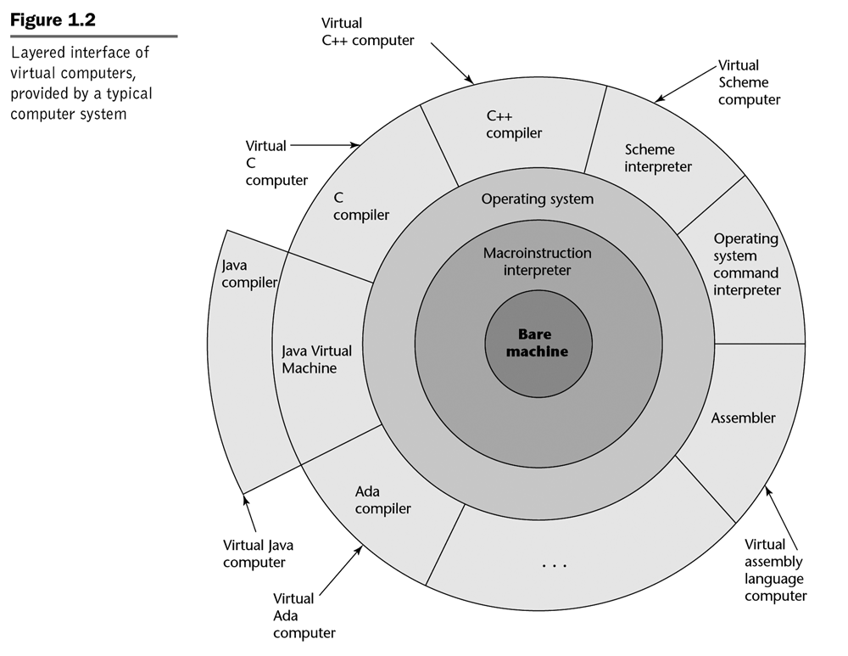
Language Implementations
Layered architectures
Mappings from high-level to low-level instructions

Slide 4
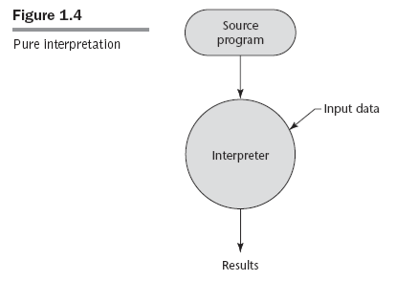
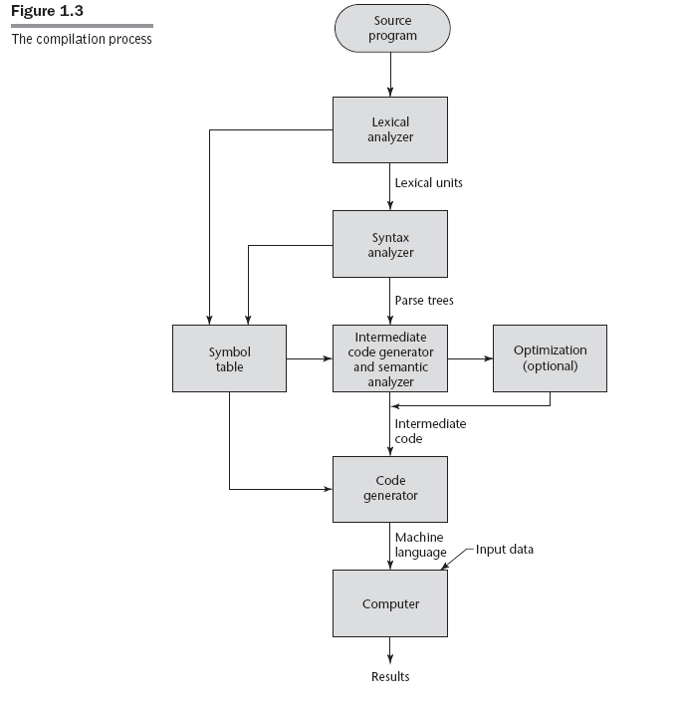
Compiler-based implementations
Mapping
High-level syntax to machine code
Plus linking of external resources
(Some) Advantages:
(Usually) faster execution due to optimizations
Both algorithmic and machine-specific
(Some) Disadvantages:
Compiled code coupled to specific hardware architecture
Long iterative cycle
Requires complete program

Slide 5
Interpreter-based implementations
Mapping
High-level syntax executed by interpreter
Interpreter “wraps” around machine and maps to machine code
(Some) Advantages:
Higher accessibility
Ease of experimentation
Portable from machine to machine
As long as an interpreter exists for each
Dynamic code generation
(Some) Disadvantages:
(Usually) slower due to interpreter layer

Slide 6
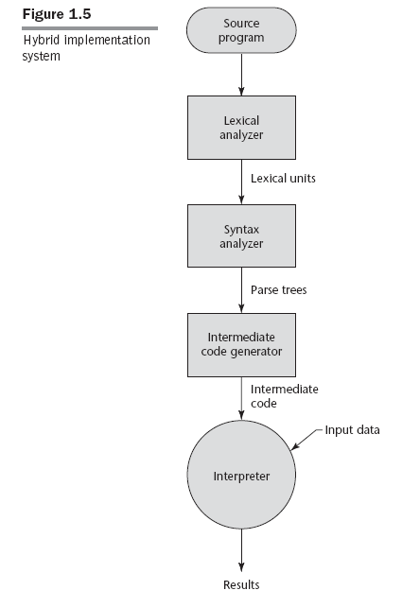
Hybrid implementations
Mapping
High-level syntax to interpreter instructions (intermediate representation)
Or purely interpreted
Interpreter still “wraps” around machine and maps intermediate representation to machine code
(Some) Advantages:
Improved performance (over fully interpreted options)
Enabling compiler-type optimizations
Higher accessibility
Intermediate representation portable from machine to machine
(Some) Disadvantages:
Longer iterative cycle than fully interpreted options
(Usually) still slower due to interpreter layer

Slide 7
Other Characteristics of Prog. Lang.
Binding
Association between entity and attribute
Type bindings: static/dynamic, implicit/explicit
Storage bindings: static, stack, heap
Abstraction
Support for defining new composite elements

Slide 8
INF502
Lecture: Introduction to Python
Dr. Igor Steinmacher
e-mail: Igor.Steinmacher@nau.edu
Twitter: @igorsteinmacher

Slide 9
Welcome to Python

Slide 10
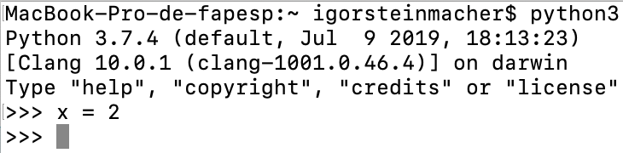
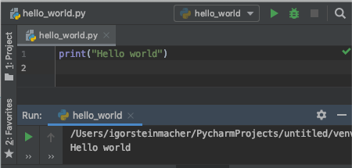
Kicking Off
Python: Interpreted language
Interactive editor
Running from a file
Using an IDE (like Anaconda or PyCharm)

Slide 11
Formatting
Python uses indentation to delimit blocks of code
Comments start with #
Colons “:” are used to start a new block for different constructs
#function that answers if a number is even or not
def isEven (number):
#is the remainder when dividing number by 2 equals to 0
if (number % 2 == 0):
#yes, the number is even
return True
return False

Slide 12
Variables
Variables are created when they are assigned a value
Type-binding is associated 'on-the-fly'
>>> x = 2 #x is an integer
>>> y = 'Igor' #y is a String
>>> y = 2.5 #y is now a floating point
>>> z = [1,2,3] #z is a list
>>> #each position in z is an integer
>>> type (z)
<class 'list'>
>>> x = y = z = 4 #chained assignment

Slide 13
Arithmetic
Mathematics apply
>>> a = 2+3 #a is 5
>>> b = 7-4 #b is 3
>>> c = 2*2.5 #c is 5.0 (float!!)
>>> d = 2**4. #d is 16
>>> e = 5%2 #e is 1
>>> f = 7/2 #f is 3.5
>>> g = 7//2 #g is ...

Slide 14
Strings
Strings are delimited by single or double quotation marks
>>> single_quote = 'python'
>>> double_quote = “python”
>>> I_want_the_quote = 'It\'s python'
>>> yes_the_quote = “It's python”
>>> multi_line = 'this is a multi line \
sentence. It is possible to break it in \
multiple lines.’

Slide 15
Strings
Operations using Strings
#operations using strings
>>> salutation = ”Hello”
>>> name = ”John”
>>> complete_salut = salutation + ', ' + name + '!'
>>> print (complete_salut)
Hello, John!
>>> real_long_string = ('this is a long string. ',
‘It has multiple parts, ',
‘but all in one line.‘)

Slide 16
How to Input??
Getting user inputs is usually important
#input() function waits for an input from the keyboard
>>> salutation = ”Hello”
>>> name = input(“Tell me your name: “)
Tell me your name: <INPUT + ENTER>
>>> complete_salut = salutation + ', ' + name + '!'
>>> print (complete_salut)
Hello, <NAME ENTERED>!
>>> weight = input(“Enter your weight in lb: ”)
Enter your weight in lb: 200
>>> weight = int(weight) #what am I doing here???
>>> weight_kg = weight/2.205
>>> print (weight_kg)
90.70294784580499

Slide 17
4-minute madness
Write a program to prompt the user for hours and rate per hour to compute gross pay.
Enter Hours: 35
Enter Rate: 2.75
Pay: 96.25
Write a program which prompts the user for a Celsius temperature, convert the temperature to Fahrenheit, and print out the converted temperature.

Slide 18
Conditional
if – else (and more…)
if (x > y):
print (“x is greater than y”)
elif (y > x):
print (“y is greater than x”)
else:
print (“they are equal!”)
parity = "even" if x % 2 == 0 else "odd"

Slide 19
Comparison Operations
Operation | Meaning
< | strictly less than
<= | less than or equal
> | strictly greater than
>= | greater than or equal
== | equal
!= | not equal
is | object identity
is not | negated object identity

Slide 20
Less Suffering
Let’s use files instead of Interactive Prompt
Create a file with the extension “.py”
To run:
python3 <filename>.py

Slide 21
3-minute madness
Write a program to prompt the user age and returns:
“You are a kid” → in case the person is 12 or younger
“Teenager around” → If the age is from 13 to 19
“An adult, eh?” → If older than 19
Do it in a file called age.py and run it

Slide 22
Functions
Functions break up your code into reusable chunks
They take arguments and can return values
Increases maintainability
Makes easy to use
#function that answers if a number is even or not
def isEven (number):
#is the remainder when dividing number by 2 equals to 0
if (number % 2 == 0):
#yes, the number is even
return True
return False
isEven(10)
True
isEven(17)
False

Slide 23
Functions
Functions break up your code into reusable chunks
They take arguments and can return values
Increases maintainability
Makes easy to use
# Calculates the body mass index (weight in kg, height in m)
def BMI(weight, height):
bmi = weight/(height**2) #height to the power of 2
return bmi
bmi(98, 1.85)
28.634039444850252

Slide 24
Functions
Two type of functions: user-defined functions and user-defined
BMI(weight, height) -> Body mass index calculator
len(s) -> Return the length (the number of items) of an object.

Slide 25
10-Minutes and go
Create a function called “convert_lb_to_kg” which receives the weight in pounds and converts to kilograms
Create a function called “convert_ft_in_to_m” which receives the height in feet and inches (2 parameters) and converts to meters
Use the 3 functions we have now to calculate the BMI with inputs using imperial metrics.

Slide 26
Combining Functions and Conditionals
Create a function to return the BMI interpretation according to CDC (centers for disease and control)
The program must print one of these BMI interpretations for Adults (20 years old or older) Below 18.5 = Underweight 18.5-24.9 = Normal or Healthy Weight 25.0-29.9 = Overweight 30.0 or Above = Obese

Slide 27
Lists
A Python list is an ordered, mutable sequence of objects
Lists can contain a mixture of any sort of object: numbers, Booleans, strings, other lists, …
Lists can grow or shrink
>>> list_of_numbers = [1,2,3,4,5]
>>> len(list_of_numbers)
5
>>> list_of_numbers[0]
1
>>> list_of_numbers[4]
5
>>> list_of_numbers[-2]
4

Slide 28
Lists
#extending it
>>> list_of_numbers.extend([6,7,8])
>>> print(list_of_numbers)
[1,2,3,4,5,6,7,8]
#slicing it
>>> piece = list_of_numbers[:4] #beginning to 4
>>> print (piece)
[1,2,3,4]
>>> piece = list_of_numbers[2:6] #from position 2 to 6
>>> print (piece)
[3,4,5,6]
#shrinking it
>>> del list_of_numbers [2:5]
>>> print(list_of_numbers)
[1,2,6,7,8]

Slide 29
Lists
#merging
>>> list1 = [1,2,3]
>>> list2 = [4,5,6]
>>> list3 = list1 + list2
>>> print(list3)
[1,2,3,4,5,6]
>>> list1.extend(list2)
>>> print(list1)
[1,2,3,4,5,6]
#sorting
>>> list1 = [-1,4,0,9,2,7]
>>> list1.sort()
>>> print (list1)
[-1,0,2,4,7,9]
#other functions
>>> list1.append(<value>)
>>> list1.insert(<pos>,<value>)
>>> list1.remove(<value>)
>>> list1.clean()
>>> list1.remove(<value>)
>>> list1.index(<value>)
>>> list1.reverse()
>>> list1.set()
>>> <value> in list1

Slide 30
Iterations (Loops)
Starting with the for (highly used with iterable objects)
But… also for counting
list_of_numbers = [1,2,3,4,5]
for element in list_of_numbers:
print (element)
for x in range(10): #will iterate from 0 to 9
if (x%3==0):
continue
print (x)
#what is the output?

Slide 31
Iterations (Loops)
Now iterating over a list of lists
# grades is a list that stores the name and the grade
# of students. Each position of the list has one list
# with two positions. The first stores the name, and
# the second stores the grade
grades = [["John",60],["Paul", 84],[”Ben", 70], ["Tony",35]]
for entry in grades:
if (entry[1]>60):
print(entry[0] + ": approved")
else:
print(entry[0] + ": talk to the instructor")

Slide 32
Iterations (Loops)
Now iterating over a list of lists
# grades is a list that stores the name and the grade
# of students. Each position of the list has one list
# with two positions. The first stores the name, and
# the second stores the grade
grades = [["John",60],["Paul", 84],[”Ben", 70], ["Tony",35]]
for name, grade in grades:
if (grade>60):
print(name + ": approved")
else:
print(name + ": talk to the instructor")

Slide 33
Iterations (Loops)
Now iterating over a list of lists
# grades is a list that stores the name and the grade
# of students. Each position of the list has one list
# with two positions. The first stores the name, and
# the second stores the grade
grades = [["John",60],["Paul", 84],[”Ben", 70], ["Tony",35]]
for name, grade in grades:
if (grade>60):
print(name + ": approved")
else:
print(name + ": talk to the instructor")

Slide 34
Iterations (Loops)
Using While Loop
i = 1
while i <= 10:
print(i)
i += 1

Slide 35
Tutorial time
I will create a program that stores a set of numbers in a list.
The list will be filled with random numbers. The user needs to be able to:
Add a number to the list
Present the number of elements in the list, and list the numbers (one per line)
Clear the list
Exit the application

Slide 36
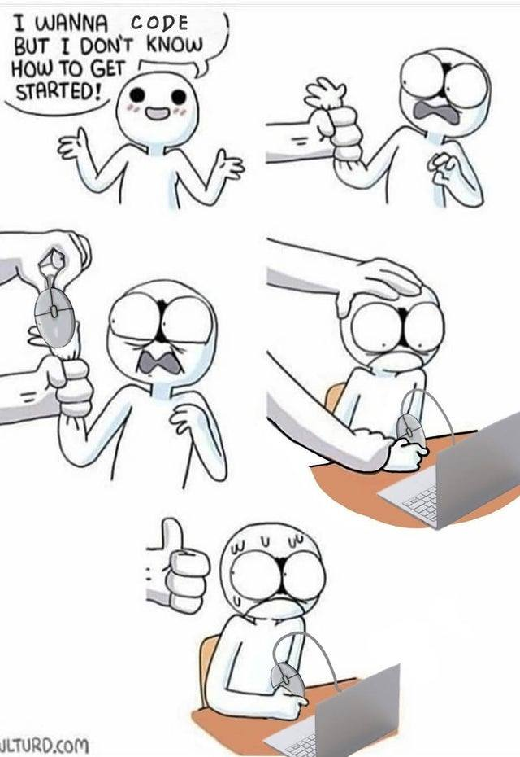
Practice time

Slide 37
Tuples
A Python tuple is an ordered, immutable sequence of objects
Like lists, but cannot be altered
Do not have methods like reverse(), sort()
>>> my_tuple = (6,34,6,7,2)
>>> len(mytuple)
5
>>> my_tuple[3]
7
>>> my_tuple[1:4]
[34, 6, 7]
>>> my_tuple[2]=8
Traceback (most recent call last):
File "<stdin>", line 1, in <module>
TypeError: 'tuple' object does not support item assignment

Slide 38
10-minute madness
Write a program which repeatedly reads integers until the user enters “done”. Once “done” is entered, print out the total, count, and average of the numbers. If the user enters anything other than an integer, print an error message and skip to the next number.
Hint: isinstance (variable, int) → returns True if the variable is an integer
Rewrite the program above to use the following list instead of prompting the user:
list_numbers=[2,6,2,5,8,2,7,3,5,3,5,7]

Slide 39
Dictionaries
A dictionary associates values with unique keys
Use braces instead of square brackets
>>> grades = {"John": 60, "Paul": 84, "Ben": 70, "Tony": 35}
>>> print(grades["John"])
60
>>> grades["Kate"] = 100 # adds another entry
>>> grades["John"] = 90 # changes John’s grade
>>> print(grades)
{'John': 90, 'Paul': 84, 'Ben': 70, 'Tony': 35, 'Kate': 100}

Slide 40
Dictionaries
>>> "John" in grades
True
>>> ”Igor" in grades
False
>>> grades.get("Joel", -1) # will return -1 (avoid errors)
>>> grades.get(”John", -1) # will return 90 (exists)
>>> all_keys = grades.keys(). # return a list of all keys
>>> all_values = grades.values() # return a list of all values
>>> all_pairs = grades.items() # a list of (key, value) tuples

Slide 41
Dictionaries
# Nested structures... why not?
family = {"John": {"age": 30, "weight": 170, "city": "Flagstaff"},
"Paul": {"age": 45, "weight": 200, "city": "Buenos Aires"},
"Anna": {"age": 26, "weight": 130, "city": "Paris"}}
# Lazy iteration
for member in family:
print(member)
for member in family:
print(family[member])

Slide 42
Training a bit
Given the grades dictionary provided previously
{'John': 90, 'Paul': 84, 'Ben': 70, 'Tony': 35, 'Kate': 100}
Create a program that enables the user to choose one of the options:
See the grade of someone by providing a name
Add a new student and grade
Change a grade given a name of an existing student
List all the grades in the dictionary
Each of the options needs to be implemented as a different function.

Slide 43
If we still have time (Extra!)
Mountain Heights
Wikipedia has a list of the tallest mountains in the world, with each mountain's elevation. Pick five mountains from this list.
Create a dictionary with the mountain names as keys, and the elevations as values.
Create a function that receives the dictionary as a parameter and prints out just the mountains' names and elevations, as a series of statements telling how tall each mountain is: "Everest is 8848 m tall."
Mountain Heights 2
Change your function adding a second parameter (Boolean) called sorted. When this parameter is True, your algorithm needs to print the same statements as before, but in alphabetical order.

