Slide 1
Prediction of Movies Box Office Performance using Social Media
Ojas Juneja
Saurabh Patel
Ronak Bhuptani

Slide 2
Outline
Problem Statement
Related Work
Main Tasks
What is Hype
Data Collection
Box Office prediction
Sentimental Analysis
Movie Performance Classification
References

Slide 3
Problem Statement
Predict Movie Performance using Hype factor on twitter and Sentimental Analysis.
The Hypothesis:
“A Movie Well Talked About is Well Watched”
Pre-release buzz- a success factor
People’s sentiment toward a particular matter when expressed online, can be very useful in many cases. The volume of discussion about products on Twitter can be correlated with the product’ s performance. It is also known that social network users represent the aggregate voice of millions of potential consumers.
Box-office performance of a movie is mainly determined
Number of tweets regarding that movie in the pre week of its release
Pre-Release hype is an important factor as far as estimating the openings of the movie
Estimate movie performance through user opinions expressed online on sites such as Twitter, Facebook and YouTube.

Slide 4
Related Work
REFERENCE | DESCRIPTION
[1] Box-Office Opening Prediction of Movies based on Hype Analysis through Data Mining [ARTICLE in INTERNATIONAL JOURNAL OF COMPUTER APPLICATIONS · OCTOBER 2012] | Refer : how to calculate hype and reach factor for movie, before it’s pre-release.
[2] Using Twitter data to predict the performance of Bollywood movies [Dipak Damodar Gaikar and Bijith Marakarkandy, Department of Information Technology, Thakur College of Engineering and Technology, Mumbai, India] | Refer : methodology to cluster movie in different categories, which factor we should consider to classify movie in Hit, Flop and Average.

Slide 5
Main Tasks
There are main two tasks in our project.
First task is to estimate box office opening weekend collection, it was predicted by pre-release hype factor, Tweet rate, total number of shows per day on all screens and the average house full collection per screen.
Second Task is movie performance, for this we have used two components, first component was sentiment score for tweets from Twitter, comments from Facebook page and you tube comments from official trailer video and second component corresponding to movie actor, actress and director popularity.

Slide 6
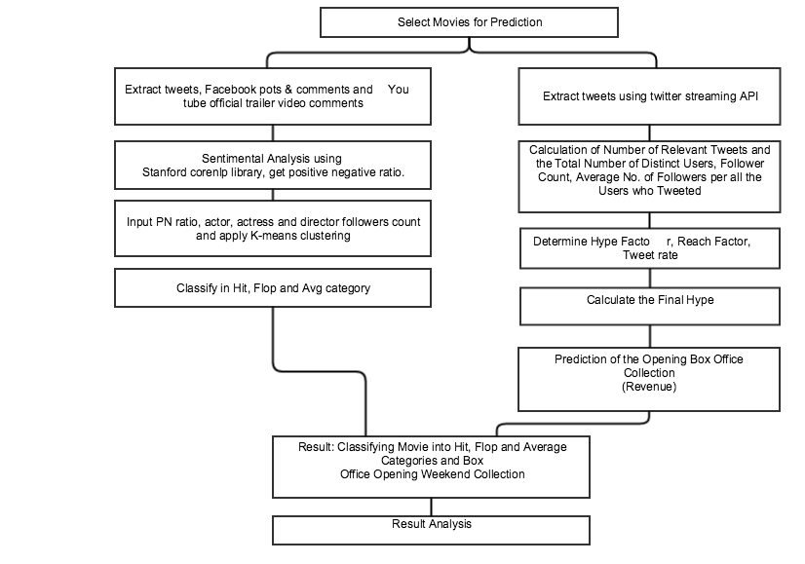

Slide 7
What is Hype
We considered tweets which are tweeted one week before movie release for hype calculation.
Hype Factor calculation require following things :
Initial Hype, Tweet rate and reach factor
Find the total number of relevant tweets
Number of distinct users those posted the tweets.
The number of distinct users can be calculated by counting user-id of the users.

Slide 8
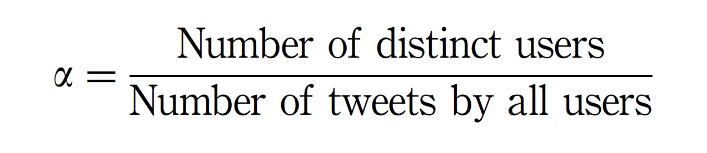
What is Hype (Continue...)
The following formula we used for the initial hype (α ) calculation
By considering only the tweets, the actual hype would not be determined.
Consider following example,
Let the number of users who have posted the tweet be 2 and the number of tweets being posted by them pertaining to a movie be 100.
Let the number of users who have posted the tweet be 90 and the number of tweets being posted by them pertaining to a movie be 100.

Slide 9
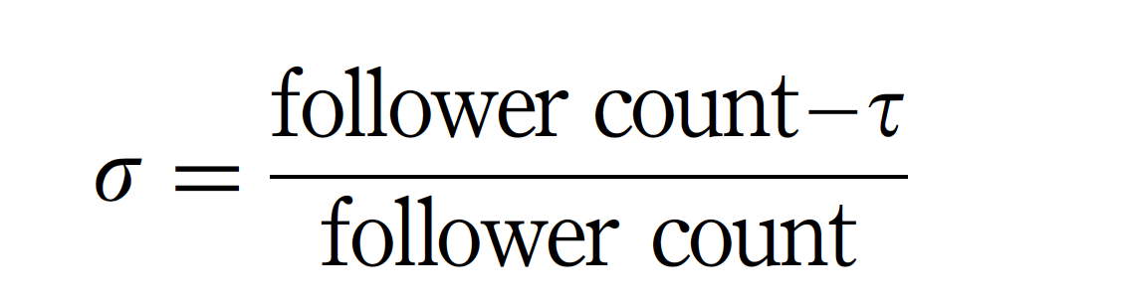
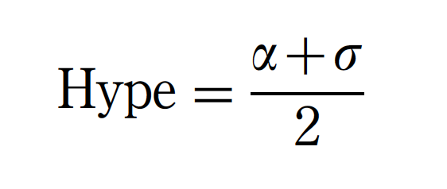
What is Hype (Continue...)
Reach Factor
Where τ. average number of followers per all tweeted users
If follower count is less than τ, reach factor is taken as 0.1

Slide 10
What is Hype (Continue...)
Tweet Rate
= (Total Number of Tweets)/ (Number of Hours)
Hype

Slide 11
Data Collection
We faced many problems in terms of collecting data from Twitter, Facebook, YouTube
Problems we faced :
Multiple Twitter/Facebook session connection for every movie.
How to run python script continues to gather data.
Getting more than 100 comments from YouTube videos
Used single connection and segregated tweets in different movie category based on movie related query keywords match.
Used Amazon EC2, instance to run python script continues 24*7.
For Calculation of Hype
Created csv file which contains only one week before tweets with timestamp, user ID and followers count.

Slide 12
YouTube Data API
We have used YouTube Data API V3 to extract comments from official trailer videos from YouTube.
To use this API, we need Google account to access google developer console, request an API and register our application.
We need to create and download discovery document from Download Discovery Document.
We need to create client_secret.json file which will have client_id and client_secret and authentication URI.
Next, we need to get YouTube Service object using discovery document and client_secrets.json
Lastly, we can get comments from YouTube video using youtube commentThreads method in which we need to specify pageToken recursively if the video has more than 100 comments as YouTube Data API does not give more than 100 comments.
It uses ElementTree for XML parsing and we can get respective library from gdata-python-client.

Slide 13
Data Collection
We collected following data over 23 days of period for sentimental analysis.

Slide 14
Data Collection
We collected following data in one week before to it’s release date for calculation Hype factor.

Slide 15
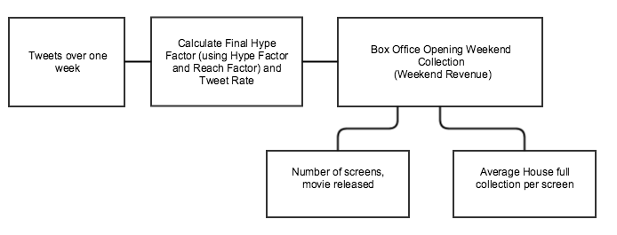

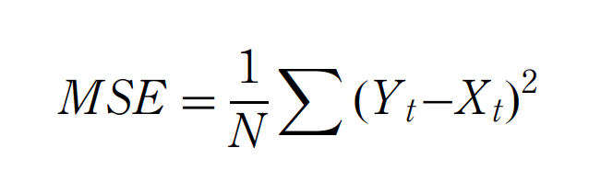
Box Office Prediction
Steps to predict opening weekend collection:
Formula to predict opening weekend collection and calculate Mean Square Error

Slide 16
Box Office Prediction (Continue...)
We have calculated following data to estimate the opening weekend gross.

Slide 17
Box Office Prediction (Continue...)
Based on above table and formula, we have come with following results. Following collection is shown in Million $ except for Fan movie which is based in India and its collection is shown in Million INR.

Slide 18
Sentimental Analysis
Sentimental Analysis using Stanford Core NLP
We have done sentimental analysis on twitter data using Stanford Core NLP which classifies data into positive, negative and neutral. We considered neutral data as noisy data.
e.g. Neutral tweet = “chance win x tickets movie London premiere”
Problems while doing sentimental analysis :-
1. Since we have unsupervised data, there is no train data available.
2. Even if there is train data, it should be in Positive, Negative, Neutral format because neutral text need to be removed from our analysis.

Slide 19
Sentimental Analysis
Preprocessing of Data
Remove English stop words
Remove punctuation, Special characters
Remove User mentions and user id from tweets.
Remove URL, Hashtags, replace movie name with “MOVIE” word as it gives problem for sentimental analysis. For example, Criminal, Die, Demolition words creates negative sentimental.
Used Porter Stemmer to remove morphological endings from words in English

Slide 20
Sentimental Analysis
Using Classifiers
Stanford Core NLP removes all this drawbacks by classifying data into positive, negative and neutral and we do not require any train data for this.
Classifier | Input | F-Score
SVM – linear kernel | Sentimental140 – 25K positive,25K negative | 0.701
SVM – RBF kernel | Sentimental140 – 25K positive,25K negative | 0.72
Naïve Bayes | Sentimental140 – 25K positive,25K negative | 0.61

Slide 21
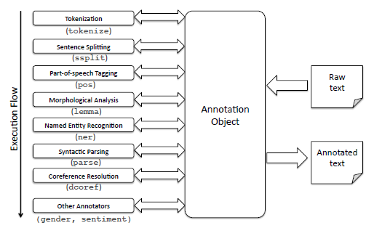
Sentimental Analysis
Stanford Core NLP Processing
Prepared classifier with ~12000 sentences using Recursive Deep Learning

Slide 22
Movie Performance
After doing Sentimental analysis on data we classified the movie into Hit, Flop and average by considering the factors:
PN ratio,
Actor popularity,
Actress popularity,
Director Popularity
PN ratio = Number of positive tweets &comments/ negative tweets & comments.
Director, Actor, Actress popularity = Number of followers on twitter.
Problems with collecting popularity data:
1) For some movies, there is no Facebook page or tweet page for director/Actor/Actress.
2) For some movies, there are more than one lead actors/actress.

Slide 23
Movie Performance (Continue…)

Slide 24
Movie Performance: Classification
Hit, Flop and Average is decided by the ratings from IMDB.com.
Normalization Equation :
y = 1 + (value - minimum) * (maxscale - minscale) / (maximum - minimum)
Approach | Input | Accuracy
Non Weighted K Means | PNratio,Actor,Actress,Director popularity scaled to 0 - 10 | 64%
Weighted K means | PNratio scaled to 0 -20 and other attributes scaled to 0-10 | 54%
Weighted K means | PNratio scaled to 0 -30 and other attributes scaled to 0-10 | 62%
Weighted K means | PNratio scaled to 0 -40 and other attributes scaled to 0-10 | 72%
Sentiment Score K means | Only PN ratio is considered | 45%

Slide 25
References
https://www.scipy.org/
http://pandas.pydata.org/
Box-Office Opening Prediction of Movies based on Hype Analysis through Data Mining [ARTICLE in INTERNATIONAL JOURNAL OF COMPUTER APPLICATIONS · OCTOBER 2012]
Using Twitter data to predict the performance of Bollywood movies [Dipak Damodar Gaikar and Bijith Marakarkandy, Department of Information Technology, Thakur College of Engineering and Technology, Mumbai, India]
Predicting the Future with Social Media- S Asur, B Huberman, HP Labs, HP Journal, Jan 2012
https://developers.google.com/youtube/v3/docs/commentThreads/list
http://nlp.stanford.edu/nlp/javadoc/javanlp/edu/stanford/nlp/pipeline/StanfordCoreNLP.html
http://thinknook.com/twitter-sentiment-analysis-training-corpus-dataset-2012-09-22/
http://www.imdb.com/
http://www.boxofficemojo.com/
https://en.wikipedia.org/wiki/The_Jungle_Book_(2016_film)#Box_office

