Slide 1
EasyLang
Activity Monitoring
Sprint 1 technical overview
Authentication and role-based access
Spring Boot
React + TypeScript
PostgreSQL
Technical presentation for Sprint 1
Notes:
Purpose: introduce the implemented Sprint 1 foundation. Source: README.md and docs/SPRINT_1_STATUS.md.

Slide 2
Sprint 1 result
A user can sign in and enter only the workspace assigned to the role stored in the database.
01
Database-backed login
02
Automatic role detection
Spring Security verifies email and a BCrypt password hash from PostgreSQL.
The authenticated database user determines the frontend route and API permissions.
03
Protected workspaces
04
Session lifecycle
Translator, Chief Editor, and Project Manager routes have separate server rules.
The application restores the session after refresh and clears the cookie on logout.
EasyLang / Sprint 1
02
Notes:
Explain the user-visible acceptance criteria. Source: docs/SPRINT_1_STATUS.md.

Slide 3
System architecture
React + TypeScript
Spring Boot
PostgreSQL
JSON over HTTP
JPA + Flyway
Browser UI
Login, routes, session state
Security, business logic, API
Port 8080
Users and roles
Host port 55432
Deployment boundary
The frontend and backend run independently. The backend owns security and database access. PostgreSQL never connects directly to the browser.
Current shape
Layered modular monolith
EasyLang / Sprint 1
03
Notes:
Use this slide to explain the three tiers and separate runtime processes. Source: docs/CODE_ARCHITECTURE.md and compose.yaml.

Slide 4
Backend code organization
Request path
Controller
Service
Repository
Model
HTTP input and output
Use cases and decisions
Database queries
Entities and roles
Supporting packages
A
security
B
dto
C
config + common
API requests, responses, and safe profile data
Spring wiring, access rules, and consistent errors
JWT filter and authenticated principal
Rule: controllers call services; services call repositories.
EasyLang / Sprint 1
04
Notes:
Explain why the backend remains one application while packages keep responsibilities clear. Source: docs/CODE_ARCHITECTURE.md.

Slide 5
Login and role authorization flow
01
CSRF token
02
Credential check
The browser requests a token before sending credentials.
Spring Security loads the user and compares the BCrypt hash.
03
JWT cookie
04
Role redirect
The API signs a token and stores it in an HttpOnly cookie.
React opens the workspace for the returned database role.
05
Request authentication
06
Backend role rule
The JWT filter verifies the cookie and reloads the active user.
Spring returns data, 401, or 403 before the controller executes.
The frontend route guard improves navigation. Spring Security enforces access.
EasyLang / Sprint 1
05
Notes:
Mention that JWT never enters localStorage. CSRF protects state-changing cookie requests. Source: docs/ARCHITECTURE.md and SecurityConfig.java.

Slide 6
Data model and API surface
app_users
Authentication API
GET
/api/v1/auth/csrf
id
email
initials
full_name
password_hash
role
is_active
created_at
POST
/api/v1/auth/login
GET
/api/v1/auth/me
POST
/api/v1/auth/logout
Role endpoints
Database rules
/workspaces/translator
/workspaces/chief-editor
/workspaces/project-manager
Unique email, constrained role, Flyway migration, Hibernate validation
EasyLang / Sprint 1
06
Notes:
Explain that Sprint 1 implements only the user slice of the future ERD. Source: db/migration/V1__create_app_users.sql and docs/API.md.

Slide 7
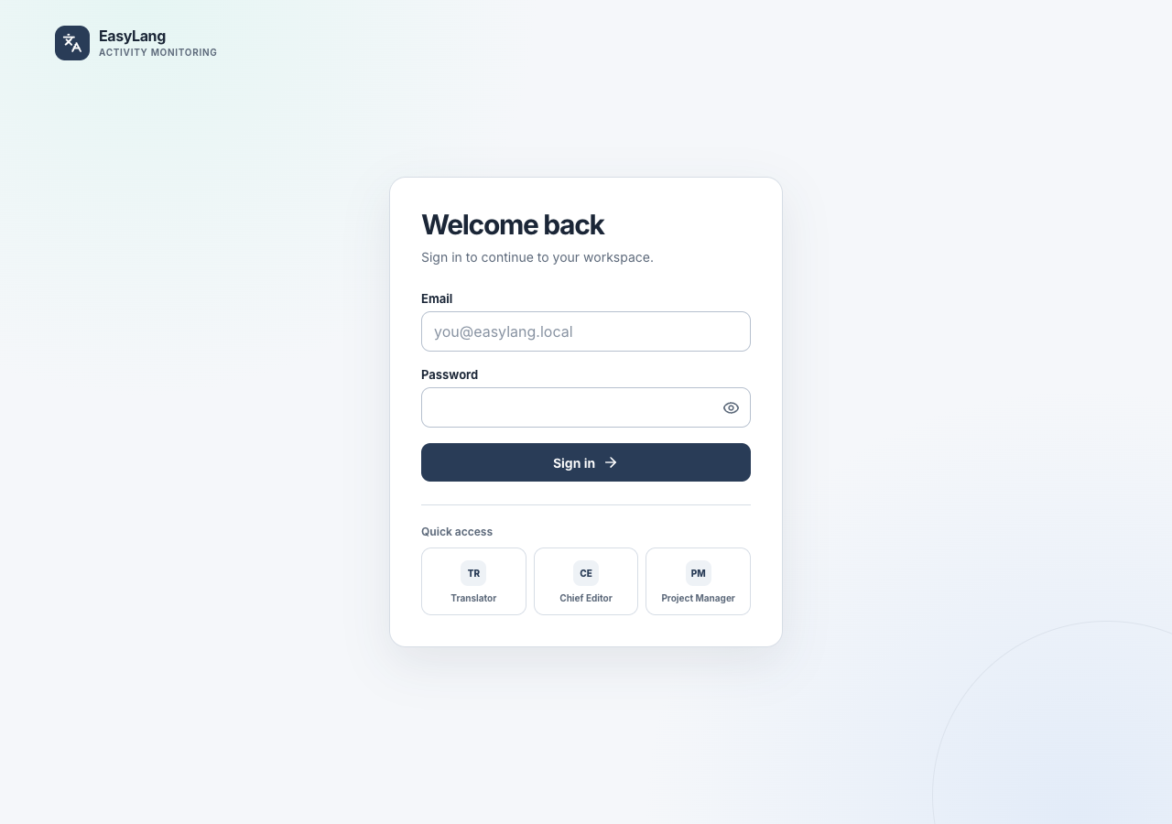
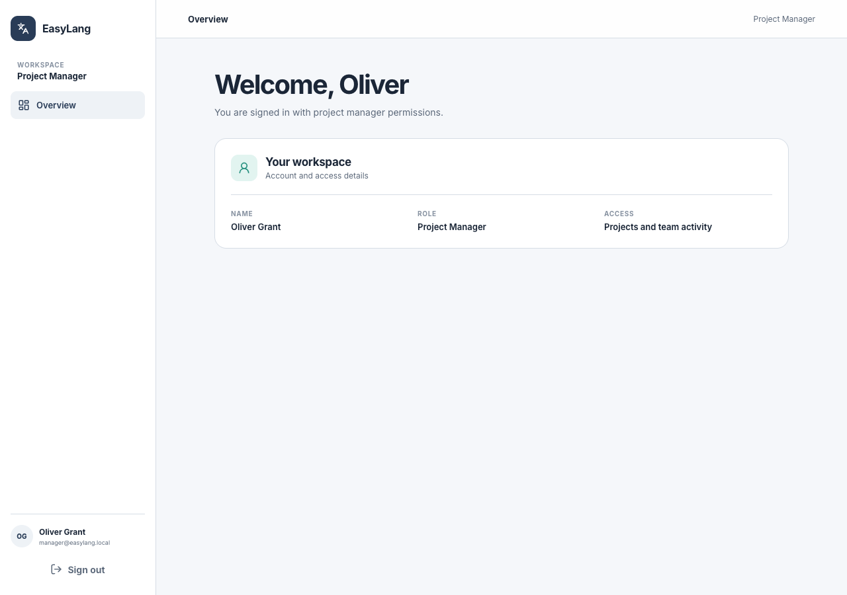
Implemented user interface
Login
Project Manager workspace
Compact light design, demo role autofill, responsive layout, visible account and access scope
EasyLang / Sprint 1
07
Notes:
Demonstrate the login screen and one protected workspace. Source images: Playwright desktop screenshots in frontend/test-results.

Slide 8
Verification evidence
5 / 5
21
3
3
Backend integration tests
End-to-end scenarios
Roles verified
Responsive viewports
What the tests prove
Valid and invalid login
Unauthenticated requests return 401
Cross-role requests return 403
Logout protects the former workspace
CORS accepts the local frontend
Frontend unit test, lint, and production build pass
The browser suite runs against real PostgreSQL and the running API.
EasyLang / Sprint 1
08
Notes:
Verification record: mvn test 5 passed, npm test 1 passed, lint/build passed, Playwright 21 passed. Source: docs/SPRINT_1_STATUS.md.

Slide 9
Growth path
The current foundation supports the next domain modules without changing authentication or role boundaries.
02
Projects and activities
03
Progress estimates
Translator assignments and daily work records
Remaining-text estimates, completion rules, and reminders
04
Chief Editor review
05
Monitoring and risk
Review outcomes, corrections, and re-review
Staffing, workload, trends, and delivery-risk signals
Redis, Kafka, Kubernetes, and CI/CD enter only when a concrete deployment or scaling requirement needs them.
EasyLang / Sprint 1
09
Notes:
Close with the reason for the layered monolith: clear boundaries today and low-cost extraction later. Source: docs/PROJECT_CONTEXT.md and docs/CODE_ARCHITECTURE.md.

