Slide 1



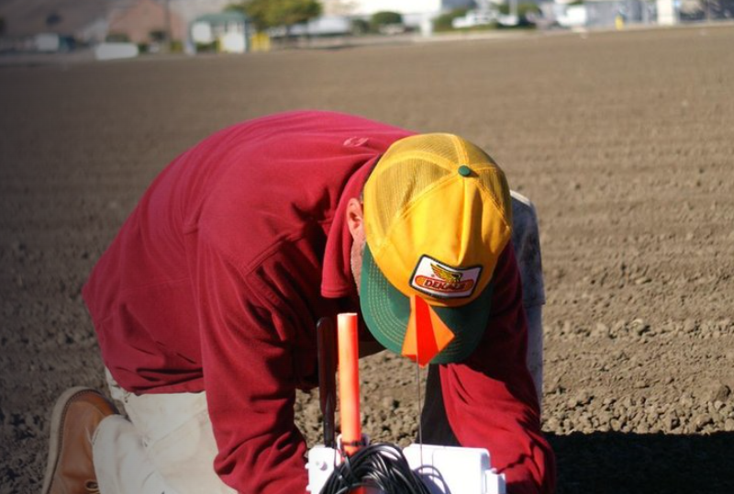

Agri Data Base (ADB)
Amina M
Gulmira Z
Dmitriy P
Arseniy B
Mariya F
Aibek Z
Leveraging Earth Observation Data for Informed Agricultural Decision-Making
2024 NASA SPACE APPS CHALLENGE

Slide 2

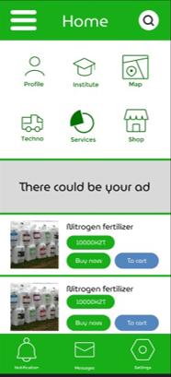
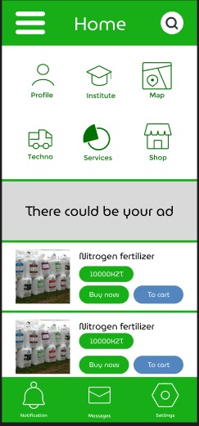
Agri Data Base (ADB)
Problem: provide farmers with access to scientific data, agricultural automation
Solution:
ADB
Purpose: introduction of comprehensive digitalization of agriculture in Kazakhstan

Slide 3
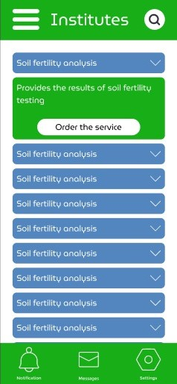
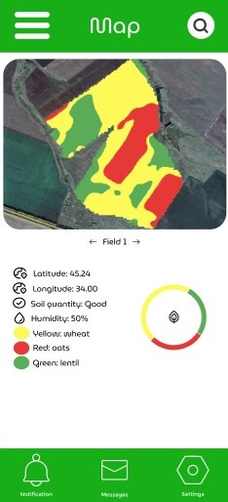
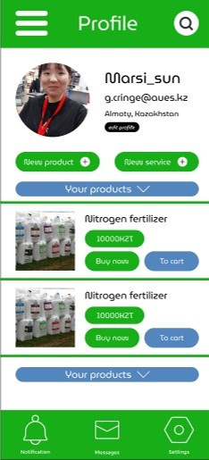
Scheme of communication
The app will give you access to information about your fields and data about them from research institutes they can provide you with satellite images as well as natural risks in your area by water and climate conditions.

Slide 4
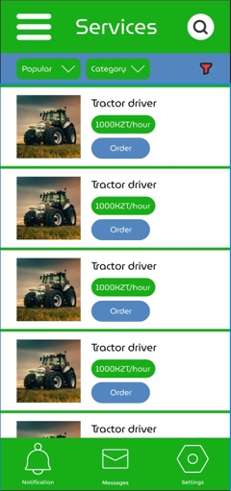
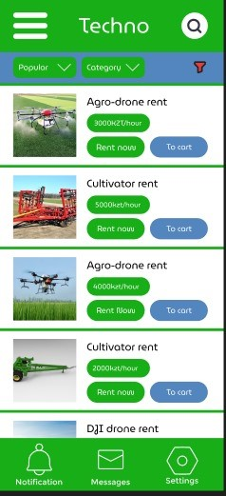
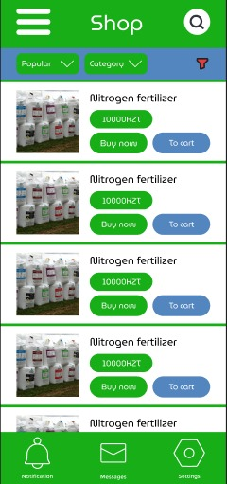
Trade & Services
The application includes a convenient service for purchasing products needed for farmland, as well as for selling and buying crops. In addition, users can obtain and provide services such as repairing agricultural machinery and cultivating fields.

Slide 5
Merits
Participation of institutes in the project allows linking scientific institutions and private enterprise
The possibility for farmers to make quick decisions based on access to the latest data.
Access to scientific data and state-of-the-art technology
The collection of agricultural statistics in each region.

Slide 6







Example
ADB
Results if the soil is fertile
ADB
Leasing
Purchase
Services
Leasing
Agronomist
The field
Institutes
The field
Products

Slide 7
Conclusion
By developing this project, we are trying to greatly simplify the work of agricultural spheres, in fact, creating a social network uniting the entire agricultural community, which will have access to all the necessary for the agronomist list of data, goods and services.

