Slide 1
Social Network Analysis

Slide 2
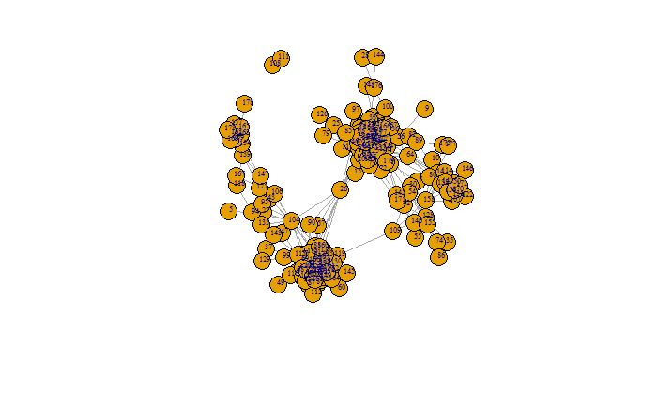
Friends Graph
The graph g has 1294 edges and 179 vertices.
In graph g the diameter
can be built with path 86 -155 -30 -32 -34- -26- 104 -121 -139 -165 -178.
The density of g is approximately 0.08.

Slide 3
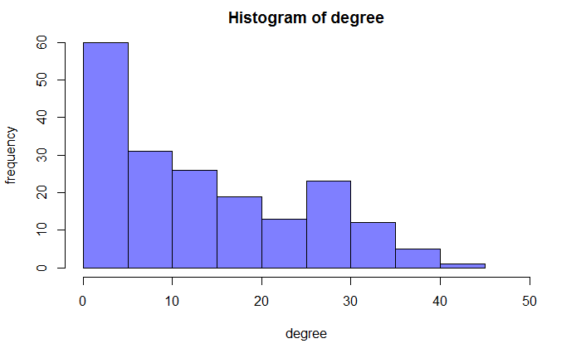
Degree distribution
Min. 1st Qu. Median Mean 3rd Qu. Max.
1.00 4.00 12.00 14.46 24.00 43.00

Slide 4
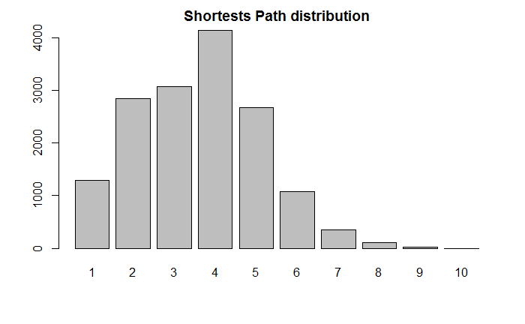
Shortest Path distribution

Slide 5
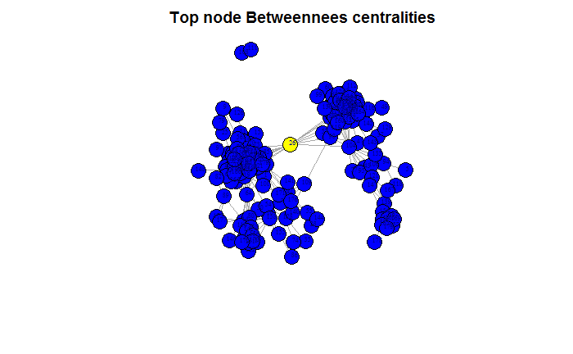
Betweenness Centrality
Min. 1st Qu. Median Mean 3rd Qu. Max.
0.000 3.387 29.727 226.279 218.710 6384.425

Slide 6
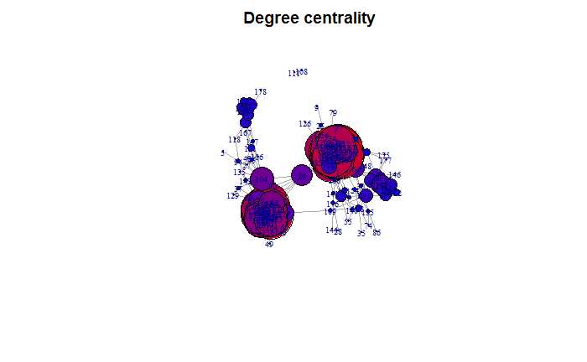
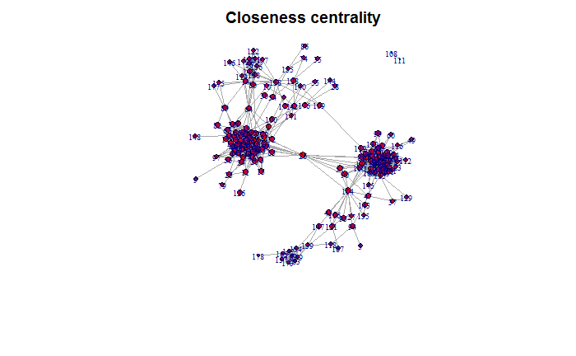
Degree centrality, closeness cenrality
Min. 1st Qu. Median Mean 3rd Qu. Max.
3.156e-05 9.565e-04 1.041e-03 1.010e-03 1.090e-03 1.280e-03

Slide 7
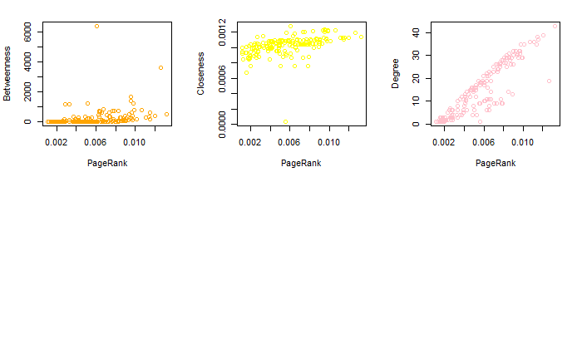
Page-Rank. Comparison with centralities

Slide 8
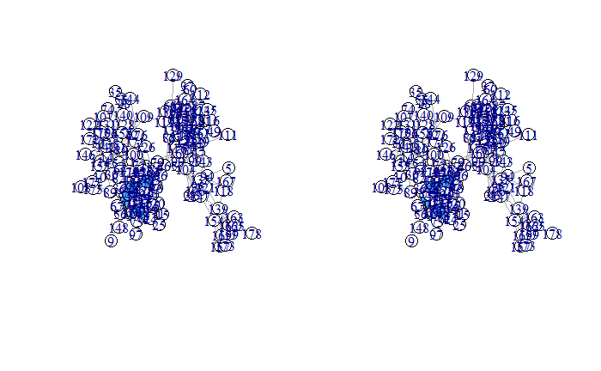
Cliques
Clique is a subset of vertices of an undirected graph such that its induced subgraph is complete. That is, every two distinct vertices in the clique are adjacent. In the plot the subset is highlighted with the blue color.

Slide 9
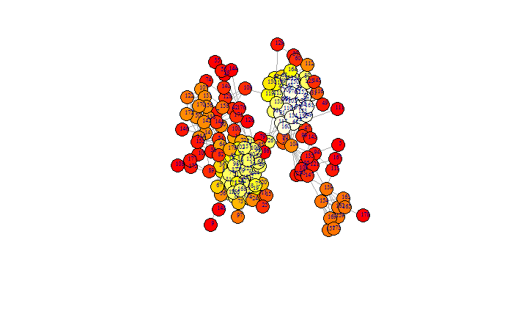
k-core
A k-core is the largest subgraph such that each vertex is connected to at least k others in subset

Slide 10
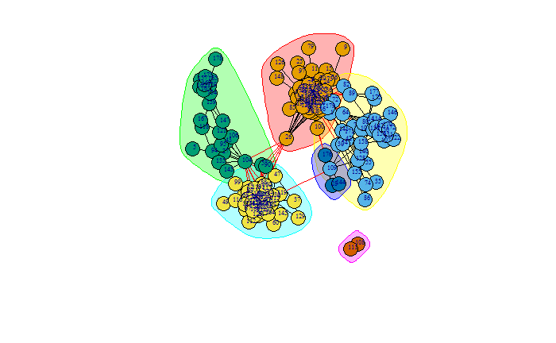
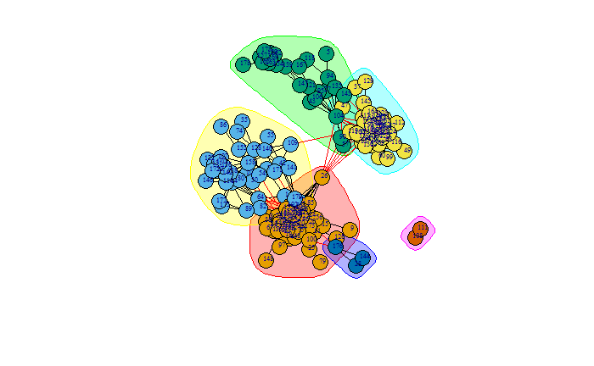
Fast greedy algorithm for cluster, community detection
6 communities 6 clusters

Slide 11
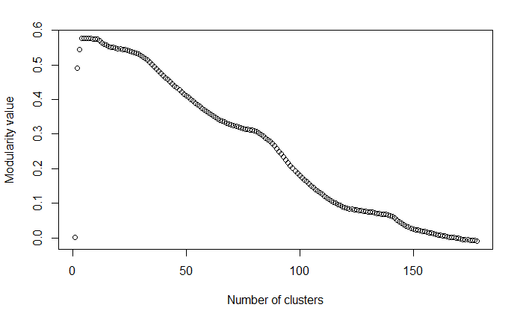
Number of clusters vs Modularity values

Slide 12
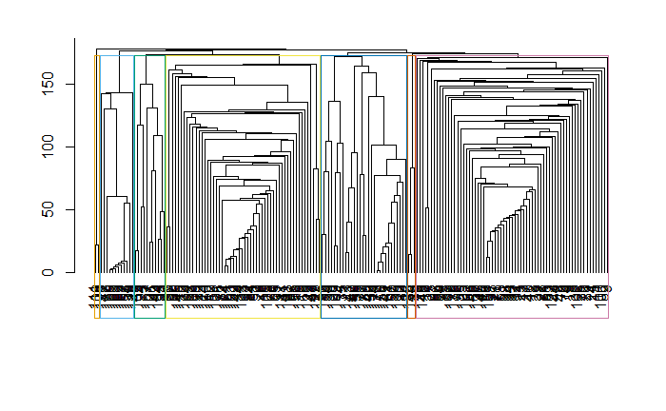
Edge betweenness algorithm

Slide 13
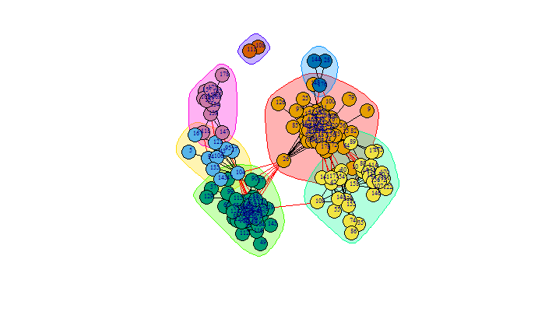
Edge betweenness algorithm divides our graph g into 7 clusters.

