Slide 1

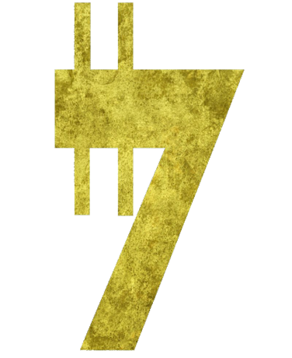
184.184.010.941
Galactic Stocks Surge on Lightsaber Technology
Breakthrough**News:** Today, Jedi Technologies revealed a game-changing advancement in lightsaber construction, sparking a surge in stock prices across the Star Wars Marketplace. The breakthrough promises to revolutionize combat and industry alike, with investors scrambling to capitalize on the opportunity.
Market
Jabba‘s Hangout
Hutt‘s Playground
Jabba‘s Stocks

