Slide 1
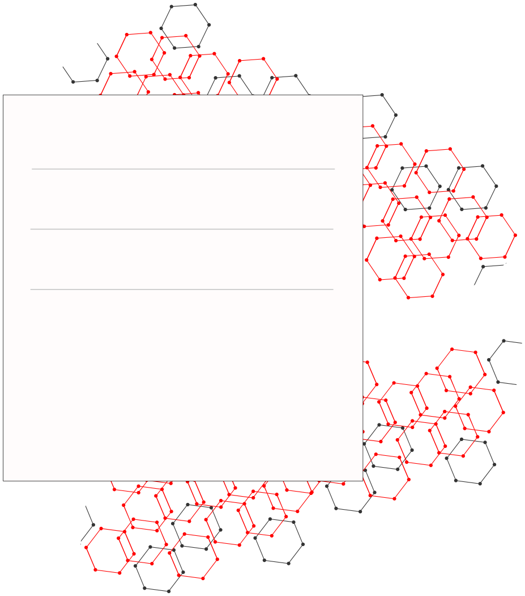



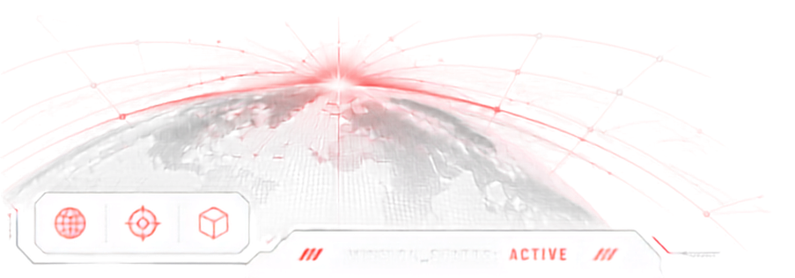
01 // 09
TEAM NAME
Codeators
MEMBERS
OMNIKON
2 [Prince Sherathiya, Soham Shetye]
THEME
CyberTech
Problem Statement: Omni_CyberTech_4 • Round 2 / Phase 2 Progress
Detecting Deepfake and Manipulated Media
SATYAKAVACH
AI-Powered Deepfake & Manipulated Media Detection
Detect • Verify • Trust

Slide 2

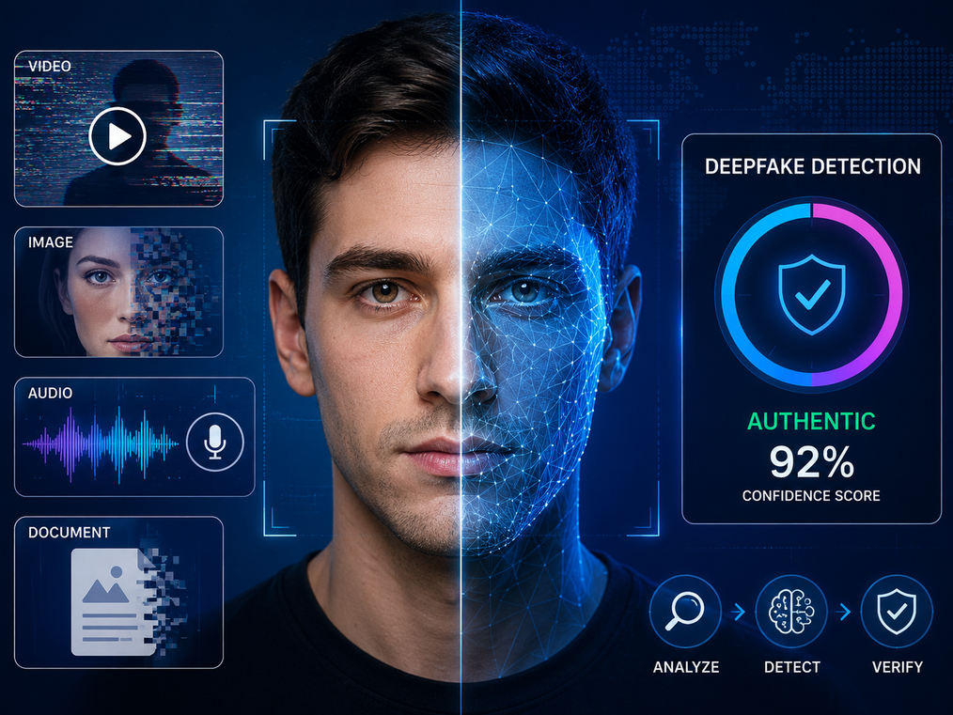



SatyaKavach - AI-Powered Deepfake & Manipulated Media Detection
02 // 09
Problem Title
AI-Powered Detection of Deepfake & Manipulated Media
500M+
MULTI-MODAL
Challenge Overview
Deepfake videos and images
are expected to circulate
across digital platforms
globally each year.
Image • Video • Audio
Verification in one
unified platform.
Generative AI can now create highly realistic fake images, videos, and voices that are difficult for ordinary users to distinguish from authentic content.
Deepfakes are increasingly used to spread misinformation, impersonate individuals, manipulate public opinion, and damage trust in digital media.
Citizens, journalists, educators, and organizations need an accessible way to verify whether media is authentic or manipulated before acting on it.
Why did your team choose this?
01 - Deepfakes are becoming more realistic
AI-generated media quality has improved significantly, making manual detection increasingly difficult.
02 - Misinformation spreads rapidly
Manipulated videos, images, and audio can reach millions of users before verification occurs.
03 - Lack of citizen-friendly tools
Most deepfake detection solutions are research-focused or enterprise-oriented rather than accessible to everyday users.
04 - Need for explainable verification
Users need evidence-backed explanations, not just a "fake" or "real" label.
96%
3X FASTER
of detected deepfakes
in public datasets
contain manipulated faces.
Spread of highly engaging
manipulated media compared
to verified content.
Sources: DFDC, FaceForensics++, FakeAVCeleb, DeepFakeBench
ONE MISSION. BUILD THE IMPOSSIBLE.

Slide 3
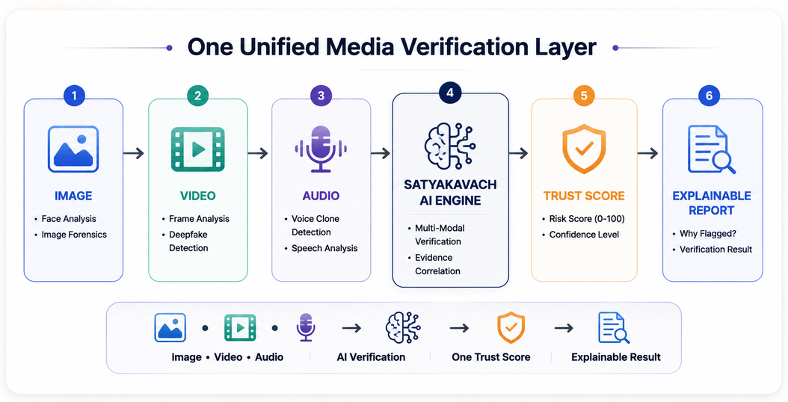
WHY THIS PROBLEM MATTERS
03 // 09
WHO FACES THIS?
CURRENT GAP IN THE SYSTEM
Citizens are the first victims of manipulated media.
Social media users
Journalists & fact-checkers
Students & educators
Government & public institutions
Anyone consuming digital content
Key insight: People can no longer reliably distinguish authentic media from AI-generated content.
Today's detection ecosystem is fragmented.
Image tools → Image analysis only
Video tools → Video verification only
Audio tools → Voice cloning detection
Research models → Difficult for citizens to use
The gap: Users need one simple platform that can verify images, videos, and audio with explainable results.
HOW WE FILL IT
ALIGNS WITH INDIA'S DIGITAL ECOSYSTEM
SatyaKavach supports responsible AI adoption
MeitY initiatives on trustworthy AI
Digital India mission
Citizen awareness against misinformation
Media authenticity verification
Explainable AI for public trust
Complements existing digital trust initiatives.
One Unified Media Verification Layer
ONE MISSION. BUILD THE IMPOSSIBLE.

Slide 4
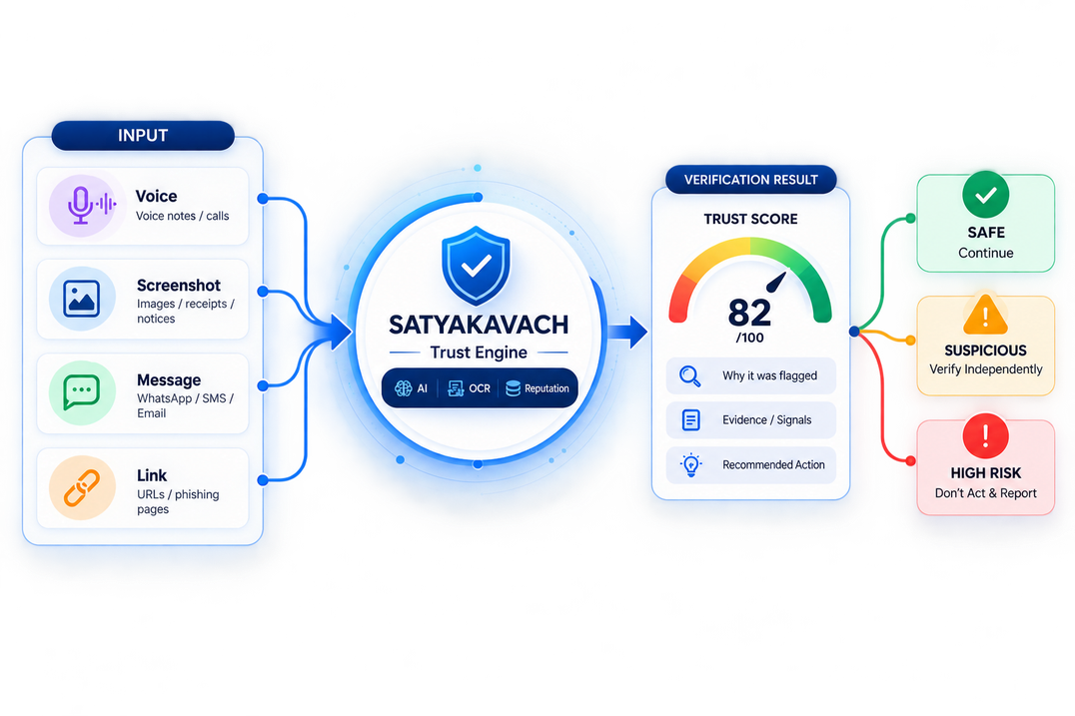
OUR SOLUTION — NOW BUILT
04 // 09
01
What Have We Built?
SatyaKavach is now a working end-to-end platform: a citizen uploads suspicious media and receives a Trust Score with an explainable verdict.
Accepted inputs: image, video, audio, screenshot, or a suspicious link.
The backend runs parallel AI analysis, fuses all signals into one score, and generates a Hindi-first evidence report with a clear recommended action.
02
What are the 3-4 Key Features?
Deepfake Face Detection
AI Voice Clone Detection
Media Forensics Engine
Unified Trust Score
Detect manipulated faces in images and videos using AI-powered forensic analysis.
Identify synthetic or cloned voices through audio authenticity verification.
Analyze images, videos and audio for signs of tampering, editing and manipulation.
Combine multimodal AI signals into one confidence score and explainable verdict.
03
What makes it different or innovative?
Our Innovation: One Verification Layer
Multimodal
Explainable
Action-oriented
Existing protection is fragmented across different tools and content types. SatyaKavach combines image, video and audio verification into one explainable AI workflow.
Image + Video + Audio verification in one platform.
Shows evidence and confidence behind every detection.
Provides a clear trust score and verification recommendation.
ONE MISSION. BUILD THE IMPOSSIBLE.

Slide 5




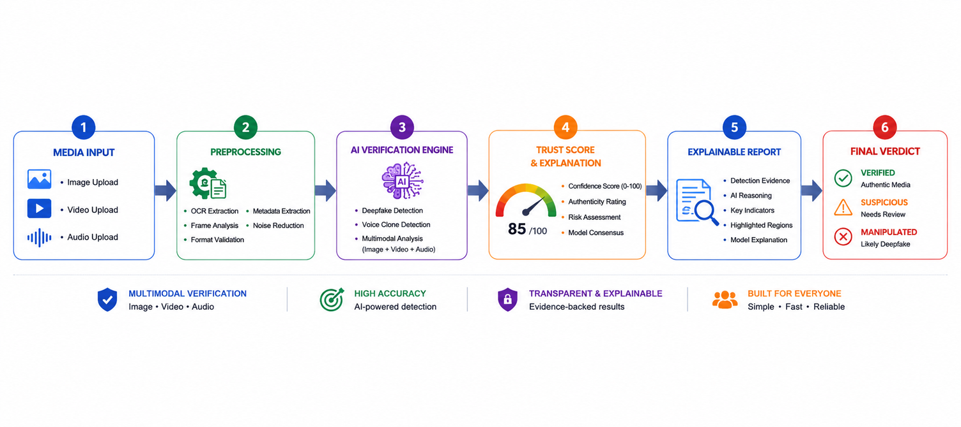
TECHNICAL ARCHITECTURE — AS BUILT
05 // 09
1. PRESENTATION LAYER
Citizen & Hindi-first Interface
2. BACKEND & ORCHESTRATION
APIs, Logic & Verification Services
3. AI & INTELLIGENCE LAYER
Detection, Reasoning & Explainability
4. DATA LAYER
Evidence, Reports & Intelligence
THREAT INTELLIGENCE
External Security Signals
React.js + TypeScript
Built — premium Hindi-first citizen PWA
PostgreSQL
Users • uploads • verdicts • audit logs
VirusTotal API
URL/domain/file reputation
FastAPI (Python) — LIVE • REST + async pipeline
Gemini
Context reasoning & report writing
Google Safe Browsing
Known malicious URL detection
Tailwind CSS
Clean, accessible UI components
REST APIs
Frontend ↔ AI/verification services
Whisper
Transcription & voice-clone signals
AWS S3
Evidence storage (S3-compatible)
PhishTank
Phishing URL intelligence
PWA
Installable, mobile-first experience
JWT Authentication
Secure session & access control
EasyOCR
Phase B — screenshot text extraction
Threat Intelligence Cache
URL/domain reputation results
Domain Reputation
Additional URL risk signals
Voice / Upload Interface
Voice • Screenshot • Message • Link
Risk Engine
LIVE — weighted fusion → Trust Score 0–100
NLP / Scam Classifier
Phase B — message intent analysis
Audit Logs
Verification & security events
I4C / 1930 Ecosystem
Citizen reporting & cyber-fraud support
Purpose: Simple, accessible verification for everyday citizens
Purpose: Secure, scalable and asynchronous verification workflow
Purpose: Multimodal analysis with explainable results
Purpose: Secure, structured and traceable data layer
Purpose: Works alongside existing systems.
SECURITY FIRST - HTTPS • JWT • Input Validation • Secure File Handling
CLOUD READY - Docker Compose • Nginx • Render/Vercel/Neon deploy plan
SCALABLE - Stateless APIs • Async Processing • Modular AI Services
ONE MISSION. BUILD THE IMPOSSIBLE.

Slide 6





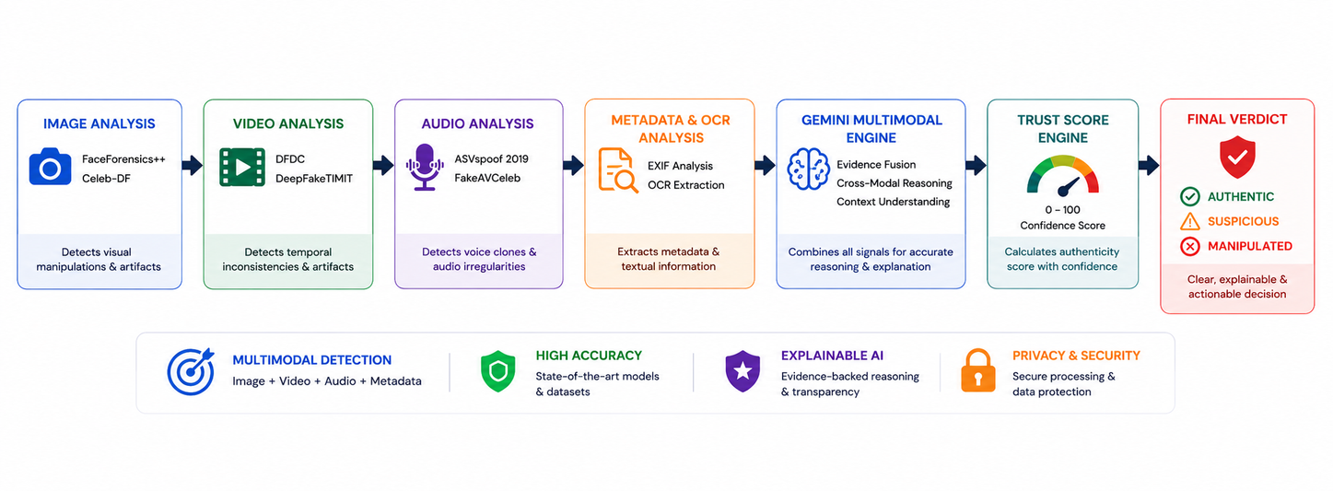
FEATURES IMPLEMENTED
06 // 09
01
02
03
04
IMAGE DEEPFAKE DETECTION • BUILT
VIDEO DEEPFAKE DETECTION • BUILT
AUDIO DEEPFAKE DETECTION • BUILT
RISK ENGINE + EVIDENCE REPORT • BUILT
Datasets
FaceForensics++
Celeb-DF v2
DFDC Dataset
Models
Gemini Vision (live)
EfficientNet + XceptionNet
CPU inference path
Shipped
POST /api/v1/upload/
Manipulation score + class
Datasets
FaceForensics++
DFDC
DeepFakeTIMIT
Models
TimeSformer + Video Swin
Frame extraction pipeline
Gemini Vision assist
Shipped
Frame-level detection
Video authenticity score
Datasets
ASVspoof 2019
FakeAVCeleb
WaveFake
Models
Whisper transcription
Wav2Vec2 + spectrogram
Voice-clone scoring
Shipped
Voice clone detection
Audio authenticity score
Inputs
Image signals
Video + Audio signals
Threat intel signals
Engine
Weighted Risk Engine
Re-normalising fusion
Gemini 2.5 report writer
Output
Trust Score 0–100
Hindi-first evidence report
ONE MISSION. BUILD THE IMPOSSIBLE.

Slide 7
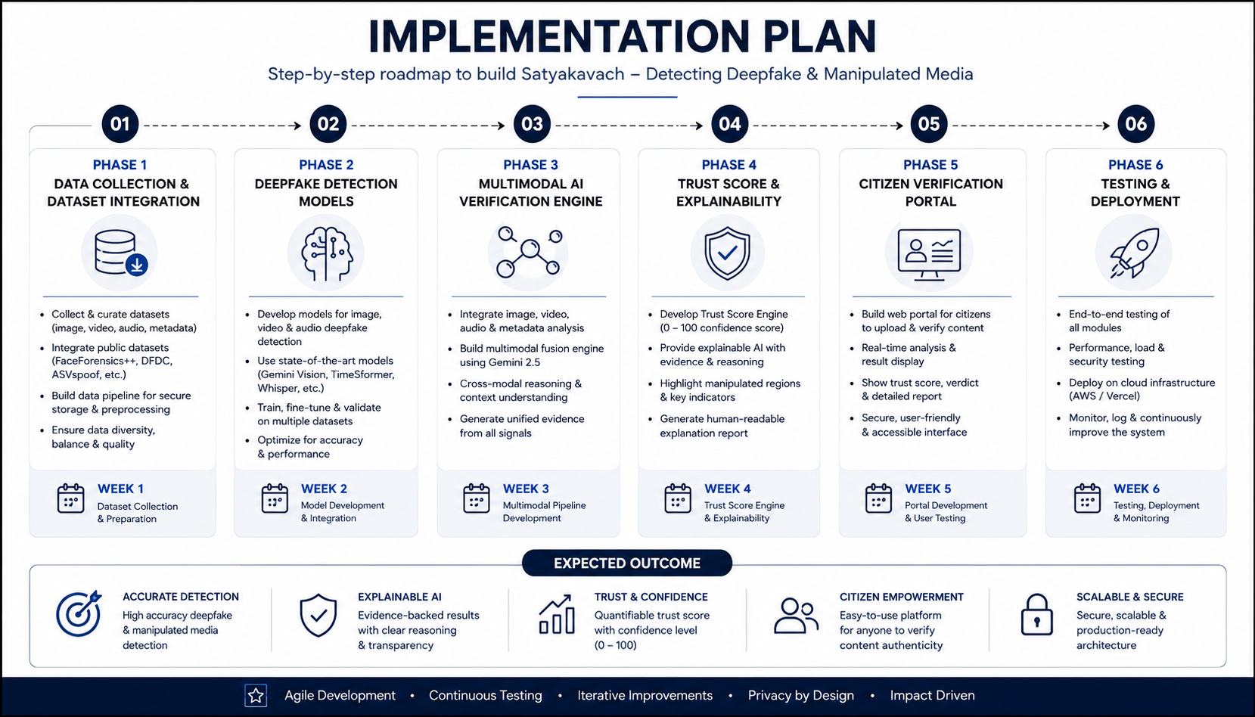
PROGRESS MADE
07 // 09
DELIVERED SINCE ROUND 1 — WORKING SYSTEM, NOT A CONCEPT
LIVE DEMO — WORKING END-TO-END
✓
Backend platform — FastAPI + PostgreSQL: uploads, async jobs, verdicts, auth, audit logs
1
Upload any image / video / audio or paste a link
✓
Multimodal AI pipeline — image, video & audio detector services running in parallel
2
AI services analyse it in parallel (demo mode needs zero API keys)
✓
Weighted Risk Engine — signal fusion → Trust Score 0–100 with three-tier verdict
3
Trust Score gauge + Hindi evidence report in under 30 seconds
✓
Explainable reports — Gemini-written evidence summaries, Hindi-first templates
[ App screenshots — drop UI captures here ]
✓
Threat intelligence — VirusTotal, Safe Browsing & PhishTank adapters + TTL cache
✓
Engineering quality — 27 unit + property-based tests passing; JWT roles & rate limits
✓
Deployment stack — full stack Dockerised: API • database • object storage • Nginx
✓
Citizen PWA — drag-&-drop upload → animated Trust Score dashboard (EN / हिंदी)
ONE MISSION. BUILD THE IMPOSSIBLE.

Slide 8
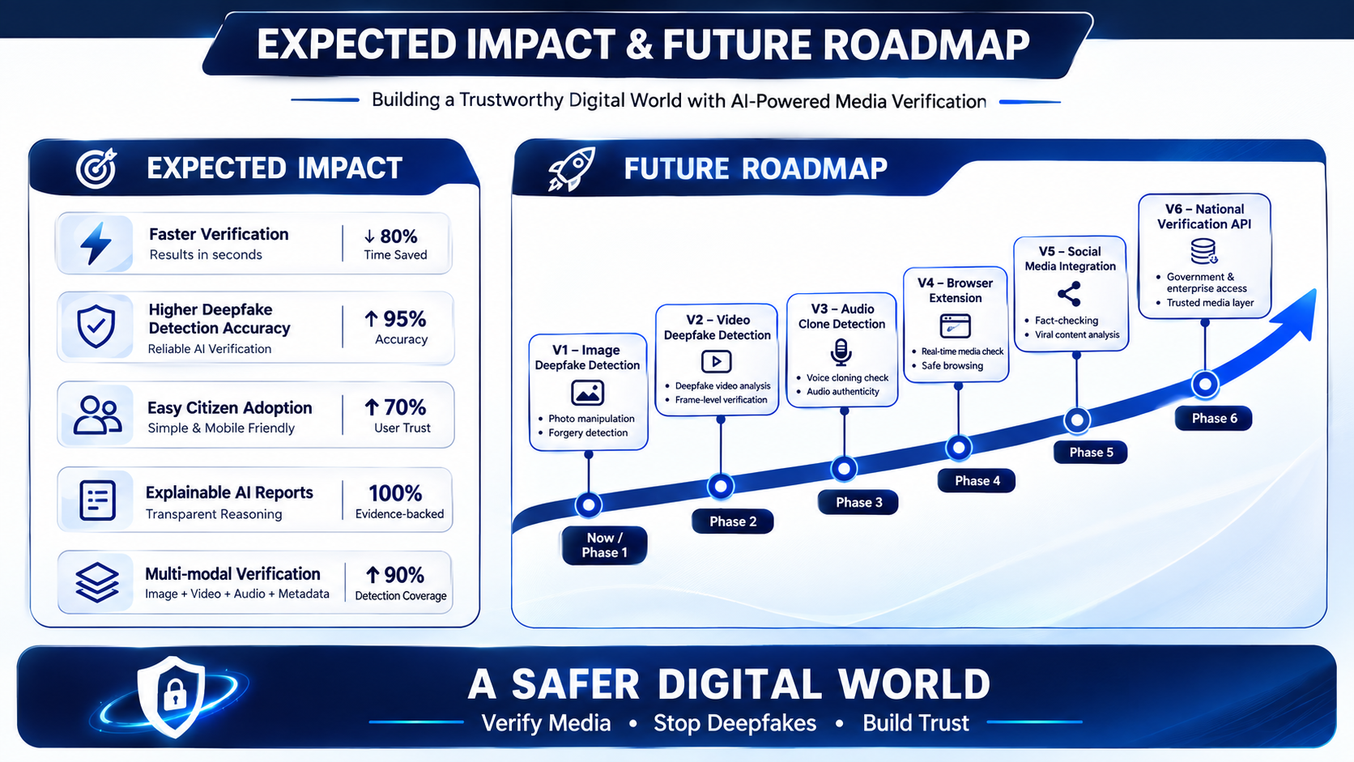
CHALLENGES FACED & ROAD AHEAD
08 // 09
CHALLENGES FACED — AND HOW WE SOLVED THEM
ROAD AHEAD — FROM PILOT TO PLATFORM
1
GPU-heavy deepfake models
Fix → Demo-mode engine ships now; HuggingFace Spaces (16 GB RAM free) path ready for real inference
NEXT 30 DAYS
PUBLIC PILOT
Deploy free stack (Vercel + Render + Neon) • OCR scam-message classifier • I4C / 1930 reporting flow
2
Free-tier API rate limits
Fix → Threat-intel cache with TTL + SHA-256 dedup eliminates repeat calls
3 MONTHS
REACH
Browser extension & WhatsApp bot intake • admin dashboard • journalist verification workspace
3
Fair multimodal signal fusion
Fix → Re-normalising weights over available signals — no single failure blocks a verdict
6–12 MONTHS
4
Hindi-first explainability
Fix → Bilingual prompt templates; every claim cites extracted artifacts, not a black-box score
SCALE
Regional Indian languages • real-time video verification • government & fact-check partnerships
EXPECTED IMPACT — Faster public verification • fewer deepfake-fraud losses • supports MeitY / Digital India trust goals
ONE MISSION. BUILD THE IMPOSSIBLE.

Slide 9
RESEARCH AND REFERENCES
09 // 09
Threat Intelligence
PhishTank - https://phishtank.org
Google Safe Browsing https://safebrowsing.google.com
VirusTotal - https://www.virustotal.com
AI & Research
Gemini API Documentation
https://ai.google.dev
EasyOCR
https://github.com/JaidedAI/EasyOCR
OpenCV
https://opencv.org
Datasets
FaceForensics -https://github.com/ondyari/FaceForensics
DeepFake Detection Challenge (DFDC) - https://ai.meta.com/datasets/dfdc
Celeb-DF v2 - https://cse.buffalo.edu/~siweilyu/celeb-deepfakeforensics.html
ASVspoof 2019 - https://www.asvspoof.org
ONE MISSION. BUILD THE IMPOSSIBLE.

