Slide 1


NU FAIRVIEW · STUDENT DISCIPLINE OFFICE
SDO Portal
UI state reference: every screen, state and workflow step, one screen per slide
Notes:
Chronological UI reference: web screens first, then mobile. One screen per slide.

Slide 2
CONTENTS
How this reference is organised
Part 1 · Web
Part 2 · Mobile
Desktop layout with sidebar, 1440 × 840. Sign-in, gate form, staff portal, student portal, page states.
Phone layout, 390 × 844. Sidebar hidden; bottom tab bar and More drawer. Same order as Part 1.
Each slide names the screen, the user role, the UI state, and the action that led to it or its result. Sample data follows the same students and cases throughout: Juan Dela Cruz (2023-100123), Maria Santos (2023-100456), cases SDO-2026-011 to 018.
Notes:
Order of the reference.

Slide 3
PART 1
Web views
Access · Gate form · Staff portal · Student portal · Page states
Notes:
Part 1: web and desktop views.

Slide 4
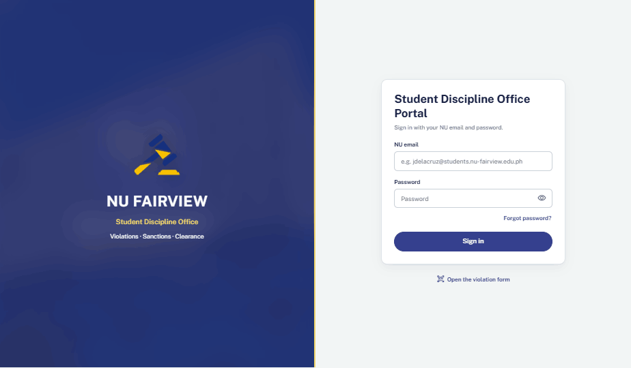
WEB · PUBLIC · 01
Sign-in
App opens on the sign-in form for students and staff.
Initial
Notes:
PUBLIC. Sign-in — Initial. App opens on the sign-in form for students and staff.

Slide 5
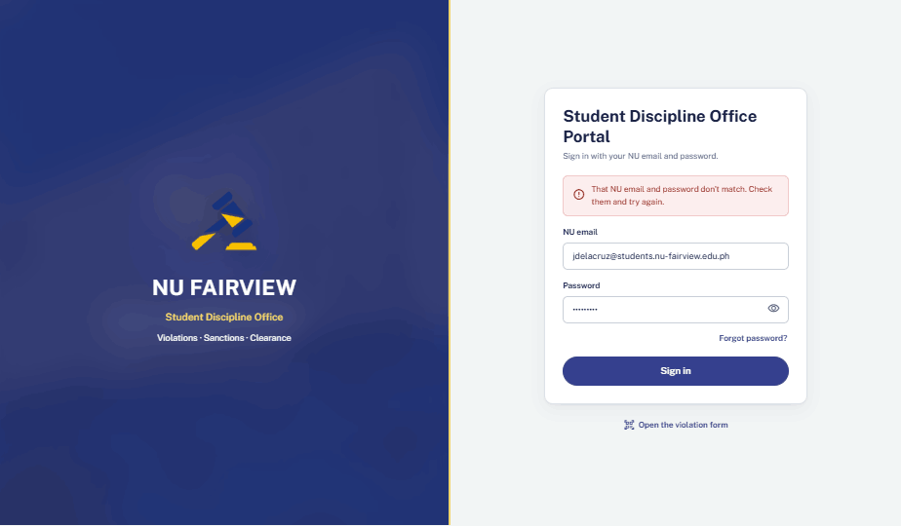
WEB · PUBLIC · 02
Sign-in
Wrong password submitted. Inline alert; the email stays filled in.
Error
Notes:
PUBLIC. Sign-in — Error. Wrong password submitted. Inline alert; the email stays filled in.

Slide 6
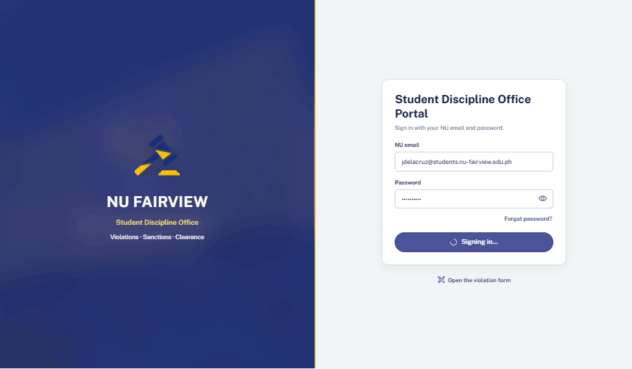
WEB · PUBLIC · 03
Sign-in
Sign in clicked. Button locks with a spinner while credentials are checked.
Loading
Notes:
PUBLIC. Sign-in — Loading. Sign in clicked. Button locks with a spinner while credentials are checked.

Slide 7
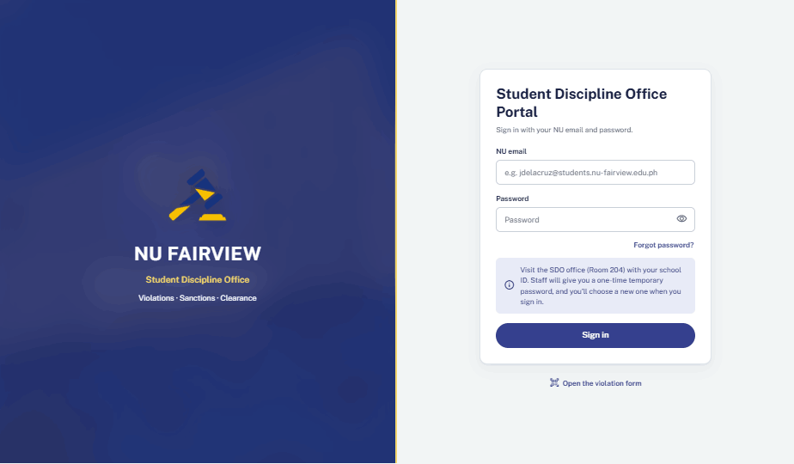
WEB · PUBLIC · 04
Sign-in
Forgot password clicked. Note explains how to get a temporary password from the SDO.
Help shown
Notes:
PUBLIC. Sign-in — Help shown. Forgot password clicked. Note explains how to get a temporary password from the SDO.

Slide 8
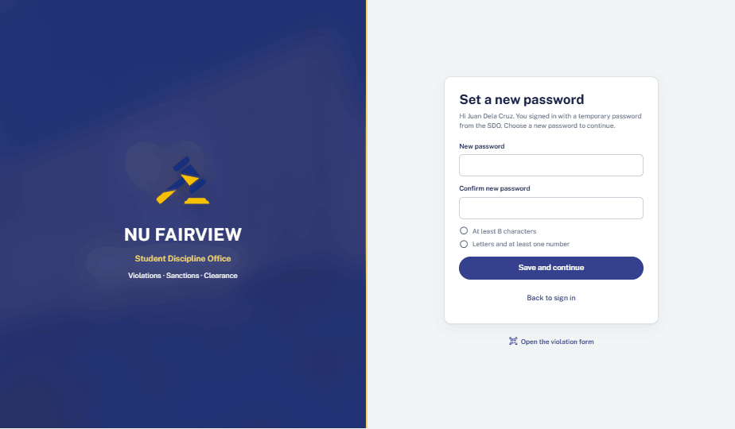
WEB · STUDENT · 05
Set a new password
Signed in with a temporary password. A new password must be set first.
Initial
Notes:
STUDENT. Set a new password — Initial. Signed in with a temporary password. A new password must be set first.

Slide 9
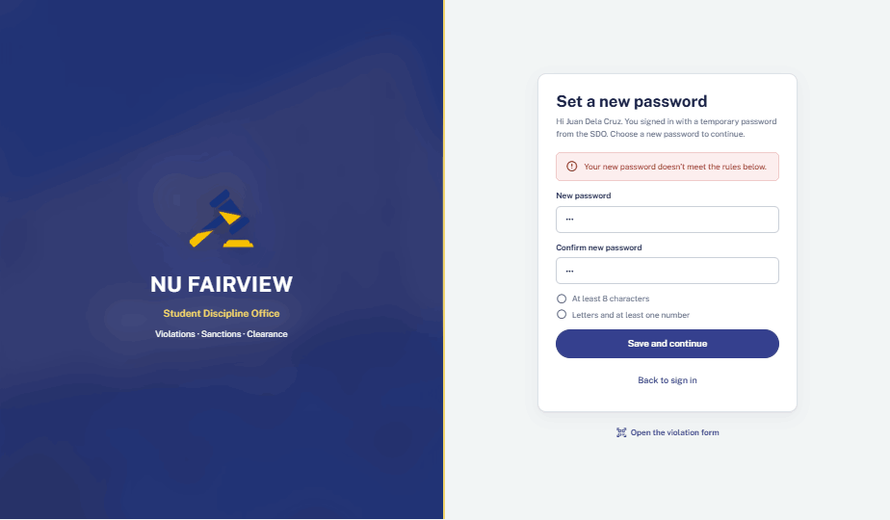
WEB · STUDENT · 06
Set a new password
Passwords do not match and rules are not met. Alert plus rule checklist.
Validation error
Notes:
STUDENT. Set a new password — Validation error. Passwords do not match and rules are not met. Alert plus rule checklist.

Slide 10
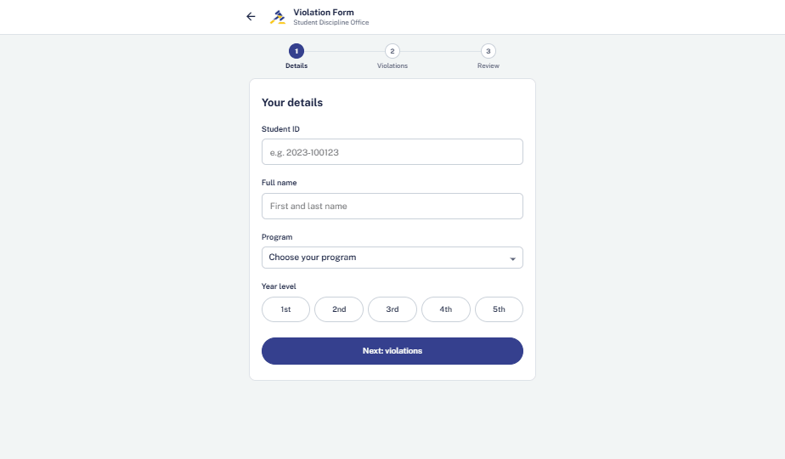
WEB · PUBLIC · 07
Gate violation form · Step 1
Open the violation form clicked from sign-in. Details step is empty.
Initial
Notes:
PUBLIC. Gate violation form · Step 1 — Initial. Open the violation form clicked from sign-in. Details step is empty.

Slide 11
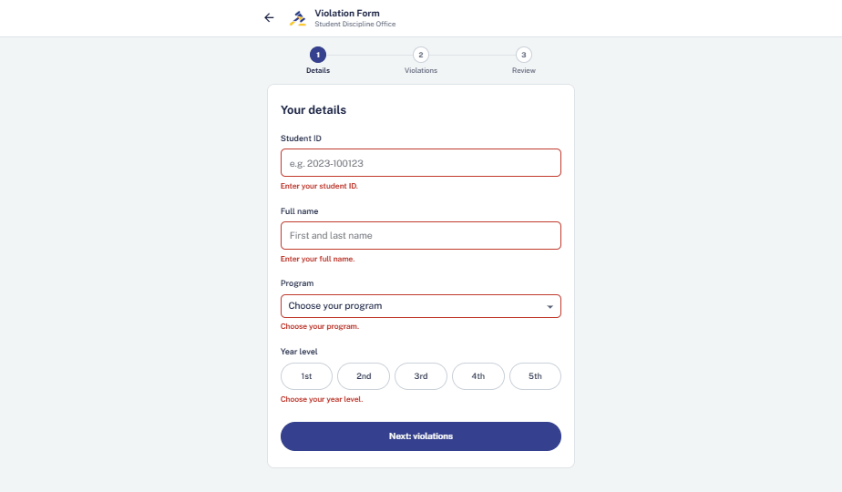
WEB · PUBLIC · 08
Gate violation form · Step 1
Next clicked with empty fields. Each field shows its own message.
Validation error
Notes:
PUBLIC. Gate violation form · Step 1 — Validation error. Next clicked with empty fields. Each field shows its own message.

Slide 12
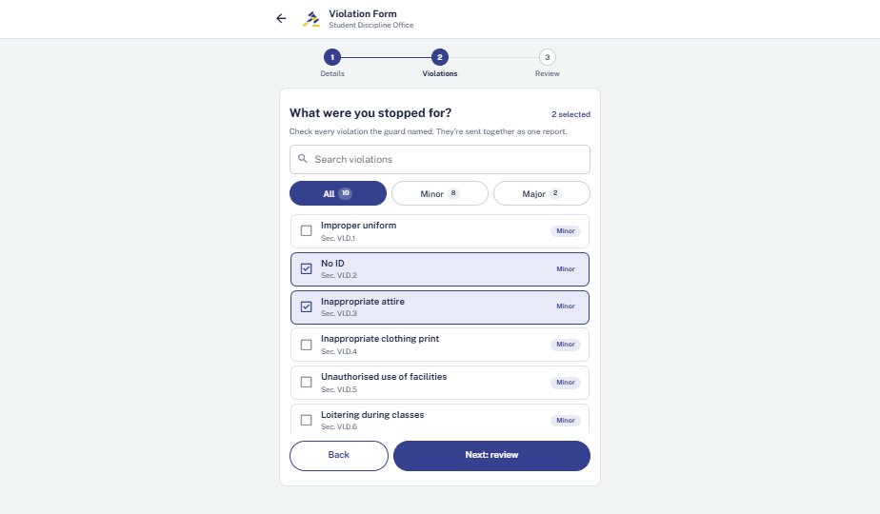
WEB · PUBLIC · 09
Gate violation form · Step 2
Details accepted. Two violations ticked: No ID, Inappropriate attire.
Populated
Notes:
PUBLIC. Gate violation form · Step 2 — Populated. Details accepted. Two violations ticked: No ID, Inappropriate attire.

Slide 13
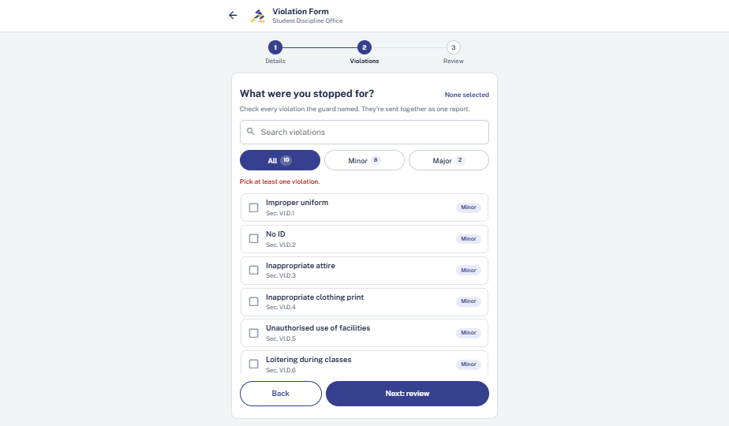
WEB · PUBLIC · 10
Gate violation form · Step 2
Review clicked with nothing ticked. Asks for at least one violation.
Validation error
Notes:
PUBLIC. Gate violation form · Step 2 — Validation error. Review clicked with nothing ticked. Asks for at least one violation.

Slide 14
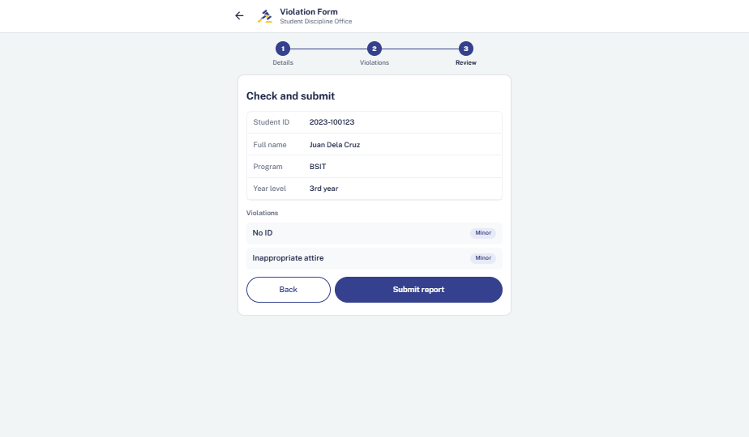
WEB · PUBLIC · 11
Gate violation form · Step 3
Summary of details and violations before submitting.
Review
Notes:
PUBLIC. Gate violation form · Step 3 — Review. Summary of details and violations before submitting.

Slide 15

WEB · PUBLIC · 12
Gate violation form · Step 3
Submit report clicked. Buttons lock while sending.
Loading
Notes:
PUBLIC. Gate violation form · Step 3 — Loading. Submit report clicked. Buttons lock while sending.

Slide 16
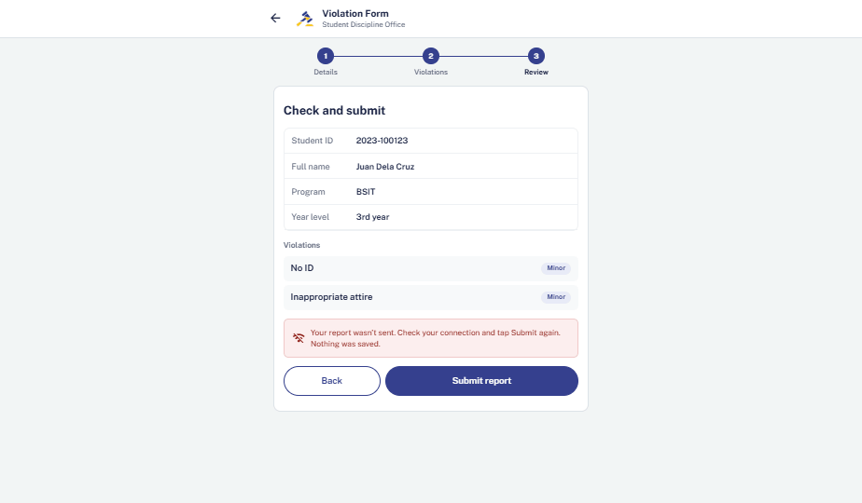
WEB · PUBLIC · 13
Gate violation form · Step 3
Connection failed. Nothing was saved; the student can submit again.
Error
Notes:
PUBLIC. Gate violation form · Step 3 — Error. Connection failed. Nothing was saved; the student can submit again.

Slide 17
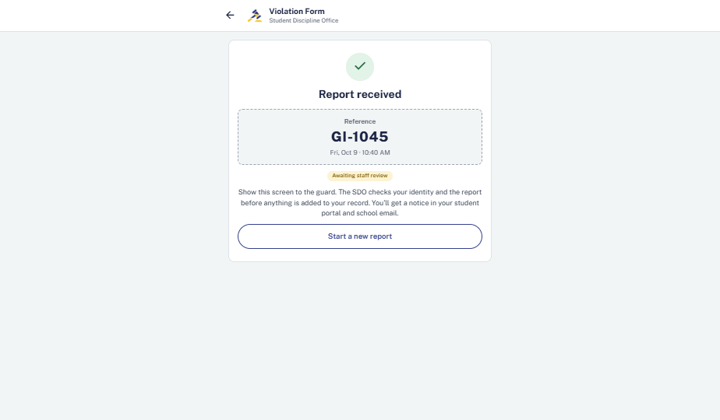
WEB · PUBLIC · 14
Gate violation form
Report received with reference GI-1045 to show the guard.
Success
Notes:
PUBLIC. Gate violation form — Success. Report received with reference GI-1045 to show the guard.

Slide 18
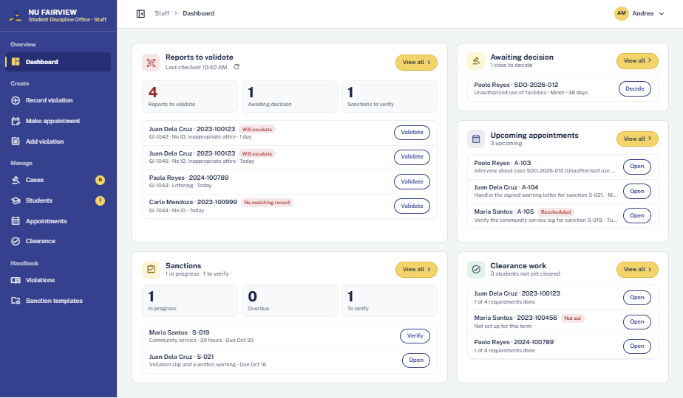
WEB · STAFF · 15
Staff dashboard
Officer signs in. Reports to validate lead; decisions, appointments and clearance follow.
Populated
Notes:
STAFF. Staff dashboard — Populated. Officer signs in. Reports to validate lead; decisions, appointments and clearance follow.

Slide 19
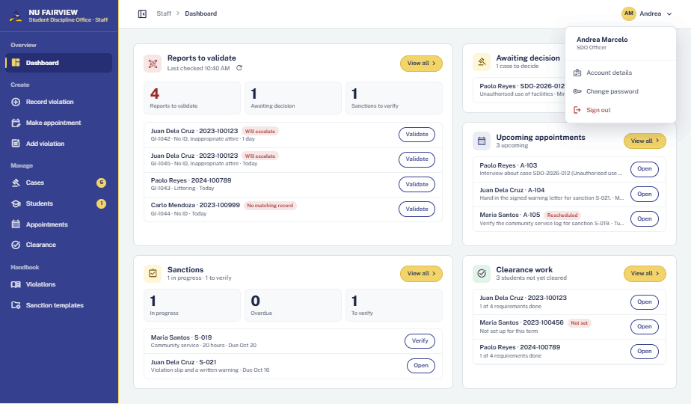
WEB · STAFF · 16
Account menu
Avatar clicked. Account details, change password, sign out.
Open
Notes:
STAFF. Account menu — Open. Avatar clicked. Account details, change password, sign out.

Slide 20
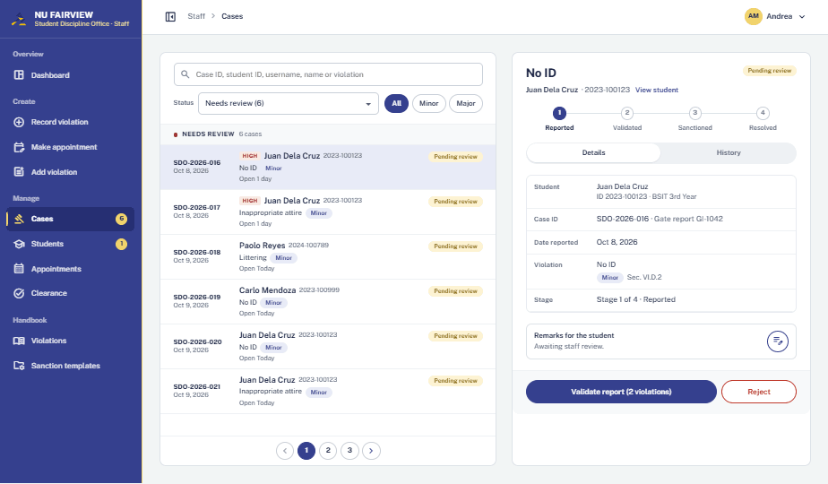
WEB · STAFF · 17
Cases · SDO-2026-016
Gate report for Juan Dela Cruz opened from the queue. Validate or Reject.
Reported
Notes:
STAFF. Cases · SDO-2026-016 — Reported. Gate report for Juan Dela Cruz opened from the queue. Validate or Reject.

Slide 21
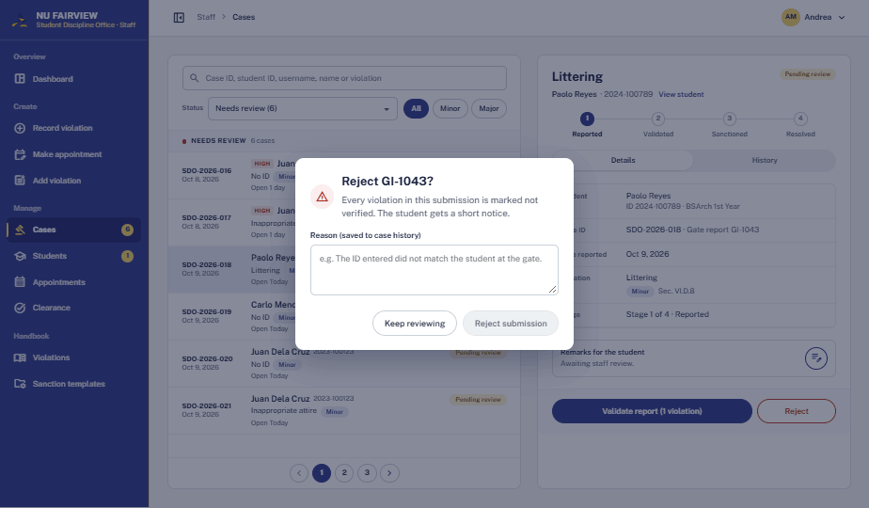
WEB · STAFF · 18
Cases · SDO-2026-018
Reject clicked. A reason is required and sent to the student.
Confirmation
Notes:
STAFF. Cases · SDO-2026-018 — Confirmation. Reject clicked. A reason is required and sent to the student.

Slide 22

WEB · STAFF · 19
Cases · SDO-2026-016
Validate report clicked. Button shows progress.
Loading
Notes:
STAFF. Cases · SDO-2026-016 — Loading. Validate report clicked. Button shows progress.

Slide 23
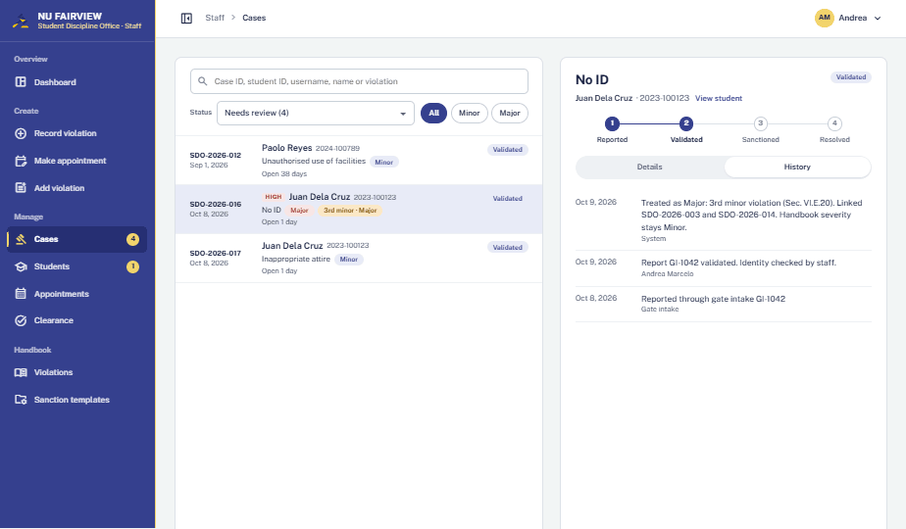
WEB · STAFF · 20
Cases · SDO-2026-016
Validated. History lists each change with date and officer.
History tab
Notes:
STAFF. Cases · SDO-2026-016 — History tab. Validated. History lists each change with date and officer.

Slide 24
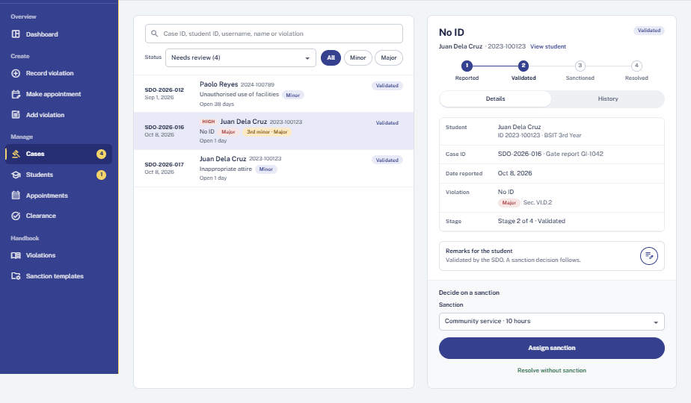
WEB · STAFF · 21
Cases · SDO-2026-016
Stage 2. Sanction picker shows handbook options for this offense.
Awaiting decision
Notes:
STAFF. Cases · SDO-2026-016 — Awaiting decision. Stage 2. Sanction picker shows handbook options for this offense.

Slide 25
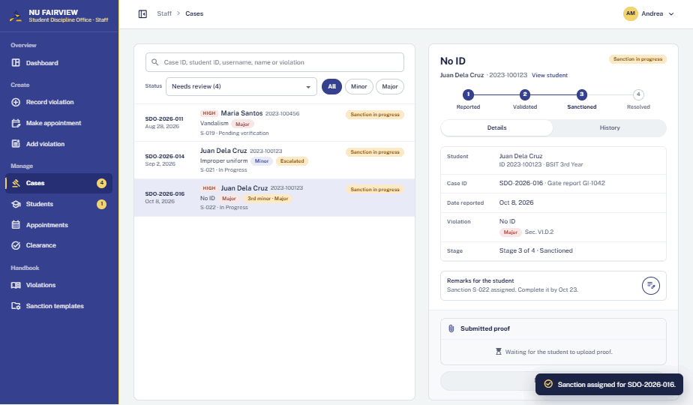
WEB · STAFF · 22
Cases · SDO-2026-016
Assign sanction clicked. Case moves to Sanctioned; toast confirms; student notified.
Success
Notes:
STAFF. Cases · SDO-2026-016 — Success. Assign sanction clicked. Case moves to Sanctioned; toast confirms; student notified.

Slide 26
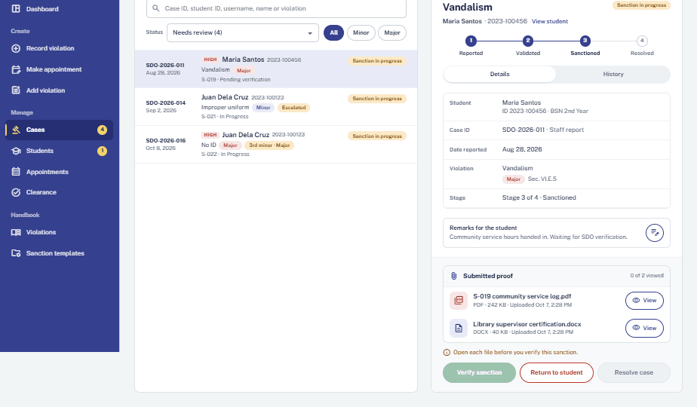
WEB · STAFF · 23
Cases · SDO-2026-011
Student uploaded two files. Verify stays locked until each is opened.
Proof submitted
Notes:
STAFF. Cases · SDO-2026-011 — Proof submitted. Student uploaded two files. Verify stays locked until each is opened.

Slide 27
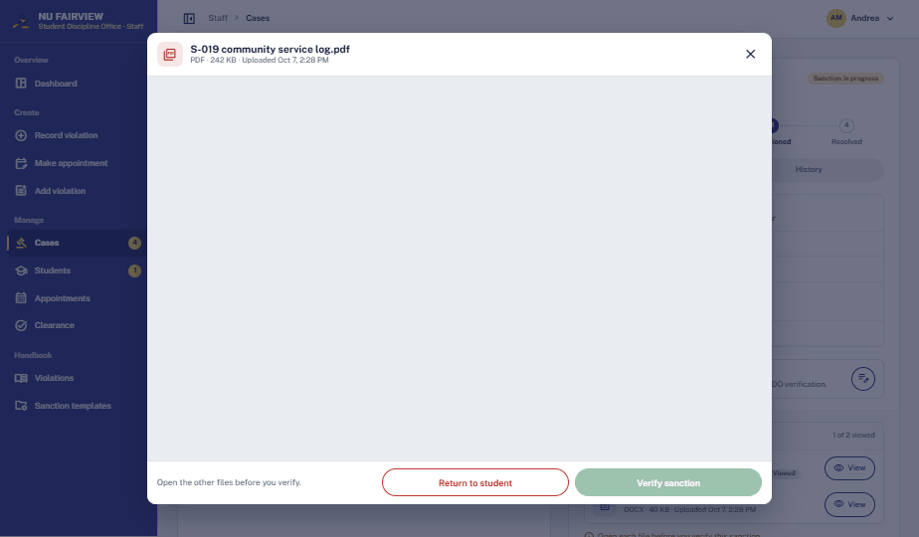
WEB · STAFF · 24
Proof file preview
View clicked on the first file. Preview opens in place.
Open
Notes:
STAFF. Proof file preview — Open. View clicked on the first file. Preview opens in place.

Slide 28
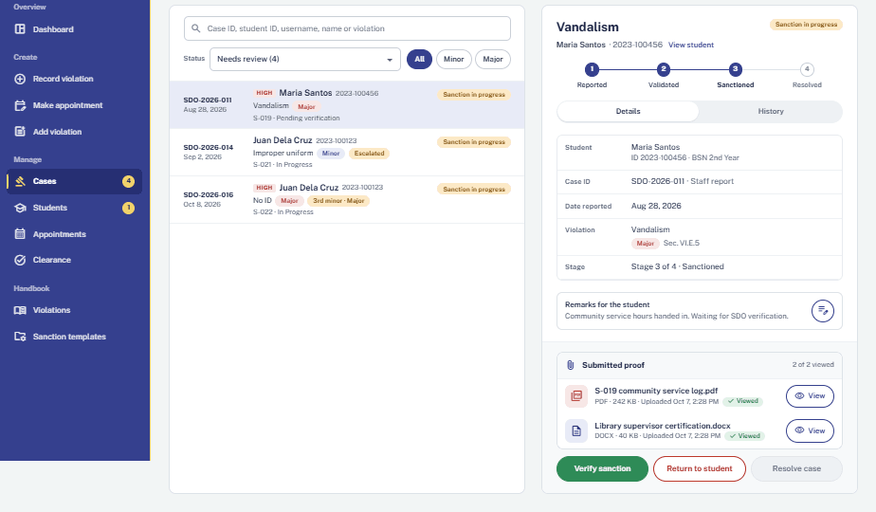
WEB · STAFF · 25
Cases · SDO-2026-011
Both files opened. Verify sanction is now enabled.
All files viewed
Notes:
STAFF. Cases · SDO-2026-011 — All files viewed. Both files opened. Verify sanction is now enabled.

Slide 29
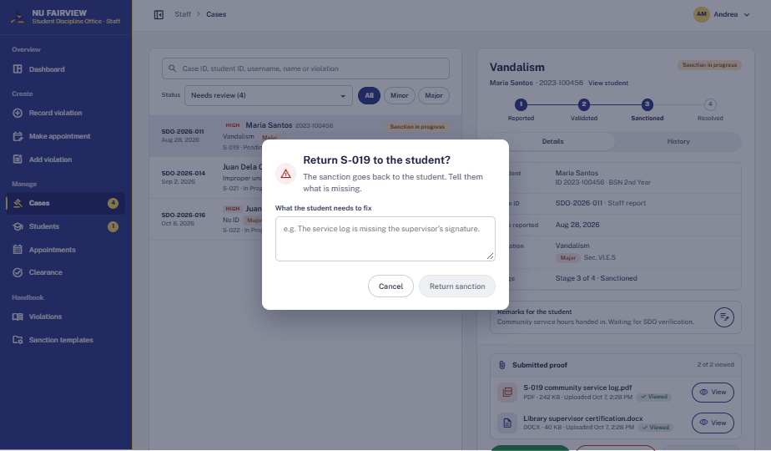
WEB · STAFF · 26
Return to student
Return to student clicked. Staff must say what needs fixing.
Confirmation
Notes:
STAFF. Return to student — Confirmation. Return to student clicked. Staff must say what needs fixing.

Slide 30
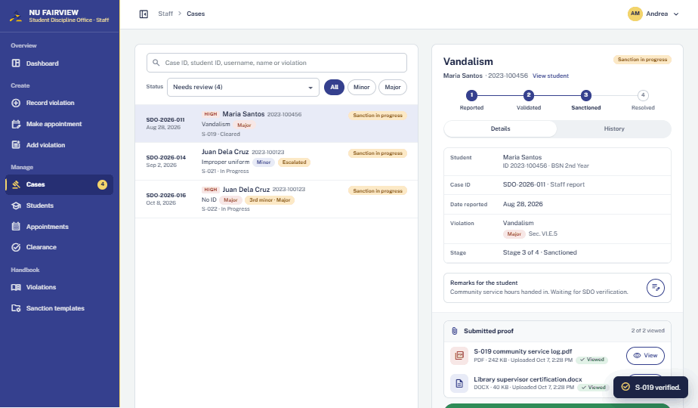
WEB · STAFF · 27
Cases · SDO-2026-011
Return cancelled; Verify sanction clicked. Sanction verified.
Success
Notes:
STAFF. Cases · SDO-2026-011 — Success. Return cancelled; Verify sanction clicked. Sanction verified.

Slide 31
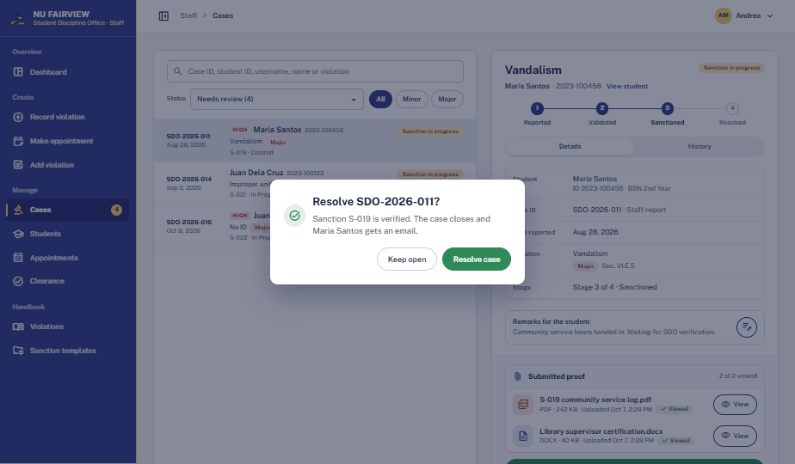
WEB · STAFF · 28
Resolve case
Resolve case clicked. Confirms closing SDO-2026-011.
Confirmation
Notes:
STAFF. Resolve case — Confirmation. Resolve case clicked. Confirms closing SDO-2026-011.

Slide 32
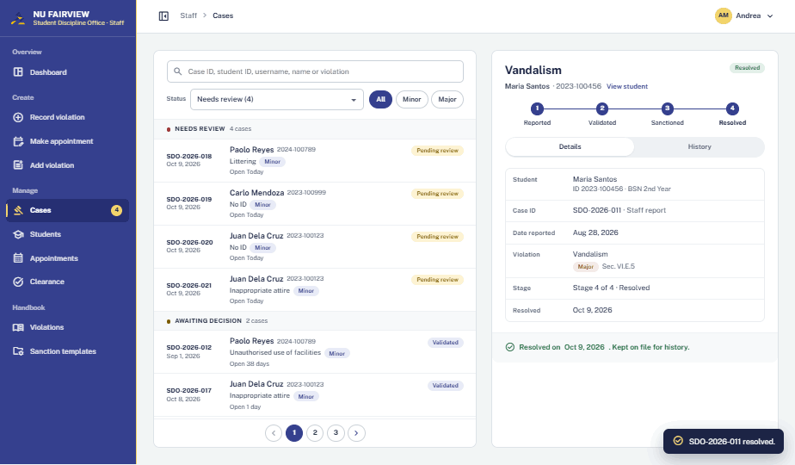
WEB · STAFF · 29
Cases · SDO-2026-011
Stage 4 of 4. Case kept on file; toast confirms.
Resolved
Notes:
STAFF. Cases · SDO-2026-011 — Resolved. Stage 4 of 4. Case kept on file; toast confirms.

Slide 33
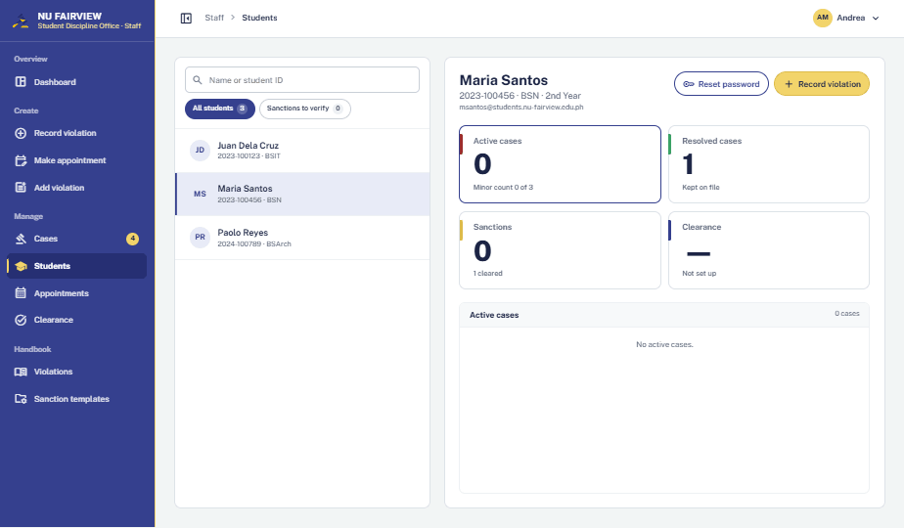
WEB · STAFF · 30
Students · Maria Santos
Student record with cases, sanctions and clearance.
Populated
Notes:
STAFF. Students · Maria Santos — Populated. Student record with cases, sanctions and clearance.

Slide 34
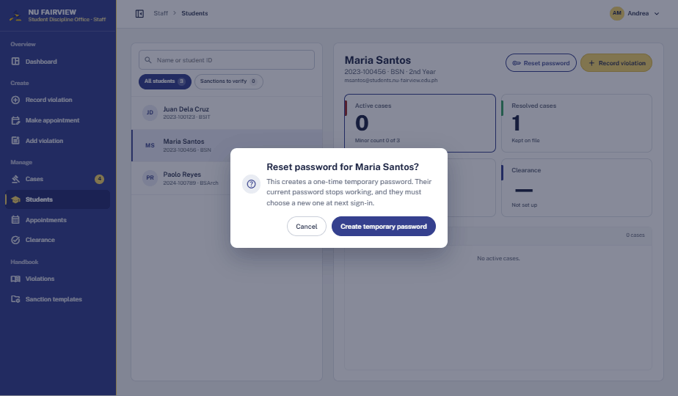
WEB · STAFF · 31
Reset password
Reset password clicked. The old password stops working.
Confirmation
Notes:
STAFF. Reset password — Confirmation. Reset password clicked. The old password stops working.

Slide 35
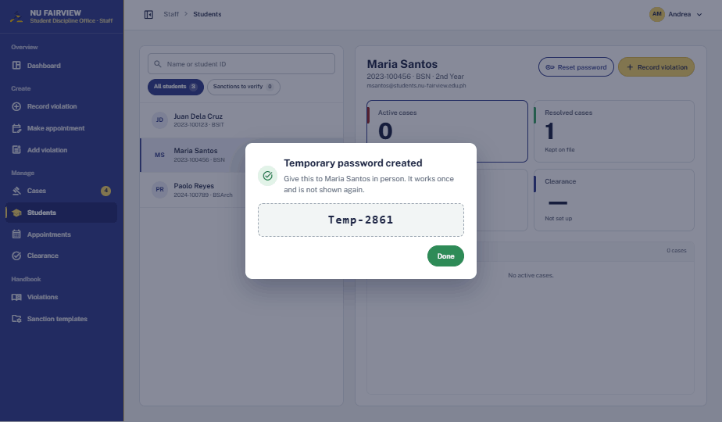
WEB · STAFF · 32
Reset password
Temporary password shown once, to hand over in person.
Success
Notes:
STAFF. Reset password — Success. Temporary password shown once, to hand over in person.

Slide 36
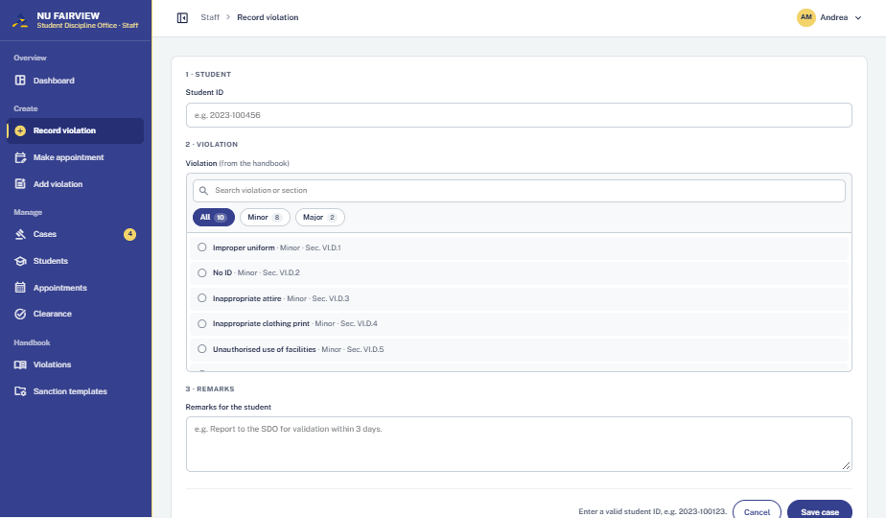
WEB · STAFF · 33
Record violation
Record violation opened from the sidebar. Student ID, violation, remarks.
Initial
Notes:
STAFF. Record violation — Initial. Record violation opened from the sidebar. Student ID, violation, remarks.

Slide 37
WEB · STAFF · 34
Record violation
Save clicked with missing fields.
Validation error
Notes:
STAFF. Record violation — Validation error. Save clicked with missing fields.

Slide 38
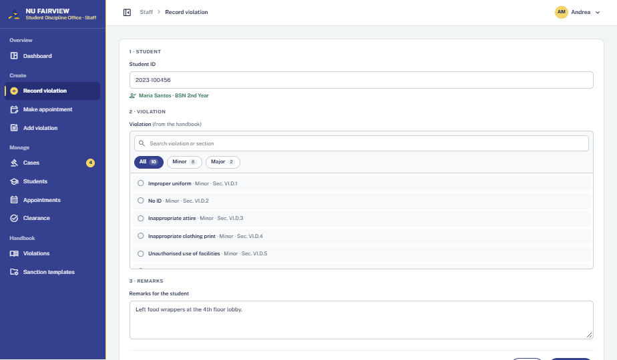
WEB · STAFF · 35
Record violation
Maria Santos found; Littering selected; remarks entered. Ready to save.
Populated
Notes:
STAFF. Record violation — Populated. Maria Santos found; Littering selected; remarks entered. Ready to save.

Slide 39
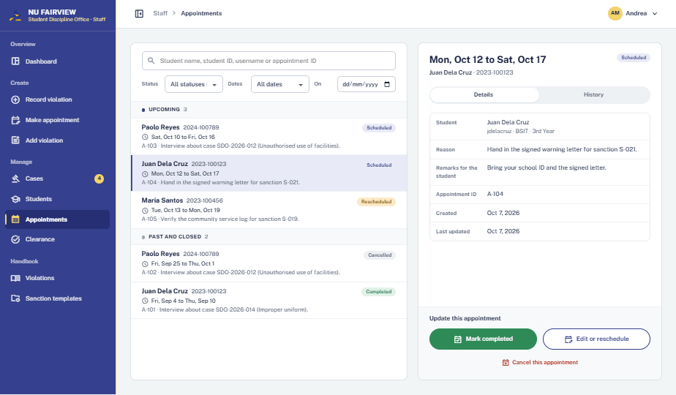
WEB · STAFF · 36
Appointments · A-104
Upcoming list with detail. Complete, edit or cancel.
Populated
Notes:
STAFF. Appointments · A-104 — Populated. Upcoming list with detail. Complete, edit or cancel.

Slide 40
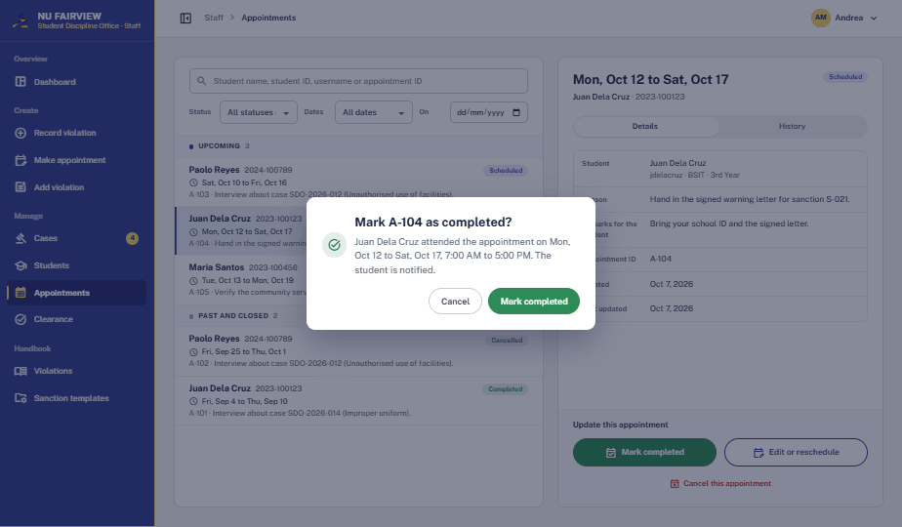
WEB · STAFF · 37
Mark completed
Mark completed clicked. Student is notified on confirm.
Confirmation
Notes:
STAFF. Mark completed — Confirmation. Mark completed clicked. Student is notified on confirm.

Slide 41
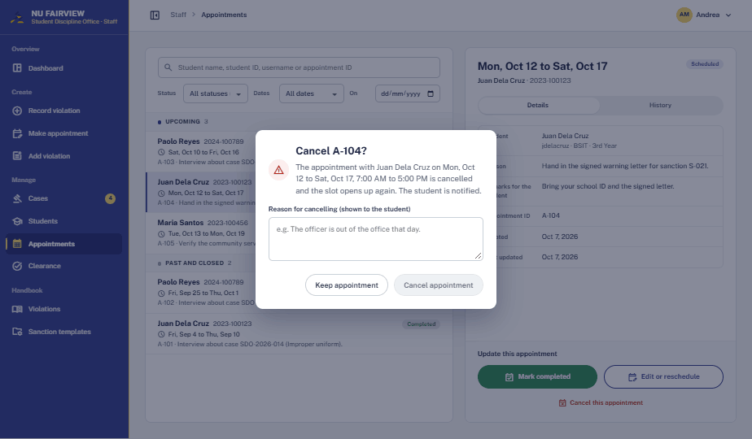
WEB · STAFF · 38
Cancel appointment
Cancel clicked. Reason required and shown to the student.
Confirmation
Notes:
STAFF. Cancel appointment — Confirmation. Cancel clicked. Reason required and shown to the student.

Slide 42
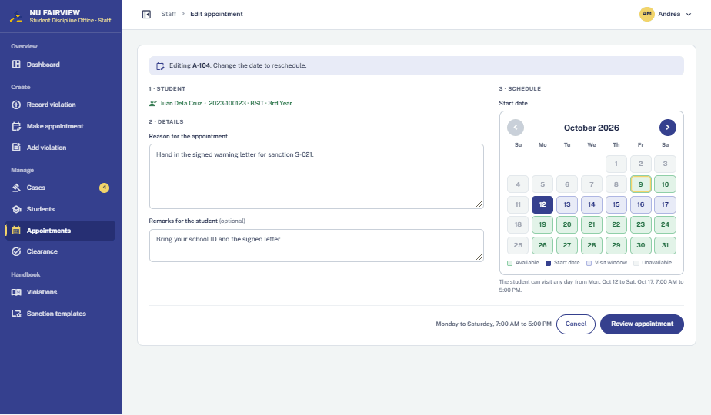
WEB · STAFF · 39
Edit or reschedule
Edit clicked. A new date marks it Rescheduled.
Editing
Notes:
STAFF. Edit or reschedule — Editing. Edit clicked. A new date marks it Rescheduled.

Slide 43
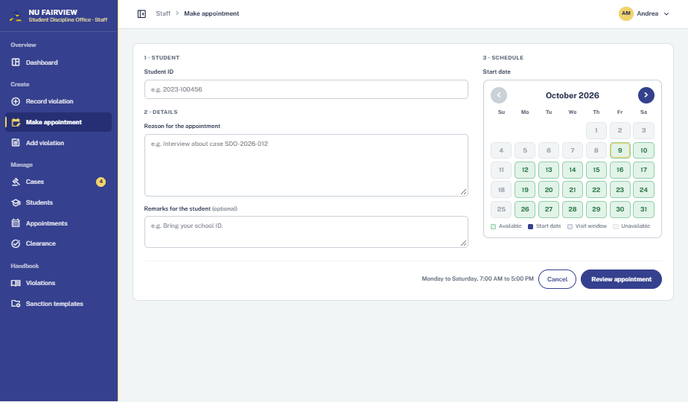
WEB · STAFF · 40
Make appointment
Make appointment opened. Student, reason, remarks, start date.
Initial
Notes:
STAFF. Make appointment — Initial. Make appointment opened. Student, reason, remarks, start date.

Slide 44
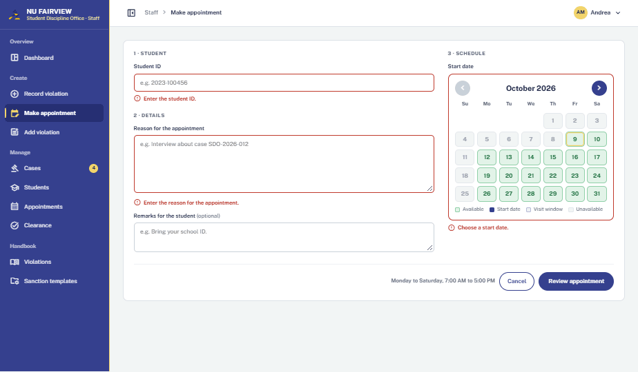
WEB · STAFF · 41
Make appointment
Review clicked with empty fields. Student ID, reason and date required.
Validation error
Notes:
STAFF. Make appointment — Validation error. Review clicked with empty fields. Student ID, reason and date required.

Slide 45
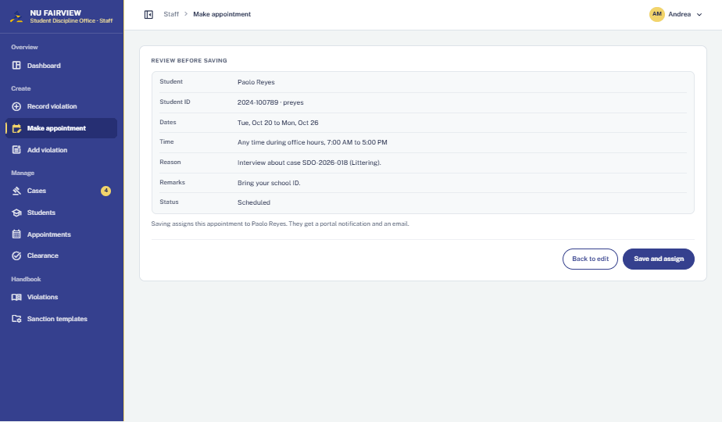
WEB · STAFF · 42
Make appointment
Fields filled for 2024-100789. Summary before saving.
Review
Notes:
STAFF. Make appointment — Review. Fields filled for 2024-100789. Summary before saving.

Slide 46
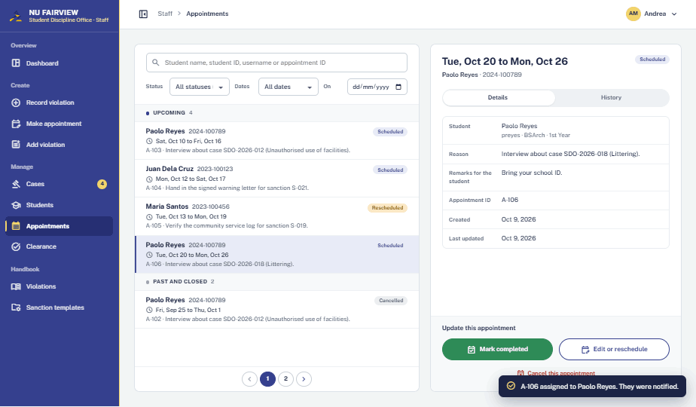
WEB · STAFF · 43
Appointments
Saved as Scheduled; toast confirms; student notified.
Success
Notes:
STAFF. Appointments — Success. Saved as Scheduled; toast confirms; student notified.

Slide 47
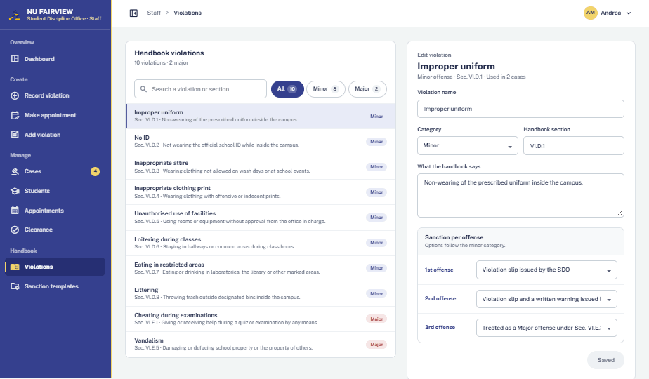
WEB · STAFF · 44
Handbook violations · Improper uniform
Violation opened. Name, category, section, text and sanction per offense.
Editing
Notes:
STAFF. Handbook violations · Improper uniform — Editing. Violation opened. Name, category, section, text and sanction per offense.

Slide 48
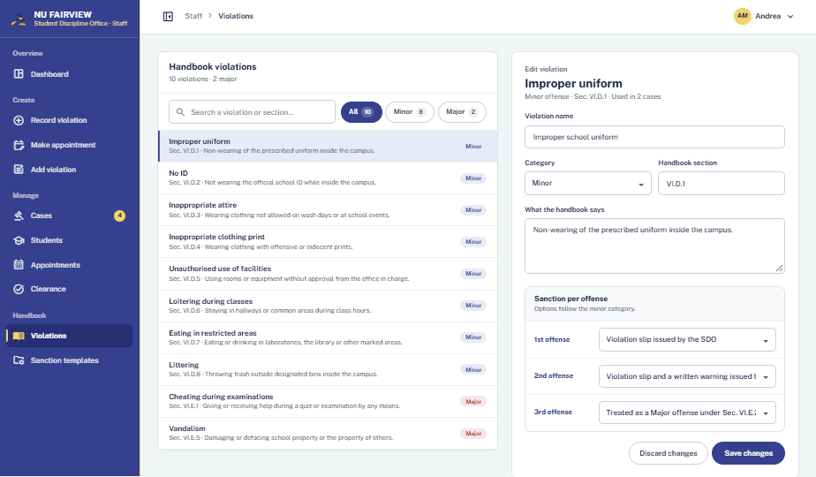
WEB · STAFF · 45
Handbook violations · Improper uniform
Name edited. Save changes and Discard become available.
Unsaved changes
Notes:
STAFF. Handbook violations · Improper uniform — Unsaved changes. Name edited. Save changes and Discard become available.

Slide 49
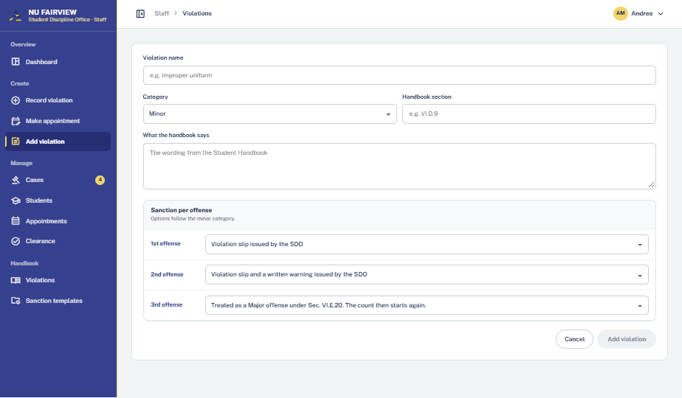
WEB · STAFF · 46
Add violation
Add violation opened. Blank entry with sanctions per offense.
Initial
Notes:
STAFF. Add violation — Initial. Add violation opened. Blank entry with sanctions per offense.

Slide 50
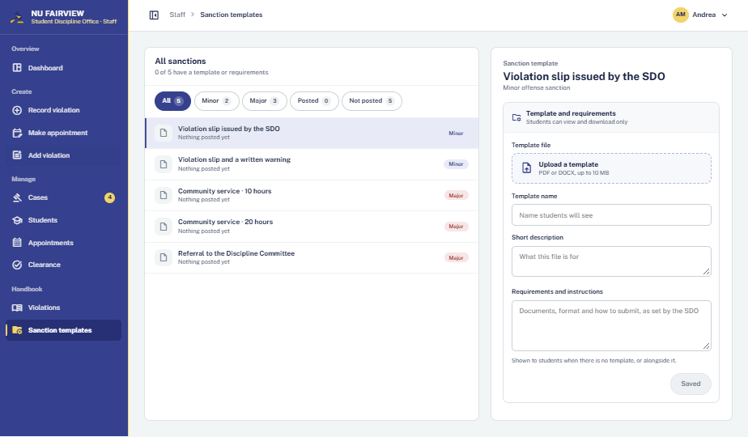
WEB · STAFF · 47
Sanction templates
No template posted for this sanction yet.
Empty
Notes:
STAFF. Sanction templates — Empty. No template posted for this sanction yet.

Slide 51
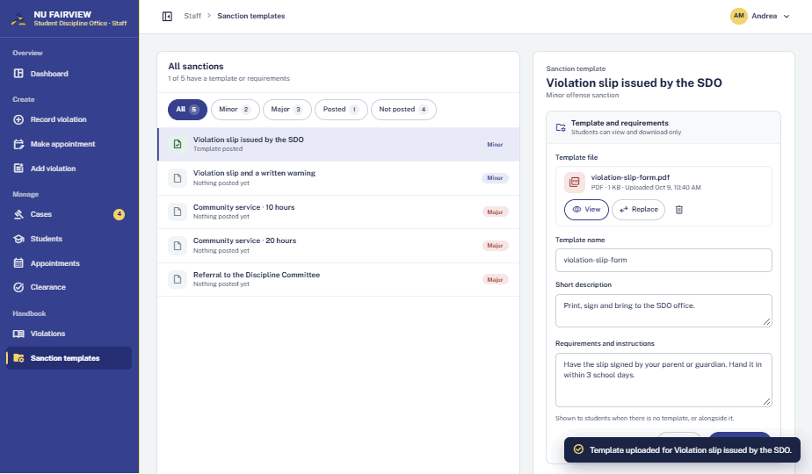
WEB · STAFF · 48
Sanction templates
violation-slip-form.pdf uploaded; description and requirements written.
File uploaded
Notes:
STAFF. Sanction templates — File uploaded. violation-slip-form.pdf uploaded; description and requirements written.

Slide 52
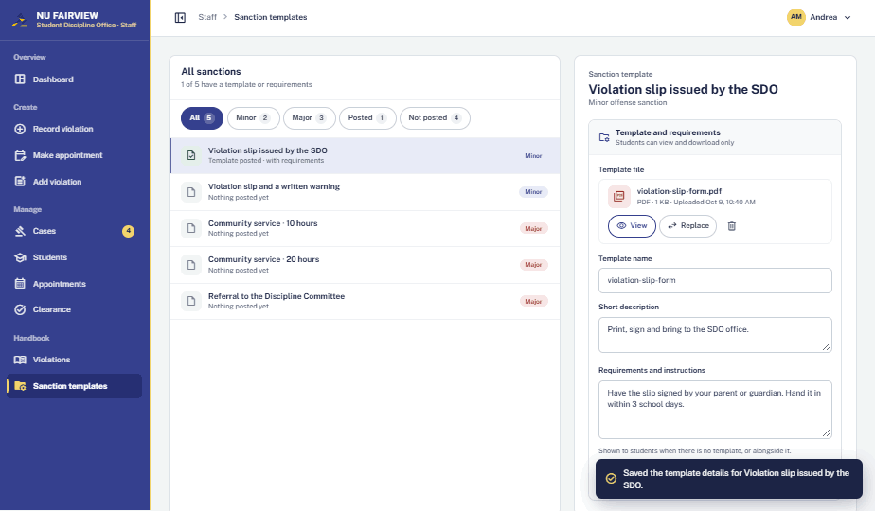
WEB · STAFF · 49
Sanction templates
Save clicked. Toast confirms; students now see it in the handbook.
Success
Notes:
STAFF. Sanction templates — Success. Save clicked. Toast confirms; students now see it in the handbook.

Slide 53
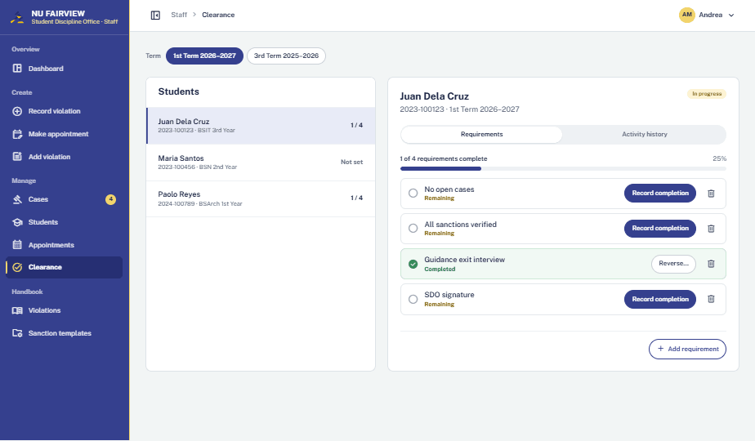
WEB · STAFF · 50
Clearance · Juan Dela Cruz
1st Term 2026–2027. 1 of 4 requirements complete.
Populated
Notes:
STAFF. Clearance · Juan Dela Cruz — Populated. 1st Term 2026–2027. 1 of 4 requirements complete.

Slide 54
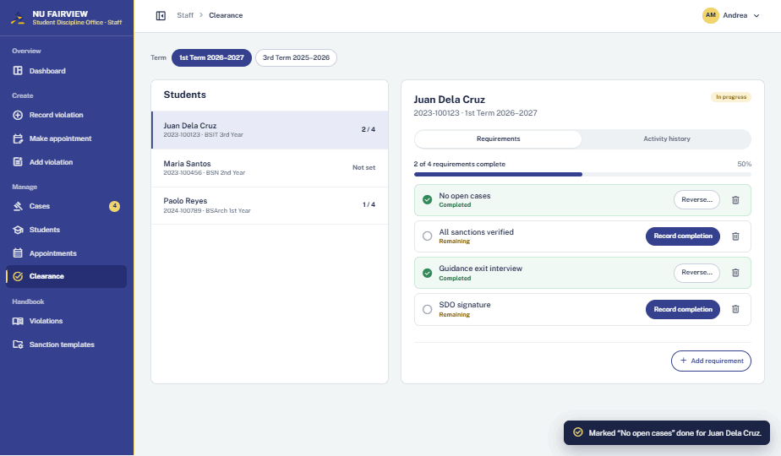
WEB · STAFF · 51
Clearance · Juan Dela Cruz
Record completion clicked. No open cases marked done; progress updates.
Success
Notes:
STAFF. Clearance · Juan Dela Cruz — Success. Record completion clicked. No open cases marked done; progress updates.

Slide 55
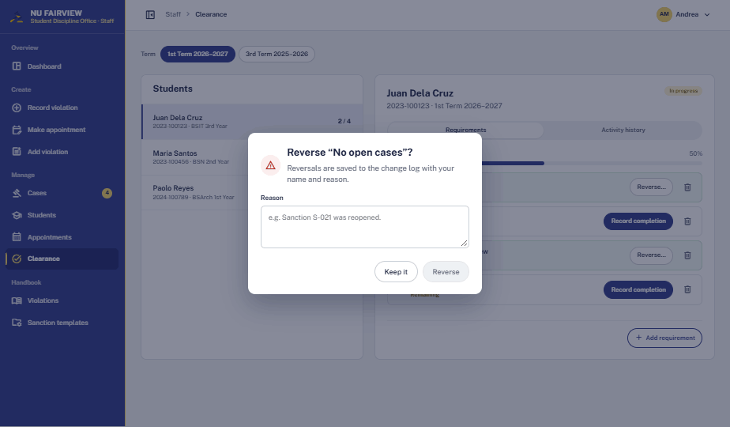
WEB · STAFF · 52
Reverse requirement
Reverse clicked. Reason is saved to the change log.
Confirmation
Notes:
STAFF. Reverse requirement — Confirmation. Reverse clicked. Reason is saved to the change log.

Slide 56
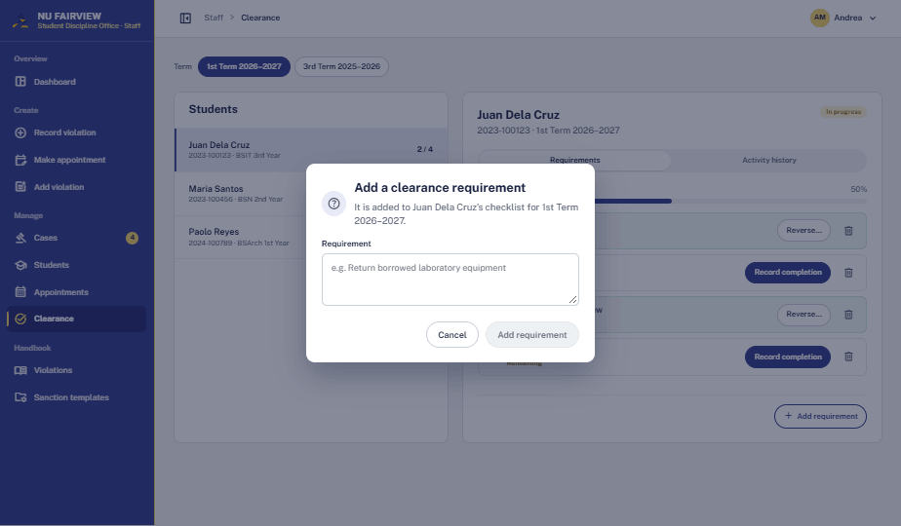
WEB · STAFF · 53
Add requirement
Add requirement clicked. Custom item for this student and term.
Initial
Notes:
STAFF. Add requirement — Initial. Add requirement clicked. Custom item for this student and term.

Slide 57

WEB · STAFF · 54
Clearance · Activity history
Every clearance change with date and officer.
Populated
Notes:
STAFF. Clearance · Activity history — Populated. Every clearance change with date and officer.

Slide 58

WEB · STAFF · 55
Clearance · Maria Santos
Not set up for this term. Set up adds the standard requirements.
Empty
Notes:
STAFF. Clearance · Maria Santos — Empty. Not set up for this term. Set up adds the standard requirements.

Slide 59

WEB · STAFF · 56
Clearance · Juan Dela Cruz
3rd Term 2025–2026, 4 of 4 complete.
Cleared
Notes:
STAFF. Clearance · Juan Dela Cruz — Cleared. 3rd Term 2025–2026, 4 of 4 complete.

Slide 60

WEB · STUDENT · 57
Student dashboard
Juan signs in. Unread count prompts Open inbox.
Notification
Notes:
STUDENT. Student dashboard — Notification. Juan signs in. Unread count prompts Open inbox.

Slide 61

WEB · STUDENT · 58
Inbox
All notifications; unread marked with a dot.
Populated
Notes:
STUDENT. Inbox — Populated. All notifications; unread marked with a dot.

Slide 62

WEB · STUDENT · 59
Inbox message
Message clicked. Full text with a link to the item.
Open
Notes:
STUDENT. Inbox message — Open. Message clicked. Full text with a link to the item.

Slide 63

WEB · STUDENT · 60
Inbox
Important notices filter applied.
Filtered
Notes:
STUDENT. Inbox — Filtered. Important notices filter applied.

Slide 64

WEB · STUDENT · 61
Inbox
Mark all as read, then Unread only. Nothing unread.
Empty
Notes:
STUDENT. Inbox — Empty. Mark all as read, then Unread only. Nothing unread.

Slide 65

WEB · STUDENT · 62
My violations
Counts by class and status filters.
Populated
Notes:
STUDENT. My violations — Populated. Counts by class and status filters.

Slide 66

WEB · STUDENT · 63
My violations · SDO-2026-016
Case detail with stage tracker and handbook reference.
Sanctioned
Notes:
STUDENT. My violations · SDO-2026-016 — Sanctioned. Case detail with stage tracker and handbook reference.

Slide 67

WEB · STUDENT · 64
My violations · SDO-2026-016
Each event on the case in order.
Timeline tab
Notes:
STUDENT. My violations · SDO-2026-016 — Timeline tab. Each event on the case in order.

Slide 68

WEB · STUDENT · 65
My sanctions · S-021
Sanction detail with four steps and due date.
In progress
Notes:
STUDENT. My sanctions · S-021 — In progress. Sanction detail with four steps and due date.

Slide 69

WEB · STUDENT · 66
My sanctions · S-021
SDO note and where to upload proof.
Next step
Notes:
STUDENT. My sanctions · S-021 — Next step. SDO note and where to upload proof.

Slide 70

WEB · STUDENT · 67
My sanctions · S-011
Cleared sanction kept for reference.
Verified
Notes:
STUDENT. My sanctions · S-011 — Verified. Cleared sanction kept for reference.

Slide 71

WEB · STUDENT · 68
Upload proof · SDO-2026-014
No files yet. PDF or DOCX, 10 MB each, up to 5 files.
Initial
Notes:
STUDENT. Upload proof · SDO-2026-014 — Initial. No files yet. PDF or DOCX, 10 MB each, up to 5 files.

Slide 72

WEB · STUDENT · 69
Upload proof
Two files chosen. View or remove before sending.
Files added
Notes:
STUDENT. Upload proof — Files added. Two files chosen. View or remove before sending.

Slide 73

WEB · STUDENT · 70
Upload proof
Remove clicked on parent-acknowledgment.docx.
File removed
Notes:
STUDENT. Upload proof — File removed. Remove clicked on parent-acknowledgment.docx.

Slide 74

WEB · STUDENT · 71
Upload proof
photo-of-letter.png rejected: wrong file type. Other files stay.
Validation error
Notes:
STUDENT. Upload proof — Validation error. photo-of-letter.png rejected: wrong file type. Other files stay.

Slide 75
WEB · STUDENT · 72
Upload proof
parent-acknowledgment.docx added again. Ready to submit.
Files added
Notes:
STUDENT. Upload proof — Files added. parent-acknowledgment.docx added again. Ready to submit.

Slide 76

WEB · STUDENT · 73
Upload proof
Submit for verification clicked. Now Pending verification.
Success
Notes:
STUDENT. Upload proof — Success. Submit for verification clicked. Now Pending verification.

Slide 77

WEB · STAFF · 74
Return to student · SDO-2026-014
Staff writes what to fix: the letter is not signed by a parent or guardian.
Confirmation
Notes:
STAFF. Return to student · SDO-2026-014 — Confirmation. Staff writes what to fix: the letter is not signed by a parent or guardian.

Slide 78

WEB · STAFF · 75
Cases · SDO-2026-014
Return to student clicked. Toast confirms; student notified.
Returned
Notes:
STAFF. Cases · SDO-2026-014 — Returned. Return to student clicked. Toast confirms; student notified.

Slide 79

WEB · STUDENT · 76
My violations · SDO-2026-014
Student sees the SDO note and can upload again.
Returned
Notes:
STUDENT. My violations · SDO-2026-014 — Returned. Student sees the SDO note and can upload again.

Slide 80

WEB · STUDENT · 77
My appointments
Visit window, reason and SDO remarks. View only.
Upcoming
Notes:
STUDENT. My appointments — Upcoming. Visit window, reason and SDO remarks. View only.

Slide 81

WEB · STUDENT · 78
My appointments
Completed and cancelled visits.
History tab
Notes:
STUDENT. My appointments — History tab. Completed and cancelled visits.

Slide 82

WEB · STUDENT · 79
Clearance
Requirements with status. Slip download stays locked.
Not yet cleared
Notes:
STUDENT. Clearance — Not yet cleared. Requirements with status. Slip download stays locked.

Slide 83

WEB · STUDENT · 80
Student handbook
All offenses with category and section.
Populated
Notes:
STUDENT. Student handbook — Populated. All offenses with category and section.

Slide 84

WEB · STUDENT · 81
Student handbook · Improper uniform
Sanction per offense; template to view or download.
Template posted
Notes:
STUDENT. Student handbook · Improper uniform — Template posted. Sanction per offense; template to view or download.

Slide 85

WEB · STUDENT · 82
Account menu
Avatar clicked. Account details, change password, sign out.
Open
Notes:
STUDENT. Account menu — Open. Avatar clicked. Account details, change password, sign out.

Slide 86

WEB · STUDENT · 83
Account details
Corrections go through the SDO.
Read only
Notes:
STUDENT. Account details — Read only. Corrections go through the SDO.

Slide 87

WEB · STUDENT · 84
Change password
Current and new password with rules.
Initial
Notes:
STUDENT. Change password — Initial. Current and new password with rules.

Slide 88

WEB · STUDENT · 85
Change password
Save clicked with empty fields. Alert above the form.
Validation error
Notes:
STUDENT. Change password — Validation error. Save clicked with empty fields. Alert above the form.

Slide 89

WEB · ALL ROLES · 86
Any page
Placeholder cards while data loads.
Loading
Notes:
ALL ROLES. Any page — Loading. Placeholder cards while data loads.

Slide 90

WEB · ALL ROLES · 87
Any page
Plain message when nothing exists.
Empty
Notes:
ALL ROLES. Any page — Empty. Plain message when nothing exists.

Slide 91

WEB · ALL ROLES · 88
Any page
Load failed. Nothing changed; Try again.
Error
Notes:
ALL ROLES. Any page — Error. Load failed. Nothing changed; Try again.

Slide 92

WEB · ALL ROLES · 89
Any page
Role lacks the page. Go to dashboard.
No access
Notes:
ALL ROLES. Any page — No access. Role lacks the page. Go to dashboard.

Slide 93
PART 2
Mobile views
Sidebar hidden · Bottom tab bar · More drawer · 44px tap targets
Notes:
Part 2: phone views, same order as Part 1.

Slide 94

MOBILE · PUBLIC · 01
Sign-in
Initial
App opens on the sign-in form.
Notes:
PUBLIC. Sign-in — Initial. App opens on the sign-in form.

Slide 95

MOBILE · PUBLIC · 02
Sign-in
Error
Wrong password. Inline alert; email kept.
Notes:
PUBLIC. Sign-in — Error. Wrong password. Inline alert; email kept.

Slide 96

MOBILE · PUBLIC · 03
Sign-in
Loading
Button locks with a spinner.
Notes:
PUBLIC. Sign-in — Loading. Button locks with a spinner.

Slide 97

MOBILE · PUBLIC · 04
Sign-in
Help shown
How to get a temporary password.
Notes:
PUBLIC. Sign-in — Help shown. How to get a temporary password.

Slide 98

MOBILE · STUDENT · 05
Set a new password
Initial
Signed in with a temporary password.
Notes:
STUDENT. Set a new password — Initial. Signed in with a temporary password.

Slide 99

MOBILE · STUDENT · 06
Set a new password
Validation error
Alert plus a live rule checklist.
Notes:
STUDENT. Set a new password — Validation error. Alert plus a live rule checklist.

Slide 100

MOBILE · PUBLIC · 07
Gate form · Step 1
Initial
Details step, empty.
Notes:
PUBLIC. Gate form · Step 1 — Initial. Details step, empty.

Slide 101

MOBILE · PUBLIC · 08
Gate form · Step 1
Validation error
Each empty field gets a message.
Notes:
PUBLIC. Gate form · Step 1 — Validation error. Each empty field gets a message.

Slide 102

MOBILE · PUBLIC · 09
Gate form · Step 2
Populated
Two violations ticked.
Notes:
PUBLIC. Gate form · Step 2 — Populated. Two violations ticked.

Slide 103

MOBILE · PUBLIC · 10
Gate form · Step 2
Validation error
At least one violation required.
Notes:
PUBLIC. Gate form · Step 2 — Validation error. At least one violation required.

Slide 104

MOBILE · PUBLIC · 11
Gate form · Step 3
Review
Check everything before submitting.
Notes:
PUBLIC. Gate form · Step 3 — Review. Check everything before submitting.

Slide 105

MOBILE · PUBLIC · 12
Gate form · Step 3
Loading
Buttons lock while sending.
Notes:
PUBLIC. Gate form · Step 3 — Loading. Buttons lock while sending.

Slide 106

MOBILE · PUBLIC · 13
Gate form · Step 3
Error
Not sent. Submit again.
Notes:
PUBLIC. Gate form · Step 3 — Error. Not sent. Submit again.

Slide 107

MOBILE · PUBLIC · 14
Gate form
Success
Reference number to show the guard.
Notes:
PUBLIC. Gate form — Success. Reference number to show the guard.

Slide 108

MOBILE · STAFF · 15
Staff dashboard
Populated
Reports to validate first. Bottom tab bar replaces the sidebar.
Notes:
STAFF. Staff dashboard — Populated. Reports to validate first. Bottom tab bar replaces the sidebar.

Slide 109

MOBILE · STAFF · 16
Staff dashboard
Scrolled
Appointments, sanctions to verify, clearance.
Notes:
STAFF. Staff dashboard — Scrolled. Appointments, sanctions to verify, clearance.

Slide 110

MOBILE · STAFF · 17
More drawer
Open
More tab tapped. Every staff page plus create actions.
Notes:
STAFF. More drawer — Open. More tab tapped. Every staff page plus create actions.

Slide 111

MOBILE · STAFF · 18
Account menu
Open
Avatar tapped. Account details, password, sign out.
Notes:
STAFF. Account menu — Open. Avatar tapped. Account details, password, sign out.

Slide 112

MOBILE · STAFF · 19
Cases
Populated
Grouped by stage; search and filter.
Notes:
STAFF. Cases — Populated. Grouped by stage; search and filter.

Slide 113

MOBILE · STAFF · 20
Cases · SDO-2026-016
Reported
Stage tracker, details, Validate or Reject.
Notes:
STAFF. Cases · SDO-2026-016 — Reported. Stage tracker, details, Validate or Reject.

Slide 114

MOBILE · STAFF · 21
Reject report
Confirmation
Reason required; student notified.
Notes:
STAFF. Reject report — Confirmation. Reason required; student notified.

Slide 115

MOBILE · STAFF · 22
Cases · SDO-2026-016
Success
Validated; toast confirms.
Notes:
STAFF. Cases · SDO-2026-016 — Success. Validated; toast confirms.

Slide 116

MOBILE · STAFF · 23
Cases · SDO-2026-016
History tab
Every change with date and officer.
Notes:
STAFF. Cases · SDO-2026-016 — History tab. Every change with date and officer.

Slide 117

MOBILE · STAFF · 24
Cases · SDO-2026-016
Awaiting decision
Stage 2 adds the sanction picker.
Notes:
STAFF. Cases · SDO-2026-016 — Awaiting decision. Stage 2 adds the sanction picker.

Slide 118

MOBILE · STAFF · 25
Choose a sanction
Selecting
Options follow the handbook entry.
Notes:
STAFF. Choose a sanction — Selecting. Options follow the handbook entry.

Slide 119

MOBILE · STAFF · 26
Cases · SDO-2026-016
Success
Sanction assigned; student notified.
Notes:
STAFF. Cases · SDO-2026-016 — Success. Sanction assigned; student notified.

Slide 120

MOBILE · STAFF · 27
Cases · SDO-2026-016
Waiting for proof
No files yet; resolve disabled.
Notes:
STAFF. Cases · SDO-2026-016 — Waiting for proof. No files yet; resolve disabled.

Slide 121

MOBILE · STAFF · 28
Cases · SDO-2026-011
Proof submitted
Open each file before verifying.
Notes:
STAFF. Cases · SDO-2026-011 — Proof submitted. Open each file before verifying.

Slide 122

MOBILE · STAFF · 29
Cases · SDO-2026-011
All files viewed
Verify unlocks at 2 of 2.
Notes:
STAFF. Cases · SDO-2026-011 — All files viewed. Verify unlocks at 2 of 2.

Slide 123

MOBILE · STAFF · 30
Return to student
Confirmation
Staff say what needs fixing.
Notes:
STAFF. Return to student — Confirmation. Staff say what needs fixing.

Slide 124

MOBILE · STAFF · 31
Cases · SDO-2026-011
Success
Sanction verified. Resolve case next.
Notes:
STAFF. Cases · SDO-2026-011 — Success. Sanction verified. Resolve case next.

Slide 125

MOBILE · STAFF · 32
Cases · SDO-2026-011
Resolved
Stage 4 of 4.
Notes:
STAFF. Cases · SDO-2026-011 — Resolved. Stage 4 of 4.

Slide 126

MOBILE · STAFF · 33
Students
Populated
Badges count sanctions to verify.
Notes:
STAFF. Students — Populated. Badges count sanctions to verify.

Slide 127

MOBILE · STAFF · 34
Students · Maria Santos
Populated
Reset password or record a violation.
Notes:
STAFF. Students · Maria Santos — Populated. Reset password or record a violation.

Slide 128

MOBILE · STAFF · 35
Students · Maria Santos
Scrolled
Cases, sanctions and clearance.
Notes:
STAFF. Students · Maria Santos — Scrolled. Cases, sanctions and clearance.

Slide 129

MOBILE · STAFF · 36
Reset password
Confirmation
Old password stops working.
Notes:
STAFF. Reset password — Confirmation. Old password stops working.

Slide 130

MOBILE · STAFF · 37
Reset password
Success
Temporary password shown once.
Notes:
STAFF. Reset password — Success. Temporary password shown once.

Slide 131

MOBILE · STAFF · 38
Record violation
Initial
Student ID, violation, remarks.
Notes:
STAFF. Record violation — Initial. Student ID, violation, remarks.

Slide 132

MOBILE · STAFF · 39
Record violation
Validation error
Invalid student ID blocks saving.
Notes:
STAFF. Record violation — Validation error. Invalid student ID blocks saving.

Slide 133

MOBILE · STAFF · 40
Record violation
Populated
Student found; name confirms the match.
Notes:
STAFF. Record violation — Populated. Student found; name confirms the match.

Slide 134

MOBILE · STAFF · 41
Record violation
Ready to save
Staff reports are saved as validated.
Notes:
STAFF. Record violation — Ready to save. Staff reports are saved as validated.

Slide 135

MOBILE · STAFF · 42
Appointments
Populated
Upcoming and closed; filters.
Notes:
STAFF. Appointments — Populated. Upcoming and closed; filters.

Slide 136

MOBILE · STAFF · 43
Appointments · A-104
Detail
Complete, edit or cancel.
Notes:
STAFF. Appointments · A-104 — Detail. Complete, edit or cancel.

Slide 137

MOBILE · STAFF · 44
Mark completed
Confirmation
Student notified on confirm.
Notes:
STAFF. Mark completed — Confirmation. Student notified on confirm.

Slide 138

MOBILE · STAFF · 45
Cancel appointment
Confirmation
Reason required.
Notes:
STAFF. Cancel appointment — Confirmation. Reason required.

Slide 139

MOBILE · STAFF · 46
Edit or reschedule
Editing
A new date marks it Rescheduled.
Notes:
STAFF. Edit or reschedule — Editing. A new date marks it Rescheduled.

Slide 140

MOBILE · STAFF · 47
Make appointment
Initial
Student, reason, remarks, start date.
Notes:
STAFF. Make appointment — Initial. Student, reason, remarks, start date.

Slide 141

MOBILE · STAFF · 48
Make appointment
Validation error
Reason and start date required.
Notes:
STAFF. Make appointment — Validation error. Reason and start date required.

Slide 142

MOBILE · STAFF · 49
Make appointment
Review
Summary before saving.
Notes:
STAFF. Make appointment — Review. Summary before saving.

Slide 143

MOBILE · STAFF · 50
Appointments
Success
Listed as Scheduled; student notified.
Notes:
STAFF. Appointments — Success. Listed as Scheduled; student notified.

Slide 144

MOBILE · STAFF · 51
Handbook violations
Populated
Search and filter by minor or major.
Notes:
STAFF. Handbook violations — Populated. Search and filter by minor or major.

Slide 145

MOBILE · STAFF · 52
Handbook violations · Improper uniform
Editing
Wording and sanction per offense.
Notes:
STAFF. Handbook violations · Improper uniform — Editing. Wording and sanction per offense.

Slide 146

MOBILE · STAFF · 53
Handbook violations · Improper uniform
Unsaved changes
Save enables once a field changes.
Notes:
STAFF. Handbook violations · Improper uniform — Unsaved changes. Save enables once a field changes.

Slide 147

MOBILE · STAFF · 54
Add violation
Initial
Blank entry with sanctions per offense.
Notes:
STAFF. Add violation — Initial. Blank entry with sanctions per offense.

Slide 148

MOBILE · STAFF · 55
Sanction templates
Populated
Filter by posted or not posted.
Notes:
STAFF. Sanction templates — Populated. Filter by posted or not posted.

Slide 149

MOBILE · STAFF · 56
Sanction templates
Empty
No template yet.
Notes:
STAFF. Sanction templates — Empty. No template yet.

Slide 150

MOBILE · STAFF · 57
Sanction templates
File uploaded
View, replace or remove the file.
Notes:
STAFF. Sanction templates — File uploaded. View, replace or remove the file.

Slide 151

MOBILE · STAFF · 58
Sanction templates
Success
Students see it in the handbook.
Notes:
STAFF. Sanction templates — Success. Students see it in the handbook.

Slide 152

MOBILE · STAFF · 59
Clearance
Populated
Students per term with progress.
Notes:
STAFF. Clearance — Populated. Students per term with progress.

Slide 153

MOBILE · STAFF · 60
Clearance · Juan Dela Cruz
Requirements
Record, reverse or remove each item.
Notes:
STAFF. Clearance · Juan Dela Cruz — Requirements. Record, reverse or remove each item.

Slide 154

MOBILE · STAFF · 61
Clearance · Juan Dela Cruz
Success
Marked done; progress 2 of 4.
Notes:
STAFF. Clearance · Juan Dela Cruz — Success. Marked done; progress 2 of 4.

Slide 155

MOBILE · STAFF · 62
Reverse requirement
Confirmation
Reason saved to the change log.
Notes:
STAFF. Reverse requirement — Confirmation. Reason saved to the change log.

Slide 156

MOBILE · STAFF · 63
Add requirement
Initial
Custom item for one student and term.
Notes:
STAFF. Add requirement — Initial. Custom item for one student and term.

Slide 157

MOBILE · STAFF · 64
Clearance · Activity history
Populated
Every change with date and officer.
Notes:
STAFF. Clearance · Activity history — Populated. Every change with date and officer.

Slide 158

MOBILE · STAFF · 65
Clearance · Maria Santos
Empty
Not set up for this term.
Notes:
STAFF. Clearance · Maria Santos — Empty. Not set up for this term.

Slide 159

MOBILE · STAFF · 66
Clearance · Juan Dela Cruz
Cleared
A past term at 4 of 4.
Notes:
STAFF. Clearance · Juan Dela Cruz — Cleared. A past term at 4 of 4.

Slide 160

MOBILE · STUDENT · 67
Student dashboard
Notification
Unread count prompts Open inbox.
Notes:
STUDENT. Student dashboard — Notification. Unread count prompts Open inbox.

Slide 161

MOBILE · STUDENT · 68
Student dashboard
Scrolled
Appointment, sanctions and clearance.
Notes:
STUDENT. Student dashboard — Scrolled. Appointment, sanctions and clearance.

Slide 162

MOBILE · STUDENT · 69
Inbox
Populated
Filter by type; unread marked with a dot.
Notes:
STUDENT. Inbox — Populated. Filter by type; unread marked with a dot.

Slide 163

MOBILE · STUDENT · 70
Inbox message
Open
Full text with a link to the item.
Notes:
STUDENT. Inbox message — Open. Full text with a link to the item.

Slide 164

MOBILE · STUDENT · 71
Inbox
Filtered
Important notices only.
Notes:
STUDENT. Inbox — Filtered. Important notices only.

Slide 165

MOBILE · STUDENT · 72
Inbox
Empty
Nothing unread after Mark all as read.
Notes:
STUDENT. Inbox — Empty. Nothing unread after Mark all as read.

Slide 166

MOBILE · STUDENT · 73
My violations
Populated
Counts by class; status filters.
Notes:
STUDENT. My violations — Populated. Counts by class; status filters.

Slide 167

MOBILE · STUDENT · 74
My violations · Case detail
Detail
Stage tracker and handbook reference.
Notes:
STUDENT. My violations · Case detail — Detail. Stage tracker and handbook reference.

Slide 168

MOBILE · STUDENT · 75
My violations · Case detail
Timeline tab
Each event in order.
Notes:
STUDENT. My violations · Case detail — Timeline tab. Each event in order.

Slide 169

MOBILE · STUDENT · 76
My sanctions
Populated
In progress, pending, cleared.
Notes:
STUDENT. My sanctions — Populated. In progress, pending, cleared.

Slide 170

MOBILE · STUDENT · 77
My sanctions · S-021
In progress
Four steps with due date.
Notes:
STUDENT. My sanctions · S-021 — In progress. Four steps with due date.

Slide 171

MOBILE · STUDENT · 78
My sanctions · S-021
Next step
SDO note and where to upload proof.
Notes:
STUDENT. My sanctions · S-021 — Next step. SDO note and where to upload proof.

Slide 172

MOBILE · STUDENT · 79
My sanctions · S-011
Verified
Kept for reference.
Notes:
STUDENT. My sanctions · S-011 — Verified. Kept for reference.

Slide 173

MOBILE · STUDENT · 80
Upload proof · SDO-2026-014
Initial
PDF or DOCX, 10 MB, up to 5 files.
Notes:
STUDENT. Upload proof · SDO-2026-014 — Initial. PDF or DOCX, 10 MB, up to 5 files.

Slide 174

MOBILE · STUDENT · 81
Upload proof
Files added
View or remove before sending.
Notes:
STUDENT. Upload proof — Files added. View or remove before sending.

Slide 175

MOBILE · STUDENT · 82
Upload proof
Validation error
Wrong file type rejected; others stay.
Notes:
STUDENT. Upload proof — Validation error. Wrong file type rejected; others stay.

Slide 176

MOBILE · STUDENT · 83
Upload proof
Success
Now Pending verification.
Notes:
STUDENT. Upload proof — Success. Now Pending verification.

Slide 177

MOBILE · STUDENT · 84
Upload proof
Under review
Replace or remove until verified.
Notes:
STUDENT. Upload proof — Under review. Replace or remove until verified.

Slide 178

MOBILE · STAFF · 85
Cases · SDO-2026-014
Returned
Return note stays on the case; student notified.
Notes:
STAFF. Cases · SDO-2026-014 — Returned. Return note stays on the case; student notified.

Slide 179

MOBILE · STUDENT · 86
My violations · Escalated case
Escalated
Timeline records the escalation to Major.
Notes:
STUDENT. My violations · Escalated case — Escalated. Timeline records the escalation to Major.

Slide 180

MOBILE · STUDENT · 87
My appointments
Upcoming
Visit window, reason and remarks.
Notes:
STUDENT. My appointments — Upcoming. Visit window, reason and remarks.

Slide 181

MOBILE · STUDENT · 88
My appointments
History tab
Completed and cancelled visits.
Notes:
STUDENT. My appointments — History tab. Completed and cancelled visits.

Slide 182

MOBILE · STUDENT · 89
Clearance
Not yet cleared
Slip download stays locked.
Notes:
STUDENT. Clearance — Not yet cleared. Slip download stays locked.

Slide 183

MOBILE · STUDENT · 90
Clearance
Scrolled
How to get cleared and what to do next.
Notes:
STUDENT. Clearance — Scrolled. How to get cleared and what to do next.

Slide 184

MOBILE · STUDENT · 91
Student handbook
Populated
All offenses with section.
Notes:
STUDENT. Student handbook — Populated. All offenses with section.

Slide 185

MOBILE · STUDENT · 92
Student handbook · Entry
Detail
Sanction per offense count.
Notes:
STUDENT. Student handbook · Entry — Detail. Sanction per offense count.

Slide 186

MOBILE · STUDENT · 93
Student handbook · Improper uniform
Template posted
View or download the file.
Notes:
STUDENT. Student handbook · Improper uniform — Template posted. View or download the file.

Slide 187

MOBILE · STUDENT · 94
Account menu
Open
Account details, password, sign out.
Notes:
STUDENT. Account menu — Open. Account details, password, sign out.

Slide 188

MOBILE · STUDENT · 95
Account details
Read only
Corrections go through the SDO.
Notes:
STUDENT. Account details — Read only. Corrections go through the SDO.

Slide 189

MOBILE · STUDENT · 96
Change password
Initial
Current and new, with rules.
Notes:
STUDENT. Change password — Initial. Current and new, with rules.

Slide 190

MOBILE · STUDENT · 97
Change password
Validation error
Alert above the form.
Notes:
STUDENT. Change password — Validation error. Alert above the form.

Slide 191

MOBILE · ALL ROLES · 98
Any page
Loading
Placeholder cards while data loads.
Notes:
ALL ROLES. Any page — Loading. Placeholder cards while data loads.

Slide 192

MOBILE · ALL ROLES · 99
Any page
Empty
Plain message when nothing exists.
Notes:
ALL ROLES. Any page — Empty. Plain message when nothing exists.

Slide 193

MOBILE · ALL ROLES · 100
Any page
Error
Nothing changed; Try again.
Notes:
ALL ROLES. Any page — Error. Nothing changed; Try again.

Slide 194

MOBILE · ALL ROLES · 101
Any page
No access
Back to dashboard.
Notes:
ALL ROLES. Any page — No access. Back to dashboard.

Slide 195
NEXT
Open items
Sanction templates are not pre-filled; staff create and upload them
Handbook content needs to be loaded and reviewed by the SDO
The staff notices editor has no entry in the current navigation
Notes:
Items still open after this review.

Slide 196
NEXT
Open items
Sanction templates are not pre-filled; staff create and upload them
Handbook content needs to be loaded and reviewed by the SDO
The staff notices editor has no entry in the current navigation

Slide 197
NEXT
Open items
Sanction templates are not pre-filled; staff create and upload them
Handbook content needs to be loaded and reviewed by the SDO
The staff notices editor has no entry in the current navigation

Slide 198
NEXT
Open items
Sanction templates are not pre-filled; staff create and upload them
Handbook content needs to be loaded and reviewed by the SDO
The staff notices editor has no entry in the current navigation

Slide 199
NEXT
Open items
Sanction templates are not pre-filled; staff create and upload them
Handbook content needs to be loaded and reviewed by the SDO
The staff notices editor has no entry in the current navigation

