Slide 1

Anomaly Detection and Predictive Maintenance
Mithun Prasad, PhD miprasad@Microsoft.com

Slide 2

Getting Started
Introduction of the Learn-AI team
Instructor introductions and backgrounds
Quick survey of participant backgrounds and expectations from the course

Slide 3
Agenda
Time | Topic
9.00 AM – 9.30 AM | Machine Learning on Azure
9.30 AM – 10.30 AM | Data Prep w/ ADB (1; Hands On)
10.30 AM – 10.45 AM | Coffee Break
10.45 AM – 11.45 AM | Data Prep w/ ADB (2; Hands On)
11.45 AM – 12.30 PM | Logistic Regression w/ Spark ML (Hands On)
12.30 PM – 1.30 PM | Lunch
1.30 PM – 3.00 PM | AML Model Management and ML Experimentation (Hands On)
3.00 PM – 3.15 PM | Coffee Break
3.15 PM – 4.15 PM | Automated ML (Hands On w/ AML + ADB)
4.15 PM – 5.00 PM | Real-time scoring w/ AKS - Deployment to AKS (Hands On)

Slide 4
Learning Goals
Understand how to use Azure AI Platform tools to solve real-world problems
Learn to think like a data scientist and speak the language
Learn to follow best practices to handle complex projects
Use the Azure SDK together with Azure Databricks to manage Workspaces and train/deploy models
Understand automated machine learning and how it can help discover “best” models

Slide 5
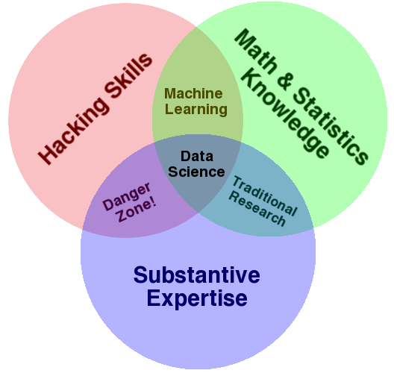
What do Data Scientists do?
Translate a business problem to a data problem
Use machine learning to find a good-enough solution
Make the solution useful by finding the right way to surface it

Slide 6
Applications of Anomaly Detection
Intrusion detection
Fraud detection
Medical and public health anomaly detection
Industrial damage detection
Image processing
Sensor networks

Slide 7
Different Categories of Anomalies
Point anomalies
Contextual anomalies
Collective anomalies

Slide 8
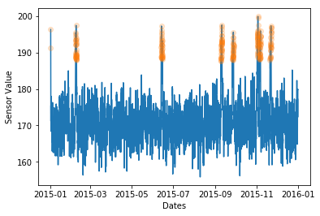
Point Anomalies
One or more individual data instances can be anomalous with respect to the rest of data.

Slide 9
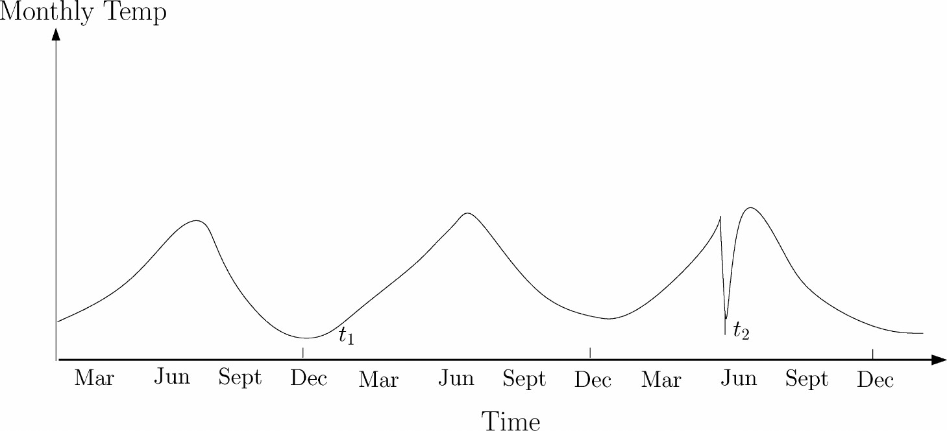
Contextual Anomalies
A data instance is anomalous in a specific context, but not otherwise.
Example: Having an employee try to log onto her corporate account using her credentials is not anomalous per se. However, when this does not happen within the pre-defined business hours, the instance becomes anomalous in the temporal context.

Slide 10
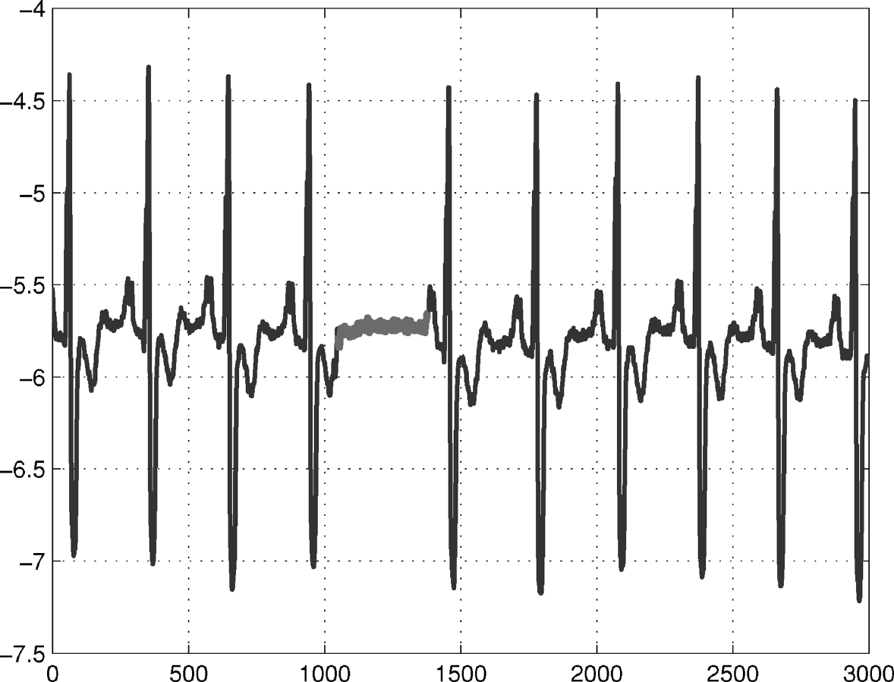
Collective Anomalies
The individual data instances in a collective anomaly may not be anomalies by themselves.

Slide 11
Predictive Maintenance (aka preventive maintenance):
By trying to predict failures before they happen and run just in time maintenance. This approach is often more optimal in balancing the cost failures and the labor and opportunity cost of equipment maintenance.

Slide 12
Common PdM Use - Cases
Airline: Flight delay and cancellations due to mechanical problems
Banking: ATM failure due to paper jam
Energy: Wind turbine or circuit break failures
Transportation: Elevator door failures or train wheel failures

Slide 13
Azure Machine Learning

Slide 14
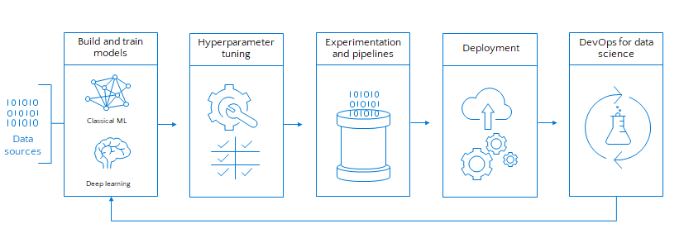
Building blocks for a Data Science Project

Slide 15








Machine Learning on Azure
Domain Specific Pretrained Models
To reduce time to market
…
Vision
Speech
Language
Search
Familiar Data Science Tools
To simplify model development
PyCharm
Jupyter
Visual Studio Code
Command line
Popular Frameworks
To build machine learning and deep learning solutions
PyTorch
TensorFlow
Scikit-Learn
ONNX
Productive Services
To empower data science and development teams
Azure Databricks
Azure Machine Learning
Machine Learning VMs
Powerful Infrastructure
To accelerate deep learning
CPU
GPU
FPGA
From the Intelligent Cloud to the Intelligent Edge

Slide 16
Azure Databricks

Slide 17






What is Azure Databricks?
A fast, easy and collaborative Apache® Spark™ based analytics platform optimized for Azure
Designed in collaboration with the founders of Apache Spark
One-click set up; streamlined workflows
Interactive workspace that enables collaboration between data scientists, data engineers, and business analysts.
Native integration with Azure services (Power BI, SQL DW, Cosmos DB, Blob Storage)
Enterprise-grade Azure security (Active Directory integration, compliance, enterprise -grade SLAs)
Best of Databricks
Best of Microsoft

Slide 18

Why Spark?
Open-source data processing engine built around speed, ease of use, and sophisticated analytics
In memory engine that is up to 100 times faster than Hadoop
Largest open-source data project with 1000+ contributors
Highly extensible with support for Scala, Java and Python alongside Spark SQL, GraphX, Streaming and Machine Learning Library

Slide 19
AML SDK + Databricks
End-to-end custom Machine Learning
Easily install the SDK in Azure Databricks clusters
Use the SDK for:
Logging training run metrics
Containerize Spark ML models
Deploy them into ACI or AKS, just like any other models.
Automated ML (public preview) of Azure ML SDK with Azure Databricks

Slide 20
AML SDK + Databricks
Azure Databricks Cluster to run experiments with or without automated machine learning:
azureml-sdk[databricks]
azureml-sdk[automl_databricks]
Leverage the local worker nodes with autoscale and auto termination capabilities:
Autoscaling
Cluster size is automatically adjusted between minimum and maximum number of worker limits during the cluster’s lifetime.
During runtime, Databricks dynamically reallocates workers to account for the characteristics of your job.
Certain parts of your pipeline may be more computationally demanding than others.
Databricks automatically adds additional workers during these phases of your job.
Notes:
Azure Databricks monitors load on Spark clusters and decides whether to scale a cluster up or down and by how much.

Slide 21
AutoML

Slide 22
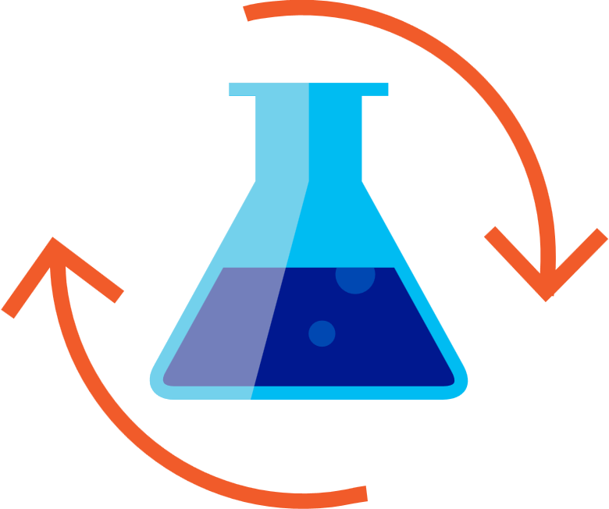

Machine Learning Process
SQL DB
Cosmos DB
Datawarehouse
Data lake
Blob storage
…
Prepare Data
Build & Train
Deploy

Slide 23
Machine Learning Problem Example
How much is this car worth?

Slide 24
Model Creation Is Typically Time-Consuming
Which features?
Which algorithm?
Which parameters?
Mileage
Condition
Car brand
Year of make
Regulations
…
Gradient Boosted
Nearest Neighbors
SVM
Bayesian Regression
LGBM
…
Parameter 1
Parameter 2
Parameter 3
Parameter 4
…
Mileage
Gradient Boosted
Condition
Nearest Neighbors
Car brand
Car brand
50%
Year of make
30%
Year of make
Model
Iterate

Slide 25
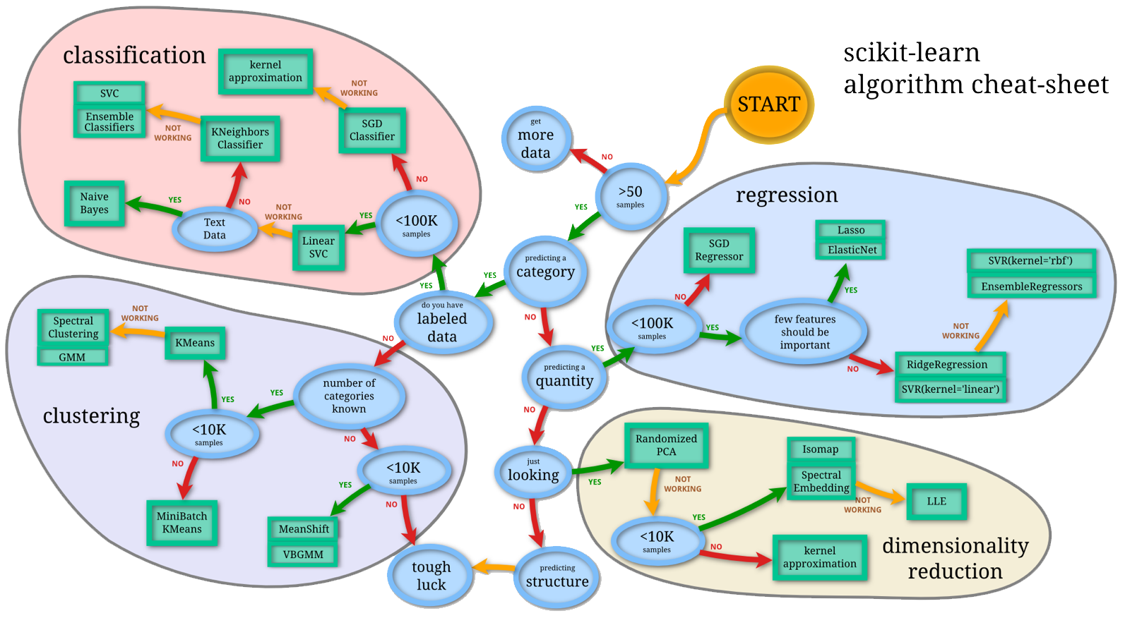
Machine Learning Complexity
Source: http://scikit-learn.org/stable/tutorial/machine_learning_map/index.html

Slide 26

Model Selection & Hyperparameter Tuning
Dataset
Model Training
Infrastructure
Training Algorithm 1
Training Algorithm 2
Model 1
Model 2
Model 3
Model 4
Hyperparameter
Values – config 1
Hyperparameter
Values – config 2
Hyperparameter
Values – config 3
Repetitive & Manual
Hyperparameter
Values – config 4

Slide 27
Introducing Automated Machine Learning
Dataset
Optimization
Metric
Automated ML
ML Model
Constraints
(Time/Cost)
Accessible & Faster

Slide 28
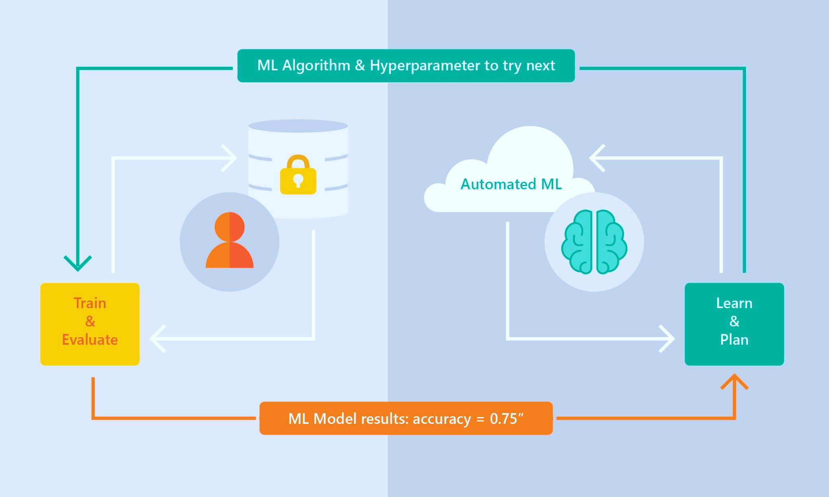
Automated ML Capabilities
Based on Microsoft Research
Brain trained with several million experiments
Collaborative filtering and Bayesian optimization
Privacy preserving: No need to “see” the data

Slide 29
Automated ML Capabilities
ML Scenarios: Classification & Regression
Integration: Azure Machine Learning, Azure Notebooks, Jupyter Notebooks
Data Type: Numeric, Text
Languages: Python SDK for deployment and hosting for inference
Training Compute: Local Machine, Remote Azure DSVM (Linux), Azure Batch AI
Transparency: View run history, model metrics
Scale: Faster model training using multiple cores and parallel experiments

