Slide 1
Scoring
Mithun Prasad, PhD
miprasad@microsoft.com

Slide 2
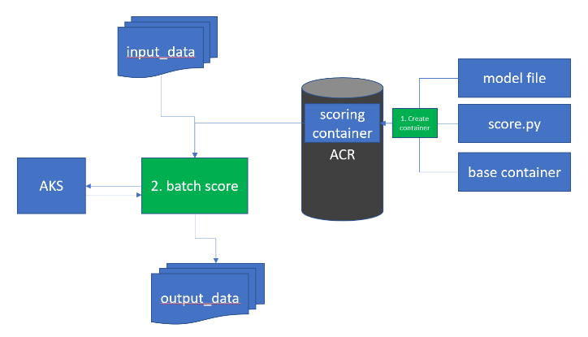
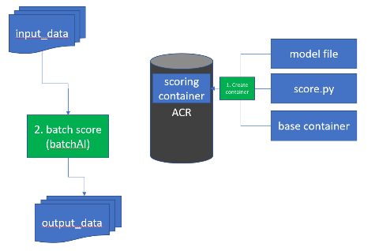
Real-time vs. Batch
data
ws.submit_pipeline( “myscoringpipeline”,inputs_path, scoringImage, outputs_path)
https://my/workspace/pipelines/mymodelbatchpredict/submit
{
inputs_path=“aml://datastore/inputs”,
outputs_path=“aml://datastore/outputs”)
}
data
https://my/model/v1/score
{
data: [1,2,3,4,5]
|
partition
predict()
prediction
predict()
predict()
predict()
outputs
Request-response vs. fire-and-forget
Short-lived vs. long-running
DISCLAIMER:
These are example (fake) APIs!

Slide 3
Real Time Inference
Package your model into a container and deploy it as a service
3 step to live
1. Register model (model registry)
2. Package, validate, profile model
3. Deploy service
Deployment Targets:
ACI: web service used mainly for development and testing
AKS: web service for high scale production (FE)
IoT Edge
Component: Scoring FE
Provides auth, logging, Model Data Collection, SSL
Service auto-scales as more requests come in

Slide 4
Where to deploy models
Compute target | Deployment type | Description
Azure Container Instances (ACI) | Web service | Fast deployment. Good for development or testing.
Azure Kubernetes Service (AKS) | Web service | Good for high-scale production deployments. Provides autoscaling, and fast response times.
Azure IoT Edge | IoT module | Deploy models on IoT devices. Inferencing happens on the device.

Slide 5
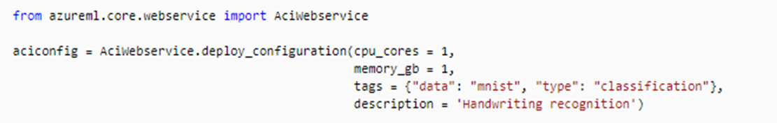
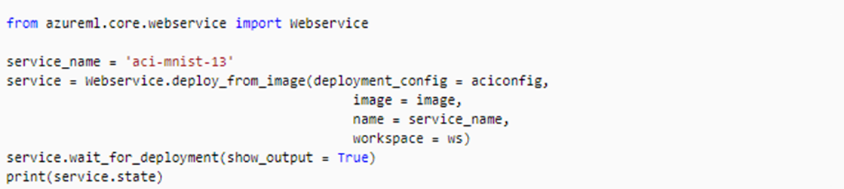
Deploy to Azure Container Instances
1. Define the deployment configuration. For example, a configuration that uses one CPU core and 1GB of memory:
2. To deploy the image created in the Create the image section of this document:

Slide 6
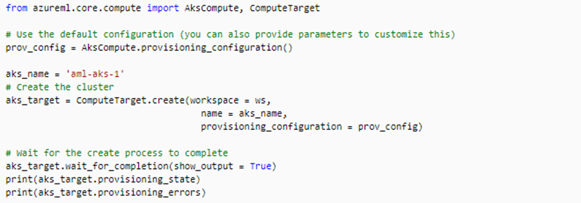
Deploy to Azure Kubernetes Service
1. To create an AKS cluster:

Slide 7
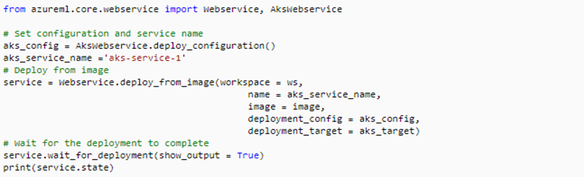
Deploy to Azure Kubernetes Service
2. To deploy the image created, use the following code:

Slide 8
Batch Inference
Cost-effective inference with unparalleled throughput for asynchronous applications.
Should scale to perform inference on TBs of production data.
Integrates into other core ML scenarios, such as
Model validation
Batch labeling
Model retraining
…
Optimized for
Easy to use (fire and forget)
Fast (data locality / distributed processing)
Cheap (dynamic spin-up / tear-down)
Scales automatically using Machine Learning Compute

