Slide 1
Open Contracting Data Standards
Initial exploration
March 2013

Slide 2
Initial exploration: scope and purpose
5 day development sprint
Testing feasibility of common standard
Scoping opportunities and challenges
Identifying possible building blocks of v0.1 standard
Supply side only

Slide 3
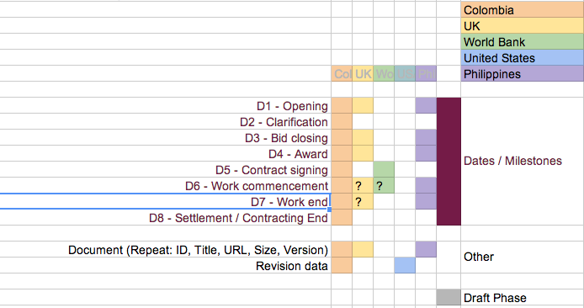

Process
1) What sort of information do existing contract datasets contain?

Slide 4
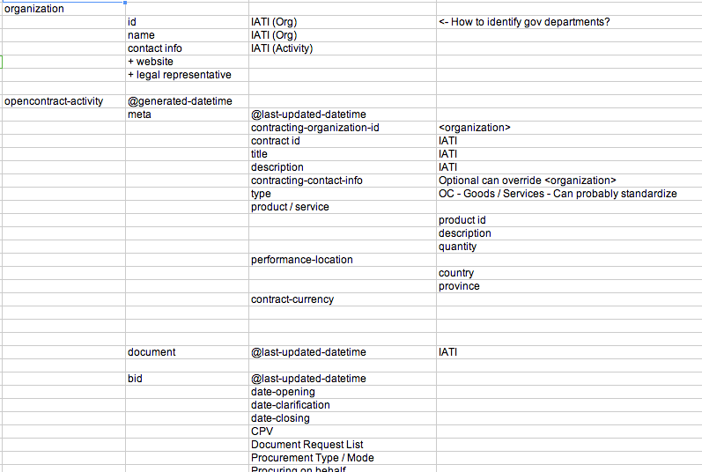
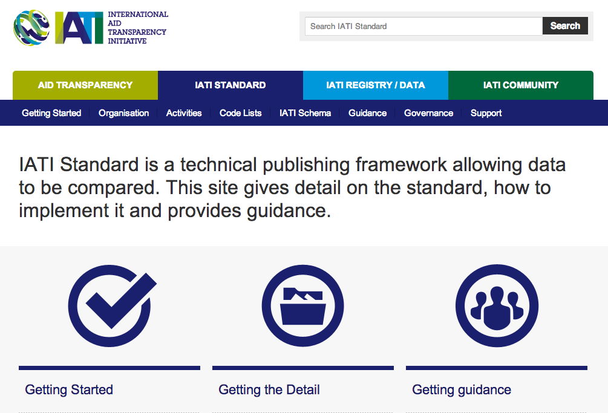
Process
2) Working out a structure that could contain the data

Slide 5

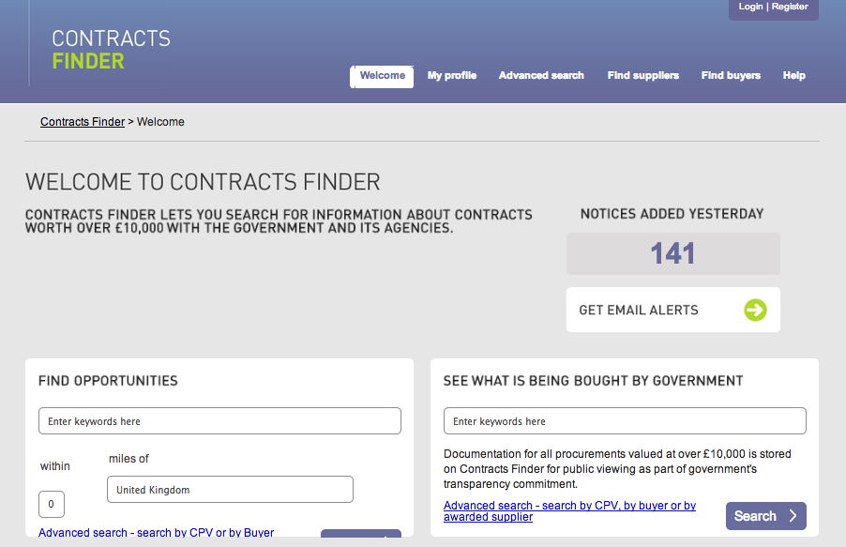
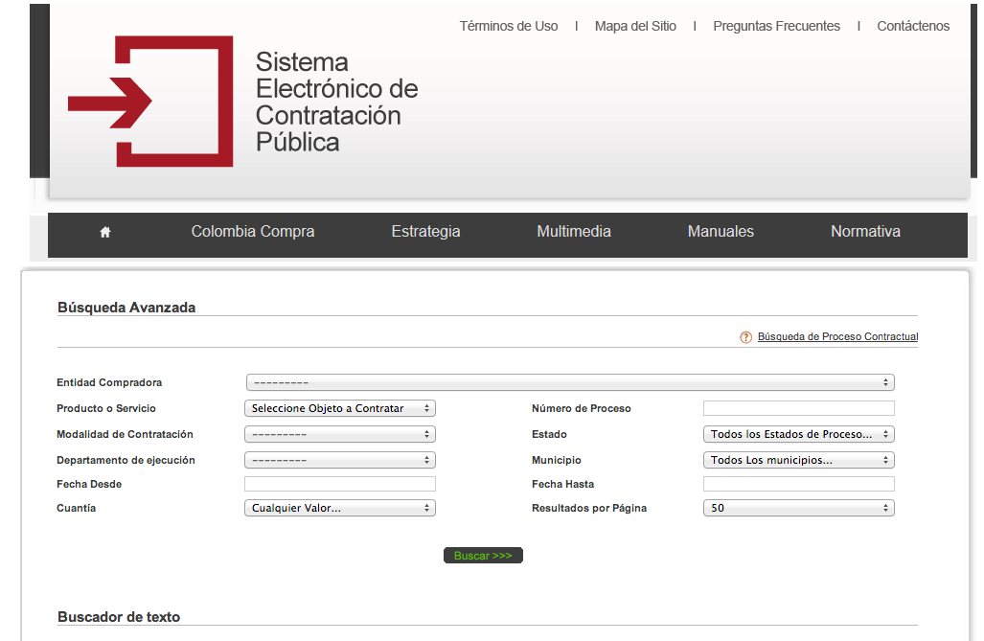
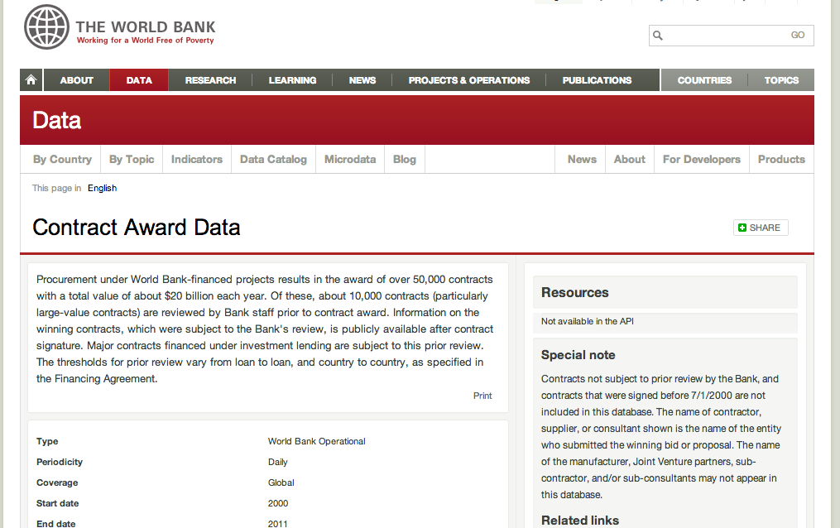
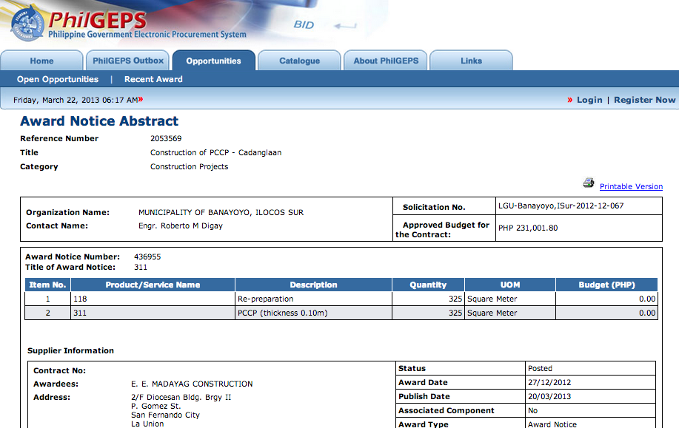

Process
3) Scraping real data and trying to map it into a v0.1 standard
draft standard

Slide 6
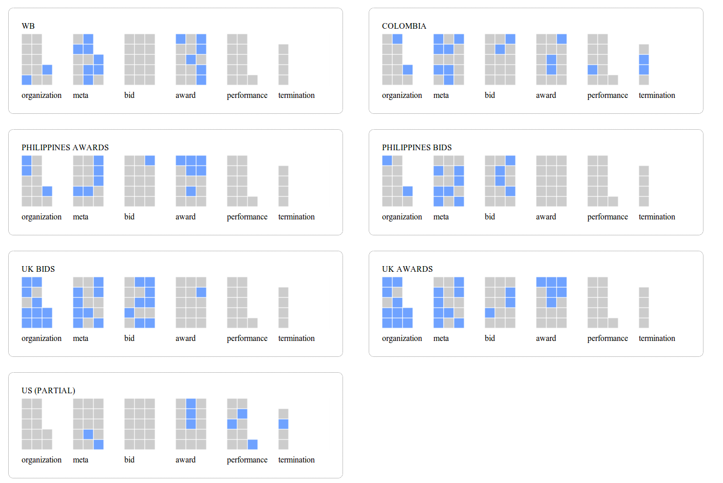
Process
draft standard
4) Analysing the aggregated data to assess how far the standard covers required areas, and to identify harmonization challenges

Slide 7
Findings: draft standard structure
Not lowest-common-denominator
Pulled good ideas from all datasets
Common Phases
Organization
Register organizations (IATI) – both supplier and contracting party
Meta
General contracting information applicable to all phases
Bid
Information about the bid
Award
Information about the awarded contract
Performance
Information about performance including payments
Termination
Information on end of contract life
Documents
Accompanying documents
Tension between one report for each phase and multiple reports – pros and cons

Slide 8
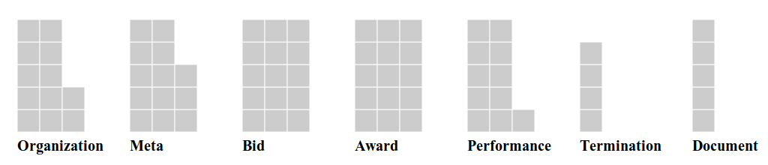
Organization
Register organizations (IATI) – both supplier and contracting party
Meta
General contracting information applicable to all phases
Bid
Information about the bid
Award
Information about the awarded contract
Performance
Information about performance including payments
Termination
Information on end of contract life
Documents
Accompanying documents
Each grey square is a data point in the proposed standard (some small approximations to allow for visualizations)

Slide 9
Findings: coverage
Datasets:
Colombia All (machine-readable*) – 27 fields
Philippines Bids (screenscraped) – 22 fields
Philippines Awards (screenscraped) – 26 fields
UK Bids (machine-readable) – 104 fields
UK Awards (machine-readable) – 11 fields
WB (machine-readable) – 20 fields
US Performance (machine-readable) – 213 fields
* Website could not be screenscraped, a machine-readable dataset provided by Colombia data team with limited fieldset was used

Slide 10
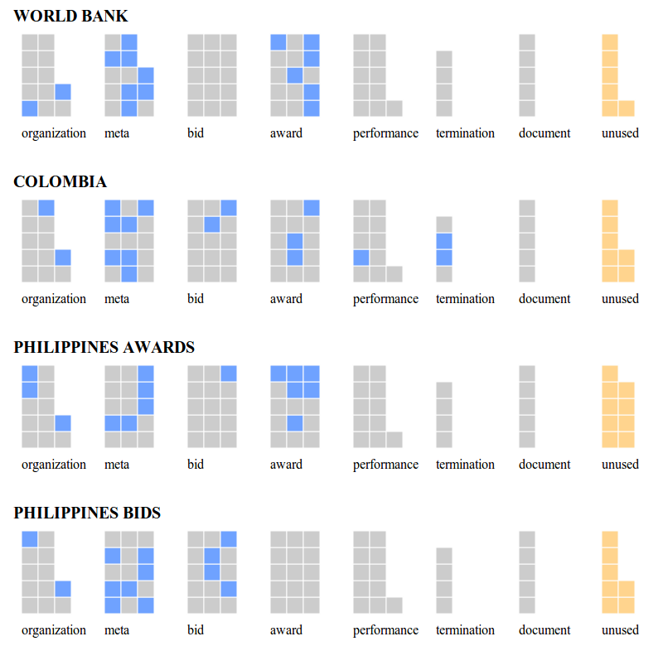
Coverage (used data)
Used most datapoints (actually have more from Colombia data set)

Slide 11
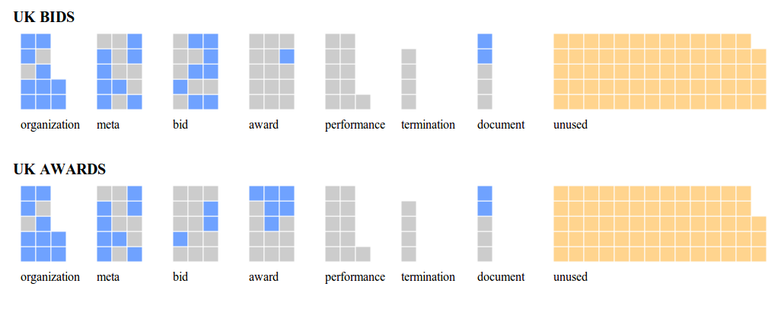
Coverage (used data)
But UK & US very large – do we want a succinct snapshot or all possible data?
(US not pictured below as mapping not completed, only looked at performance data in time available)

Slide 12
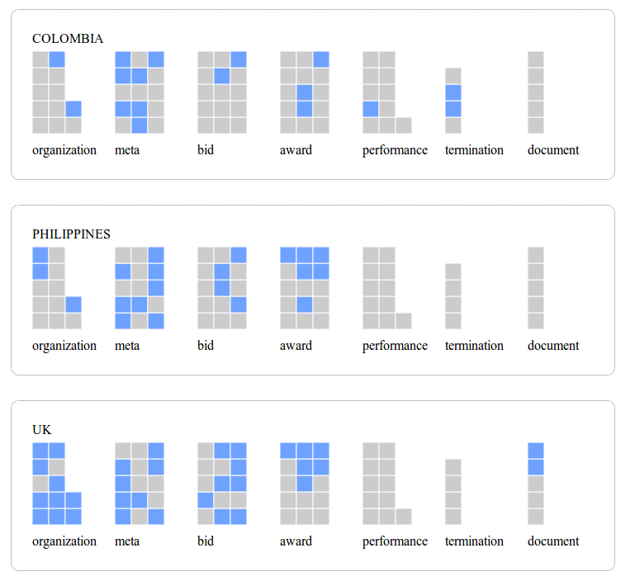
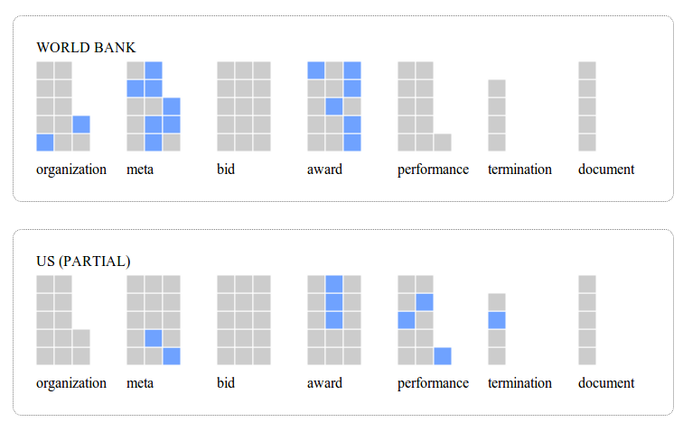
Coverage (cntd)

Slide 13
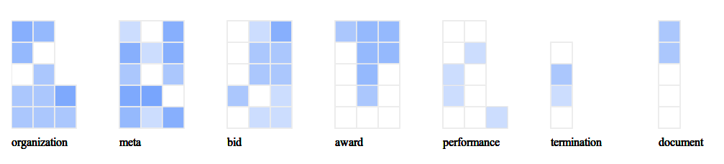
Coverage (overlay)
good coverage
poor coverage
BUT – hard to harmonize – all free text, little opportunity for
codifying across reporting organizations i.e. can’t have a global registry of all businesses!

Slide 14
Findings: harmonization
A number of fields will be readily harmonizable:
Dates (bid/award/contract start/end etc.)
Amounts
A number of fields are good to collect, but probably do not need to be harmonized:
Contract contact person
Item code & description

Slide 15
Findings: harmonization
A few fields offer an opportunity for harmonization & shouldn’t be too hard to standardize. e.g. Category
Goods | 136
Consultoría | 9
Civil Works | 56
Goods - General Support Services | 6
Concesión | 6
Arrendamiento | 9
Otro Tipo de Contrato | 38
Interventoría | 4
Compraventa | 100
Fiducia | 5
Prestación de Servicios | 283
Obra | 430
Services | 625
Supplies | 185
Works | 147
Suministro | 115
Goods | 136
Goods | 6
Supplies | 185
Supplies | 115
Services | 283
Services | 625
Works | 147
Works | 430
Works | 56
Trading | 100
Consultancy | 9
Concesión | 6
Leasing | 9
Other | 38
Interventoría | 4
Fiducia | 5
Goods | 142
Supplies | 300
Services | 908
Works | 633
Translate & group
Cull & sum – retained 92% of original data
with minimal work

Slide 16
Findings: harmonization
A number of fields will require effort:
Organization (challenging to get accurate)
Performance (complicated data)
Termination (disparate terminology)

Slide 17
Issues for discussion
Publication model
single record vs record per stage
(how to update either?)
Harmonization – what fields are worth it?
Which fields are must-haves for comparable data?

Slide 18
Resources for discussion
- Github code
- Google Doc
-

Slide 19
Gaps
demand side
linking challenge
performance data
other contract types e.g. extraction, PPP

Slide 20
Possible next steps
Demand driven approach to build v0.2
- Test v0.2 standard against wider range of datasets
- Identify processes for further standard development
- Identify other building blocks: identifiers; taxonomies etc.

