Slide 1
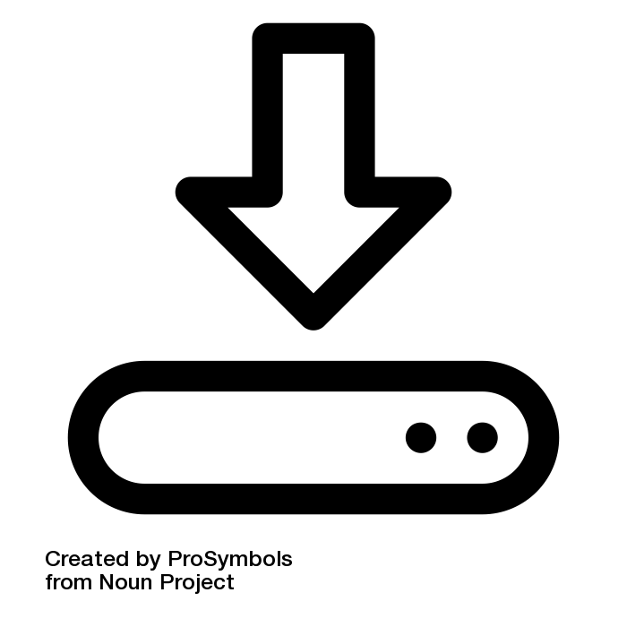
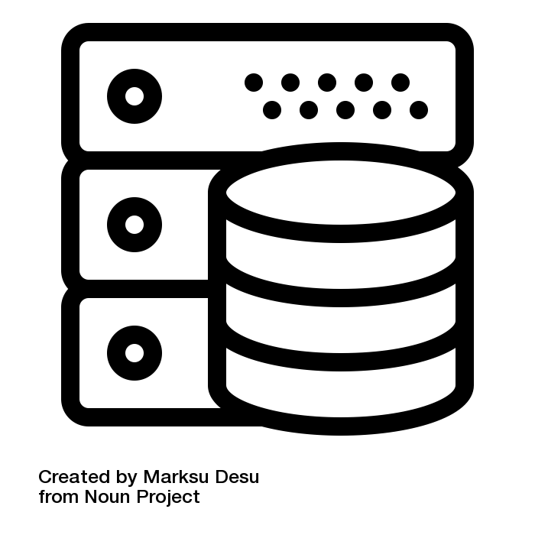
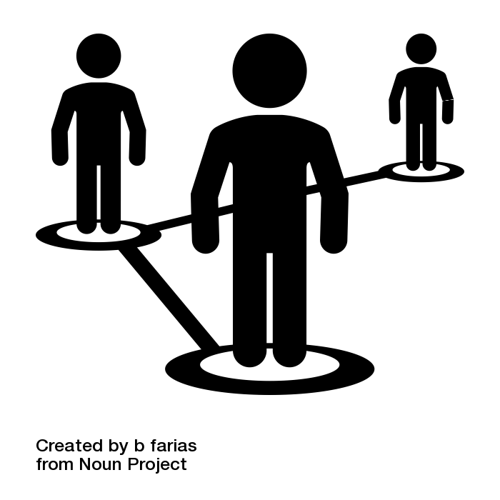
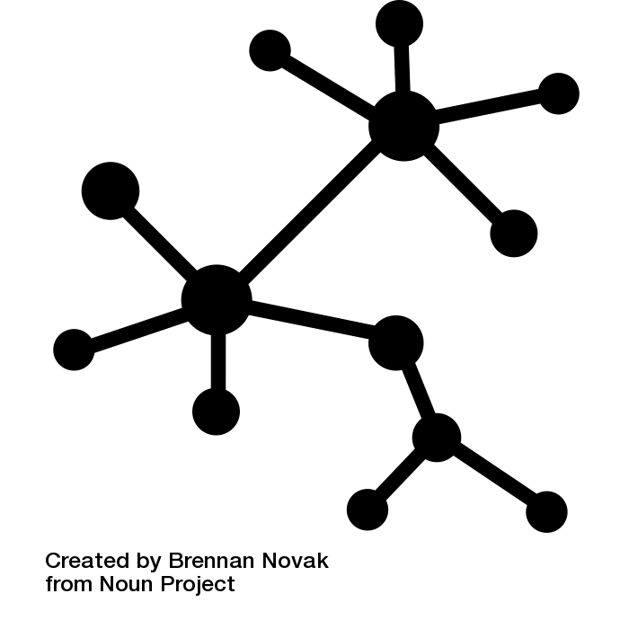
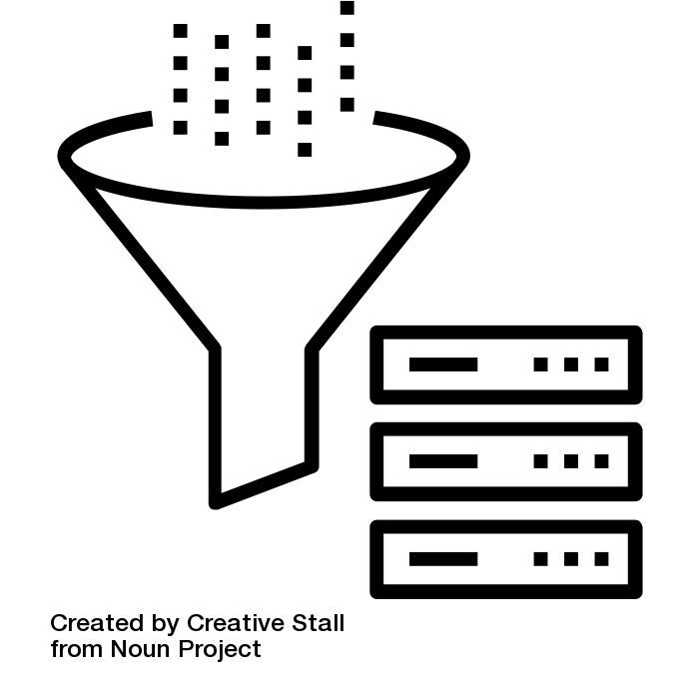
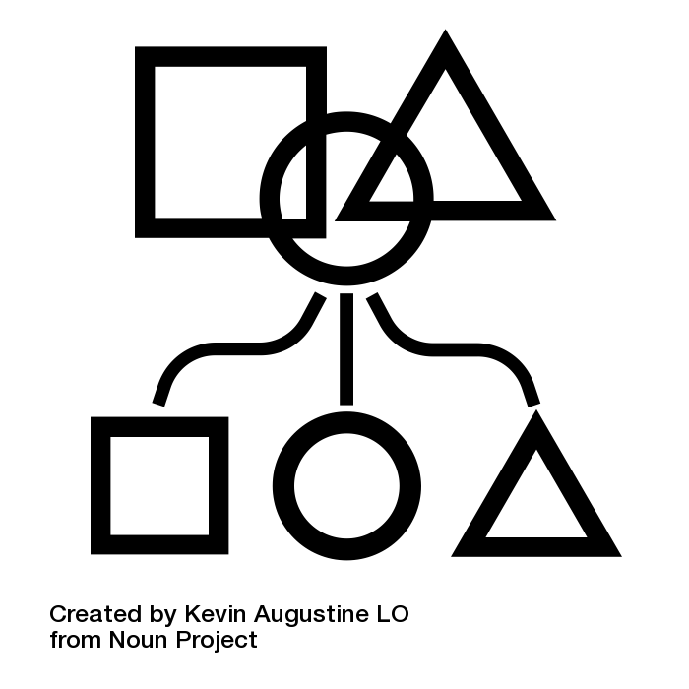
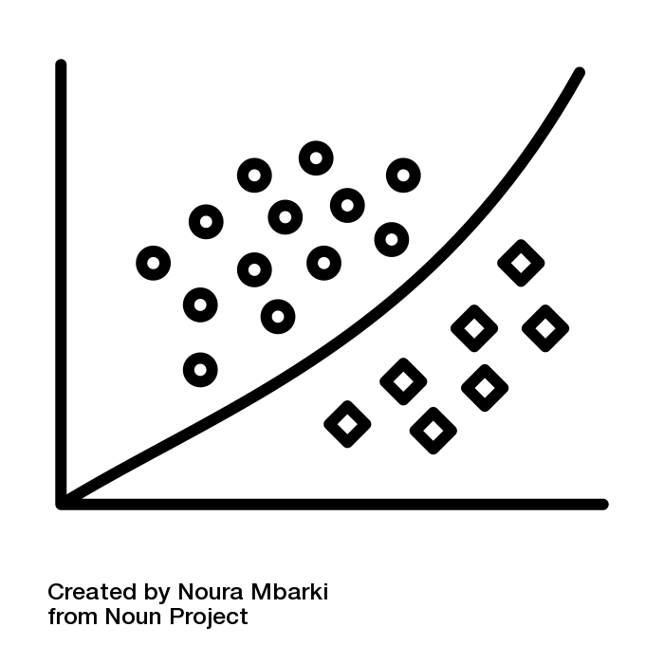
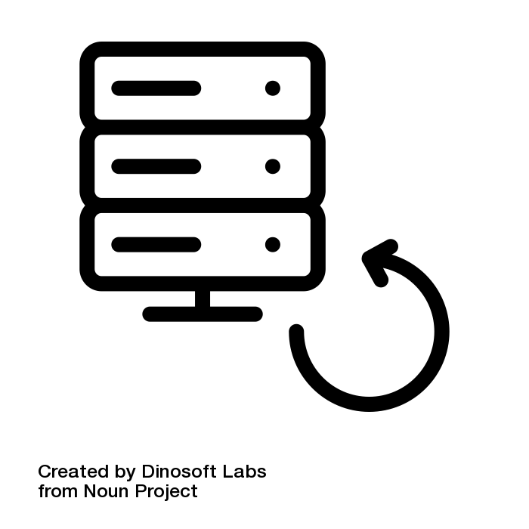
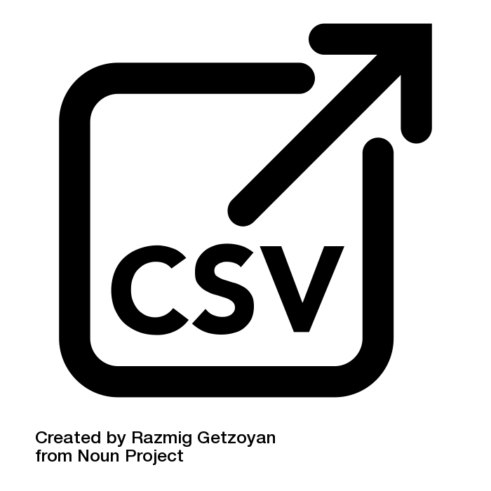
1. Download Pubmed OA Collection
2. Create database
3. Identify authors
4. Calculate citations (pub and author)
5. Extract DAS for BMC and PLOS
6. Annotate training dataset
7. Train classifier
8. Label the rest of the articles
9. Export data as csv
Fig 1. Data extraction and processing steps. We first downloaded the Pubmed open access collection (1) and created a database with all articles with a known identifier and which contained at least one reference (2; N=1,969,175). Next we identified and disambiguated authors of these papers (3) and calculated citations for each author and each publication from within the collection (4). We used these citation counts to calculate a within-collection H-index for each author. Our analysis only focuses on PLOS and BMC articles as these publishers introduced mandated data availability statements so we filtered the database for these articles and extracted DAS from each publication (5). We annotated a training dataset of these statements into one of three classes (6) and used those labels to train a natural language processing classifier (7). Using this classifier we then categorised the remaining DAS in the database (8). Finally, we exported this categorised dataset of 531,889 publications to a csv file (9) and archived it at DOI ZENODO.

