Slide 1
Flowcharts
What are the Shapes?
Why are they Important?
Why are they Used?
By: Aidan Hamme

Slide 2
What is a Flowchart?
Think of it like a list of what to do.
You start and go one-by-one through it until it’s finished.
Flowcharts will quickly and easily show what code does.
It isn’t just for programming, and can / is used outside of programming and in different fields.

Slide 3
Why are they Important?
Work:
You will probably need to make a flowchart in the field of IT
It might be to show somebody / your boss what you are doing
It also shows you know what the code does, or will do
Personal:
You could make a flowchart for a personal project you have
NOCTI:
You will need to know it for the NOCTI

Slide 4
Why are they Used?
They are used to help visualize the workflow.
This could be for a business structure or flow.
We can use it to help lay out our code.
They can also be easier to look at than just straight code.
Sometimes code can be hard to look at.
Flowcharts Make Code Look More Simple

Slide 5
How to write a Flowchart
Step to do
You can use Visio to easily make a flowchart.
You will need a shape and then put what will happen in that step.
Then use arrows to show which way the program will go.

Slide 6
What are the Shapes?
There are many different Shapes
Here are some of the most common ones, and how they are used.

Slide 7
The Oval (Start / End)
Start
Use: Start / End
This is used to show the start and the end of the code
Start
Work
End

Slide 8
The Rectangle (Process Step)
Process
Use: Run code without user input
It is used to run code that would happen without the user knowing.
It could add numbers or place items in arrays.
Start
Set z = x + y
Add x to ‘items’ array
End

Slide 9
The Parallelogram (Input / Output)
Input
Use: Get Input from user, or Show the user something
It is used to ask the user for input. Ex: Ask for Name
It could be used to show data to the user. Ex: A Variable
Ex: Program that says a persons age 10 years from now.
Start
ask age
(Save as ‘age’)
Take age and add 10
Show Age
End

Slide 10
The Diamond (Decision Step)
Use: If statements or anything that could have multiple outcomes
It could be an IF statement and check if a variable equal something
Or it could be and for loop that looks through an array
These will always have multiple outputs
Say Number is More than 0
TRUE
IF Number is more than 0
End
Start
Ask for a number
Say Number is Less than 0
FALSE

Slide 11
Other Shapes
The Circle: This circle is used for “Jumps” it can jump to a different area of the flowchart.
Can be used to make the flowchart look better / cleaner.
The Cylinder: This shows a database
Can be used to show where data came from
Jump
Data.db

Slide 12
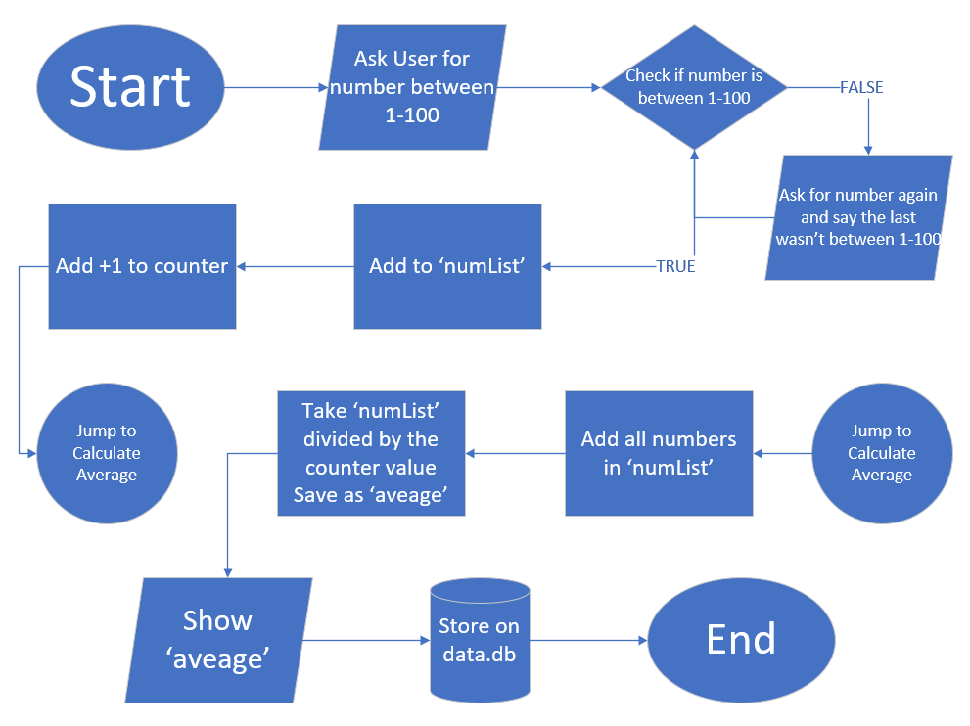
What would one look like?
This is an example of a flowchart.
Note that what is happening in each step is in the shape.
That the arrows connect the shapes and show with way to go.
That the text is not straight code, but pseudo code instead.

