Slide 1
Distributed Multi-Sensor Control for Multi-Target Tracking
22/11/2022
Aidan Blair, Amirali Khodadadian Gostar, Ruwan Tennakoon, Alireza Bab-Hadiashar, Xiaodong Li, Jennifer Palmer and Reza Hoseinnezhad
RMIT University, Melbourne, Australia

Slide 2
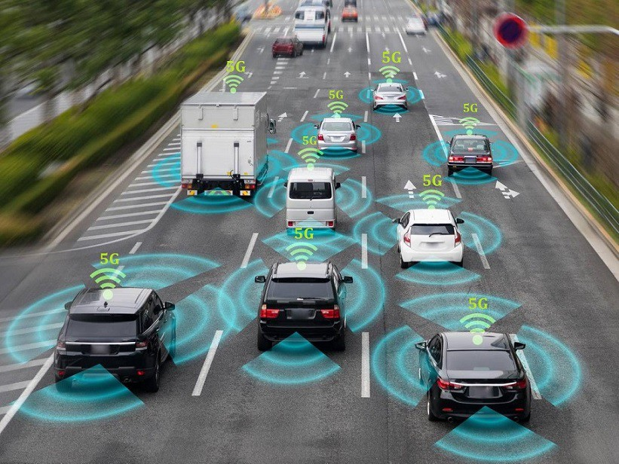
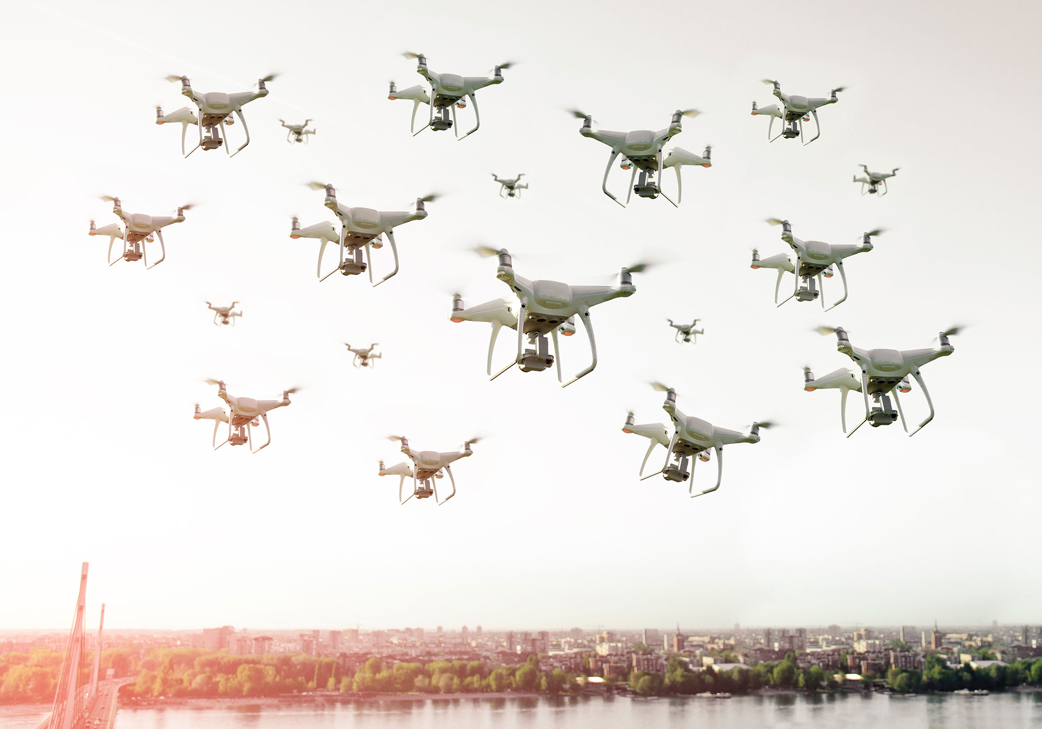
Multi-Sensor, Multi-Target Tracking Background
Aim is to track the states of multiple targets using multiple sensors with limited FoV.
Many domains: Autonomous cars, drones, on water/underwater vehicles, satellites.

Slide 3
Multi-Sensor Control Background
Aim to move the sensors in a way that they get the best measurements to accurately track the targets.
Quality of actions is measured either by information gain or optimizing a heuristic objective function.

Slide 4
Problem Statement
To control a distributed & dynamic network of mobile sensors to accurately track a time-varying number of mobile targets.

Slide 5
Problem Formulation
The problem has been formulated as a distributed multi-sensor control problem using RFS filters for multi-target tracking and distributed information fusion.

Slide 6
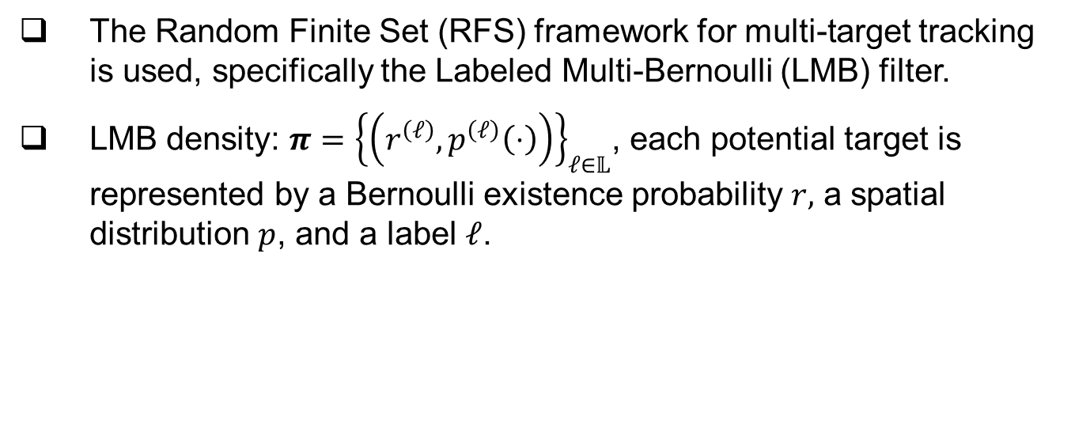
LMB Filter
The Random Finite Set (RFS) framework for multi-target tracking is used, specifically the Labeled Multi-Bernoulli (LMB) filter.
LMB density: $π={\left\{\left(r^{\left(ℓ\right)},p^{\left(ℓ\right)}\left(⋅\right)\right)\right\}}_{ℓ∈𝕃}$, each potential target is represented by a Bernoulli existence probability $r,$ a spatial distribution $p$, and a label $ℓ$.

Slide 7
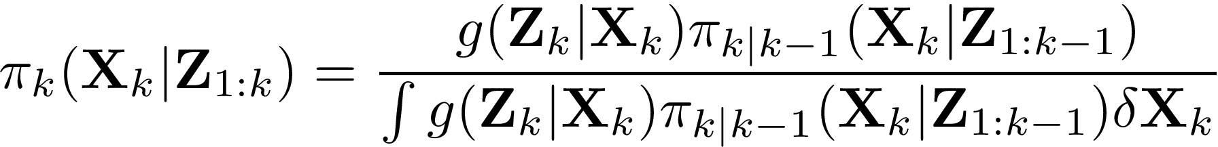
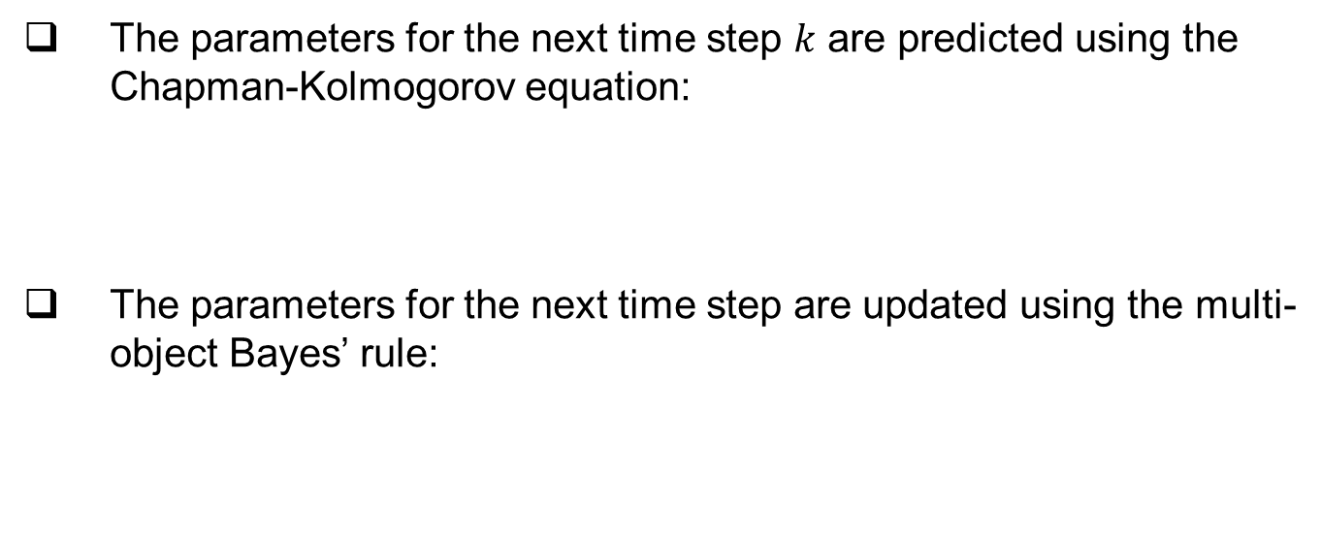
Prediction & Update Steps
The parameters for the next time step $k$ are predicted using the Chapman-Kolmogorov equation:
The parameters for the next time step are updated using the multi-object Bayes’ rule:

Slide 8
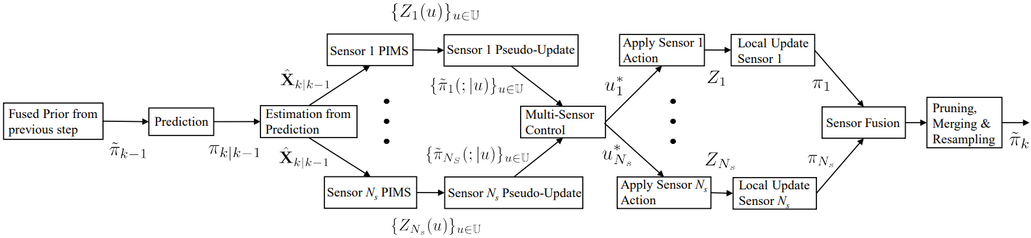

Multi-Sensor Control Formulation
Each sensor has a number of possible sensor control commands $u∈𝕌$.
A multi-sensor control command is formed as a tuple of single-sensor control commands, $𝔲=\left(u_{1},…,u_{N}\right)∈𝕌^{N}$.

Slide 9
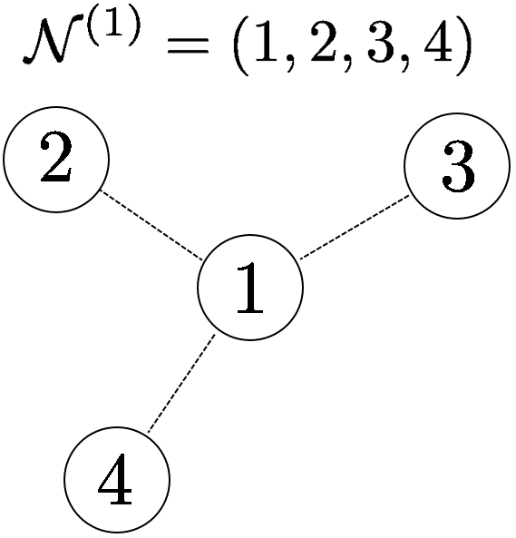
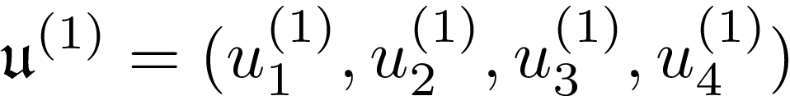

Proposed Solution
Each sensor $i$ looks at local sensor neighborhood $𝒩^{(i)}$.
Sensors calculate best multi-sensor control command $𝔲^{(i)}={\left(u_{n}\right)}_{n∈𝒩^{(i)}}$ for neighborhood, using coordinate descent to quickly optimize solutions at each sensor.

Slide 10
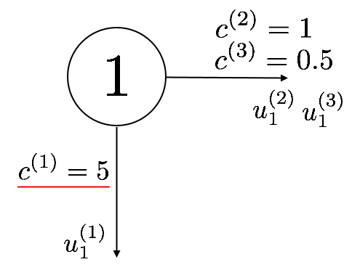
Proposed Solution
Each sensor communicates to neighbors the single-sensor control command they calculated for the neighbor, and the corresponding objective function value.
The sensor control command with the highest objective function value is chosen.

Slide 11
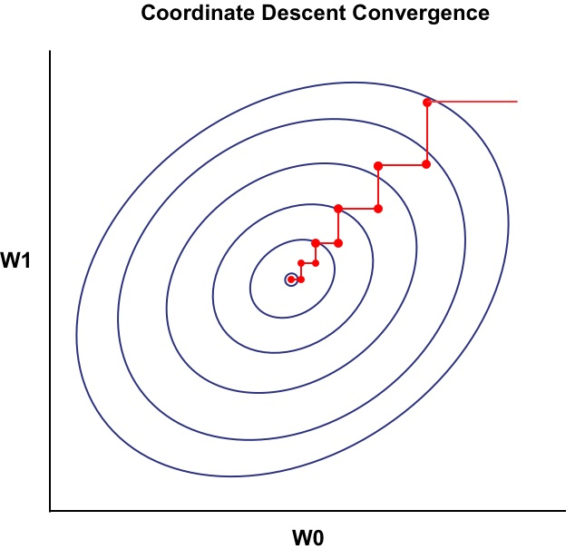
Coordinate Descent
Similar to gradient descent, except only a single parameter is optimized at a time.
Suitable for optimizing a multi-sensor control command, as each single-sensor control command is discrete.

Slide 12
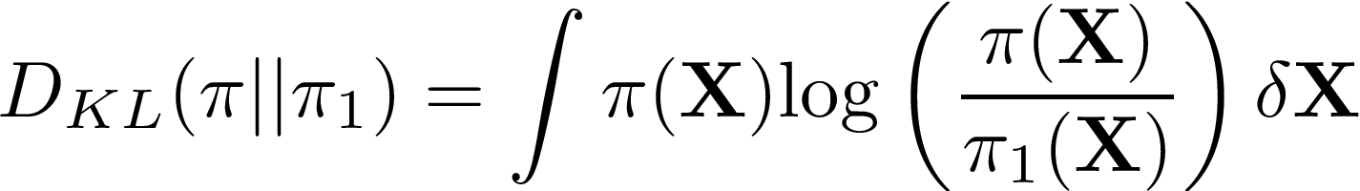
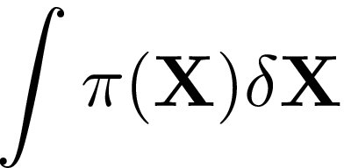
Kullback-Leibler Divergence
The Kullback-Leibler Divergence (KLD) is a statistical measure for the difference between two distributions.^{[1]}
denotes the set integral from FISST.^{[2]}
[1] Kullback, S. & Leibler, R.A., On information and sufficiency, 1951.
[2] Mahler, R., Random-set approach to data fusion, 1994.

Slide 13
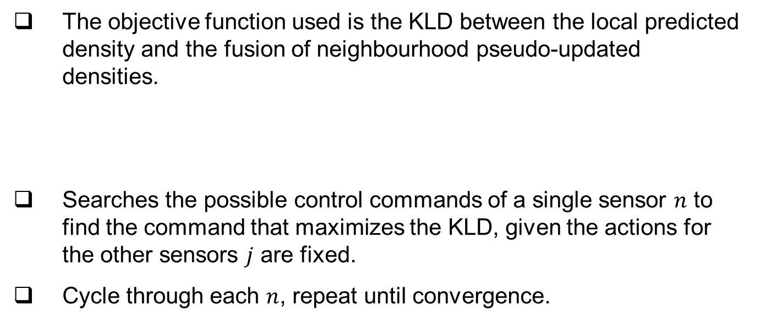
Objective Function
The objective function used is the KLD between the local predicted density and the fusion of neighbourhood pseudo-updated densities.
Searches the possible control commands of a single sensor $n$ to find the command that maximizes the KLD, given the actions for the other sensors $j$ are fixed.
Cycle through each $n$, repeat until convergence.

Slide 14
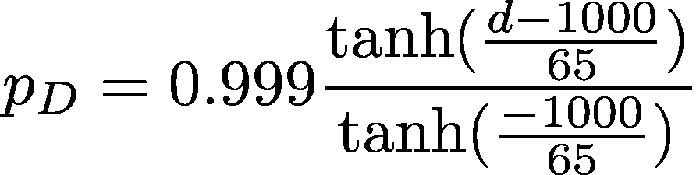
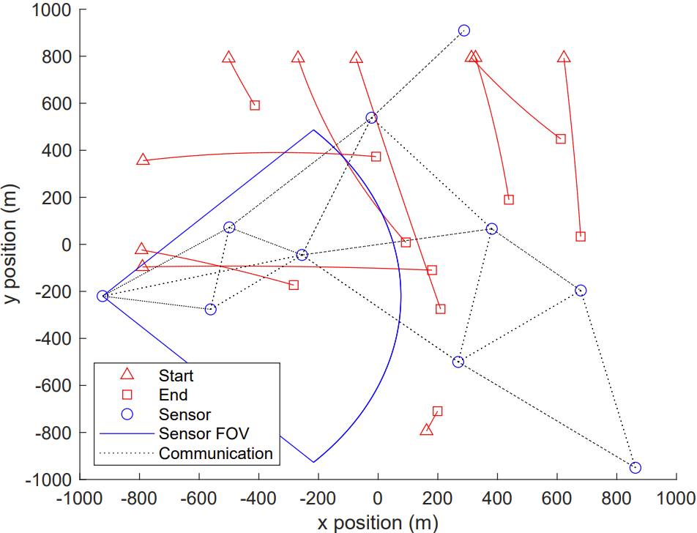
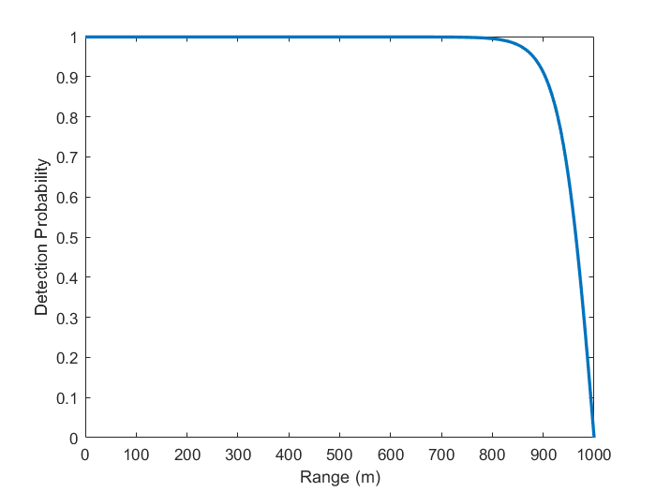
Simulation Scenario

Slide 15
Scenario Parameters
Used Distributed Complementary Fusion^{[3]}
3 Possible Actions: Stationary, Rotate 22.5 deg Clockwise & Rotate 22.5 deg Anti-Clockwise
Accuracy measured by Optimal Sub-Pattern Assignment (OSPA) distance^{[4]}, composed of localization and cardinality errors.
Use a particle filter approximation for LMB densities
[3] Klupacs, J. et al., Distributed Complementary Fusion for Connected Vehicles, 2022.
[4] Schuhmacher, D., Vo, B.-T. & Vo, B.-N., A consistent metric for performance evaluation of multi-object filters, 2008.

Slide 16
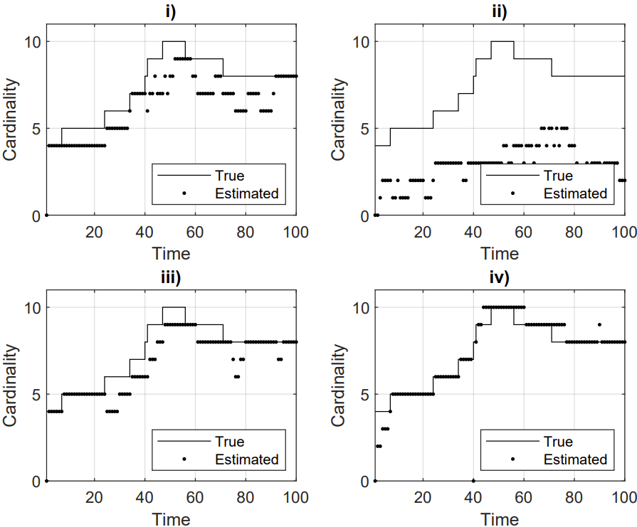
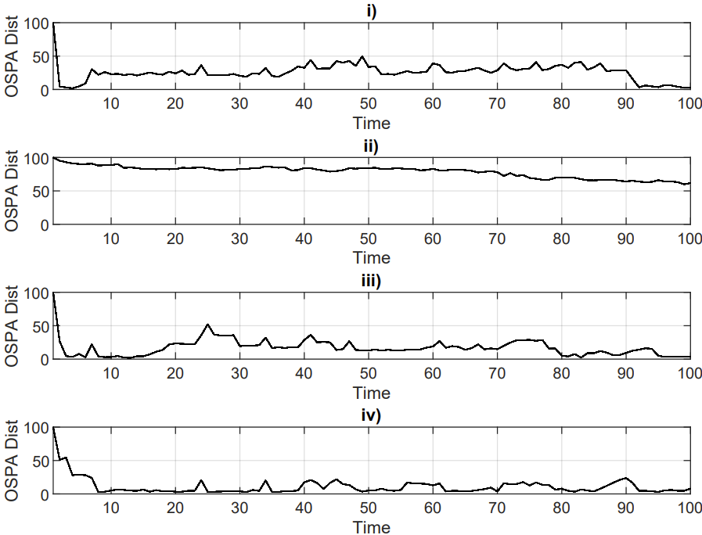
Scenario Results

Slide 17
Scenario Results - OSPA
 | OSPA Distance | OSPA Localization | OSPA Cardinality
Fixed w/ fusion | 27.0212 | 6.3738 | 20.6478
Independent Multi-Sensor Control w/ fusion | 76.9432 | 1.3996 | 75.5436
Independent Multi-Sensor Control w/o fusion | 16.2745 | 5.6233 | 10.6512
Multi-Sensor Control with fusion | 11.3912 | 4.7822 | 6.6090

Slide 18
Conclusion
A sensor control algorithm for a distributed & dynamic sensor of networks for RFS based multi-target tracking applications has been developed.
Areas to explore further: computationally cheaper methods and more complicated scenarios.

Slide 19
Thank you for listening!

Slide 20
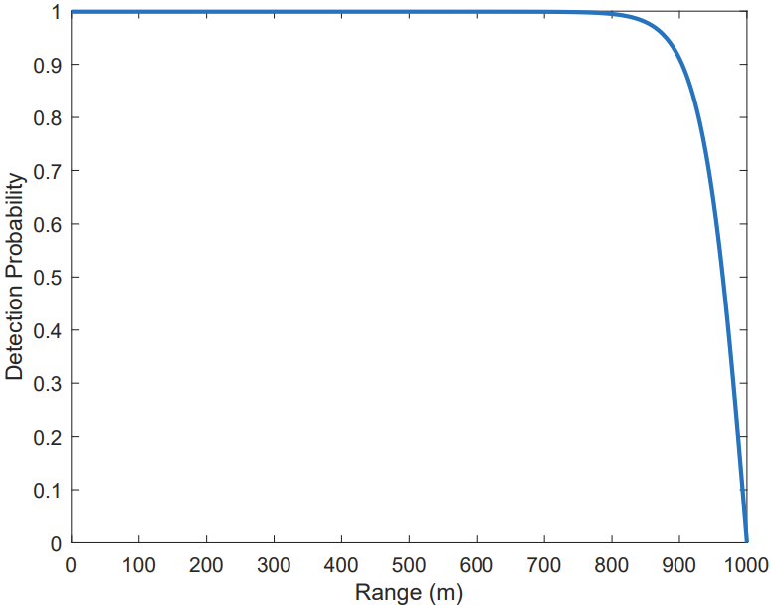

Target Measurements
Each sensor partially observes the multi-target state $X∈𝕏$, returning a measurement set $Z∈ℤ$.
Observation depends on sensor FoV and detection probability $p_{D}$.

Slide 21
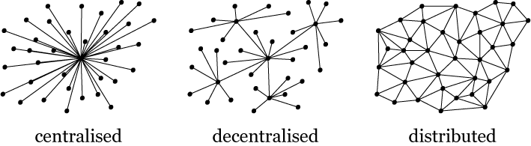
Distributed & Dynamic Sensor Network

Slide 22
Contents
Background
Problem Statement
Problem Formulation
Proposed Solution
Results
Conclusion

