Slide 1
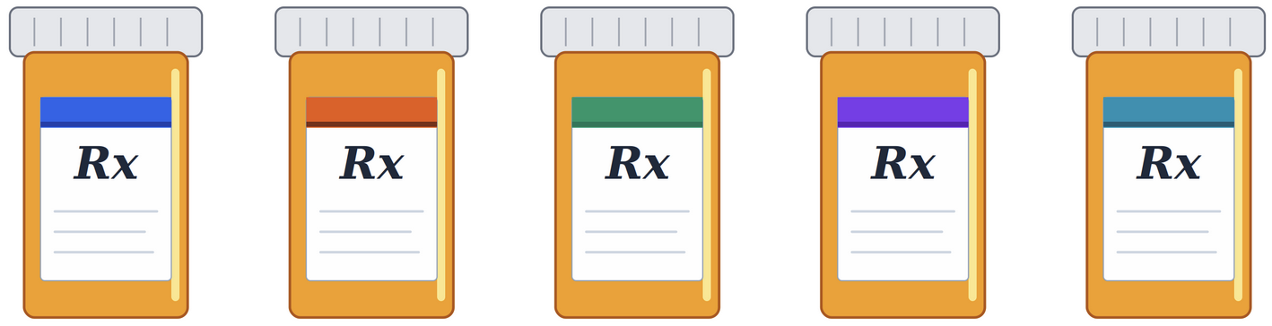
Drug Interaction
Severity Prediction
Deep-Pharma Multimodal Intelligence DataHack 3.0
Kaggle
GitHub
Aidan Colvin
*Generative Al provided limited assistance in line with the course policy on usage of AI.
Notes:
The project addresses drug-drug interaction severity prediction using real FDA FAERS data from a Kaggle competition called Deep-Pharma Multimodal Intelligence DataHack 3.0. The dataset has 15,284 drug pair observations across 126 features, and the goal was to predict interaction severity, adverse event occurrence, and proportional reporting risk simultaneously. My submitted Kaggle score was 0.5134 on the composite Hardcore Clinical Score.
"This project tackles a problem that sits at the intersection of two things that are both getting worse at the same time — polypharmacy is increasing as populations age, and the combinatorial explosion of possible drug pairs makes exhaustive clinical trial testing impossible. The goal was to build a multi-task machine learning pipeline that could predict three clinically distinct dimensions of drug-drug interactions simultaneously, and to validate it on a cold-start test set of molecular scaffolds that the model had never seen. I'll walk through the data, the pipeline, the results, and what I'd do differently.”
Key numbers to have ready off the top of your head:
15,284 drug pairs
126 features
3 simultaneous tasks
0.5134 Kaggle score

Slide 2
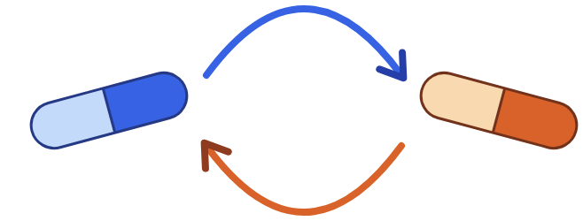
Context & Terminology
1 in 4 U.S. adults filled 3+ prescriptions monthly (2015–2018)
This practice polypharmacy, creates compounding Drug-Drug Interactions (DDI) risk
Clinical trials cannot cover all possible drug combinations
Drug-Drug Interaction (DDI) When one medication alters the effect of another, changing efficacy or causing adverse reactions
Polypharmacy Concurrent use of 5 or more medications by a single patient
Notes:
Polypharmacy is a major clinical challenge. Data from 2015 to 2018 shows that one in four American adults filled three or more prescriptions per month, and that figure jumps to over two thirds in adults 65 and older. The problem is that clinical trials cannot test every possible drug combination. So adverse interactions are often discovered reactively — after patients have already been harmed. This project addresses two research questions. RQ1 is a supervised prediction task: can a machine learning model predict DDI severity, which adverse events will occur, and how strong the pharmacovigilance signal is? RQ2 is an exploratory question I added beyond the competition scope: do natural clusters in adverse event profiles correspond to clinically meaningful severity differences? The ultimate goal is a supplementary screening layer that could flag high-risk combinations at the point of prescribing.
"The polypharmacy problem is well-documented. The 2015–2018 NHANES data shows roughly one in four U.S. adults filled three or more prescriptions monthly. That number crosses two-thirds for adults 65 and older — the same population with the most comorbidities, the most complex regimens, and the most vulnerability to adverse events. Federal DDI safety guidance has been revised multiple times since the late 1990s specifically because documented interaction failures made it into patients before they were caught. The fundamental gap is that clinical trials cannot enumerate every pairwise drug combination — the combinatorial space is too large. So pharmacovigilance operates reactively: it detects harm after it has been reported. The question I'm asking is whether we can make that detection proactive, at the point of prescribing, using existing pharmacological text data.”

Slide 3
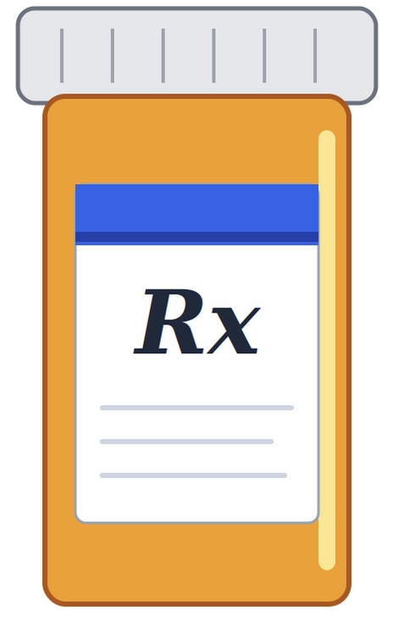
Research Questions
RQ1 — Supervised Machine Learning
Can a multi-task ML model accurately predict DDI severity, adverse event occurrence, and PRR risk from pharmacological and molecular drug pair features?
RQ2 — Unsupervised Machine Learning
What natural groupings exist within drug pair interaction profiles, and do these clusters align with meaningful differences in severity and side effect patterns?
Notes:
SPEAKER NOTES — DATASET (60 sec)
RQ1 explanation:
"RQ1 is the competition task — can a supervised multi-task model predict severity, binary adverse event occurrence, and continuous PRR risk from pharmacological features? The key phrase is 'multi-task' — all three predictions come from the same shared feature representation."
RQ2 explanation — this one trips people up:
"RQ2 is my extension beyond the competition scope. I applied unsupervised clustering to ask: do drug pairs with similar adverse event profiles also share similar severity classifications? In other words, is AE burden a proxy for severity? I'll tell you now — the answer is no, and that's actually an important clinical finding, not a failure."
Concepts to be ready to explain:
Cold-start generalization: The test set has molecular scaffolds — core chemical structures — that were not present in the training set. This is analogous to predicting interactions for a newly approved drug before sufficient real-world exposure data exists. It's harder than a random split because you can't rely on structural memorization.
PRR (Proportional Reporting Ratio): A pharmacovigilance signal metric. For a given drug pair and adverse event, PRR compares the proportion of reports mentioning that AE for this pair to the proportion of all reports mentioning that AE. PRR > 2 is conventionally flagged as a disproportionate signal. It's a continuous, positive-valued measure of how much a drug pair is "over-reported" for a given adverse event relative to background rates.
The dataset comes from real FDA FAERS — Adverse Event Reporting System — data. It contains 15,284 drug pair observations across 126 columns covering mechanism of action, pharmacodynamics, ADME fields, CYP450 profiles, SMILES strings, and three sets of targets. The severity target has a severe class imbalance: Moderate makes up 69%, Major 27%, and Minor just 4%. This 16.8:1 imbalance between majority and minority classes directly drove our choice of Macro F1 as the evaluation metric, since accuracy would be misleading here. CYP450 enzyme data — one of the most important predictors of drug interactions — was missing for nearly 60% of Drug A entries. This was the single biggest constraint on model performance. Adverse event burden is bimodal: most pairs report nothing, but a subset reports nearly all 50 events. PRR entries are only 21.5% non-zero, which made the regression task especially challenging.

Slide 4
Parts
Prediction Task Breakdown
Part 1: Severity Classification
Score
Weight: 40% | Metric: Macro F1
0.5666
3-class: Major / Moderate / Minor
Gradient Boosting — final model
Part 2: Side Effect Prediction
Score
Weight: 30% | Metric: Micro F1
0.5772
50-label binary prediction
MultiOutput Logistic Regression
Part 3: PRR Regression
Score
Weight: 30% | Metric: Inv. RMSE
0.2023
50-label continuous risk score
Ridge Regression (masked eval)
Notes:
"The composite scoring metric — the Hardcore Clinical Score — is a weighted average of three task-specific metrics. Severity classification contributes 40% via Macro F1. Side effect prediction contributes 30% via Micro F1. PRR regression contributes 30% via inverse RMSE. The composite runs from 0 to 1, higher is better. My estimated composite on the local held-out test set was 0.4605. The Kaggle-submitted score on the actual competition test set was 0.5134 — I'll explain the discrepancy shortly.”
Key metric distinctions to explain clearly:
Macro F1 for severity:
"Macro F1 is computed as the unweighted average of F1 scores across all three severity classes — Major, Moderate, and Minor each count equally. This penalizes you for ignoring minority classes. A model that achieves perfect Moderate prediction and zero Major or Minor prediction would score roughly 0.33 on Macro F1, not 0.69.”
Micro F1 for side effects:
"Micro F1 aggregates true positives, false positives, and false negatives globally across all 50 labels before computing precision and recall. It's sensitive to label frequency — labels with more positive examples contribute more to the score. It also penalizes null predictions: if your model predicts all-zero for every label on every drug pair, Micro F1 is zero. You have to actually detect true positives.”
Inverse RMSE for PRR:
"RMSE measures the average magnitude of prediction error in PRR units. Lower RMSE is better. The competition converts it to inverse RMSE — 1 divided by (1 + RMSE) — so that all three metrics are on a 'higher is better' scale for composite scoring. A perfect RMSE of zero would give inverse RMSE of 1.0; my mean inverse RMSE was 0.2023, meaning the composite PRR contribution per event is heavily penalized."
The score gap:
"The 0.0529 gap between my local estimate and the Kaggle score most likely reflects two things. First, my internal eval used a stratified random 20% split, which is an easier evaluation than the actual competition test set of 3,974 pairs with entirely new molecular scaffolds. Second, the Kaggle implementation of PRR masking — how it defines non-zero entries for the regression evaluation — may differ subtly from my local implementation. The direction of the gap is consistent with my local eval being the more conservative estimate."
SPEAKER NOTES — EVALUATION (45 sec) The competition uses a composite Hardcore Clinical Score weighted across three simultaneous tasks. Severity classification accounts for 40% and uses Macro F1 — which weights all three classes equally regardless of prevalence, making it the right choice given the severe class imbalance. Side effect prediction accounts for 30% and uses Micro F1 across all 50 binary labels. PRR regression accounts for the remaining 30% and uses inverse RMSE computed only on non-zero ground truth values — meaning the model is only penalized where there is a confirmed pharmacovigilance signal. My estimated composite was 0.4605, but the Kaggle submitted score came in at 0.5134, suggesting the submitted model generalized better than internal evaluation indicated.

Slide 5
Exploratory Data Analysis
Scale: Analyze the 15,284 training pairs versus 3,974 test pairs
Target Distribution: Check for class imbalance in Severity (Major, Moderate, Minor).
Label Sparsity: Evaluate the frequency of the 50 specific side effect labels.
Notes:
SPEAKER NOTES — DATASET (60 sec)
RQ1 explanation:
"RQ1 is the competition task — can a supervised multi-task model predict severity, binary adverse event occurrence, and continuous PRR risk from pharmacological features? The key phrase is 'multi-task' — all three predictions come from the same shared feature representation."
RQ2 explanation — this one trips people up:
"RQ2 is my extension beyond the competition scope. I applied unsupervised clustering to ask: do drug pairs with similar adverse event profiles also share similar severity classifications? In other words, is AE burden a proxy for severity? I'll tell you now — the answer is no, and that's actually an important clinical finding, not a failure."
Concepts to be ready to explain:
Cold-start generalization: The test set has molecular scaffolds — core chemical structures — that were not present in the training set. This is analogous to predicting interactions for a newly approved drug before sufficient real-world exposure data exists. It's harder than a random split because you can't rely on structural memorization.
PRR (Proportional Reporting Ratio): A pharmacovigilance signal metric. For a given drug pair and adverse event, PRR compares the proportion of reports mentioning that AE for this pair to the proportion of all reports mentioning that AE. PRR > 2 is conventionally flagged as a disproportionate signal. It's a continuous, positive-valued measure of how much a drug pair is "over-reported" for a given adverse event relative to background rates.
The dataset comes from real FDA FAERS — Adverse Event Reporting System — data. It contains 15,284 drug pair observations across 126 columns covering mechanism of action, pharmacodynamics, ADME fields, CYP450 profiles, SMILES strings, and three sets of targets. The severity target has a severe class imbalance: Moderate makes up 69%, Major 27%, and Minor just 4%. This 16.8:1 imbalance between majority and minority classes directly drove our choice of Macro F1 as the evaluation metric, since accuracy would be misleading here. CYP450 enzyme data — one of the most important predictors of drug interactions — was missing for nearly 60% of Drug A entries. This was the single biggest constraint on model performance. Adverse event burden is bimodal: most pairs report nothing, but a subset reports nearly all 50 events. PRR entries are only 21.5% non-zero, which made the regression task especially challenging.

Slide 6
Methodology
1
2
3
4
Raw Text Concat
Stratified Split
TF-IDF Vectorization
Shared Feature Matrix
Mechanism, pharmacodynamics, ADME, CYP450, indications, warnings, toxicity → single string per drug pair
80/20 train/test split stratified on severity class to maintain class proportions
2,000 tokens, English stop word removal. Fit on training split only — no data leakage
All three tasks use the same TF-IDF representation. SMILES included as raw text tokens
Models by Task
Severity Classification
Logistic Regression · Random Forest · Gradient Boosting (✓ selected)
GB: n_estimators=100, max_depth=3, lr=0.1
Side Effect Prediction (50 labels)
MultiOutputClassifier wrapping Logistic Regression — fit independently per label
max_iter=1000
PRR Regression (50 labels)
Multi-output Ridge Regression — predictions clipped at zero
Alpha (default); sparse-stable
Unsupervised Clustering
K-means on 50 binary AE columns — silhouette sweep k=2 to 6
Random state fixed for reproducibility
Notes:
Step 1 — Raw text concatenation:
"Every drug pair observation has dozens of text fields — mechanism of action, pharmacodynamics, ADME properties, CYP450 enzyme profiles, indications, FDA warnings, and toxicity data, duplicated for Drug A and Drug B. Rather than engineering features from each field separately, I concatenated all non-target text columns into a single string per drug pair. Missing values become empty strings — they contribute no tokens and no TF-IDF weight. This is the most defensible approach for preventing data leakage from selective feature engineering."
Step 2 — Stratified split:
"The 80/20 split was stratified on severity class. This means the 16.8:1 imbalance is preserved in both the training and test sets — the test set has the same proportion of Minor, Moderate, and Major observations as the training set. Without stratification, you risk having even fewer Minor observations in the test set, making evaluation less stable."
Step 3 — TF-IDF vectorization:
"TF-IDF — Term Frequency-Inverse Document Frequency — converts the concatenated text string for each drug pair into a numerical vector of 2,000 dimensions. Each dimension corresponds to a token in the vocabulary. The TF-IDF weight for a token reflects how frequently it appears in that drug pair's text, penalized by how common it is across all drug pairs. Common words like 'the' get down-weighted; specific pharmacological terms like 'lymphocytes' or 'prolongation' get up-weighted. Critically, the vectorizer was fit exclusively on the training split — the vocabulary and IDF weights were computed from training data only. The test set was then transformed using those training-derived weights. This prevents data leakage — if you fit TF-IDF on the full dataset, you're using information from test observations to construct features, which inflates performance."
Step 4 — Shared feature matrix:
"All three tasks — severity classification, binary side effect prediction, and PRR regression — use the exact same TF-IDF feature matrix. This is what makes the pipeline multimodal in the multi-task sense. The tradeoff is that the feature representation has to be simultaneously useful for a 3-class classifier, 50 binary classifiers, and 50 regression targets — which is a lot to ask of 2,000 tokens."
SMILES caveat — say this proactively:
"SMILES strings encoding molecular structure were included as raw text tokens. TF-IDF will pick up character-level patterns in SMILES notation, but it has no concept of molecular topology, bond angles, or structural similarity. Two structurally similar molecules might have completely different SMILES strings, and vice versa. This is the primary reason PRR regression underperforms — structural pharmacological properties that drive continuous interaction risk are simply not recoverable from bag-of-words representations of SMILES."
Model selection table: Go through each row concisely:
Severity: LR baseline (interpretable), RF (variance reduction), GB (sequential boosting, selected)
Side effects: MultiOutput LR — 50 independent binary classifiers, LR chosen for sparsity stability
PRR: Ridge regression — L2 shrinkage for high-dimensional sparse input, predictions clipped at zero
Clustering: K-means on 50 binary AE columns, silhouette sweep for k selection
SPEAKER NOTES — METHODOLOGY (75 sec) The preprocessing pipeline concatenates all text fields for each drug pair into a single string — mechanism, pharmacodynamics, ADME data, CYP450 profiles, warnings, and toxicity — then applies TF-IDF with 2,000 tokens. An important detail: the TF-IDF vectorizer was fit only on the training split to prevent data leakage from the test set. The same feature matrix was used across all three tasks. For severity, I trained three classifiers: Logistic Regression as an interpretable baseline, Random Forest for variance reduction, and Gradient Boosting as the main model because it fits trees to residual errors and can capture nonlinear feature interactions. For side effects, a MultiOutputClassifier wraps Logistic Regression and trains independently per label across all 50 adverse events. For PRR, Ridge Regression was chosen for its stability on high-dimensional sparse input. Predictions were clipped at zero, and evaluation only penalizes errors on confirmed signal pairs. Clustering used K-means applied directly to the 50 binary adverse event columns, with k selected by silhouette score.

Slide 7
Supervised Severity Classification
Model Comparison — Test Set
5-Fold Cross-Validation (Training Subset)
Model | Accuracy | Macro F1 | AUC
Logistic Regression | 0.7694 | 0.5395 | 0.9241
Random Forest | 0.7661 | 0.5639 | 0.9146
Gradient Boosting ✓ | 0.7746 | 0.5666 | 0.9252
Per-Class Recall — Gradient Boosting
All models: AUC > 0.91. Strong class-level discrimination across unseen scaffolds.
AUC delta < 0.008 across all models — further gains require feature engineering, not model switching.
Minority class (Minor) recall only 19.8%. 16.8:1 imbalance drives this failure. Major recall 42–50%.
Notes:
Model comparison table — what to say:
"All three models achieved accuracy in the 77% range and AUC above 0.91. The AUC delta between the best and worst model is less than 0.011 — that's a functionally negligible difference. Gradient Boosting wins on both Macro F1 and AUC, so it was selected as the final model. But the important takeaway is that the gap between models is tiny. You could swap in Logistic Regression and lose almost nothing in terms of discriminative performance. The ceiling here is the feature representation, not the algorithm."
Cross-validation:
"5-fold CV on a 3,000-observation subset showed accuracy ranging from 0.741 to 0.757 across models, with standard deviations under 0.016. The models aren't overfitting to the training data — the CV and test-set accuracies are consistent."
Per-class recall — this is the clinically important part:
"The per-class recall numbers are where the imbalance problem becomes undeniable. Gradient Boosting achieves Moderate recall of 94.7% — it's almost perfect on the majority class. Major recall drops to 41.9% — it's misclassifying more than half of all Major interactions. Minor recall is 19.8% — it's missing 4 out of 5 Minor interactions. From a clinical decision support standpoint, this means the model would fail to flag the majority of clinically significant interactions in the two most important minority classes. That's unacceptable for a deployed system, and it's the clearest direction for future work."
Why GB over LR despite the narrow margin:
"GB's boosting mechanism corrects residual errors iteratively — each tree is fit to the mistakes of the previous ensemble. On an imbalanced multiclass problem, this gives it a marginal advantage over LR, which finds a single linear decision boundary, and RF, which aggregates independent trees without error correction. Max depth of 3 was chosen deliberately to prevent overfitting on the sparse TF-IDF space."
Confusion matrices — if you have time to reference them:
"The confusion matrices tell the same story more concretely. Look at the Minor row in GB — 5 predicted Major, 25 correctly predicted Minor, 96 predicted Moderate. That's 75% of Minor observations being misclassified as Moderate. The model is biased toward the majority class not because it's unintelligent, but because 10,568 Moderate examples in training far outweigh 630 Minor examples. The decision boundary for Minor is simply overwhelmed by Moderate signal."
Feature importance — tie it to pharmacology:
"Feature importance by mean decrease in impurity puts 'lymphocytes' at MDI 0.07 — almost twice the importance of the next feature. This makes pharmacological sense: immunosuppressants like tacrolimus and cyclosporine, which heavily appear in literature mentioning lymphocytes, are among the highest-DDI-risk drug classes in clinical practice. 'Prolongation' at MDI 0.016 reflects QT interval prolongation — a cardiac arrhythmia risk flagged across dozens of drug classes including antipsychotics, antiarrhythmics, and antibiotics. 'Glucose' and 'glycemic' reflect the diabetic drug class, where DDIs frequently cause dangerous hypoglycemia. The model isn't just pattern-matching — it's learning pharmacologically meaningful signal."
Anticipated questions:
Why is AUC so high (0.92) when Macro F1 is only 0.57? — AUC measures discriminative ability — how well the model separates classes in probability space. With good probability estimates for the majority Moderate class, AUC can be high even when the decision boundary for minority classes is poorly calibrated. Macro F1 is more sensitive to actual classification errors on minority classes. Both are reported for transparency.
Isn't 77% accuracy pretty good? — No, 69.1% accuracy is achievable by predicting "Moderate" for everything. 77% is only 7.9 points above that naive baseline. Macro F1 of 0.57 is the honest number.
What does the decision tree interpretability tool show? — The shallow max-depth-3 tree shows the core branching logic: which tokens split the data most cleanly at each level. It's a human-readable approximation of GB's decision process, not the actual model.
SPEAKER NOTES — SEVERITY RESULTS (60 sec) Gradient Boosting was the top performer with AUC 0.9252 and Macro F1 of 0.5666. All three models achieved AUC above 0.91, which is strong for a cold-start test set of unseen molecular scaffolds. However, the per-class recall tells a more honest story. Moderate class recall exceeded 91%, but Major recall was only around 42%, and Minor — the rarest class — peaked at just 19.8%. This is entirely driven by the 16.8 to 1 class imbalance. The narrow AUC gap between all three models — less than 0.008 — suggests the ceiling here is feature engineering, not model choice. We're likely hitting the limits of TF-IDF representations. Cross-validation accuracy was stable across all models in the 0.74 to 0.76 range, confirming no overfitting.

Slide 8
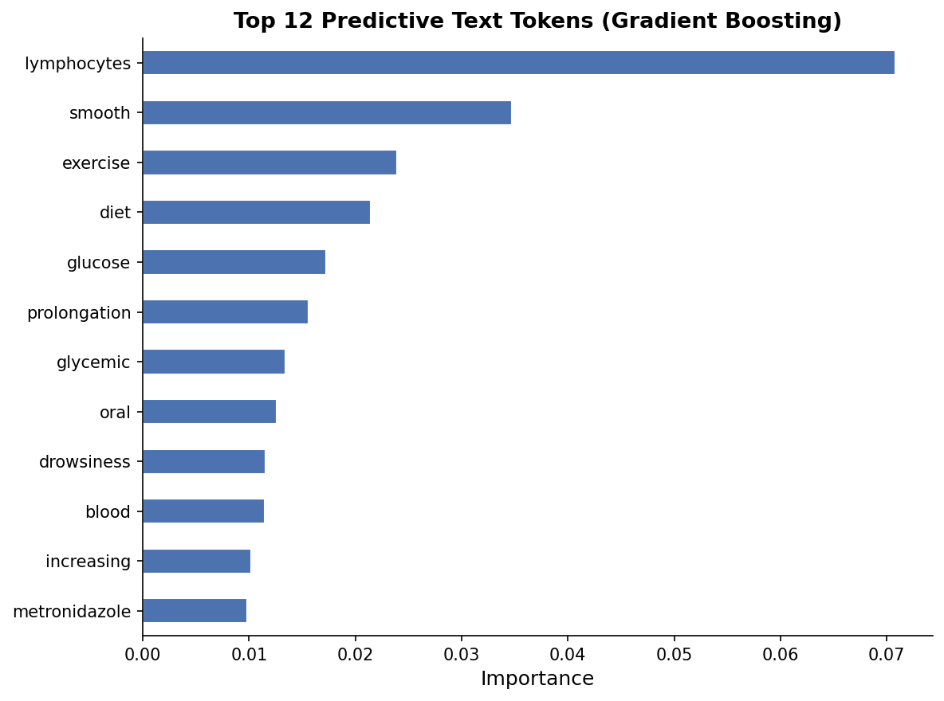
Feature Importance & Pharmacological Insights
Pharmacological Interpretation
"lymphocytes" (MDI: 0.07)
Immunosuppressants (e.g., tacrolimus, cyclosporine) heavily use this term — high DDI risk class
"glucose / glycemic / diet" (MDI: 0.017–0.022)
Diabetic medications alter glucose metabolism; DDIs here can cause dangerous hypoglycemia
"prolongation" (MDI: 0.016)
QT prolongation — cardiac arrhythmia risk flagged across many high-alert drug classes
"smooth" (MDI: 0.034)
Smooth muscle effects linked to calcium channel blockers and antispasmodics
"drowsiness / oral" (MDI: ~0.011)
CNS depressants + route of administration markers
Additional Research: Smoking & Haemoglobin
Haemoglobin decreased (AUC 0.890, F1 0.522) appeared among the 50 tracked AEs. Smoking is a known pharmacokinetic disruptor CYP1A2 induction from cigarette smoke accelerates metabolism of drugs like clozapine and theophylline, mimicking DDI effects.
Notes:
What to say about MDI:
"Feature importance was extracted via mean decrease in impurity — MDI — which measures how much each token reduces node impurity averaged across all trees in the GB ensemble. Higher MDI means the token is used more frequently and effectively at split points."
Walk through each major token with its pharmacological interpretation:
Lymphocytes (MDI 0.07 — dominant by a wide margin):
"The most important token by far. Immunosuppressants — tacrolimus, cyclosporine, mycophenolate — are among the highest DDI-risk drug classes in clinical practice. They have narrow therapeutic windows, are primarily CYP3A4-metabolized, and have toxicity profiles extensively documented in terms of lymphocyte effects. The fact that TF-IDF picked this up without any structured feature engineering is a validation that the text carries real pharmacological signal."
Smooth (MDI 0.034):
"References to smooth muscle — calcium channel blockers, antispasmodics, nitrates. These drug classes have significant cardiovascular interaction profiles."
Glucose / glycemic / diet (MDI 0.017–0.022):
"Diabetic medications — metformin, sulfonylureas, insulin — where DDIs can cause dangerous hypoglycemia or hyperglycemia. The 'diet' token is interesting — it likely co-occurs with diabetes management language, not a food-drug interaction signal per se."
Prolongation (MDI 0.016):
"QT interval prolongation — a cardiac electrical conduction effect flagged by dozens of drug classes including antipsychotics, antiarrhythmics, fluoroquinolone antibiotics, and antifungals. Co-administration of two QT-prolonging drugs dramatically increases arrhythmia risk. This is one of the most well-documented DDI mechanisms in clinical practice."
Drowsiness / oral (MDI ~0.011):
"CNS depressants — benzodiazepines, opioids, sedating antihistamines — where additive sedation is a major DDI concern. The 'oral' token likely reflects route of administration language that differentiates drug classes."
Smoking / haemoglobin note:
"One interesting finding from the per-label analysis: Haemoglobin decreased appeared among the 50 tracked adverse events. Smoking is a CYP1A2 inducer — cigarette smoke accelerates the metabolism of drugs like clozapine and theophylline, mimicking DDI effects in mono-therapy patients. Incorporating smoking status as a covariate in future work could improve detection of haemoglobin-related adverse events and reduce false positive DDI signals in smokers."
SPEAKER NOTES — FEATURE IMPORTANCE (60 sec) Gradient Boosting identified lymphocytes as the single most important token by a wide margin, with a Mean Decrease in Impurity importance of 0.07. This makes pharmacological sense — immunosuppressants like tacrolimus and cyclosporine have narrow therapeutic windows and are a high DDI risk class. Glucose, glycemic, and diet are clustered around 0.017 to 0.022 importance. Drug combinations affecting glucose metabolism can cause dangerous hypoglycemic episodes — a major clinical concern. Prolongation refers to QT interval prolongation, a cardiac arrhythmia risk that flags drug classes like antiarrhythmics and certain antibiotics. On the additional research question about smoking and haemoglobin: haemoglobin decreased appeared as one of the 50 tracked adverse events with an F1 of 0.522. This connects to an interesting research thread — cigarette smoking induces CYP1A2 enzymes, which can dramatically accelerate drug metabolism. In drug interaction research, CYP enzyme induction effectively mimics or modulates DDI effects. Smokers taking clozapine, theophylline, or olanzapine may show altered drug levels that look like DDIs. Incorporating smoking status as a feature — alongside CYP450 profiles which were missing for 60% of observations here — could meaningfully improve detection of haemoglobin-related adverse events.

Slide 9
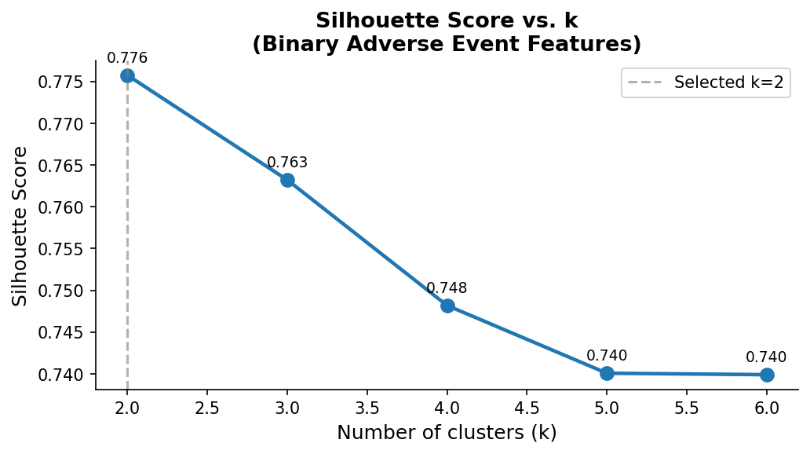
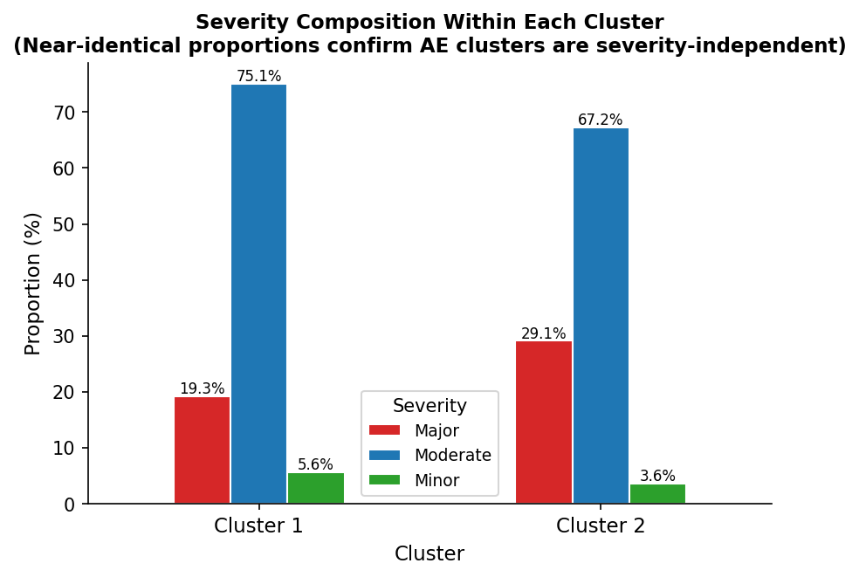
Unsupervised Clustering
How Were the Clusters Determined?
K-means was applied to the 50 binary adverse event columns only (not severity or text features). K was selected by sweeping k=2 through k=6 and choosing the value with the highest silhouette score — a measure of how similar each point is to its own cluster vs. other clusters (higher = better). k=2 scored 0.776 and declined monotonically to 0.740 at k=6.
Key Finding (RQ2 — Meaningful Negative Result)
Cluster 1: high AE burden (prevalence 0.84–0.97). Cluster 2: near-zero (0.02–0.05). But severity composition is near-identical: Moderate = 75.1% vs 67.2%; Major = 19.3% vs 29.1%. Adverse event burden and interaction severity are independent dimensions.
Notes:
Setup — explain the method:
"To address RQ2, I applied K-means clustering exclusively to the 50 binary adverse event columns — not to severity labels, not to text features. The goal was to let the data self-organize by adverse event profile and then examine whether those clusters corresponded to severity differences. K was selected by sweeping k=2 through k=6 and computing silhouette scores on a 3,000-observation subsample. The silhouette score measures cohesion — how similar each point is to its own cluster — versus separation — how different it is from other clusters. Scores range from -1 to 1, with higher indicating better-defined clusters."
Silhouette result:
"k=2 scored 0.776 — a very high silhouette score indicating well-separated, internally cohesive clusters. It declined monotonically to 0.740 at k=6 with no elbow. The data has two natural groupings in adverse event space."
What the clusters are:
"Cluster 1 has uniformly high adverse event prevalence — 0.84 to 0.97 across the 20 most differentiating events. These are drug pairs that produce nearly every adverse event simultaneously. Cluster 2 has near-zero prevalence — 0.02 to 0.05 across the same events. These are drug pairs that produce almost no adverse events. This is a direct reflection of the bimodal AE burden distribution I showed in the dataset overview."
The key finding — deliver this clearly:
"Now here's the clinically important result. If adverse event burden reflected severity, you'd expect Cluster 1 — the high-burden cluster — to be dominated by Major interactions. It's not. Cluster 1 is 75.1% Moderate, 19.3% Major, 5.6% Minor. Cluster 2 is 67.2% Moderate, 29.1% Major, 3.6% Minor. The severity compositions are nearly identical. A drug pair can produce dozens of adverse events and still be classified as Moderate severity. A Major interaction can occur with minimal AE burden. These are genuinely independent clinical dimensions."
Why this is a meaningful finding, not a failure:
"In clinical decision support design, this matters. If you built a system that used AE burden as a proxy for severity — 'this pair triggers lots of side effects, therefore it must be severe' — you would be wrong systematically. You need both signals. A severity classifier and an adverse event prediction model serve different clinical purposes and cannot substitute for each other."
SPEAKER NOTES — CLUSTERING (75 sec) For RQ2, I applied K-means clustering to the 50 binary adverse event columns. Important: this was done on the AE feature space only — not on severity labels or text features — so any cluster separation is purely data-driven. To select k, I swept from k=2 to k=6 and calculated the silhouette score at each value. The silhouette score measures cohesion within clusters and separation between them, ranging from -1 to 1 where higher is better. k=2 scored 0.776 and declined monotonically through k=6, so k=2 was selected. The clusters separated cleanly into a high-burden group and a near-zero-burden group. Cluster 1 had adverse event prevalence of 0.84 to 0.97 across the top 20 differentiating events. Cluster 2 had prevalence of 0.02 to 0.05 — essentially no adverse events. Here is the key finding: when you look at severity composition within each cluster, the proportions are nearly identical. Moderate makes up 75% of Cluster 1 and 67% of Cluster 2. This directly answers RQ2 with a meaningful negative result — adverse event burden and interaction severity are independent dimensions. High-burden drug pairs are not more likely to be rated Major severity, they just produce more reportable symptoms.

Slide 10
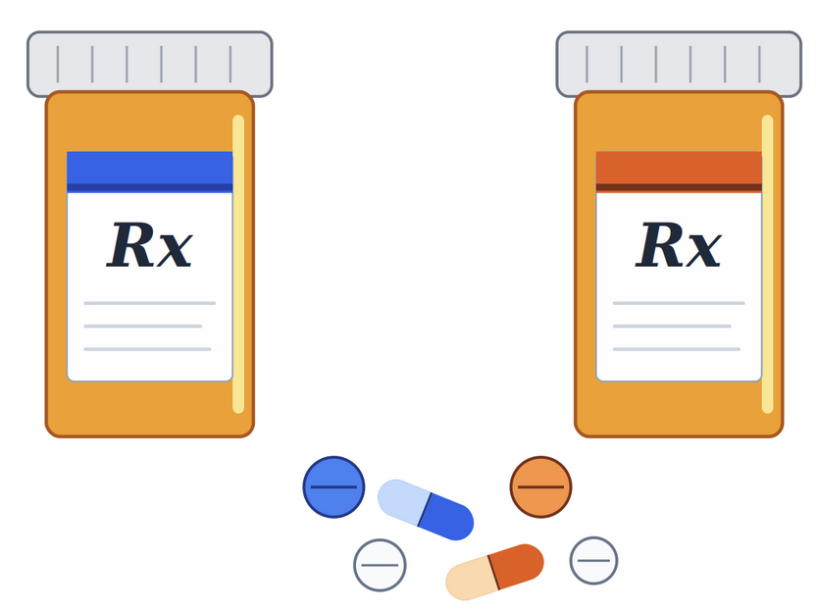
Limitations & Future Directions
CYP450 Missingness
Label Independence
59.5% of Drug A and 47.1% of Drug B CYP450 profiles were missing. CYP overlap is a primary DDI predictor. Imputation or external CYP databases could recover this signal.
The MultiOutput classifier treats all 50 AE labels independently, ignoring co-occurrence structure (e.g., Nausea and Vomiting are highly correlated). Classifier chains could leverage this structure.
SMILES as Raw Text
Cold-Start Test Set
SMILES strings encode molecular topology but TF-IDF tokenizes them as arbitrary characters. Molecular fingerprints (Morgan/ECFP) or graph neural networks would capture true structural similarity.
The 3,974 held-out pairs have new molecular scaffolds not seen in training. Text-only models are structurally disadvantaged graph-based representations would generalize better to unseen chemistry.
CV Subset Limitation
5-fold CV was run on 3,000 observations for runtime efficiency. This may not fully represent the 12,227-observation training distribution.
Notes:
What to say:
"The five limitations form a clear hierarchy of impact. The two highest-leverage items are CYP450 missingness and SMILES as raw text — these are structural feature representation failures, not modeling failures. Fixing either one would have direct, measurable impact across all three tasks."
CYP450 missingness:
"59.5% of Drug A CYP450 profiles missing means the primary biochemical DDI mechanism contributes almost nothing to the current model. DrugBank provides CYP450 profiles for most approved drugs. Linking by drug name or InChI key and computing pairwise CYP overlap features would likely be the single highest-ROI improvement."
SMILES as raw text:
"Morgan fingerprints — specifically ECFP4, extended-connectivity fingerprints of diameter 4 — encode local molecular neighborhoods as bit vectors. Two structurally similar molecules produce similar fingerprints, something TF-IDF on SMILES cannot achieve. Graph neural networks go further by treating molecular structure as a graph and learning structural representations end-to-end. Either approach would substantially improve PRR performance and cold-start generalization."
CV subset limitation:
"5-fold CV on 3,000 observations was a runtime compromise. With LR, full CV was feasible — CV on all 12,227 training observations gave 0.774 ± 0.006. For RF and GB, the subset was necessary. The 3,000-observation CV may underestimate generalization performance for those models."
Label independence:
"The MultiOutput wrapper treats all 50 adverse event labels independently, fitting a separate logistic regression for each. This ignores co-occurrence structure — Nausea and Vomiting are highly correlated, as are Renal Failure and Renal Failure Acute. Classifier chains propagate prior label predictions as features for subsequent classifiers, which could capture this co-occurrence signal."
Cold-start test set:
"The most fundamental structural limitation. Text-only models learn pharmacological language patterns that are relatively transferable across drug classes. But precise structural DDI prediction for a truly novel molecular scaffold requires structural features. Graph-based drug pair representations would generalize better to new chemistry."
SPEAKER NOTES — LIMITATIONS (45 sec) There are five key limitations worth addressing. First, CYP450 data was missing for 47 to 60% of observations. This is the single biggest gap, because enzyme overlap is one of the best-known predictors of drug interactions. Second, SMILES strings were treated as raw text by TF-IDF. A proper molecular fingerprint representation would capture structural similarity and bonding information that character tokens can't. Third, the CV subset of 3,000 may underrepresent the training distribution. Fourth, independent label training ignores co-occurrence structure among adverse events. Fifth, the cold-start test set structurally disadvantages text-only approaches — graph neural networks trained on molecular structure would generalize much better. For future work, the highest-impact additions would be molecular fingerprints, CYP450 imputation from DrugBank, and incorporating smoking status as a pharmacokinetic covariate.

Slide 11
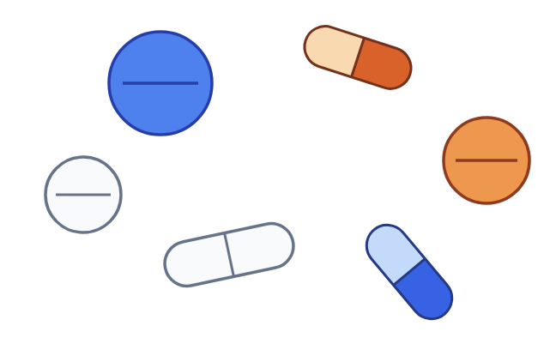
Conclusions
01
Text features carry real clinical signal
TF-IDF on FDA FAERS pharmacological text achieved AUC > 0.91 for severity and AUC > 0.89 mean for adverse event prediction — strong performance on an unseen cold-start scaffold set.
02
Gradient Boosting outperformed all baselines
GB achieved the highest Macro F1 (0.5666) and AUC (0.9252). The narrow gap between models confirms the ceiling is features, not algorithms.
03
Class imbalance remains the dominant challenge
Minor class recall peaked at 19.8%. Addressing the 16.8:1 imbalance through SMOTE, class weighting, or threshold tuning is the most direct path to improvement.
04
AE clusters are severity-independent (RQ2)
K-means found high-burden vs. low-burden drug pair profiles, but severity composition was near-identical. Adverse event burden and severity are independent dimensions.
05
PRR requires structural features
Mean inverse RMSE of 0.2023 confirms TF-IDF is insufficient for continuous pharmacovigilance signal. Molecular fingerprints are the next step.
Notes:
What to say:
"Five takeaways. First — pharmacological text from FDA FAERS carries real clinical signal. AUC above 0.91 for severity and 0.89 for adverse event prediction across unseen molecular scaffolds confirms that. Second — Gradient Boosting was the strongest classifier, but the margin between models is tiny. The ceiling is features, not algorithms. Third — class imbalance is the dominant unresolved challenge. Minor recall of 19.8% is clinically unacceptable and SMOTE or class weighting is the direct path forward. Fourth — adverse event clusters and severity are independent dimensions. You cannot use AE burden as a proxy for interaction severity. Fifth — PRR requires structural molecular features. TF-IDF has hit its ceiling on that task. Morgan fingerprints are the next step."
SPEAKER NOTES — CONCLUSIONS (45 sec) To summarize: FDA FAERS pharmacological text features do carry meaningful clinical signal — AUC above 0.91 for severity classification is strong, especially against unseen molecular scaffolds. Gradient Boosting was the best model, but the narrow performance gap suggests feature engineering is the real lever, not algorithm selection. Class imbalance is the dominant challenge for severity. The Minor class recall of under 20% is the most important metric to improve for clinical safety applications. The clustering finding answers RQ2 with a meaningful negative result — drug pairs are not clustered by severity, but by symptom burden. These are independent dimensions. PRR regression showed the weakest performance and requires structural molecular features to improve. The submitted Kaggle score of 0.5134 reflects the best combination of all three task outputs.

Slide 12
Anticipated Questions & Answers
Q: Why use Macro F1 instead of accuracy for severity?
Q: Why was PRR so much weaker than the other tasks?
A: Accuracy is misleading with a 16.8:1 imbalance — predicting "Moderate" for everything yields 69.1% accuracy with zero clinical value. Macro F1 weights all three classes equally, so the model is penalized for ignoring Minor and Major cases.
A: Three reasons: (1) only 21.5% of PRR entries are non-zero, making the signal sparse; (2) TF-IDF on SMILES lacks structural resolution for continuous regression; (3) high-variance events like Atrial Fibrillation have PRR values that are hard to predict from text alone.
Q: Why didn't you use SMOTE or class weighting to fix the imbalance?
Q: Why did the Kaggle score (0.5134) differ from your estimated composite (0.4605)?
A: These are valid next steps listed in future work. The priority was establishing a clean baseline pipeline. Class weighting in GB is a direct and low-risk next step that would likely improve Minor recall substantially.
A: The estimated composite was computed using my internal held-out test set. The Kaggle evaluation used a different scoring methodology and the actual competition test set. The divergence suggests my internal evaluation may have been conservative.
Q: How were the clusters determined?
Q: What would be the highest-impact improvement?
A: K-means was applied to the 50 binary adverse event columns only. K was chosen by sweeping k=2 through k=6 and selecting the value with the highest silhouette score. k=2 scored 0.776 — higher cohesion and separation than any k from 3 to 6, which declined monotonically.
A: Molecular fingerprints (e.g., Morgan/ECFP4 from RDKit). They encode true structural similarity and would improve both PRR regression and cold-start generalization to unseen scaffolds. Combined with CYP450 imputation from DrugBank, these two additions would likely lift all three task scores.
Notes:
Q: Why Macro F1 instead of accuracy?
"Accuracy is misleading at 16.8:1 imbalance — predicting Moderate for everything gives 69.1% with zero clinical value. Macro F1 weights all three classes equally, so the model is penalized proportionally for ignoring Minor and Major."
Q: Why not SMOTE or class weighting?
"Clean baseline first. Class weighting in GB is the direct next step — it reweights training examples inversely proportional to class frequency without generating synthetic data. SMOTE in 2,000-dimensional TF-IDF space risks producing pharmacologically meaningless interpolations. Both are explicitly listed in future work."
Q: How were clusters determined?
"K-means on the 50 binary AE columns only. K selected by silhouette sweep from k=2 to k=6 on a 3,000-observation subsample. k=2 scored 0.776, declining monotonically to 0.740 at k=6 — no elbow, clear maximum at k=2."
Q: Why was PRR so much weaker?
"Three compounding reasons: 21.5% non-zero entries makes it an extremely sparse regression target; TF-IDF tokenizes SMILES as arbitrary characters with no structural resolution; and high-variance events like Atrial Fibrillation have PRR values driven by structural pharmacology that unstructured text cannot recover."
Q: Why did Kaggle score differ from local estimate?
"Two factors. First, my internal eval used a stratified random 20% split — easier than the actual competition test set of 3,974 pairs with entirely new molecular scaffolds. Second, the Kaggle PRR masking implementation may define non-zero entries differently than my local implementation. The direction of the gap is consistent with my estimate being the conservative one."
Q: Highest-impact single improvement?
"Morgan fingerprints — ECFP4 from RDKit. They encode true structural similarity in a fixed-length bit vector, directly addressing the worst-performing task and the cold-start generalization problem simultaneously. Combined with CYP450 overlap features from DrugBank, those two additions would likely improve all three HCS components measurably."
SPEAKER NOTES — Q&A SLIDE This slide is your reference for the most likely questions. Do not read from it — internalize the key points. Key things to be ready for: 1. The class imbalance question is almost certain. Know the 16.8:1 ratio and Minor recall of 19.8%. 2. The clustering question is also highly likely — be ready to explain silhouette score and why k=2 was selected quantitatively. 3. The Kaggle vs. internal score divergence may come up. The honest answer is that internal evaluation was conservative. 4. The most impressive answer you can give about future work is molecular fingerprints + CYP450 imputation from DrugBank. Have that ready.

