Slide 1
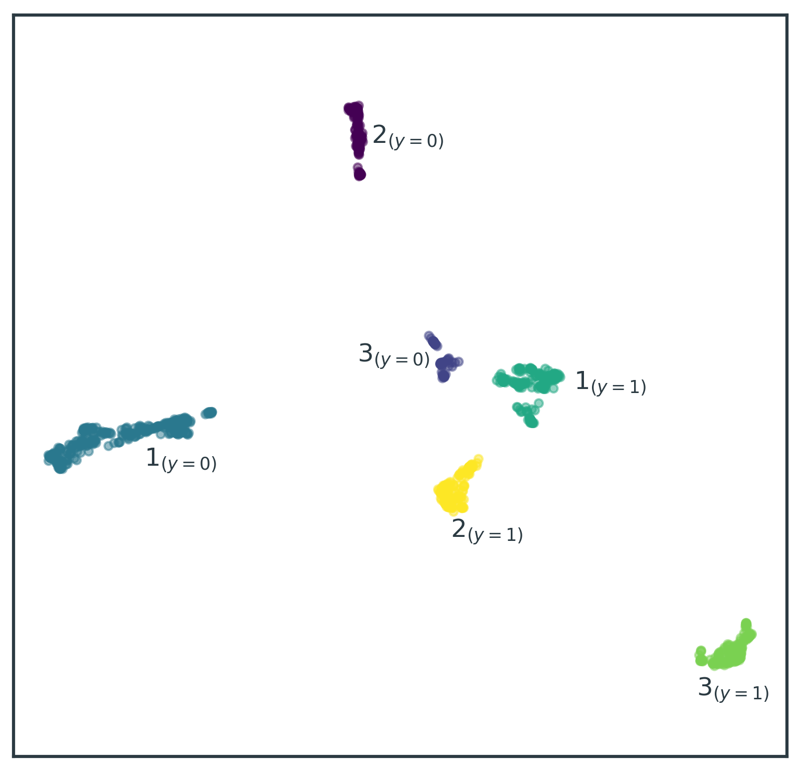


Slide 2
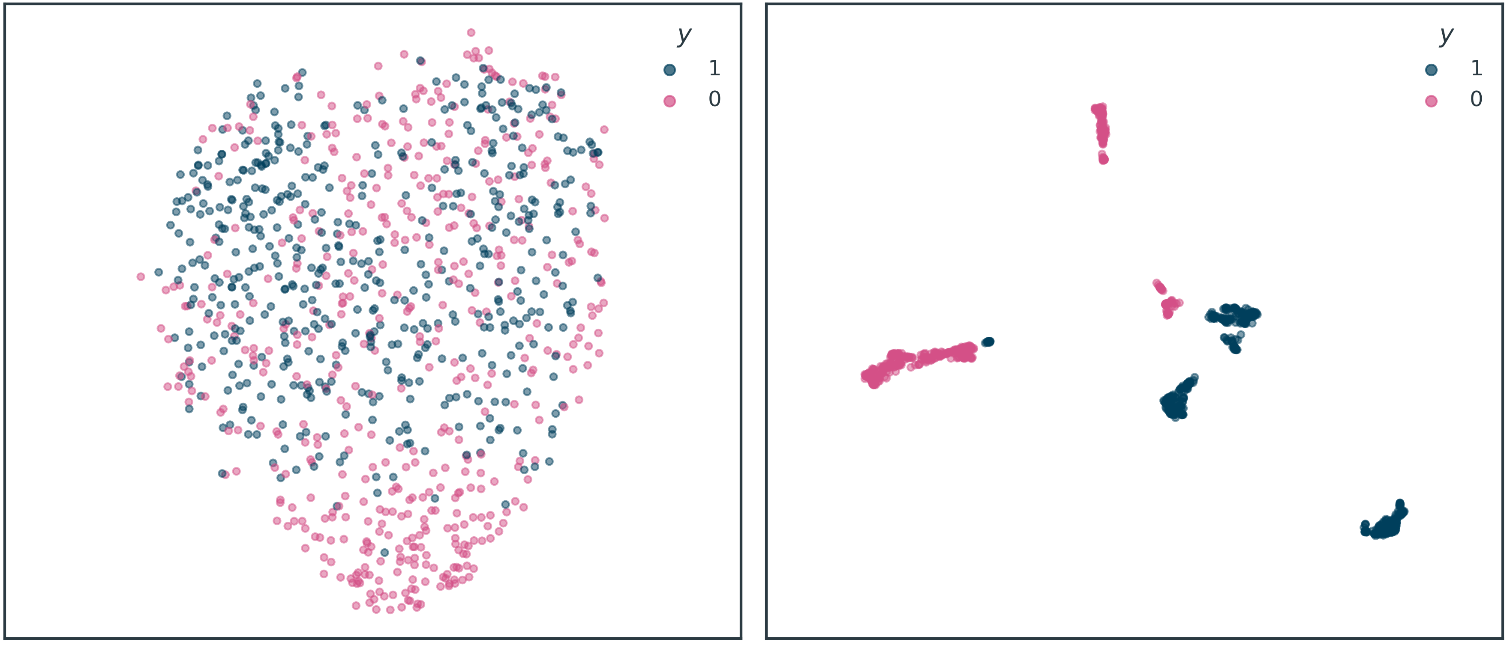


Slide 3
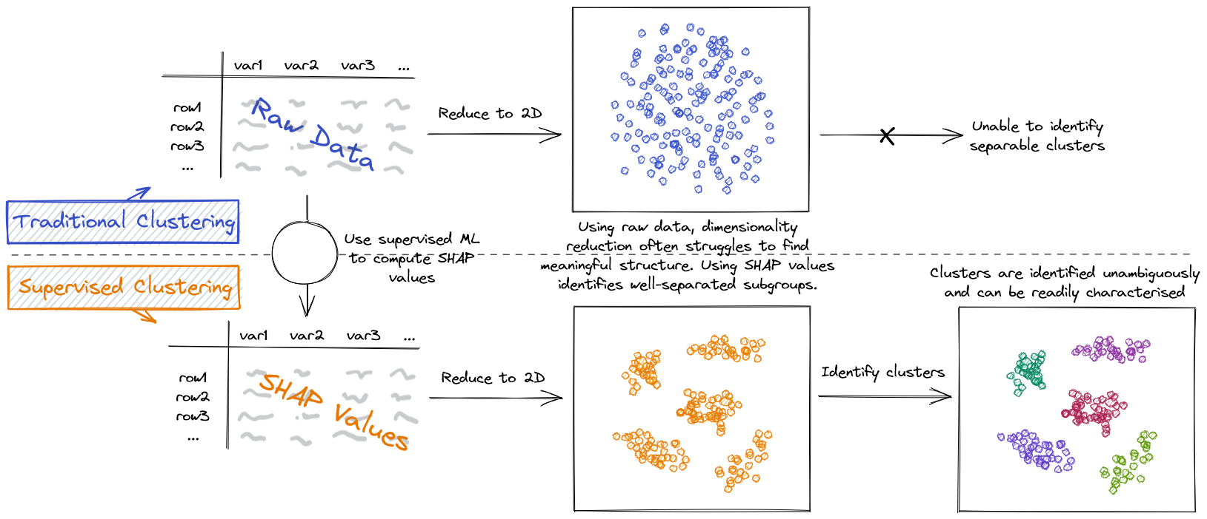

© Aidan Cooper 2022 | www.aidancooper.co.uk

